Slide 1

Efficient Large-Scale Machine Learning with TensorFlow on HPC Systems
Efe Kamasoglu
Max Planck Computing and Data Facility
TUM School of Computation, Information and Technology
Technical University of Munich, 29 June 2023

Slide 2
Machine Learning on HPC Systems
Data preparation + applying functions + optimization = ML model
Large-Scale ML = training on very large data sets
Large-Scale ML leads to high model complexity, hence significant computation time
Utilizing HPC Clusters to efficiently deal with scalability

Slide 3
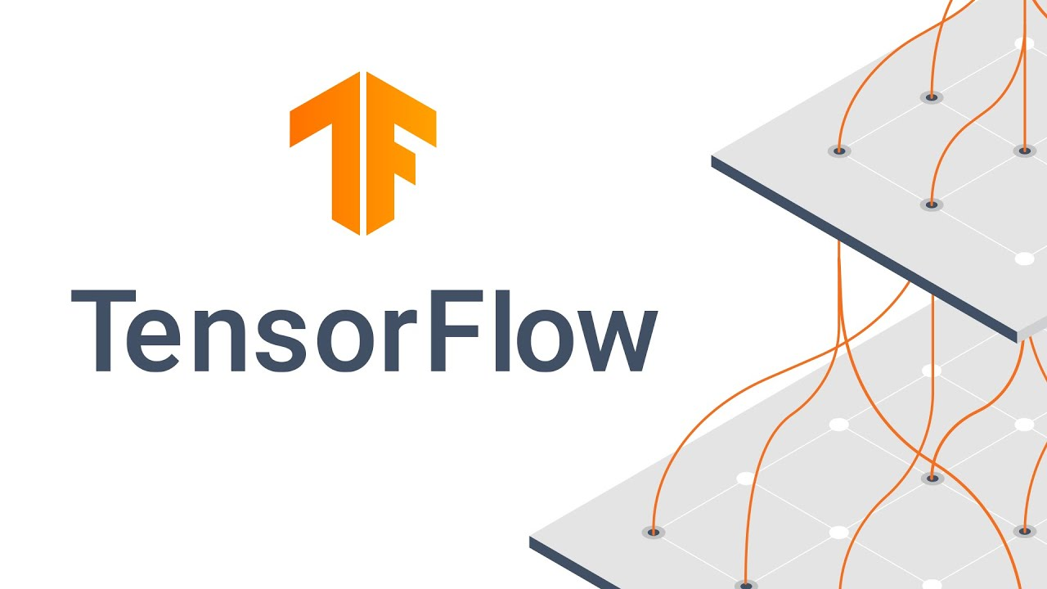
TensorFlow
An open-source framework for large-scale ML-applications
A versatile tool for deploying ML models on a wide variety of hardware
Provides an API, allowing developers to interact with its system

Slide 4
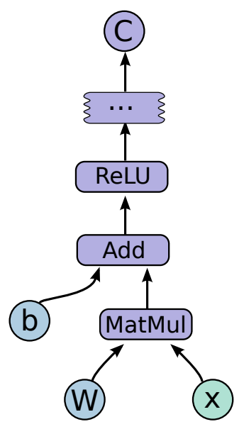
Core Principle of TensorFlow: Graph
Introducing model specifications to TensorFlow’s system through a Session
Computations represented in a directed dataflow graph
Graph can be compiled before or during execution
Components of the graph:
  Node
  Edge
  Operation
  Kernel
  Tensor
  Device

Slide 5
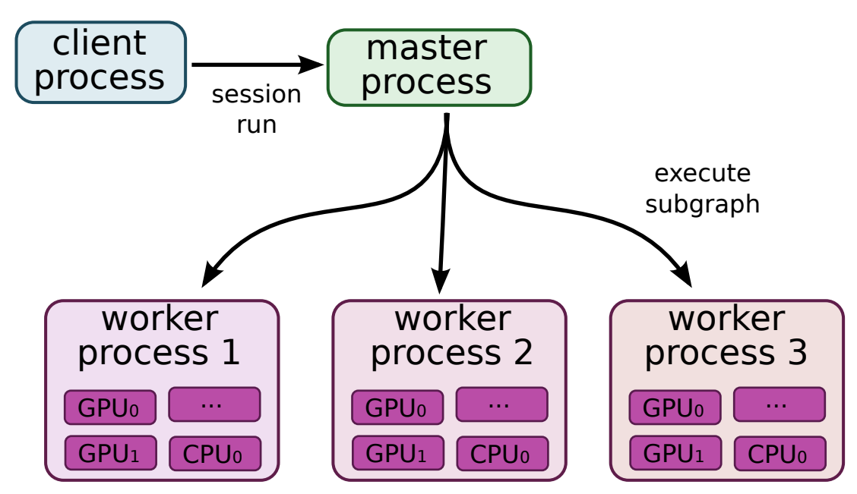
Graph Execution
Different implementations for single-device and multiple-device systems
Each implementation follows the same standard
Dividing the graph into subgraphs
Creation of one master process and a number of worker processes
Distribution of a subgraph execution to a worker by the master

Slide 6
Distributed Implementation
Single-device system: one master, one worker with a single-device => fairly easy
Distributed system: one master, multiple workers with multiple devices
Programming challenges on a distributed system as to
  Mapping of subgraph execution to different types of devices
  Intercommunication between the devices
  Memory management

Slide 7
Mapping of Subgraph Execution
Greedy Algorithm for mapping:
  deviceMap;
  for each node in graph do:
    costModel;
    D = selectAvailableDevices(node);
    for each device in D do:
      result = device.performExecution(node);
      costModel.add(result);
      deviceMap.add(node, min(costModel));
  return deviceMap;

Slide 8
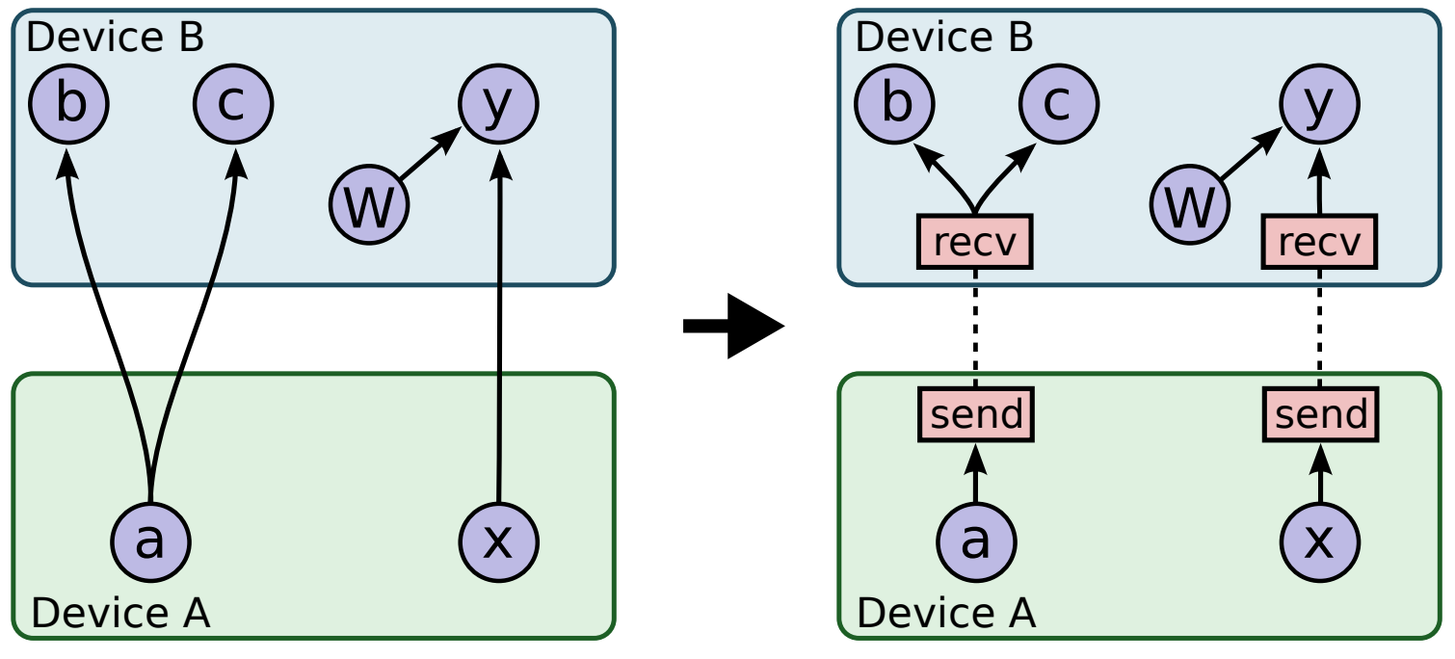
Device Intercommunication
Two nodes which are assigned to different devices
An edge between those nodes
Data flows one to another through the edge => intercommunication
Two types of nodes to handle intercommunication: Send-Node, Receive-Node
Edges are replaced by those new nodes

Slide 9
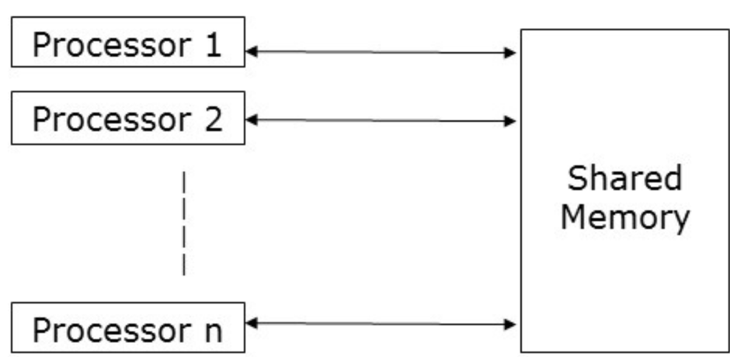
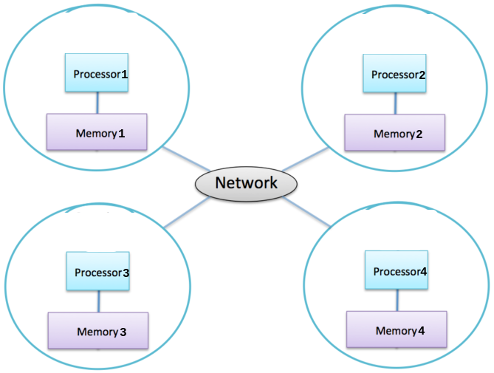
Memory Management
Goal: minimizing computation time without wasting too much memory
Deciding for a memory model regarding the preferred ML-application
Two common architectural approaches:
  Shared Memory Model
  Distributed Memory Model
HPC systems nowadays have the combination of two

Slide 10
Optimizations within TensorFlow
Optimizations provided by TensorFlow’s implementation:
  Common Subexpression Elimination: Elimination of redundant nodes
  Eager Execution: Completion of the graph at runtime => feature of TensorFlow 2
  Code Portability:
    Abstraction of underlying hardware
    Compatibility with several HPC libraries

Slide 11

Optimizations outside of TensorFlow - Horovod
Libraries and frameworks which offer further optimization => Horovod
Exploitation of TensorFlow’s system
Horovod’s Motivation: Deploying large-scale deep learning models on multiple GPUs
  Optimizing the intercommunication
    Definition of a new communication algorithm: Ring All-Reduce
  Reducing complexity of the models
    Definition of a new simpler API

Slide 12
Summary
Utilizing HPC systems to accelerate graph completion and execution
Distributed implementation of TensorFlow for HPC => programming challenges
Deciding for a memory model depending on the ML-application
Optimizations provided by TensorFlow itself
Exploiting TensorFlow through frameworks for further optimization => Horovod
Key point: Good estimation of the use case
  How computationally intensive is the preferred ML model?
  How to deal with resource management, as the model scales?

