Slide 1
NovaTech Enterprise
Knowledge Assistant
Project outcome
A working enterprise knowledge assistant that retrieves from internal policy documents, uses hybrid search plus reranking, supports follow-up questions, and avoids unsupported answers.
Advanced RAG project overview
Multi-format ingestion • Hybrid retrieval • Reranking • Conversational memory • Grounded answers with sources
27 automated tests passing
Python 3.11
OpenAI
ChromaDB
Streamlit
Ingestion, retrieval, memory, and RAG behavior verified.
NovaTech Enterprise Knowledge Assistant
1
Notes:
Sources: Project implementation and user-provided project artifacts. No external sources used.

Slide 2
1 / Why this exists
Problem and project objective
Employee search problem
LLM risk
Policy answers are spread across PDFs, Word documents, employee handbooks, FAQs, and security/travel guides. Simple keyword search can miss context or return too many generic results.
A general LLM can sound confident even when the company documents do not support the answer. Enterprise assistants need grounding, source visibility, and a safe fallback.
Target capability
Engineering goal
Retrieve the most relevant internal evidence, reason only over that context, answer clearly, cite sources, and handle conversational follow-up questions.
Build a modular, configurable, tested Python application with separate ingestion/indexing and online query serving.
NovaTech Enterprise Knowledge Assistant
2
Notes:
Sources: Project implementation and user-provided project artifacts. No external sources used.

Slide 3
2 / What is included
Scope and knowledge base
Sample enterprise corpus
3 formats
Document
Format
Coverage
PDF • DOCX • TXT
Leave Policy
PDF
Annual leave, carry-forward, sick leave
Travel Policy
PDF
travel class, hotel limits, expenses
IT Security Policy
PDF
data handling, password, incidents
14 pages/docs
Employee Handbook
PDF
employee practices and summary policies
Loaded by the document layer
Benefits Guide
DOCX
wellness, learning, assistance
Remote Work Policy
DOCX
eligibility, approval, reimbursements
52 chunks
Code of Conduct
DOCX
behavior, conflicts, reporting
Used by retrieval pipelines
Company FAQ
TXT
common employee questions
NovaTech Enterprise Knowledge Assistant
3
Notes:
Sources: Project implementation and user-provided project artifacts. No external sources used.

Slide 4
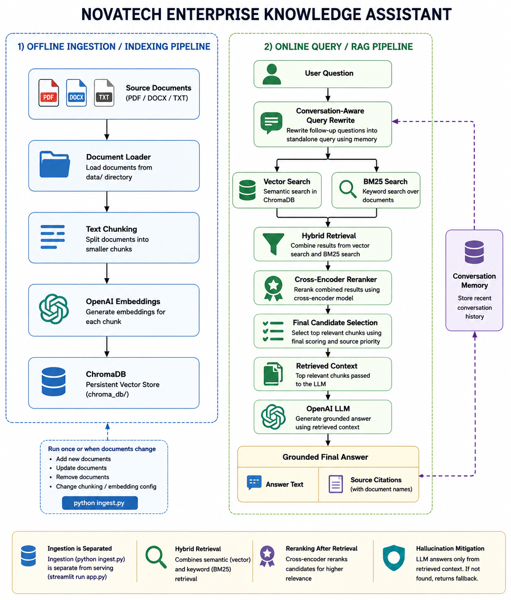
3 / System view
End-to-end architecture
NovaTech Enterprise Knowledge Assistant
4
Notes:
Sources: Project implementation and user-provided project artifacts. No external sources used.

Slide 5
4 / Build the knowledge index
Offline ingestion and indexing
1
Source files
2
Load
3
Chunk
4
Embed
5
Index
PDF, DOCX, TXT from data/
Extract text and metadata
Split into overlap-aware pieces
OpenAI text-embedding model
Persist vectors in ChromaDB
Run indexing when the knowledge base changes
Why it is separated
python ingest.py
Embedding and vector indexing are offline work. The user-facing app reuses the persisted ChromaDB index instead of rebuilding it at startup.
Index contents: chunk text, embedding vector, chunk_id, source, page, and file_type metadata.
NovaTech Enterprise Knowledge Assistant
5
Notes:
Sources: Project implementation and user-provided project artifacts. No external sources used.

Slide 6
5 / Better recall
Hybrid retrieval strategy
Vector search
BM25 keyword search
Weighted fusion
Uses OpenAI embeddings and ChromaDB to retrieve semantically similar chunks, even when the user wording differs from the document text.
Uses tokenized keyword matching for exact terms, policy words, numeric limits, and phrases such as carry forward.
Combines both result sets using configurable vector and keyword weights to produce a richer candidate pool.
Configuration example
vector_weight: 0.60 keyword_weight: 0.40 hybrid_top_k: 20
Benefit: semantic breadth plus exact-match precision before reranking.
NovaTech Enterprise Knowledge Assistant
6
Notes:
Sources: Project implementation and user-provided project artifacts. No external sources used.

Slide 7
6 / Better precision
Reranking and final context selection
1
Hybrid candidates
2
Cross-encoder reranker
3
Candidate preservation
Candidate pool from vector + BM25
Scores query–chunk relevance pairs
Keeps strong hybrid and reranked candidates
Final ranking combines multiple signals
Reranker score
Hybrid score
Source priority
relevance judged by cross-encoder
confidence from vector + keyword retrieval
small configurable authority signal
Design rationale: do not blindly trust one stage. Preserve high-confidence retrieval candidates and then rank the final evidence set.
NovaTech Enterprise Knowledge Assistant
7
Notes:
Sources: Project implementation and user-provided project artifacts. No external sources used.

Slide 8
7 / From query to answer
Conversational memory and grounded generation
Follow-up understanding
Grounded response policy
The assistant stores recent turns and rewrites vague follow-ups into standalone retrieval queries before searching.
The final answer is generated only from retrieved company context. If the context does not contain the answer, the assistant returns a configured fallback.
Example: “What about carry-forward?” → “What is the policy on carrying forward unused annual leave?”
Output includes answer text plus source document names.
Safe fallback example
“I could not find this information in the available company documents.”
NovaTech Enterprise Knowledge Assistant
8
Notes:
Sources: Project implementation and user-provided project artifacts. No external sources used.

Slide 9
8 / Streamlit experience
User-facing application
NovaTech Knowledge Assistant
Interface features
Chat-style input and response history
Expandable source list
Clear conversation action
Loading indicator
Friendly error handling
User: What is the annual leave policy?
Assistant: Employees receive 20 working days... Carry-forward is limited to 10 unused annual leave days...
Sources: leave_policy.pdf, employee_handbook.pdf
Operational behavior
User: What about carry-forward?
App loads the existing ChromaDB index
BM25 is built in memory at startup
Questions run through the RAG chain
Sources are shown in the UI
NovaTech Enterprise Knowledge Assistant
9
Notes:
Sources: Project implementation and user-provided project artifacts. No external sources used.

Slide 10
9 / Final readiness
Engineering quality and maintainability
Modular code
Configuration driven
Logging
Loader, chunker, embeddings, vector store, BM25, hybrid retrieval, reranker, memory, prompts, RAG chain, UI.
Models, chunking, retrieval counts, weights, reranking, memory, source priority, and logging live in config.yaml.
Operational print statements replaced with structured Python logging at INFO/DEBUG/WARNING/ERROR levels.
Secret handling
Automated tests
Repository hygiene
OpenAI API key lives in .env. .env.example is provided. .env is excluded from Git.
27 passing tests cover document loading, chunking, retrieval, memory, and RAG behavior.
.venv, .venv_test, chroma_db, __pycache__, and .DS_Store are ignored.
NovaTech Enterprise Knowledge Assistant
10
Notes:
Sources: Project implementation and user-provided project artifacts. No external sources used.

Slide 11
10 / Honest boundaries
Security, constraints, and production considerations
Current implementation
Security posture
Production path
Local sample documents
Local ChromaDB vector store
Streamlit session memory
No enterprise authentication
No document-level authorization
API key stored in .env
Secrets excluded from Git
No real confidential data in sample corpus
User-facing errors are generic
Technical details go to logs
Add enterprise identity
Enforce document permissions
Automate document ingestion
Persist conversation logs safely
Add monitoring and evaluation
Important limitation: BM25 is currently rebuilt in memory when the application initializes, while the vector index is persisted in ChromaDB.
NovaTech Enterprise Knowledge Assistant
11
Notes:
Sources: Project implementation and user-provided project artifacts. No external sources used.

Slide 12
11 / Outcome
Project completion summary
What was delivered
Multi-format document ingestion
Result
OpenAI embeddings + local ChromaDB
Vector + BM25 hybrid retrieval
A complete, tested, configurable enterprise RAG application that can retrieve from internal documents, answer with sources, handle follow-up questions, and avoid unsupported claims.
Cross-encoder reranking
Conversational memory and query rewrite
Grounded answers with source display
27 tests passed
Streamlit application
Logging, tests, README, and architecture documentation
Validated core ingestion, retrieval, memory, and RAG flows.
Future: enterprise connectors
Future: RBAC
Future: incremental indexing
Future: observability
NovaTech Enterprise Knowledge Assistant
12
Notes:
Sources: Project implementation and user-provided project artifacts. No external sources used.

