Slide 1
Vocations
April 12

Slide 2
What is a vocation?
Comes from the Latin word vocare – to call
What are examples of jobs you consider to be vocations?
How do we distinguish between ‘regular’ jobs and vocations?
Can people within the same job have different perceptions over whether it is a vocation?

Slide 3
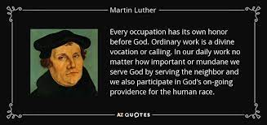
Martin Luther

Slide 4
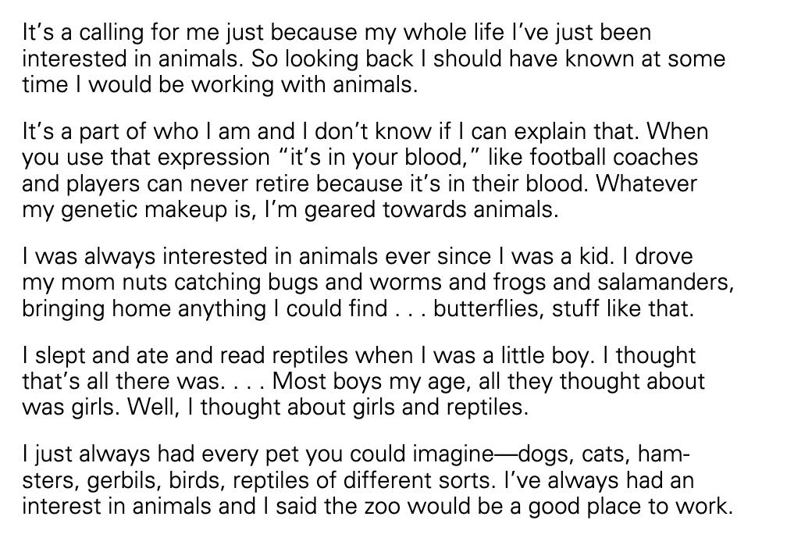
Zookeepers
Have innate or natural gifts, characteristics, predispositions that make them especially:
Well suited for the occupation
And better at it than others who do not have this connection
Inevitability of ending up in that occupation
‘meant to do’

Slide 5
Positives
Integration of identity into self-structure
Meaningfulness of work
Social importance of occupation

Slide 6
Negatives
Moral duty to work
Willingness to make sacrifices
Financial, demanding/dangerous work
More likely to be critical of work organization but also not leave it if something bad is happening due to feelings of moral duty to work
Animals being mistreated seen as reason to stay at the zoo

Slide 7
Methods → Results

Slide 8
Methods Section Outline
Data
ACT Dictionar(ies)
Variables
Independent Variable
Concept
Measurement
Dependent Variable
Concept
Measurement
Method
Simulation table

Slide 9
Results Section Outline
Figure or table of simulation results
Results:
Identify main pattern between levels of Independent Variable
Break down by behaviors
Refer back to figures and tables when you mention specific values or differences between your independent variable
Discussion
What are the implications of your findings?
Limitations
Future directions

Slide 10
Lab References
EPA
Lab 1
Deflection
Lab 2 part 1
https://youtu.be/MuWcRSZhbi4
Emotions
lab 3 question 4
https://youtu.be/tj4DZ_v4ASU
Optimal Behavior
Lab 3 question 3
https://youtu.be/tj4DZ_v4ASU

Slide 11
Making Plots
Google sheet with examples:
https://docs.google.com/spreadsheets/d/1JPPb5k6SCHKnIy_y7_6NmZQsx1UfVtB5P74lnENYqZA/edit?usp=sharing
Youtube walkthrough
https://youtu.be/Y_ai6pS4H-0
Do not edit directly
Copy sheet to your own google drive

Slide 12
Friday: change to podcast
https://www.technologyreview.com/2021/06/23/1043082/podcast-hired-by-an-algorithm-2/

