Slide 1
Occupational ‘Taste’ Differentiation
February 15, 2023

Slide 2
So far, we’ve largely discussed measures that collapse rankings or ratings across people
 | R1 | R2 | R3 | R4 | R5 | R6 | R7 | R8 | Average
teacher | 5 | 6 | 2 | 6 | 5 | 3 | 7 | 7 | 5.125
lawyer | 8 | 7 | 8 | 3 | 4 | 6 | 8 | 3 | 5.875
doctor | 8 | 8 | 7 | 6 | 5 | 6 | 9 | 5 | 6.75
judge | 9 | 8 | 8 | 5 | 5 | 8 | 9 | 5 | 7.125
banker | 8 | 6 | 3 | 5 | 3 | 6 | 7 | 2 | 5
cook | 3 | 3 | 2 | 6 | 3 | 1 | 5 | 6 | 3.625
miner | 3 | 3 | 1 | 6 | 5 | 1 | 4 | 7 | 3.75
bus driver | 3 | 1 | 2 | 5 | 4 | 1 | 4 | 6 | 3.25
accountant | 6 | 6 | 3 | 5 | 3 | 6 | 6 | 3 | 4.75
dentist | 7 | 7 | 6 | 4 | 5 | 4 | 7 | 4 | 5.5
athlete | 8 | 6 | 5 | 7 | 5 | 5 | 8 | 2 | 5.75

Slide 3
But we may be losing some information…
 | R1 | R2 | R3 | R4 | R5 | R6 | R7 | R8 | Average | SD
teacher | 5 | 6 | 2 | 6 | 5 | 3 | 7 | 7 | 5.125 | 1.81
lawyer | 8 | 7 | 8 | 3 | 4 | 6 | 8 | 3 | 5.875 | 2.23
doctor | 8 | 8 | 7 | 6 | 5 | 6 | 9 | 5 | 6.75 | 1.49
judge | 9 | 8 | 8 | 5 | 5 | 8 | 9 | 5 | 7.125 | 1.81
banker | 8 | 6 | 3 | 5 | 3 | 6 | 7 | 2 | 5 | 2.14
cook | 3 | 3 | 2 | 6 | 3 | 1 | 5 | 6 | 3.625 | 1.85
miner | 3 | 3 | 1 | 6 | 5 | 1 | 4 | 7 | 3.75 | 2.19
bus driver | 3 | 1 | 2 | 5 | 4 | 1 | 4 | 6 | 3.25 | 1.83
accountant | 6 | 6 | 3 | 5 | 3 | 6 | 6 | 3 | 4.75 | 1.49
dentist | 7 | 7 | 6 | 4 | 5 | 4 | 7 | 4 | 5.5 | 1.41
athlete | 8 | 6 | 5 | 7 | 5 | 5 | 8 | 2 | 5.75 | 1.98

Slide 4
But we are losing some information…
Not accounting for individual variation in estimates may introduce measurement error
Especially if the variation is related to:
Characteristics of the individual
Characteristics of the item
Let’s explore some possibilities:

Slide 5
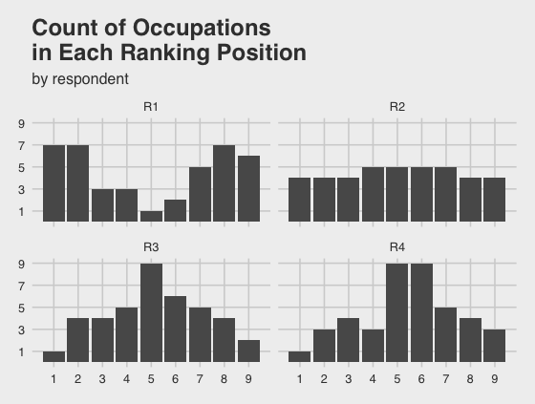

Slide 6
Quick note on reading plots
the lowest
social standing
the highest
social standing
X-axis corresponds to the spot in the ladder
according to general social standing

Slide 7
Quick note on reading plots
Y-axis corresponds to the
number of occupations that a
Respondent placed into that rung
Respondent 3 placed 2
occupations in the top/ninth rung

Slide 8
What patterns /
differences do you
see?

Slide 9
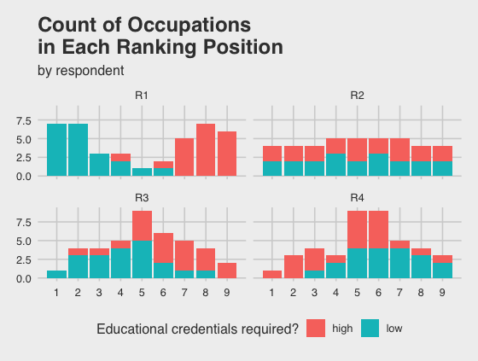
If we split each count
of occupations by the
number which require
high or low educational
credentials…
What patterns/differences
do we see?

Slide 10
Quick note on reading plots
In total, respondent 3 placed
4 occupations in rung 8

Slide 11
Quick note on reading plots
In total, respondent 3 placed
4 occupations in rung 8
3 of those occupations require
high educational attainment,
1 does not

Slide 12
If we split each count
of occupations by the
number which require
high or low educational
credentials…
What patterns/differences
do we see?

Slide 13
Why do we think preferences might be linked to social characteristics?
bit.ly/music_genre

Slide 14
Why do we think preferences might be linked to social characteristics?
https://www.youtube.com/watch?v=YaRu4g4_lCw

Slide 15
Class distinctions
What are our intuitions of how class might show up in occupational rankings?

Slide 16
Paper hypotheses
Higher education → consensus
Higher education → use education to sort occupations
Higher education → higher ratings for higher ed occupations
Higher education → greater differences in ratings for higher ed and lower ed occupations

Slide 17
Paper hypotheses
Higher education → consensus
Higher education → use education to sort occupations
Higher education → higher ratings for higher ed occupations
Higher education → greater differences in ratings for higher ed and lower ed occupations
How do these hypotheses relate to the theoretical ideas introduced in the video from Pierre Bourdieu?

Slide 18
How to test?
We need a way of measuring:
How frequently educational requirements / class distinctions seem to be used by respondents
How strong the association is between educational requirement and respondent ranking
Whether the extent to which that is used varies by:
Respondent status
How similar are respondents to each other? Can they be cleanly categorized?

Slide 19
1. Are Educational Requirements Used?
Let’s return to our fake respondent 3
Rung | Occupation | Education
9 | Surgeon | high
9 | Judge | high
8 | Lawyer | high
8 | Firefighter | low
8 | Nurse | high

Slide 20
1. Are Educational Requirements Used?
How often do high and low education occupations coincide in the same rung?
Actual / total possible
20 high education occupations & 20 low education occupations
Total possible high-low educational credential occupations is
20 * 20 = 400

Slide 21
1. Are Educational Requirements Used?
How often do high and low education occupations coincide in the same rung?
Actual / total possible
For each rung:
multiply number of high * number of low

Slide 22
1. Are Educational Requirements Used?
How often do high and low education occupations coincide in the same rung?
Actual / total possible
For each rung:
multiply number of high * number of low
 | 1 | 2 | 3 | 4 | 5 | 6 | 7 | 8 | 9
H | 0 | 1 | 1 | 1 | 4 | 4 | 4 | 3 | 2
L | 1 | 3 | 3 | 4 | 5 | 2 | 1 | 1 | 0
* | 0 | 3 | 3 | 4 | 20 | 8 | 4 | 3 | 0
Notes:
1, 3, 3, 4, 5, 2, 1, 1, 0

Slide 23
1. Are Educational Requirements Used?
How often do high and low education occupations coincide in the same rung?
Actual / total possible
For each rung:
multiply number of high * number of low
 | 1 | 2 | 3 | 4 | 5 | 6 | 7 | 8 | 9
H | 0 | 1 | 1 | 1 | 4 | 4 | 4 | 3 | 2
L | 1 | 3 | 3 | 4 | 5 | 2 | 1 | 1 | 0
* | 0 | 3 | 3 | 4 | 20 | 8 | 4 | 3 | 0
Sum up to get the total number: 45
Notes:
1, 3, 3, 4, 5, 2, 1, 1, 0

Slide 24
1. Are Educational Requirements Used?
How often do high and low education occupations coincide in the same rung?
45/400 = 11.25%
Between-category integration / segregation
Higher percent is less segregation
Lower percent is higher segregation
Notes:
1, 3, 3, 4, 5, 2, 1, 1, 0

Slide 25
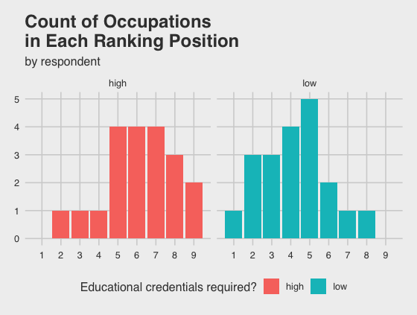
2. How strong is the association between rung location and educational credential?
Standard deviation
of each!

Slide 26
3. How similar are two respondents to each other?
Respondent 3
Rung | Occupation | Education
9 | Surgeon | high
9 | Judge | high
8 | Lawyer | high
8 | Firefighter | low
8 | Nurse | high
Respondent 2
Rung | Occupation | Education
8 | Surgeon | high
9 | Judge | high
7 | Lawyer | high
8 | Firefighter | low
5 | Nurse | high

Slide 27
3. How similar are two respondents to each other?
Occupation | R2 | R3 | Difference | Absolute Diff
Surgeon | 8 | 9 | -1 | 1
Judge | 9 | 9 | 0 | 0
Lawyer | 7 | 8 | -1 | 1
Firefighter | 8 | 8 | 0 | 0
Nurse | 5 | 8 | -3 | 3
 |  |  |  | 5

Slide 28
3. How similar are two respondents to each other?
Accounting for how respondents use the scale..
Respondent 3 | Respondent 3
Rung, std. | Rung | Occupation | Education
1.095 | 9 | Surgeon | high
1.095 | 9 | Judge | high
-0.730 | 8 | Lawyer | high
-0.730 | 8 | Firefighter | low
-0.730 | 8 | Nurse | high
Respondent 2 | Respondent 2
Rung, std. | Rung | Occupation | Education
0.396 | 8 | Surgeon | high
1.055 | 9 | Judge | high
-0.264 | 7 | Lawyer | high
0.396 | 8 | Firefighter | low
-1.583 | 5 | Nurse | high

Slide 29
3. How similar are two respondents to each other?
Occupation | R2 | R3 | Difference | Absolute Diff
Surgeon | 0.396 | 1.095 | -0.699 | 0.699
Judge | 1.055 | 1.095 | -0.04 | 0.04
Lawyer | -0.264 | -0.730 | 0.466 | 0.466
Firefighter | 0.396 | -0.730 | 1.126 | 1.126
Nurse | -1.583 | -0.730 | -0.853 | 0.853
 |  |  |  | 3.184
Notes:
3.184

Slide 30
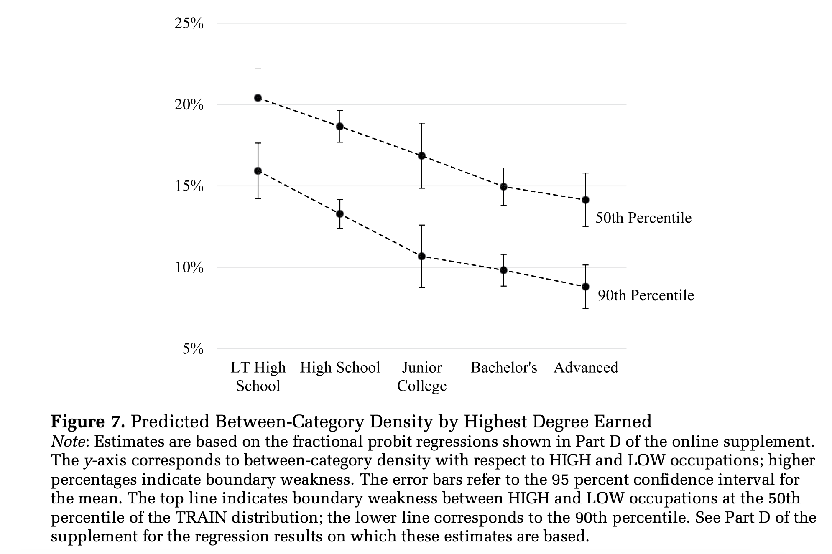
Results
More highly educated respondents exhibit stronger segregation on educational credentials

Slide 31
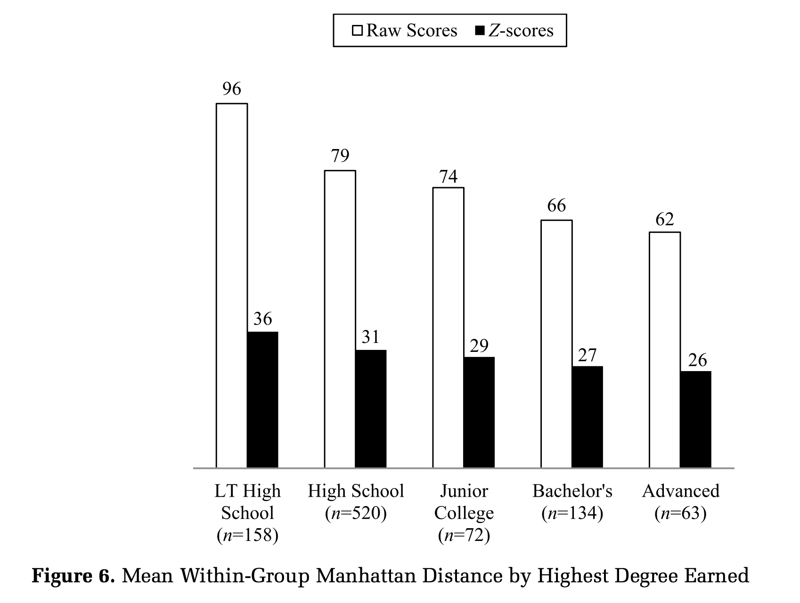
Results
More highly educated respondents exhibit stronger segregation on educational credentials

Slide 32
Results
A respondent who has higher educational attainment is:
More likely to have a higher mean rank of high ed cred occupations
More likely to have a larger difference between mean rank of high ed cred occupations and mean rank of low ed cred occupations

Slide 33
Discussion
Do you think these findings pose a significant threat to approaches that assume consensus?

Slide 34
Discussion
What other attributes of occupations do you think would be interesting to investigate their categorization across the prestige rankings?
Things like the variable educational credentials required

Slide 35
Discussion
What other attributes of individuals do you think would be interesting to investigate their categorization tendencies across the prestige rankings?
Things like the variable educational attainment

Slide 36
Discussion
What are the broad implications of these findings?

