Slide 1
Affect Control Theory: Sentiments
Jan 26, 2023

Slide 2
Outline
20 Statements Task
Measuring Culture
​Interact application
Lab!

Slide 3
Imagine you have been asked to answer the question “Who am I?” in the form of 20 statements starting with the phrase “I am …”

Slide 4
Codes
A: physical characteristics or attributes
B: roles or identities
C: personal characteristics & emotional states
D: general more than specific, existential

Slide 5
Identities
How we define ourselves & are defined by others
Shape behavioral expectations
Sometimes split into: role (B category), social , person (C category)

Slide 6
Affect Control Theory

Slide 7


Social Entities have
Cognitive meaning
definition
Affective/cultural meaning
how we *feel* about the entity

Slide 8
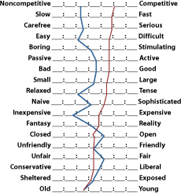
Charles Osgood Semantic Differentials
Notes:
The semantic differential (SD) is a measurement scale designed to measure a person's subjective perception of, and affective reactions to, the properties of concepts, objects, and events by making use of a set of bipolar scales. The SD is used to assess one's opinions, attitudes, and values regarding these concepts, objects, and events in a controlled and valid way. Respondents are asked to choose where their position lies, on a set of scales with polar adjectives (for example: "sweet - bitter", "fair - unfair", "warm - cold"). Compared to other measurement scaling techniques such as Likert scaling, the SD can be assumed to be relatively reliable, valid, and robust.^{[1][2][3]}

Slide 9
Measuring Meaning
Evaluation
Potency
Activity

Slide 10
8 Quadrants
Evaluation | Potency | Activity | Example terms
High | High | High | Firefighter, Winner, brain
High | High | Low
High | Low | High
High | Low | Low
Low | High | High
Low | High | Low
Low | Low | High
Low | Low | Low

Slide 11
8 Quadrants
Evaluation | Potency | Activity | Example terms
High | High | High
High | High | Low | Grandparent, writer
High | Low | High
High | Low | Low
Low | High | High
Low | High | Low
Low | Low | High
Low | Low | Low

Slide 12
8 Quadrants
Evaluation | Potency | Activity | Example terms
High | High | High
High | High | Low
High | Low | High | Baby, toddler, Infant, child
High | Low | Low
Low | High | High
Low | High | Low
Low | Low | High
Low | Low | Low

Slide 13
8 Quadrants
Evaluation | Potency | Activity | Example terms
High | High | High
High | High | Low
High | Low | High
High | Low | Low | Shrimp, doll
Low | High | High
Low | High | Low
Low | Low | High
Low | Low | Low

Slide 14
8 Quadrants
Evaluation | Potency | Activity | Example terms
High | High | High
High | High | Low
High | Low | High
High | Low | Low
Low | High | High | Mobster, gangster, pimp
Low | High | Low
Low | Low | High
Low | Low | Low

Slide 15
8 Quadrants
Evaluation | Potency | Activity | Example terms
High | High | High
High | High | Low
High | Low | High
High | Low | Low
Low | High | High
Low | High | Low
Low | Low | High | Crybaby, telemarketer
Low | Low | Low

Slide 16
8 Quadrants
Evaluation | Potency | Activity | Example terms
High | High | High
High | High | Low
High | Low | High
High | Low | Low
Low | High | High
Low | High | Low
Low | Low | High
Low | Low | Low | Do nothing, deadbeat

Slide 17
Let’s Try it ourselves
https://forms.gle/yvfsi2TnZjHEKyJm6

Slide 18
Interact

Slide 19
Download it:
https://kb-research.ca/interact/

Slide 20
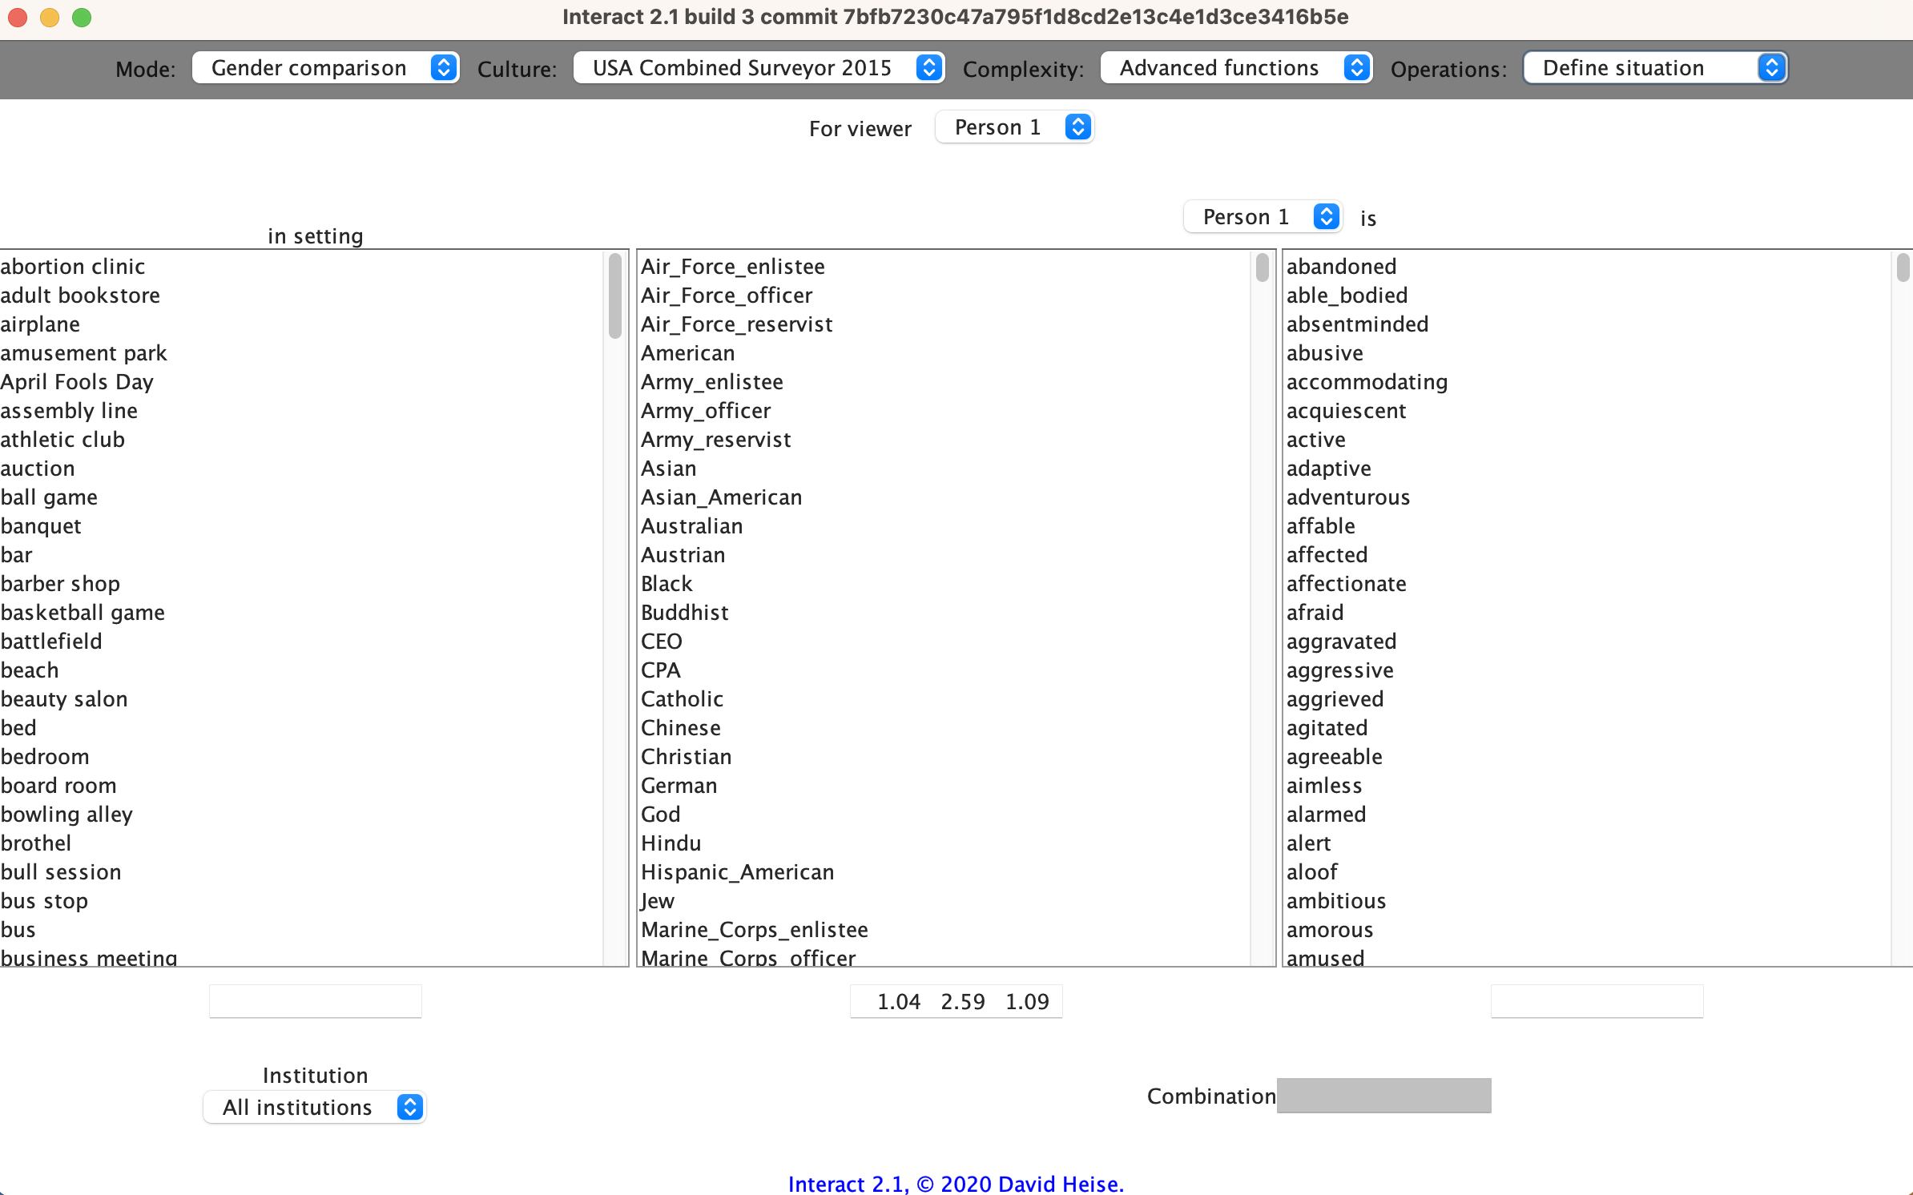
Interact

Slide 21
Interact Structure
Top bar = navigation plane
Can navigate through pages for different functions.
Today and for lab one, we will focus on 2 pages:
One for choosing identities, modifiers/traits, and settings: Define situation
One for choosing behaviors: Define events

Slide 22
Navigation Bar

Slide 23
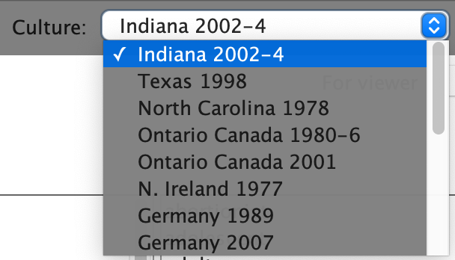
Navigation bar - Culture
How to choose which ACT dictionary you want to get estimates from

Slide 24
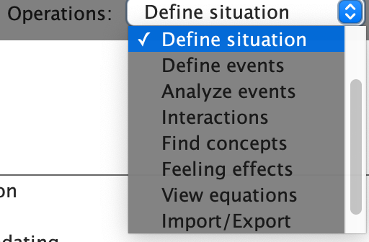
Navigation Bar - Operations
How to choose which type of ACT operations you want to calculate

Slide 25
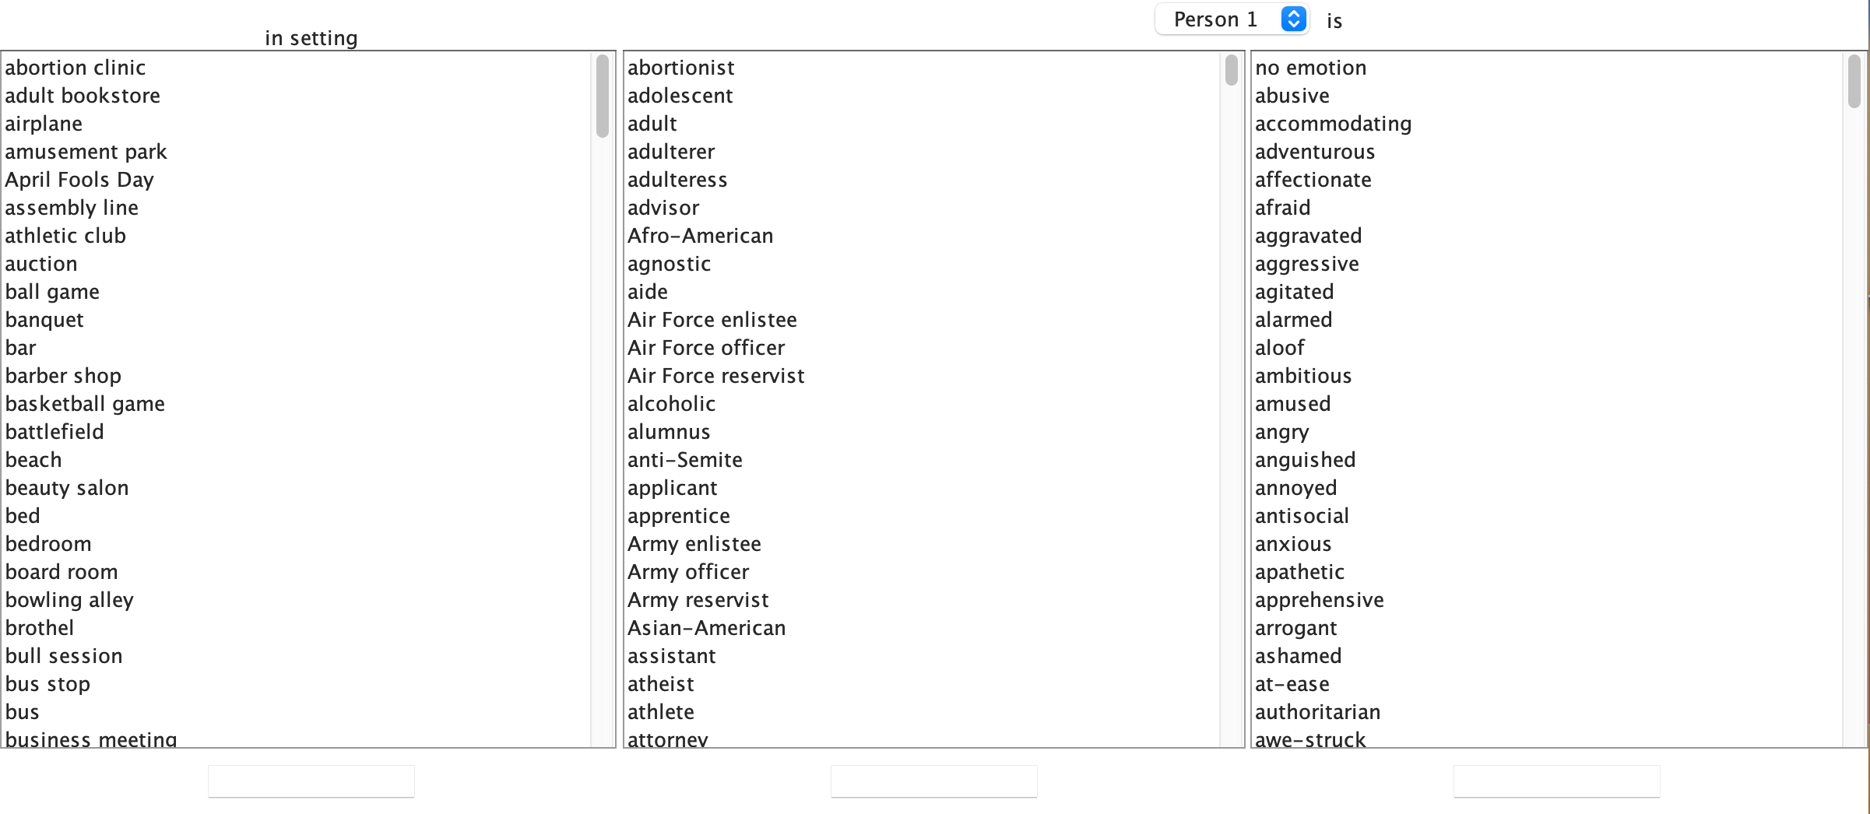
Operations – Define Situations

Slide 26
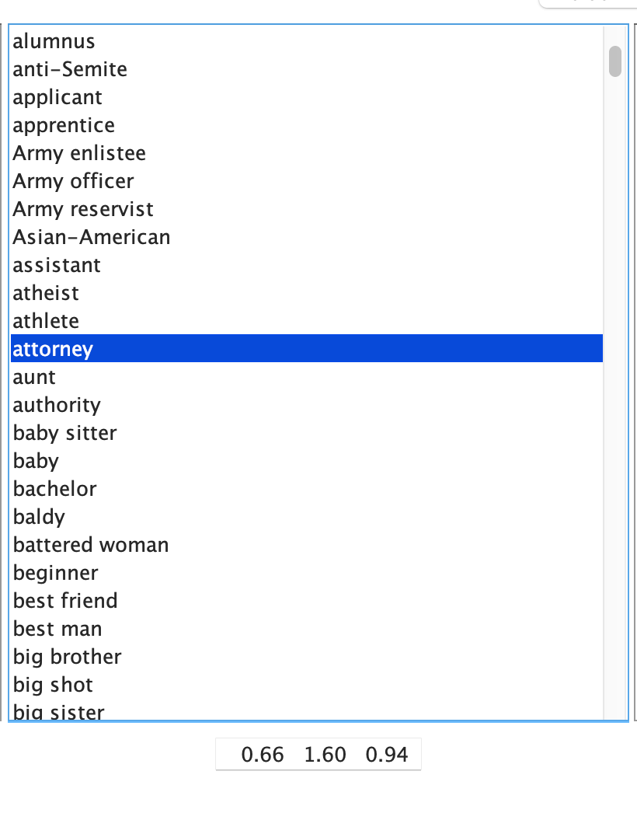
Define Situations
The middle column consists of all identities in the dictionary.
Clicking on one will display the EPA estimates in the bottom box.

Slide 27
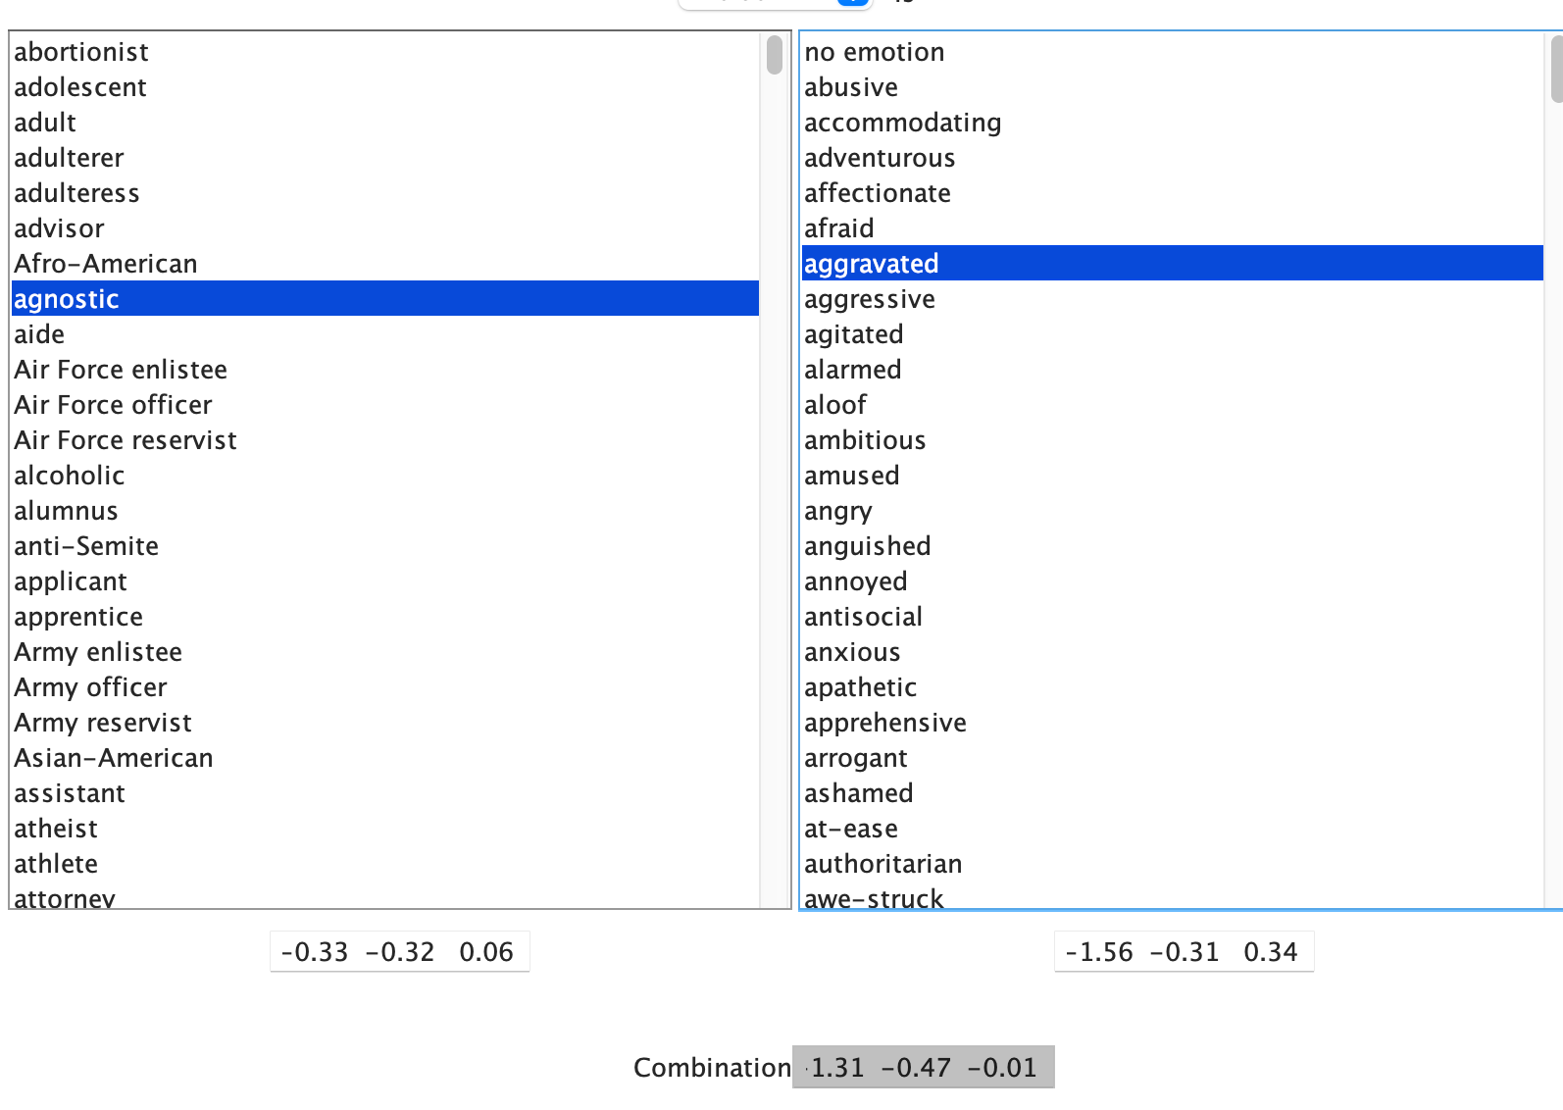
Define Situations
The right column consists of all modifiers/traits in the dictionary.
Clicking on one will display the EPA estimates in the bottom box.
Note: You must select an identity first before selecting a modifier

Slide 28
Define Situations
EPA for agnostic

Slide 29
Define Situations
EPA for aggravated

Slide 30
Define Situations
EPA for
aggravated agnostic

Slide 31
Lab
Spend the rest of class working on the lab
It’s okay to work with each other on part 1
If you have any issues, Prof. Smith-Lovin and I are here to answer your questions and help
You can also come to office hours
Due on February 10 at 8:00 am
Please email to em.k.Maloney@duke.edu

