Slide 1
Affect Control Theory: Relabeling
Feb 17, 2023

Slide 2
Updates
Mixed up a few dates –
Lab 2 is due Feb 24 at 8 am
Lab 3 is available online today, but we’ll be spending more time on Wednesday actually completing it in class.
Lab 3 is due on March 1 at 8am
No class on March 31
Both Prof. Smith-Lovin and I will be at a conference
Website schedule has been updated to reflect any changed deadlines

Slide 3
Annotated Bibliography
For each class day with an empirical reading (about occupational status / uses data), you will need to paste an entry in a shared google document here: https://docs.google.com/document/d/17zDg9zBFoUX9DIuO8OkbXfYuRhQD65QASnGmhkiO5bw/edit?usp=sharing
Post them by 8 am on course days
This link is on the course website as well.

Slide 4
Lab 1 comments
Do you see any shifts in identity meanings for your 10 identities between 2002 and 2015? If yes, do you have any hypotheses as to why? If no, do you have any hypotheses as to why not?
I see a few shifts in identity meanings between 2002 and 2015, specifically the potency of athletes decreased. One possible reason that this could have changed is because there have been arguments more recently that some athletes are exploited which could have decreased their potency . The other values did not change much because their role has remained relatively constant over the past 13 years. Then the four identities that did not have values in 2002 are because these (i.e gamer) are relatively newer concepts. Would be interesting to test this by splitting up the broad athlete identity into more specific sub groups (football player, soccer player, gymnast, etc.) and see if those most associated with stories about exploitation saw most decrease in potency

Slide 5
Reflect on these EPA scores – what potential hypotheses do you have about what they might indicate about important distinctions in US and German culture?
Although I am not very familiar with German culture, smile_at was an interesting behavior that varied largely in the potency category, with 2.60 in the USA dictionary and 0.50 in the Germany dictionary. A potential hypothesis used to explain this difference can be based in my stereotypical understanding of German culture, where Germans smile less frequently than Americans. In US culture, not smiling can be considered rude or impolite oftentimes. This difference in potency can be due to the different meaning of what smiling at means in the different cultures, where smiling at someone (i.e., a stranger) in German culture may not be considered rude and may even considered to be too familiar, unlike US culture.
Furthermore, the kill behavior variable really interested me. It seems that kill in US culture is considered to have lower activity (-0.11), whereas kill in German culture has a higher activity (2.42). A potential hypothesis of the difference in activity in the kill behavior can stem from the prevalence of firearms. The US has a high rate of gun violence, compared to other countries with stricter gun laws like Germany. The prevalence of gun-related killings in the US could be a potential reason why kill is considered to be lower in physical activity compared to knife-related violence or crime in Germany, which may be more physically strenuous.

Slide 6
Choose at least three occupational identities from the same industry/institution (e.g. Medicine, Education, Finance). How do they vary on EPA? Where does evidence of a hierarchy in the industry show up in the differences between EPA scores?
Each of them is relatively high in terms of Evaluation, which makes sense because each are teaching students, something that is good. I see the most variation in activity. It would make sense for a kindergarten teacher to be higher than a professor because they are much more hands on with their students. There isn’t necessarily a hierarchy based on these three in the education department. However, a kindergarten teacher is higher in evaluation and activity.
identity | E | P | A
Driving school teacher | 1.49 | 0.92 | 0.36
Professor | 1.74 | 1.78 | 0.03
Kindergarten teacher | 2.6 | 1.26 | 1.58

Slide 7
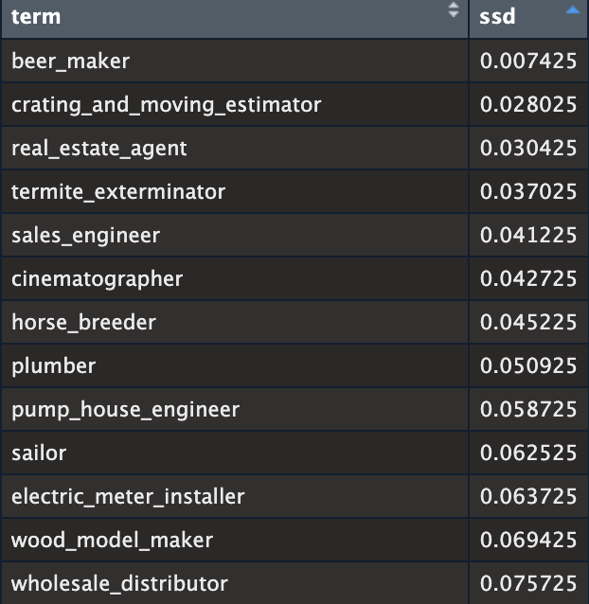
Bonus
Sum of squared differences between the median EPA and each occupational identity’s EPA – find the smallest

Slide 8
Activity
Like the game telephone…
Groups of 3-4
Count off
Before we re-arrange ourselves though, let’s review the activity

Slide 9
Each group will have 4 members
The first person in the group will receive the original narrative printed on a piece of paper and will spend 1 minute reading it
Then, they will spend 30 seconds making as many possible words as they can out of letters I will give to you.
Finally, they will spend 2 minutes re-writing the paragraph to pass onto the next player.
We repeat this process until all 4 players have read a paragraph, done the word task, and written a new paragraph.
I will keep time!

Slide 10
Assume that the story’s original teller is not lying, but keep in mind that the information as they present it may be mistaken, misinterpreted, or misleading

Slide 11
Coding in Groups
Retained in its original form (or very close)
For example: The surgeon stole prescription pads
Even though (from other surgeons) is not present, it is implied
Modified – some aspect of the original statement changed
For example: the surgeon had killed a woman → “Surgeon hurt woman”
Same general idea, but less intense in the behavior
If it’s modified, indicate which of the elements were modified (can be more than one!)
Dropped – not included in the narrative at all
For example: If Person 2 does not include anything about nurses gossiping, then “nurses gossiped with each other about the doctor” is dropped

Slide 13
Optimal behavior
What is the behavior EPA profile between our chosen actor and behavior
Surgeon
??
Telemarketer

Slide 14
Optimal behavior
What is the behavior EPA profile between our chosen actor and behavior
Surgeon
1.03
3.21
0.00
Telemarketer

Slide 15
Optimal behavior
What is the behavior EPA profile between our chosen actor and behavior
Surgeon
Influence
Telemarketer

Slide 16
Optimal behavior
What is the behavior EPA profile between our chosen actor and behavior
Telemarketer
??
Surgeon

Slide 17
Optimal behavior
What is the behavior EPA profile between our chosen actor and behavior 0.20 -1.56 1.55
Telemarketer
0.20
-1.56
1.55
Surgeon

Slide 18
Optimal behavior
What is the behavior EPA profile between our chosen actor and behavior 0.20 -1.56 1.55
Telemarketer
Babble to / Mimic
Surgeon

Slide 19
Emotions
Emotions as signals
Help others to define situations
Assess how recent situation/interaction proceeded
“Events involving you produce impressions of who you seem to be, and your identity defines who you are supposed to be. Your emotion connects the two. Your emotion, combined with your identity, creates the impression of you that is emerging in the current event. The impression generated by the conjunction of your emotion and identity duplicates the impression of you generated by the event” (Heise Expressive Order, 59)

Slide 20
Emotions
Doctor
Makes Fun of
Nurse
 | Fund. | Transient
E | 2.28 | -1.85
P | 2.22 | 1.53
A | 0.70 | 1.29
What emotion combines with the fundamental EPA profile to produce the transient outcome?
-2.53 0.13 2.51
~ Bad Tempered

Slide 21
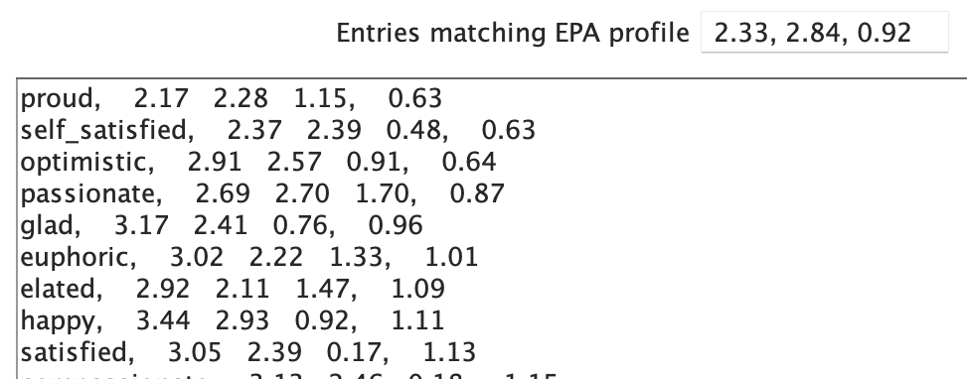
Characteristic Emotion
The emotion predicted for an identity that is perfectly confirmed through an interaction
Perfect confirmation = no movement away from the fundamental sentiment
Doctor
 | Fund. | Characteristic Emotion
E | 2.28 | 2.33
P | 2.22 | 2.84
A | 0.70 | 0.92

Slide 22
Characteristic Emotion
The emotion predicted for an identity that is perfectly confirmed through an interaction
Perfect confirmation = no movement away from the fundamental sentiment
Telemarketer
 | Fund. | Characteristic Emotion
E | -1.21 | 0.05
P | -1.19 | -0.63
A | 1.13 | 1.35

Slide 23
Structural Emotion
Emotions that are a result of optimal interactions between a dyad
Surgeon
Influence
Telemarketer
After the event, surgeons are
predicted to feel:
0.51 1.40 1.12
Eager
After the event, telemarketers are
predicted to feel:
1.42 0.13 0.63
Awestruck, Charmed

Slide 24
Optimal behavior
What is the behavior EPA profile between our chosen actor and behavior 0.20 -1.56 1.55
Telemarketer
Babble to / Mimic
Surgeon
After the event, surgeons are
predicted to feel:
0.85 -1.19 0.46
Emotional
After the event, telemarketers are
predicted to feel:
0.41 0.61 1.45
Shocked

Slide 25
Relabeling
Given the Behavior-Object pair, what actor would we have expected to behave this way?
Telemarketer
Pimp
Harm
Surgeon
-3.20 1.42 1.54

Slide 26
Relabeling
Given the Actor-Behavior pair, what object would we have expected to receive this action from this actor?
Telemarketer
Harm
Streetwalker
-0.38 -2.41 0.09

