Slide 1
Affect Control Theory: Review
April 19, 2023

Slide 2
Outline
Affect Control Theory: Sentiments
Note on Questions
Participation Grades
Cultural Meaning: EPA
Deflection
Optimal Behavior
Emotions
Research Paper Outline

Slide 3
Questions
If you are stuck,
First:
check through old power points on days when we talked about ACT
Review the readings on ACT days that correspond to your research question
Next: review labs that match your simulation strategy
Next: watch YouTube videos detailing how to do the labs and use Interact
If you are still stuck,
Then you should email Em or Prof. Smith-Lovin with a specific question regarding where you’re stuck/confused/what doesn’t make sense
Em’s office hours tomorrow from 1-2pm and during LDOC are the times they are available to meet
Otherwise, only email

Slide 4
Relevant Readings & Slides
David Heise Expressive Order
January 27, February 3, February 10, February 17
Methods readings from March 10
Identity meanings:
Villains, Victims, and Heroes in Character Theory and Affect Control Theory
Deflection:
Bereavement Adaptation as Deflection Reduction: Bereaved Caregivers Define the Event of Dying
Emotions:
Modeling Status Interventions with Affect Control Theory
The Influence of Occupational Identity on Emotional Experience
Behavior:
Villains, Victims, and Heroes in Character Theory and Affect Control Theory
Deflection:
February 8, February 10
Optimal Behavior & Emotions
February 17

Slide 5
Participation Grades
Adjusted to reflect a few in-class activities I forgot about
If you do go back and add the annotated bibliographies that you did not complete,
Please email me so I can go back and change your grade with the half-credit

Slide 6
Cultural Meaning
Evaluation
Potency
Activity
Good -- Bad
Powerful -- Weak
Fast/Young -- Slow/Old

Slide 7
8 Quadrants
Evaluation | Potency | Activity | Example identities | Example behaviors | Example emotions
High | High | High | Firefighter, Winner, brain | Rescue, save, cheer | overjoyed
High | High | Low
High | Low | High
High | Low | Low
Low | High | High
Low | High | Low
Low | Low | High
Low | Low | Low

Slide 8
8 Quadrants
Evaluation | Potency | Activity | Example identities | Example behaviors | Example emotions
High | High | High
High | High | Low | Grandparent, writer | Comfort, calm, pray_for | Peaceful, at_ease
High | Low | High
High | Low | Low
Low | High | High
Low | High | Low
Low | Low | High
Low | Low | Low

Slide 9
8 Quadrants
Evaluation | Potency | Activity | Example identities | Example behaviors | Example emotions
High | High | High
High | High | Low
High | Low | High | Baby, toddler, Infant, child | Chatter_to | acquiescent
High | Low | Low
Low | High | High
Low | High | Low
Low | Low | High
Low | Low | Low

Slide 10
8 Quadrants
Evaluation | Potency | Activity | Example identities | Example behaviors | Example emotions
High | High | High
High | High | Low
High | Low | High
High | Low | Low | Shrimp, doll | curtsey_to, wait_on, | sentimental
Low | High | High
Low | High | Low
Low | Low | High
Low | Low | Low

Slide 11
8 Quadrants
Evaluation | Potency | Activity | Example identities | Example behaviors | Example emotions
High | High | High
High | High | Low
High | Low | High
High | Low | Low
Low | High | High | Mobster, gangster, pimp | Stab, destroy | Enraged, hostile
Low | High | Low
Low | Low | High
Low | Low | Low

Slide 12
8 Quadrants
Evaluation | Potency | Activity | Example identities | Example behaviors | Example emotions
High | High | High
High | High | Low
High | Low | High
High | Low | Low
Low | High | High
Low | High | Low | Assassin, drug_dealer | Haunt, isolate | heavy_hearted
Low | Low | High
Low | Low | Low

Slide 13
8 Quadrants
Evaluation | Potency | Activity | Example identities | Example behaviors | Example emotions
High | High | High
High | High | Low
High | Low | High
High | Low | Low
Low | High | High
Low | High | Low
Low | Low | High | Crybaby, telemarketer | whine_to, complain_about | Panicked, bad_tempered
Low | Low | Low

Slide 14
8 Quadrants
Evaluation | Potency | Activity | Example identities | Example behaviors | Example emotions
High | High | High
High | High | Low
High | Low | High
High | Low | Low
Low | High | High
Low | High | Low
Low | Low | High
Low | Low | Low | Do nothing, deadbeat | submit_to, fear | Hopeless, depressed

Slide 15
Deflection
Modifier
Actor
Behavior
Object
Modifier

Slide 16
Deflection
Lawyer
Defers to
Telemarketer
 | Fund. | Transient
E | 0.83 | -0.08
P | 2.63 | 1.55
A | 1.75 | 1.23
 | Fund. | Transient
E | -0.16 | -0.17
P | 0.43 | 0.74
A | -0.44 | 0.15
 | Fund. | Transient
E | -1.76 | -1.12
P | -1.55 | -1.16
A | 1.76 | 1.21

Slide 17
Deflection
Lawyer
Defers to
Telemarketer
 | Fundamental Impression | Transient Impression
E | 0.83 | -0.08
P | 2.63 | 1.55
A | 1.75 | 1.23
After the event “Lawyer defers to telemarketer”,
lawyer is seen as:
Less Good (Lower Evaluation)
Less Powerful (Lower Potency)
Less Active (Lower Activity)

Slide 18
Deflection
Lawyer
Defers to
Telemarketer
 | Fund. | Transient
E | -0.16 | -0.17
P | 0.43 | 0.74
A | -0.44 | 0.15
After the event “Lawyer defers to telemarketer”,
the behavior ‘defer to’ is seen as:
About the same in Evaluation
More Powerful
More Active

Slide 19
Deflection
Lawyer
Defers to
Telemarketer
 | Fund. | Transient
E | -1.76 | -1.12
P | -1.55 | -1.16
A | 1.76 | 1.21
After the event “Lawyer defers to telemarketer”,
telemarketer is seen as:
More Good (Higher Evaluation)
More Powerful (Higher Potency)
Less Active (Lower Activity)

Slide 20
Calculating Deflection
Euclidean Distance:
Sum of the squared distances between each element’s fundamental sentiment and transient sentiment
 | Fundamental | Transient | Distance | Distance ^2
E | 0.83 | -0.08 | -0.91 | 0.83
P | 2.63 | 1.55 | -1.08 | 1.67
A | 1.75 | 1.23 | -0.52 | 0.27
 | Fundamental | Transient | Distance | Distance ^2
E | -0.16 | -0.17 | -0.01 | 0.0001
P | 0.43 | 0.74 | 0.31 | 0.096
A | -0.44 | 0.15 | 0.59 | 0.35
 | Fundamental | Transient | Distance | Distance ^2
E | -1.76 | -1.12 | 0.64 | 0.41
P | -1.55 | -1.16 | 0.39 | 0.152
A | 1.76 | 1.21 | -0.55 | 0.30

Slide 21
Calculating Deflection
Euclidean Distance:
Sum of the squared distances between each element’s fundamental sentiment and transient sentiment
 | Fundamental | Transient | Distance ^2
E | 0.83 | -0.08 | 0.83
P | 2.63 | 1.55 | 1.16
A | 1.75 | 1.23 | 0.27
= 2.27
 | Fundamental | Transient | Distance ^2
E | -0.16 | -0.17 | 0.0001
P | 0.43 | 0.74 | 0.096
A | -0.44 | 0.15 | 0.35
= 0.45
 | Fundamental | Transient | Distance ^2
E | -1.76 | -1.12 | 0.41
P | -1.55 | -1.16 | 0.152
A | 1.76 | 1.21 | 0.30
= 0.862

Slide 22
Calculating Deflection
Euclidean Distance:
Sum of the squared distances between each element’s fundamental sentiment and transient sentiment
 | Fundamental | Transient | Distance ^2
E | 0.83 | -0.08 | 0.83
P | 2.63 | 1.55 | 1.16
A | 1.75 | 1.23 | 0.27
= 2.27
 | Fundamental | Transient | Distance ^2
E | -0.16 | -0.17 | 0.0001
P | 0.43 | 0.74 | 0.096
A | -0.44 | 0.15 | 0.35
= 3.6
= 0.45
 | Fundamental | Transient | Distance ^2
E | -1.76 | -1.12 | 0.41
P | -1.55 | -1.16 | 0.152
A | 1.76 | 1.21 | 0.30
= 0.862

Slide 23
Interpreting Deflection
Deflection is considered an indication of how likely or unlikely an event is – due to how much the impressions of each element of the event move as a consequence of that event!
High Deflection event –
Doctor Hurts Child has a deflection of 35
Very unexpected
Deflection can be used in studies to assess how culturally expected or unexpected a theoretically interesting event is
Validated with experimental studies
This can tell us about norms and the underlying cultural beliefs attached to various social identities
For example, if we’re interested in conceptualizing occupational status how cultural expectations of deference in between occupational identities!

Slide 24
Interpreting Deflection

Slide 25
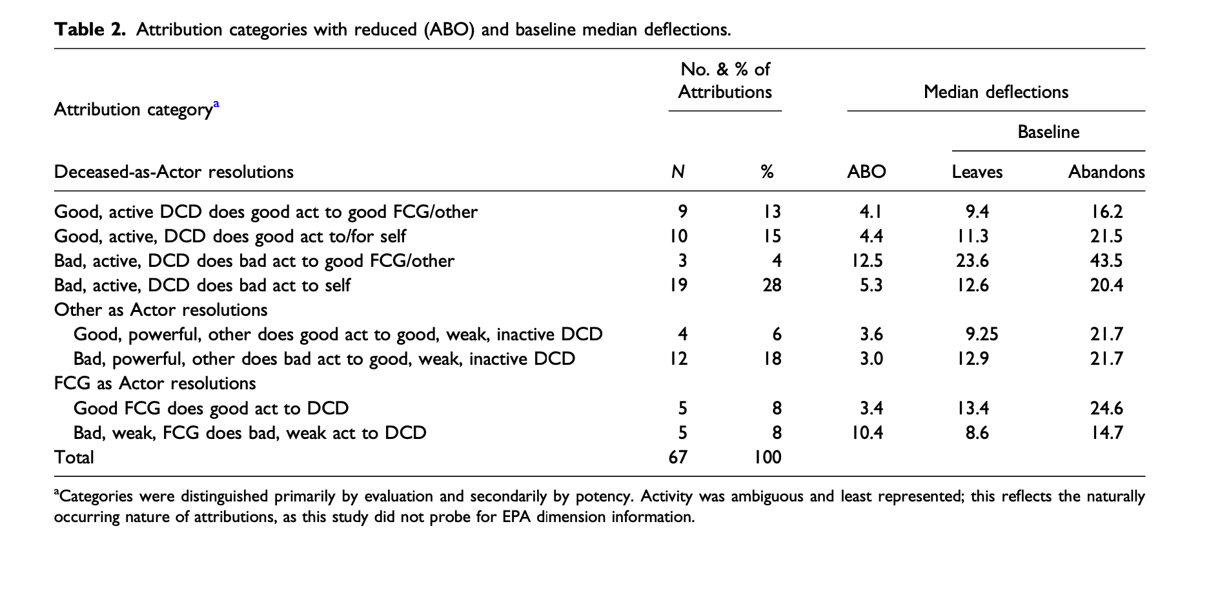
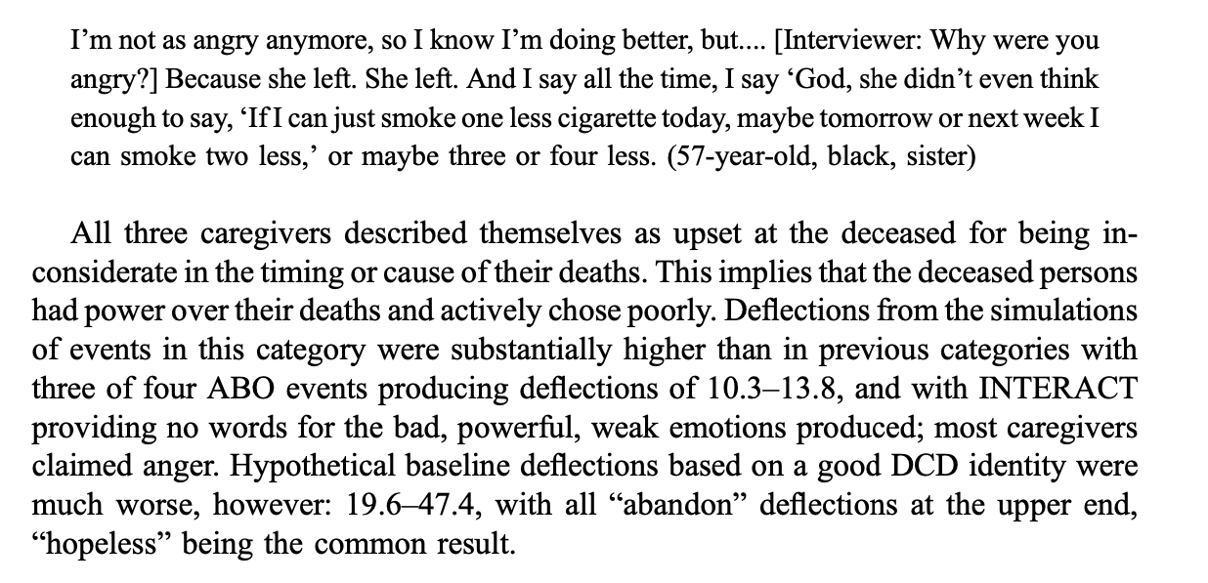
Interpreting Deflection

Slide 26
Deflection Outcome Workshop

Slide 27
Optimal behavior
What is the behavior EPA profile between our chosen actor and object that best maintains each identity
What culturally ‘should’ happen between the two
Surgeon
??
Telemarketer

Slide 28
Optimal behavior
What is the behavior EPA profile between our chosen actor and object that best maintains each identity
What culturally ‘should’ happen between the two
Surgeon
1.03
3.21
0.00
Telemarketer
Notes:
1.03
3.21
0.00

Slide 29
Optimal behavior
What is the behavior EPA profile between our chosen actor and object that best maintains each identity
What culturally ‘should’ happen between the two
Surgeon
Influence
Telemarketer

Slide 30
Optimal behavior
What is the behavior EPA profile between our chosen actor and object that best maintains each identity
What culturally ‘should’ happen between the two
Telemarketer
??
Surgeon

Slide 31
Optimal behavior
What is the behavior EPA profile between our chosen actor and object that best maintains each identity
What culturally ‘should’ happen between the two
Telemarketer
0.20
-1.56
1.55
Surgeon

Slide 32
Optimal behavior
What is the behavior EPA profile between our chosen actor and behavior 0.20 -1.56 1.55
Telemarketer
Babble to / Mimic
Surgeon

Slide 33
Interpreting Behavior
Surgeon
Influence
Telemarketer
Telemarketer
Babble to / Mimic
Surgeon
Notes:
0.20
-1.56
1.55

Slide 34
Emotions
Emotions as signals
Help others to define situations
Assess how recent situation/interaction proceeded
“Events involving you produce impressions of who you seem to be, and your identity defines who you are supposed to be. Your emotion connects the two. Your emotion, combined with your identity, creates the impression of you that is emerging in the current event. The impression generated by the conjunction of your emotion and identity duplicates the impression of you generated by the event” (Heise Expressive Order, 59)

Slide 35
Emotions
Doctor
Makes Fun of
Nurse
 | Fund. | Transient
E | 2.28 | -1.85
P | 2.22 | 1.53
A | 0.70 | 1.29
What emotion combines with the fundamental EPA profile to produce the transient outcome?
-2.53 0.13 2.51
~ Bad Tempered

Slide 36
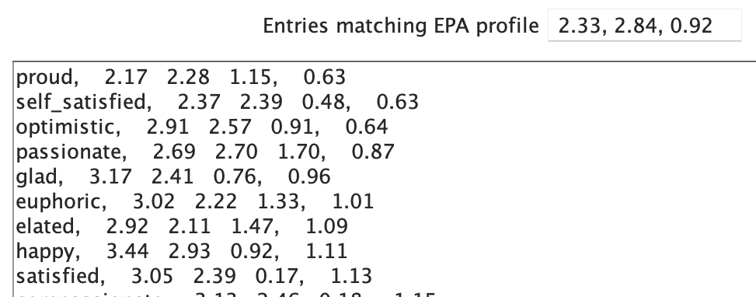
Characteristic Emotion
The emotion predicted for an identity that is perfectly confirmed through an interaction
Perfect confirmation = no movement away from the fundamental sentiment
Doctor
 | Fund. | Characteristic Emotion
E | 2.28 | 2.33
P | 2.22 | 2.84
A | 0.70 | 0.92

Slide 37
Characteristic Emotion
The emotion predicted for an identity that is perfectly confirmed through an interaction
Perfect confirmation = no movement away from the fundamental sentiment
Telemarketer
 | Fund. | Characteristic Emotion
E | -1.21 | 0.05
P | -1.19 | -0.63
A | 1.13 | 1.35

Slide 38
Structural Emotion
Emotions that are a result of optimal interactions between a dyad
Surgeon
Influence
Telemarketer
After the event, surgeons are
predicted to feel:
0.51 1.40 1.12
Eager
After the event, telemarketers are
predicted to feel:
1.42 0.13 0.63
Awestruck, Charmed

Slide 39
Structural Emotion
What is the behavior EPA profile between our chosen actor and behavior 0.20 -1.56 1.55
Telemarketer
Babble to / Mimic
Surgeon
After the event, surgeons are
predicted to feel:
0.85 -1.19 0.46
Emotional
After the event, telemarketers are
predicted to feel:
0.41 0.61 1.45
Shocked

Slide 40
Interpreting Emotions

Slide 41
Emotions Outcome Workshop

Slide 42
Relabeling
Given the Behavior-Object pair, what actor would we have expected to behave this way?
Telemarketer
Pimp
Harm
Surgeon
-3.20 1.42 1.54

Slide 43
Relabeling
Given the Actor-Behavior pair, what object would we have expected to receive this action from this actor?
Telemarketer
Harm
Streetwalker
-0.38 -2.41 0.09

Slide 44
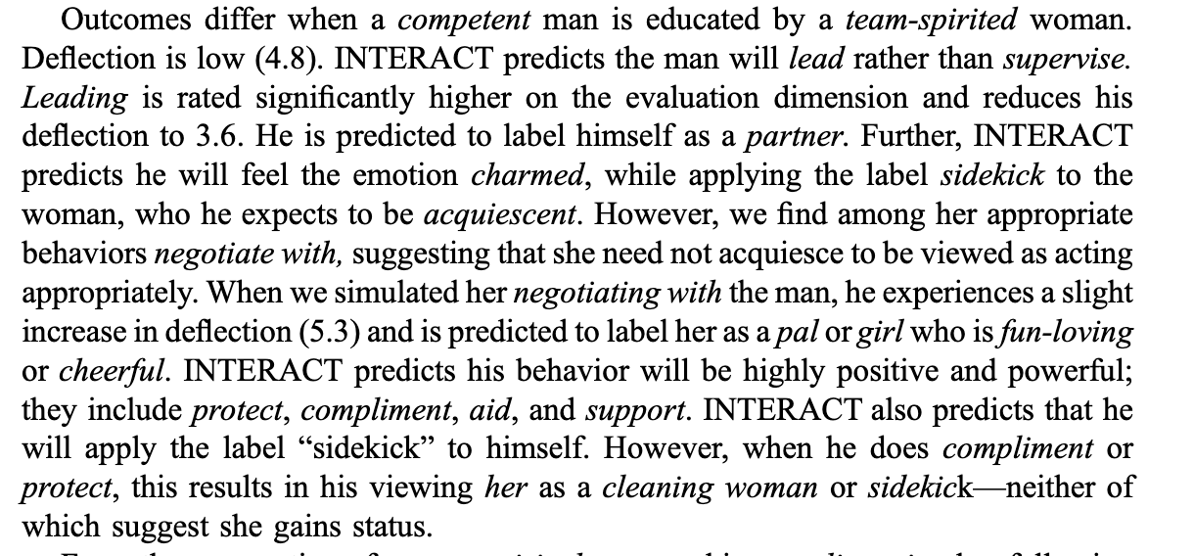
Example

Slide 45
Paper Outline
https://docs.google.com/document/d/1FZBCQMF9Ff04_W4a0H6bapquFZ1YBaA83WvGMjd_I2E/edit?usp=sharing

