Slide 1
$
April 7

Slide 2
Why do we pay some occupations more than others?
Why are professors paid more than elementary school teachers?
Why are software engineers paid more than mechanical engineers?

Slide 3
Why do we pay some occupations more than others?
Why are CEOs paid more than uber drivers?

Slide 4
Return to Weber
Social closure:
Powerful groups act in ways to maintain boundaries between themselves and others
Usually by:
Monopolizing access to valued resources and opportunities
Preventing others from easily accessing those same resources and opportunities
Can anyone think of an example of this?

Slide 5
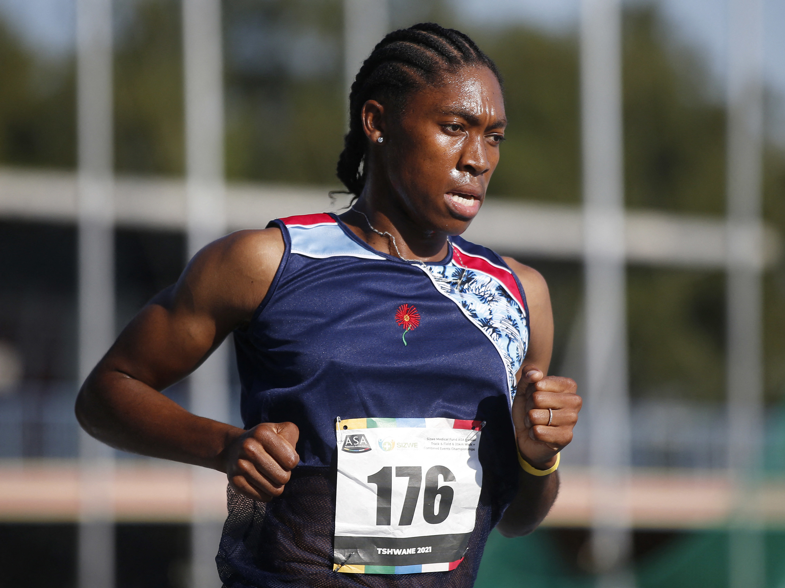
Boundary Maintenance
Enforcement of category rules / definitions / prototypes to determine who/what belongs and who/what does not
Examples at different types of social categories:
Gender

Slide 6
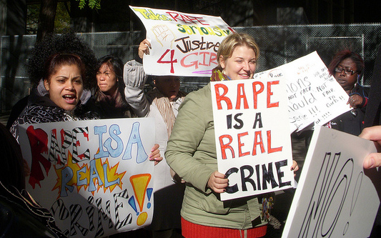
Boundary Maintenance
Enforcement of category rules / definitions / prototypes to determine who/what belongs and who/what does not
Examples at different types of social categories:
Rape / Sexual Assault

Slide 7
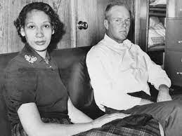
Boundary Maintenance
Enforcement of category rules / definitions / prototypes to determine who/what belongs and who/what does not
Examples at different types of social categories:
Anti-miscegenation laws

Slide 8
How do we think about Boundaries in relation to occupations?
Consider occupations not only as positions within the larger division of labor but also as social groups with a vested interest in maintaining (or attaining) new levels of status and/or rewards
We’ve seen examples of how closure can work within occupations
Tokenism mechanisms
The glass escalator / glass ceiling / racialized glass escalator
This can also occur between occupations

Slide 9
Example: What’s the difference between a job and a profession?

Slide 10
Example: What’s the difference between White and Blue Collar Jobs?

Slide 11
Occupations can act in ways to close their boundaries
But what will this result in?

Slide 12
What forms does occupational closure take?
Licensing
Educational credentials
Unions
Occupational associations
Voluntary certification

Slide 13
Mechanisms:
Reduce labor supply
Increase demand

Slide 14
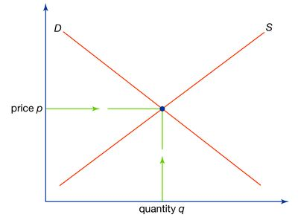
Supply and Demand
X axis = quantity of the available labor
Y axis = price of the labor (wage)
Supply has a positive slope while demand has a negative slope

Slide 15
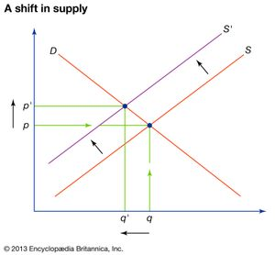
Supply and Demand
When supply decreases and demand stays the same, price increases

Slide 16
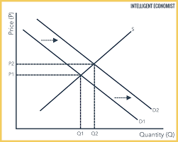
Supply and Demand
When demand increases and supply stays the same, price increases

Slide 17
Reduce Supply: Educational Credentials
Functional:
Credentials indicate to employers that one has the necessary skills and knowledge to adequately perform at the job
Conflict
Very loose coupling between credential and skill
Can be ‘bought’

Slide 18
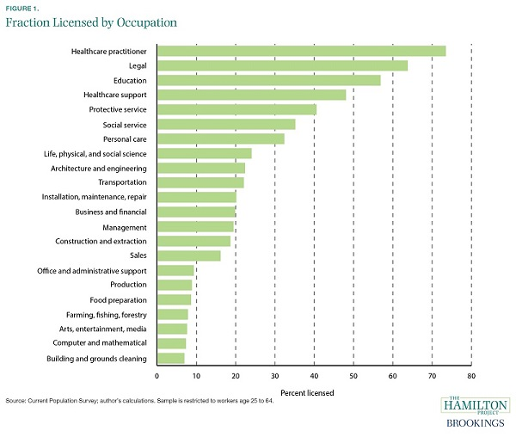
Reduce Supply: Licensing
Needed in order to legally belong to that occupation / fulfill job duties
E.g. therapists, teachers, lawyers
Usually framed as a protective measure

Slide 19
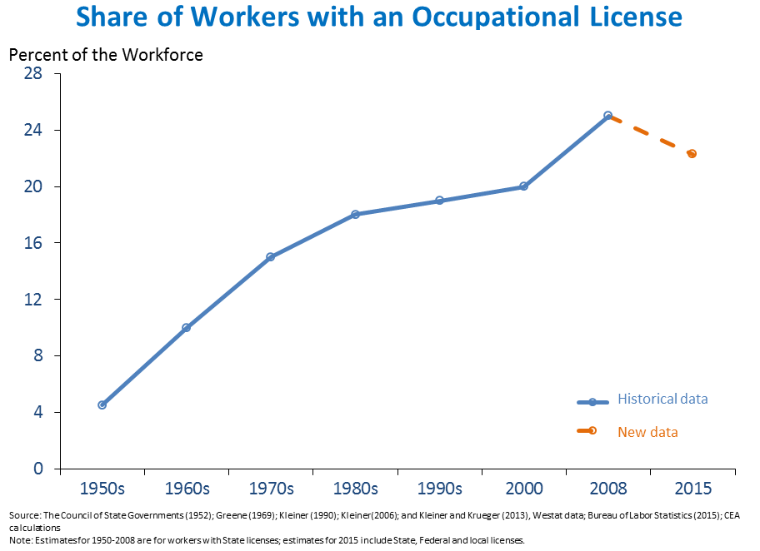
Reduce Supply: Licensing
Needed in order to legally belong to that occupation / fulfill job duties
E.g. therapists, teachers, lawyers
Usually framed as a protective measure

Slide 20
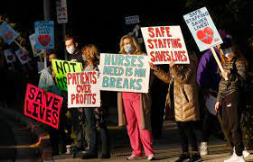
Reduce Supply: Unions
Reduce labor supply (or the threat of it) via collective action like strikes

Slide 21
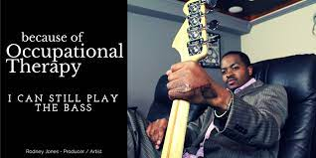
Increase Demand: Occupational Associations
Lobbying to ensure a certain amount allocated in the state budget
Teachers, police, farming
Advertising / marketing
To maintain symbolic control over a certain area

Slide 22
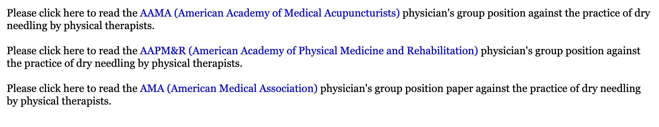
Channel Demand: Occupational Associations
If you are looking for someone to fulfill this expectation, only look to people who have this certification or belong to the occupation – even if others say they can also do it

Slide 23
Increase demand by influencing Perceived value
Voluntary Certification
Signal who are the ‘good’/ ‘competent’ members of an occupation
Occupational associations
Influence public opinion
Continually reinforce need for existence of the occupation
Licensing & credentialing
Signal themselves
Link education to occupation

Slide 24
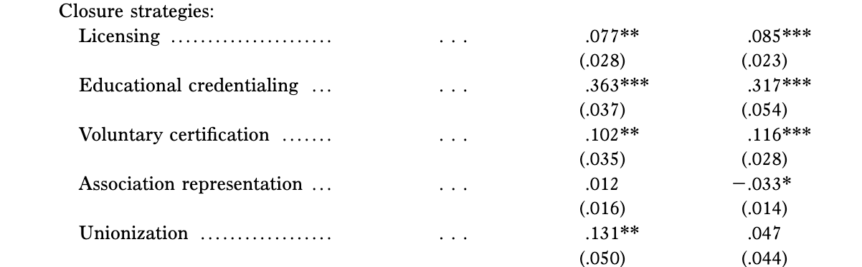
Results

Slide 25
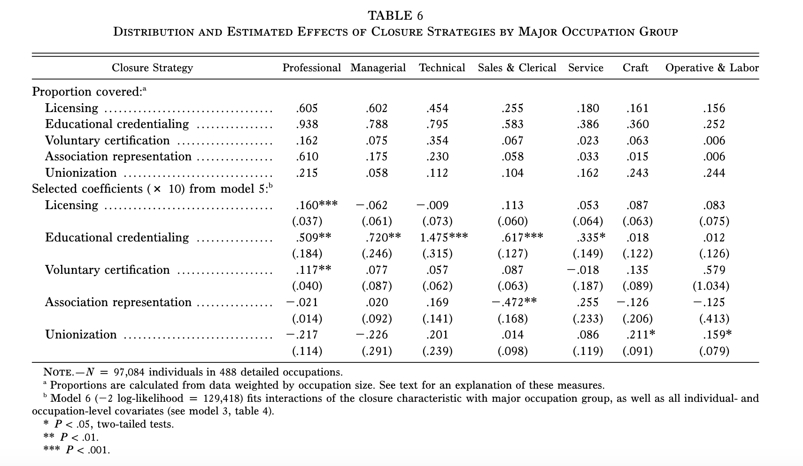
How Are these mechanisms distributed across Occupations?

Slide 26
Methods Plan → Analysis and Results

Slide 27
Example – Deflection Outcome
RQ: How does the cultural likelihood of experiencing sexual harassment at work differ between the U.S. and Germany?
ACT Dictionary | Actor | Behavior | Object | Outcome of interest
U.S. 2015 | Boss | Harass | Employee | Deflection
U.S. 2015 | Boss | Flirt_with | Employee | Deflection
U.S. 2015 | Boss | Stare_at | Employee | Deflection
Germany 2007 | Boss | Harass | Employee | Deflection
Germany 2007 | Boss | Flirt_with | Employee | Deflection
Germany 2007 | Boss | Stare_at | Employee | Deflection

Slide 28
Example – Deflection Outcome
RQ: How does the cultural likelihood of experiencing sexual harassment at work differ between the U.S. and Germany?
ACT Dictionary | Actor | Behavior | Object | Outcome of interest | Estimate
U.S. 2015 | Boss | Harass | Employee | Deflection | 12.0
U.S. 2015 | Boss | Flirt_with | Employee | Deflection | 1.5
U.S. 2015 | Boss | Stare_at | Employee | Deflection | 4.5
Germany 2007 | Boss | Harass | Employee | Deflection | 5.1
Germany 2007 | Boss | Flirt_with | Employee | Deflection | 5.3
Germany 2007 | Boss | Stare_at | Employee | Deflection | 2.6

Slide 29
Example – Emotions
RQ: What are the mental health consequences for experiencing racial microaggressions across different industries?
ACT Dictionary | Actor | Behavior | Object Modifier | Object | Outcome of interest
U.S. 2015 | Lawyer | Undermine | Black | Lawyer | Object Emotions
U.S. 2015 | Lawyer | Patronize | Black | Lawyer | Object Emotions
U.S. 2015 | Doctor | Undermine | Black | Doctor | Object Emotions
U.S. 2015 | Doctor | Patronize | Black | Doctor | Object Emotions
U.S. 2015 | Engineer | Undermine | Black | Engineer | Object Emotions
U.S. 2015 | Engineer | Patronize | Black | Engineer | Object Emotions

Slide 30
Example – Emotions
RQ: What are the mental health consequences for experiencing racial microaggressions across different industries?
ACT Dictionary | Actor | Behavior | Object Modifier | Object | E | P | A | Closest measured emotions
U.S. 2015 | Lawyer | Undermine | Black | Lawyer | 0.18 | -1.80 | 0.34 | Emotional, indignant
U.S. 2015 | Lawyer | Patronize | Black | Lawyer | 0.31 | -1.77 | 0.36 | Emotional, indignant
U.S. 2015 | Doctor | Undermine | Black | Doctor | 0.09 | -2.63 | 0.49 | Sniveling, scared
U.S. 2015 | Doctor | Patronize | Black | Doctor | 0.23 | -2.56 | 0.50 | Sniveling, anxious
U.S. 2015 | Engineer | Undermine | Black | Engineer | 0.13 | -2.32 | 0.48 | Sniveling, anxious
U.S. 2015 | Engineer | Patronize | Black | Engineer | 0.26 | -2.24 | 0.49 | Nervous, emotional

Slide 31
Workshop?
ACT Dictionary | Actor | Behavior | Object Modifier | Object | E | P | A | Closest measured emotions

