Slide 1
Designing Simulations, Customer Interactions
March 8, 2023

Slide 2
Designing Simulations

Slide 3
Possible Outcomes (DVs)
Deflection = likelihood
How likely is this event to happen
Behavior
Optimal behavior between two identities
Next behavior following an interaction
Emotions
Characteristic Emotions
Emotions as a result of an interaction
Cultural likelihood

Slide 4
Independent Variables
Identities that differ on one or more key characteristic of interest:
Difference between genders
(modify with man / woman) OR
choose occupational identities that are highly gendered
Difference between races
modify with white / black / Hispanic / etc.
Difference over time
Same IDs from different dictionaries over time
Differences between cultures
Same IDs from different cultural dictionaries
Difference in hierarchy
identities from one industry that differ on potency
Difference in status
identities from one industry that differ on evaluation
Difference in industry
Identities from different industries

Slide 5
Example
I’m interested in the experience of sexual harassment in different occupations

Slide 6
DV
I’m interested in the experience of sexual harassment in different occupations:
Could do:
cultural likelihood of experiencing sexual harassment in different occupations
emotional outcomes of experiencing sexual harassment in different occupations
Interactional responses to experiencing sexual harassment in different occupations

Slide 7
IV
I’m interested in the experience of sexual harassment in different occupations
Could do:
In woman vs. man dominated occupations
For women versus men victims
or women versus men perpetrators
In different hierarchical positions
In one occupation over time
In one occupation across cultures

Slide 8
How does the cultural likelihood of experiencing sexual harassment at work differ for women in different levels of authority in the medical field?
DV: cultural likelihood of experiencing sexual harassment
Deflection
IV: women in different levels of authority in the medical field
Identities that are different in hierarchical location:
Woman surgeon
Woman doctor
Woman nurse practitioner
Woman registered nurse

Slide 9
Choosing behavior
Simulation plan:
Need to choose a behavior that fits the experience of being sexually harassed:
Desire_sexually
Flirt_with
Harass
Kiss

Slide 10
Actor | Behavior | Object_modifier | Object | Deflection
Doctor | Flirt_with | Female | surgeon | 1.9
Doctor | Flirt_with | Female | doctor | 1.6
Doctor | Flirt_with | Female | nurse practitioner | 1.3
Doctor | Flirt_with | Female | registered nurse | 1.5
Doctor | Harass | Female | surgeon | 22.4
Doctor | Harass | Female | doctor | 22.3
Doctor | Harass | Female | nurse practitioner | 22.1
Doctor | Harass | Female | registered nurse | 23.5

Slide 11
cultural likelihood of experiencing sexual harassment in different occupations
emotional outcomes of experiencing sexual harassment in different occupations
Interactional responses to experiencing sexual harassment in different occupations
In woman vs. man dominated occupations
For women versus men victims
Women versus men perpetrators
In different hierarchical positions
In one occupation over time
In one occupation across cultures
Dependent Variable
Independent Variable

Slide 12
Dictionary search application
https://emkmaloney.shinyapps.io/dictionary_search/

Slide 13
Lab 3

Slide 14
How do the predicted behaviors to occur within these legal dyads follow what you would expect?
Actor | Object | E | P | A | Closest 3 measured behaviors
Judge | Lawyer | 1.21 | 1.37 | -0.24 | Pamper, touch, wash
Judge | Paralegal | 1.30 | 2.25 | -0.16 | Fix, supervise, medicate
Lawyer | Judge | 1.18 | 0.85 | 0.63 | Decorate, brief, bargain with
Lawyer | Paralegal | 1.29 | 1.87 | 0.73 | Convince, outwit, interview
Paralegal | Lawyer | 1.46 | -0.11 | -0.23 | Curtsy to, bathe, sit next wo
Paralegal | Judge | 1.50 | -0.25 | -0.23 | Curtsy to, obey, glance at

Slide 15
How do the predicted behaviors to occur within these legal dyads follow what you would expect?
Actor | Object | E | P | A | Closest 3 measured behaviors
Judge | Lawyer | 1.21 | 1.37 | -0.24 | Pamper, touch, wash
Judge | Paralegal | 1.30 | 2.25 | -0.16 | Fix, supervise, medicate
Lawyer | Judge | 1.18 | 0.85 | 0.63 | Decorate, brief, bargain with
Lawyer | Paralegal | 1.29 | 1.87 | 0.73 | Convince, outwit, interview
Paralegal | Lawyer | 1.46 | -0.11 | -0.23 | Curtsy to, bathe, sit next wo
Paralegal | Judge | 1.50 | -0.25 | -0.23 | Curtsy to, obey, glance at

Slide 16
How do the predicted behaviors to occur within these legal dyads follow what you would expect?
Actor | Object | E | P | A | Closest 3 measured behaviors
Judge | Lawyer | 1.21 | 1.37 | -0.24 | Pamper, touch, wash
Judge | Paralegal | 1.30 | 2.25 | -0.16 | Fix, supervise, medicate
Lawyer | Judge | 1.18 | 0.85 | 0.63 | Decorate, brief, bargain with
Lawyer | Paralegal | 1.29 | 1.87 | 0.73 | Convince, outwit, interview
Paralegal | Lawyer | 1.46 | -0.11 | -0.23 | Curtsy to, bathe, sit next wo
Paralegal | Judge | 1.50 | -0.25 | -0.23 | Curtsy to, obey, glance at

Slide 17
How do the predicted behaviors to occur within these legal dyads follow what you would expect?
Actor | Object | E | P | A | Closest 3 measured behaviors
Judge | Lawyer | 1.21 | 1.37 | -0.24 | Pamper, touch, wash
Judge | Paralegal | 1.30 | 2.25 | -0.16 | Fix, supervise, medicate
Lawyer | Judge | 1.18 | 0.85 | 0.63 | Decorate, brief, bargain with
Lawyer | Paralegal | 1.29 | 1.87 | 0.73 | Convince, outwit, interview
Paralegal | Lawyer | 1.46 | -0.11 | -0.23 | Curtsy to, bathe, sit next wo
Paralegal | Judge | 1.50 | -0.25 | -0.23 | Curtsy to, obey, glance at

Slide 18
How do the predicted behaviors to occur within these legal dyads follow what you would expect?
Actor | Object | E | P | A | Closest 3 measured behaviors
Judge | Lawyer | 1.21 | 1.37 | -0.24 | Pamper, touch, wash
Judge | Paralegal | 1.30 | 2.25 | -0.16 | Fix, supervise, medicate
Lawyer | Judge | 1.18 | 0.85 | 0.63 | Decorate, brief, bargain with
Lawyer | Paralegal | 1.29 | 1.87 | 0.73 | Convince, outwit, interview
Paralegal | Lawyer | 1.46 | -0.11 | -0.23 | Curtsy to, bathe, sit next wo
Paralegal | Judge | 1.50 | -0.25 | -0.23 | Curtsy to, obey, glance at

Slide 19
How do the predicted behaviors to occur within these legal dyads follow what you would expect?
Actor | Object | E | P | A | Closest 3 measured behaviors
Judge | Lawyer | 1.21 | 1.37 | -0.24 | Pamper, touch, wash
Judge | Paralegal | 1.30 | 2.25 | -0.16 | Fix, supervise, medicate
Lawyer | Judge | 1.18 | 0.85 | 0.63 | Decorate, brief, bargain with
Lawyer | Paralegal | 1.29 | 1.87 | 0.73 | Convince, outwit, interview
Paralegal | Lawyer | 1.46 | -0.11 | -0.23 | Curtsy to, bathe, sit next wo
Paralegal | Judge | 1.50 | -0.25 | -0.23 | Curtsy to, obey, glance at

Slide 20
How do the predicted behaviors to occur within these legal dyads follow what you would expect?
Actor | Object | E | P | A | Closest 3 measured behaviors
Judge | Lawyer | 1.21 | 1.37 | -0.24 | Pamper, touch, wash
Judge | Paralegal | 1.30 | 2.25 | -0.16 | Fix, supervise, medicate
Lawyer | Judge | 1.18 | 0.85 | 0.63 | Decorate, brief, bargain with
Lawyer | Paralegal | 1.29 | 1.87 | 0.73 | Convince, outwit, interview
Paralegal | Lawyer | 1.46 | -0.11 | -0.23 | Curtsy to, bathe, sit next wo
Paralegal | Judge | 1.50 | -0.25 | -0.23 | Curtsy to, obey, glance at

Slide 21
How do the predicted behaviors to occur within these legal dyads follow what you would expect?
Actor | Object | E | P | A | Closest 3 measured behaviors
Judge | Lawyer | 1.21 | 1.37 | -0.24 | Pamper, touch, wash
Judge | Paralegal | 1.30 | 2.25 | -0.16 | Fix, supervise, medicate
Lawyer | Judge | 1.18 | 0.85 | 0.63 | Decorate, brief, bargain with
Lawyer | Paralegal | 1.29 | 1.87 | 0.73 | Convince, outwit, interview
Paralegal | Lawyer | 1.46 | -0.11 | -0.23 | Curtsy to, bathe, sit next wo
Paralegal | Judge | 1.50 | -0.25 | -0.23 | Curtsy to, obey, glance at

Slide 22
Do the resulting emotions and behaviors of the identities have implications for interactions in legal settings?
Lawyer 1.29 1.87 0.73 Paralegal
Paralegal 1.46 -0.11 -0.23 Lawyer
Measure | E | P | A | Closest term
Actor emotions | 1.63 | 1.69 | 1.00 | Enthralled
Actor behaviors | 1.41 | 2.15 | 0.78 | Exonerate
Object emotions | 1.17 | -0.89 | 0.67 | Emotional / acquiescent
Object behaviors | 1.81 | 0.12 | -0.30 | Curtsey to
Measure | E | P | A | Closest term
Actor emotions | 1.59 | -0.34 | 0.63 | Awe-struck
Actor behaviors | 1.82 | -0.04 | -0.23 | Curtsey to
Object emotions | 1.29 | 1.07 | 0.40 | Awe struck
Object behaviors | 1.42 | 2.30 | 0.90 | Exonerate
Notes:
1.46 -0.11 -0.23

Slide 23
Customer Interactions

Slide 24
Customer facing jobs are interactionally uncertain
Both interact with others at a magnitude higher than many other occupations and
Interact with many different others at a scale higher than other occupations
May particularly be more vulnerable to negative interactions and disrespect from interaction partners
A | B | O | deflection
Customer | Disrespect | Machine Repairer | 13.3
Customer | Disrespect | Fast food | 12.0

Slide 25
Emotional Labor
Hochschild (1979, 1983)
Customer-facing employees must:
Manage or suppress their negative emotions
Perform expected positive, calm, helpful emotion
Source of alienation for workers
Concept has drifted quite a bit in the broader usage of the term
Linked with burnout, negative feelings, turnover

Slide 26
BUT
Some workers find customer interactions a source of affirmation & benefit – find meaning in helping, assisting
Fast_food_server assist customer → fast food worker expected to feel happy

Slide 27
Organizational Perspective
What is the attitude of the organization toward:
Customers
Addressing disrespectful customers
Backing up employees who deal with negative customer interactions
Fostering positive customer interactions

Slide 28
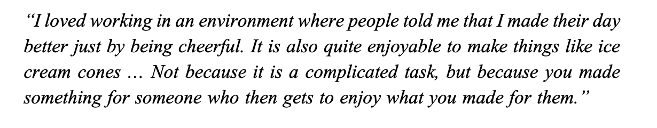
Occupational Perspective - Benefit

Slide 29
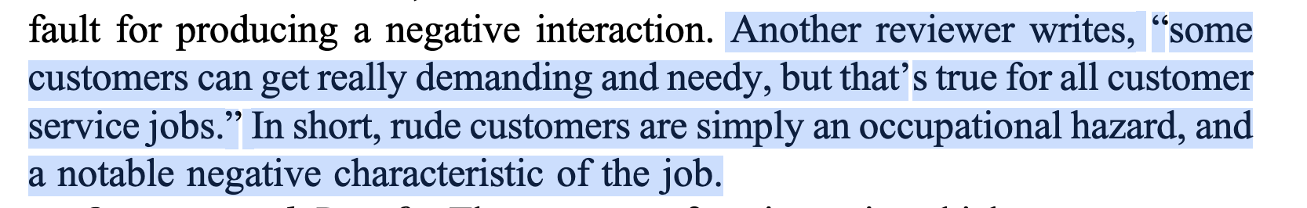
Occupational Perspective - Hazard

Slide 30
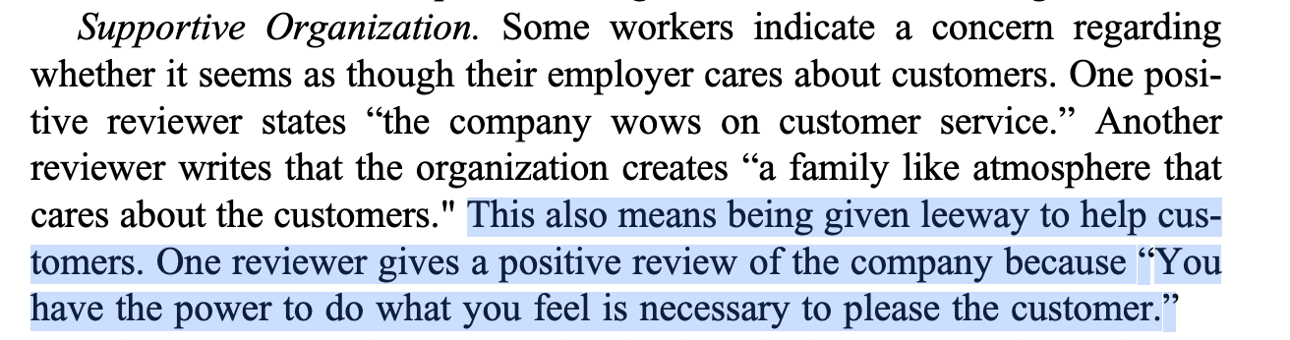
Supportive Organization

Slide 31
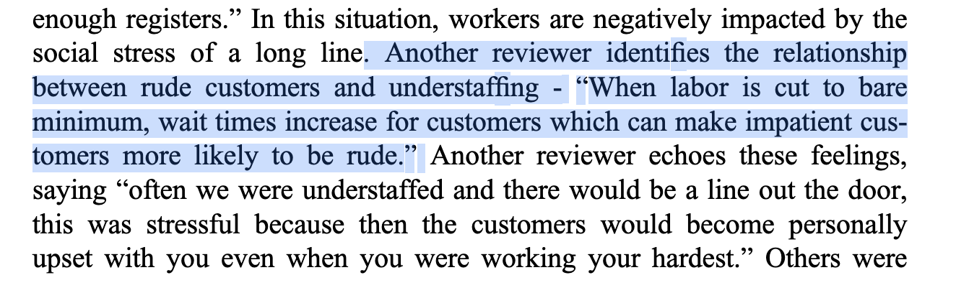
Unsupportive Organization

Slide 32
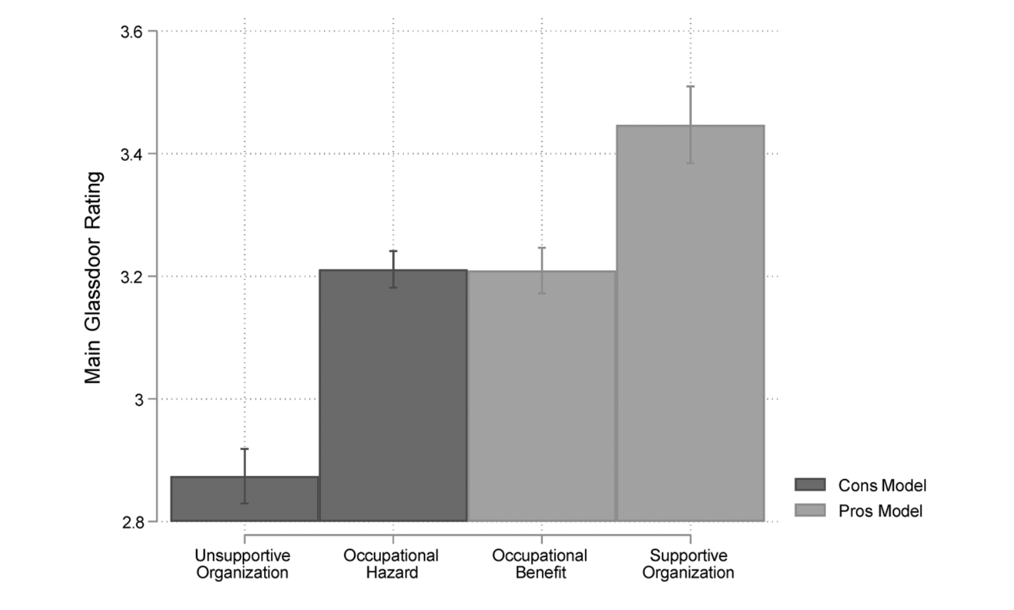
How do these perspectives relate to job satisfaction?

Slide 33
Discussion
What are the implications for studying occupations?
How do we account for the different types of interactions an occupation may have on the job?
How does this make you think about analyzing your research question through an interactional perspective?
Do you think this applies similarly to jobs that have more coworker interactions?

