Slide 1
Tokenism, Glass Escalators, and Intersectionality
March 1, 2023

Slide 2

Tokenism
Being a member of a highly under-represented minority in an occupation affects:
one’s social experiences on the job
one’s likelihood of advancing and staying in a career
Kanter (1977) uses the example when women are the tokens in men-dominated corporations

Slide 3

Dimensions of Tokenism
Visibility
Contrast
Assimiliation

Slide 4
1. Visibility
Being a member of a minority group makes you highly visible to others in the organization:
Means you are seen as a representative of your group:
Your behavior can have symbolic consequences because actions reflect strongly on the characterization of the entire group
Symbols of ‘how-women-can-do’ (Kanter 1997:207)
Creates performance pressure, stress
Leads to work being more heavily scrutinized, devalued

Slide 5
How does visibility manifest socially?
Gossip
“A woman swore in an elevator in an Atlanta hotel while going to have drinks with colleagues, and it was known all over Chicago a few days later that she was a ‘radical’” (Kanter 1997:212)

Slide 6
How does visibility manifest socially?
Easily remembered …especially for missteps
“If it seems good to be noticed, wait until you make your first major mistake”

Slide 7
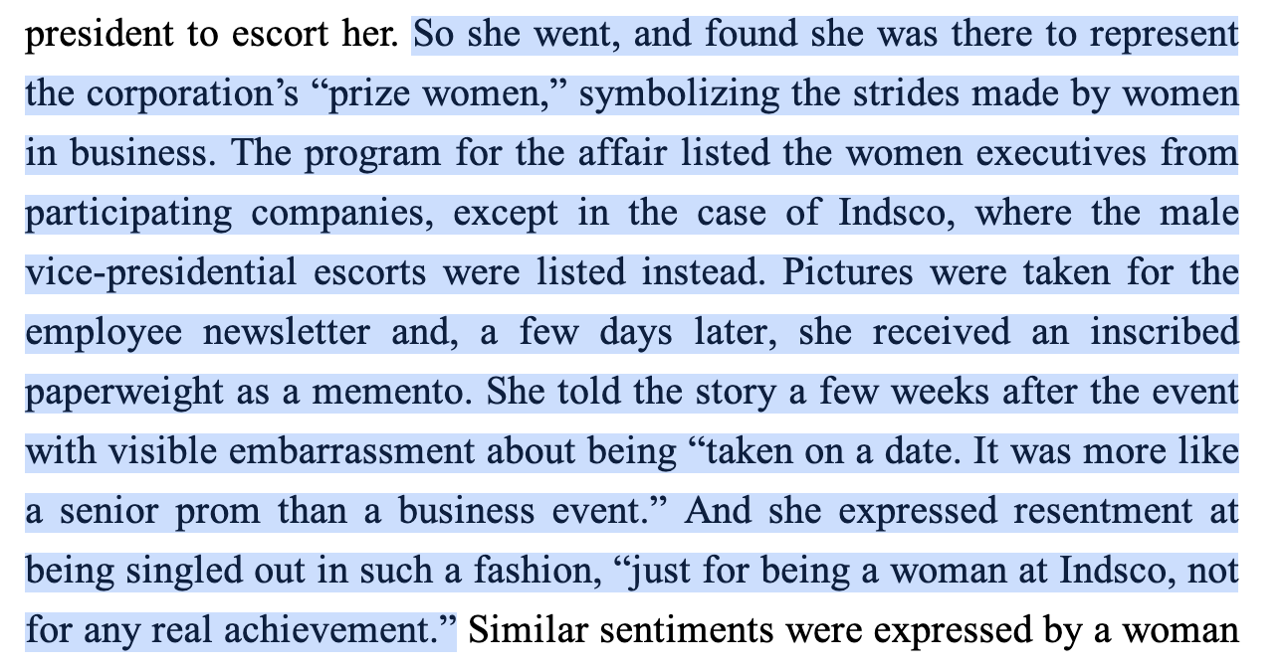
How does visibility manifest socially?
Used as advertising for company

Slide 8
How does visibility manifest socially?
Symbolic representatives:
“Speak about this as a woman”
Evaluated by 2 standards in every interaction - how behaved as women and how behaved as manager
Felt that behavior was seen as reflective of entire group
Stereotype threat

Slide 9
Token Response to Visibility
Try to be socially invisible
Usually resulted in career stagnation
Overachieve ‘nicely’
Requires high level of competence at job immediately and good social skills
Worked best for older women
Use visibility for benefit and deal with social consequences
Risky - not often successful
Sometimes resulted in these women becoming gatekeepers for other women

Slide 10
Double Bind
…fired a woman for not being aggressive enough and then reprimanded another woman who had “brought in the largest amount of new business during the past year…for being ‘too aggressive, too much of a hustler’”

Slide 11
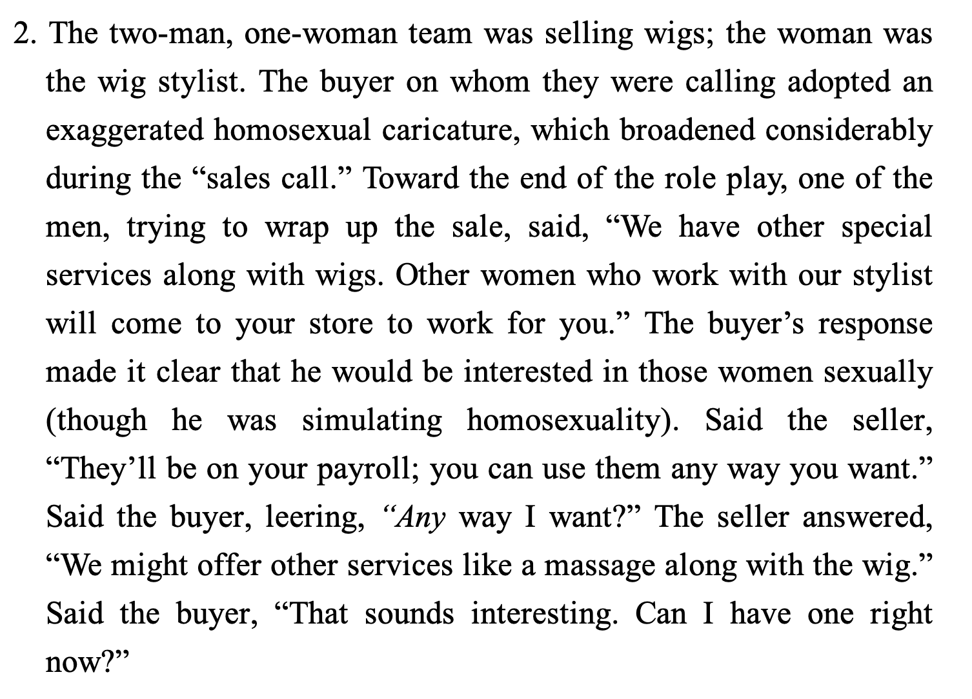
2. Contrast - Boundary maintenance
Dominant members emphasize differences between dominant group and minority group
When women were present in informal social situations, men were more likely to:
Talk about how ‘masculine prowess’ led to success – sexual innuendos or stories, sexual harassment, stories of aggression
Women report feeling ‘tested’
“Can we still____ now that women are here?”

Slide 12
How does contrast manifest socially?
Informal mechanisms of gatekeeping
who gets invited to hang out, grab a beer, etc.
Mixing business and pleasure at men-only organizations
“pre-meeting meetings”
Loyalty tests
“What are you girls talking about?”
Show loyalty by keeping other women down
“one of the guys”
Okay being butt of the joke

Slide 13
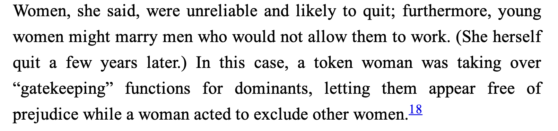
'High performing’ women can become gatekeepers themselves
Boundary maintenance

Slide 14
3. Assimilation
Visibility + Contrast make the social characteristic that is different between the dominant and minority group salient
in this case, activates gender beliefs about how men should act and how women should act
The consequences are that members of the minority group are influenced to fill stereotypical role behavior
Must fill the organizational niche available to them

Slide 15
Others’ treatment
Being mistaken for:
Secretary
Man co-worker’s wife
Man co-worker’s assistant
Being expected to do:
Secretarial work
Treated in markedly gendered ways for typical business behavior
“A professional woman at Indsco asked for a promotion and talked about looking for a better job; her manager’s first assumption was that she did not feel “loved” and it was his fault for failing to give love to a woman.” (Kanter 1977)

Slide 16
Kanter’s Types
Mother
Expected to nurture, emotionally soothe men co-workers
Seductress
Seen as sexually desirable, available (may be intentional or put-upon by ‘protector’ men)
Pet
Treated as a cheerleader for men coworkers
‘look-what-she-can-do-and-she’s-only-a-woman’
Iron Maiden
Strong/tough, cold - aband

Slide 17
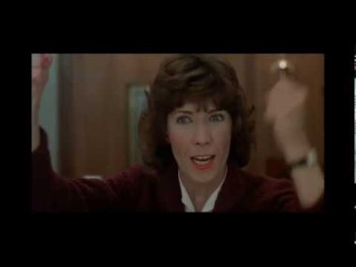
Example
Nine to Five
Lily Tomlin = Iron Maiden
Dolly Parton = Seductress
Jane Fonda = Pet

Slide 18
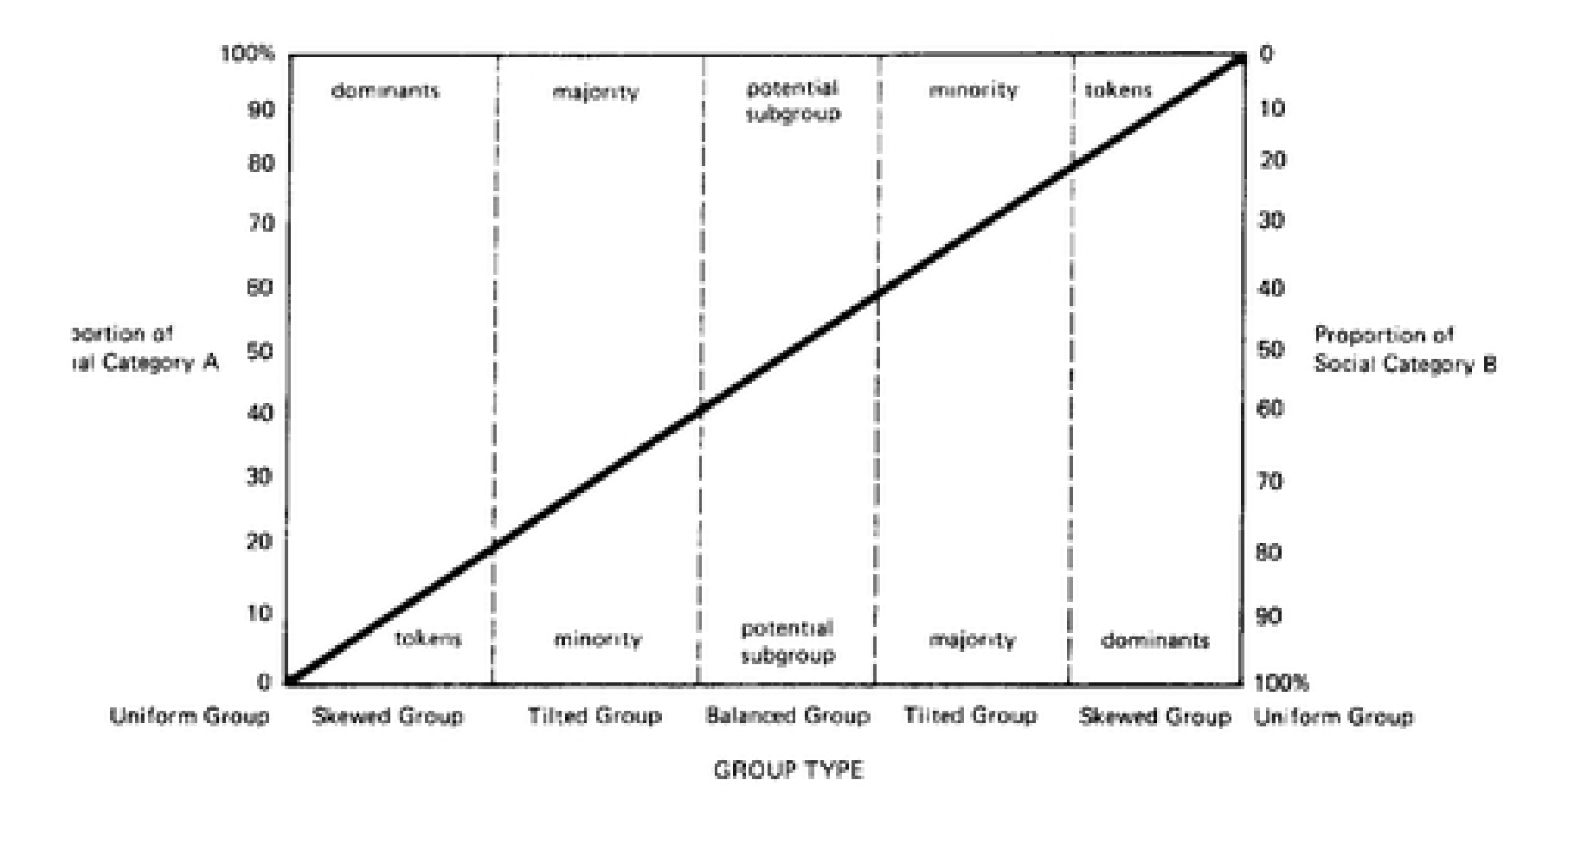
Kanter’s Conclusions
This is a consequence of numbers:
Mechanisms of tokenism will occur below the 15/85 minority/majority percentage line

Slide 19
What is the glass escalator?

Slide 20
Why is it different for (white) men in women-dominated industries?
Visibility
Contrast
Assimilation

Slide 21
Why is it different for (white) men in women-dominated industries?
Relationships with colleagues and supervisors
Impressions of ‘suitability’ for work
Distancing from femininity
Discrimination from outsiders
Fears over men in female-dominated occupations being pedophiles/sexual abusers

Slide 22
How did Wingfield complicate the findings by focusing on Black men in women-dominated industries?
Visibility
Contrast
Assimilation

Slide 23
Intersectionality
Race
Nationality
Gender
Disability
Sexuality

Slide 24
Intersectionality
What it means to be a man is different for:
Black men
White men
What it means to be a woman is different for:
Black women
White women
Not additive – overlapping, can produce distinct outcomes

Slide 25
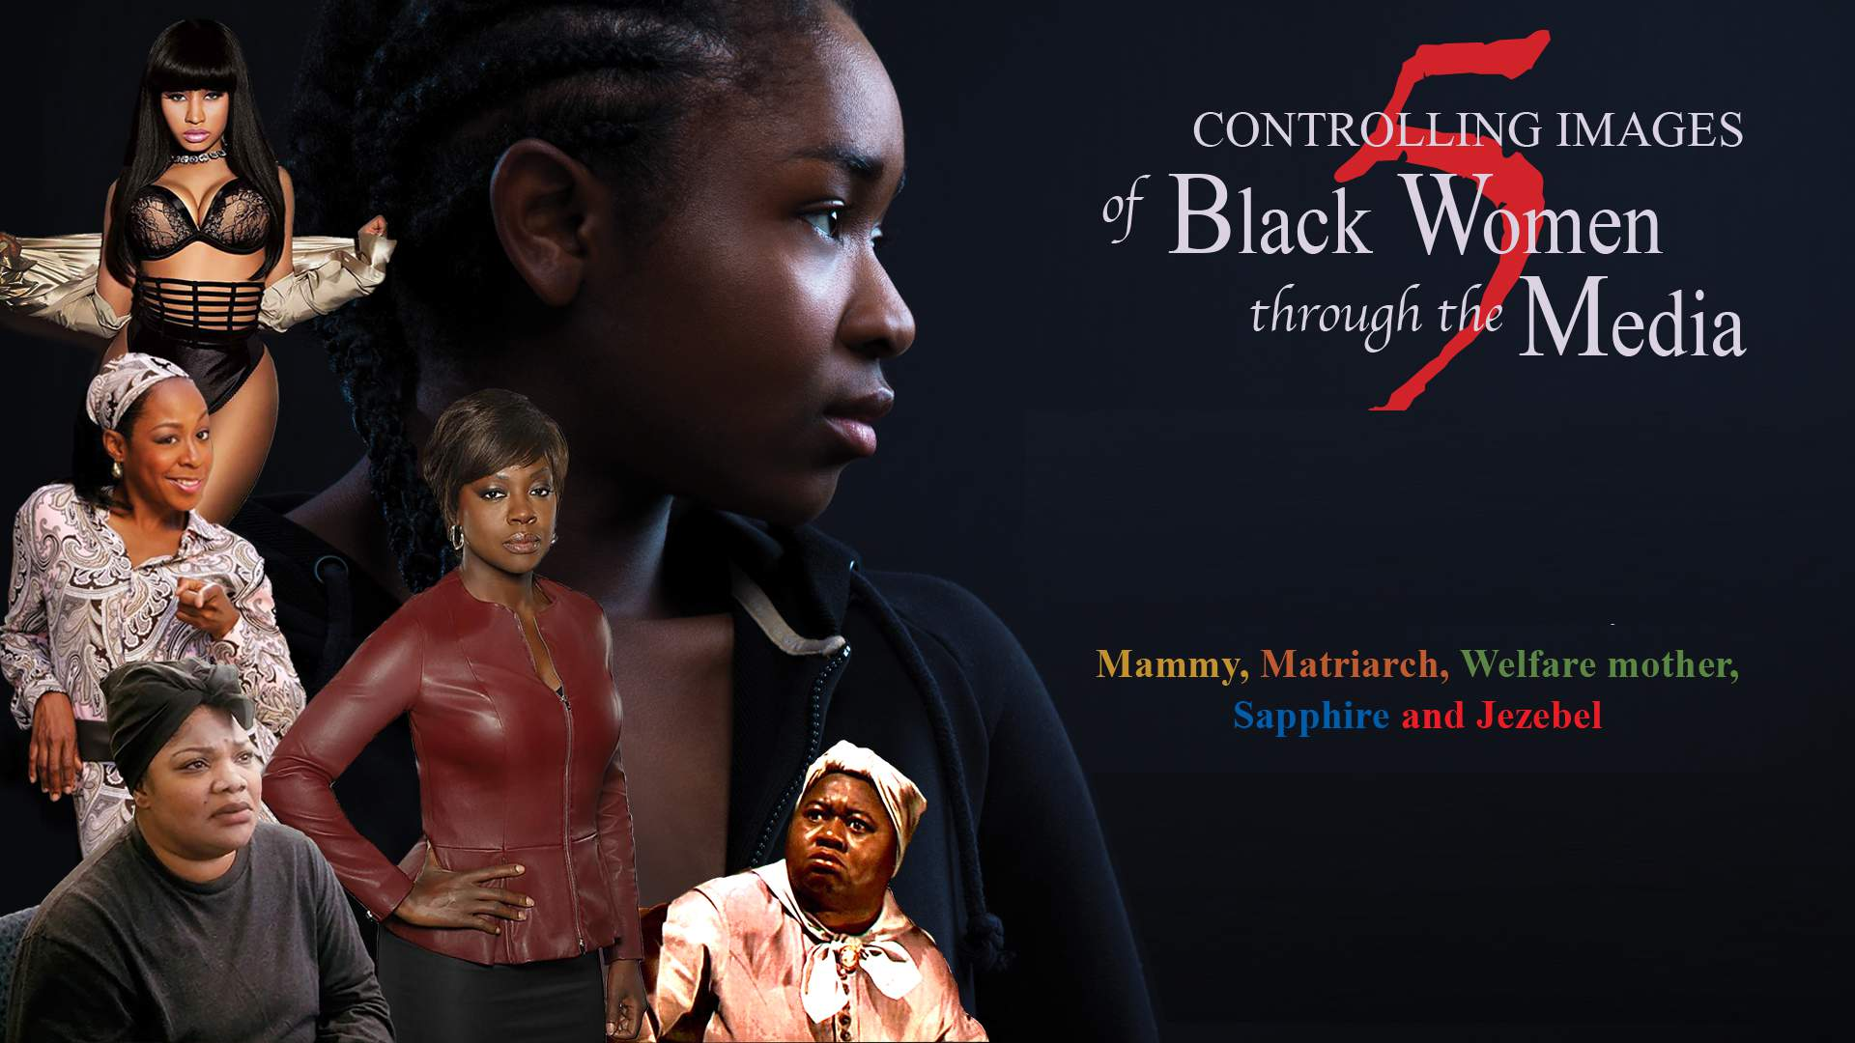
Controlling Images

