Slide 1
Occupational Identity & Occupational Segregation
February 1, 2023

Slide 2
Identity Theories in Sociology - Foundation
Identities
Self-concept
Self
To read more about identity theories in sociology:
Owens, Timothy J., Dawn T. Robinson, and Lynn Smith-Lovin. 2010. “Three Faces of Identity.” Annual Review of Sociology 36(1):477–99. doi: 10.1146/annurev.soc.34.040507.134725.

Slide 3
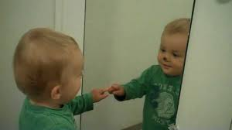
Self
Reflexive
the ability to consider how others view you
Develops as a consequence of social interaction
Notes:
the self is a phenomenon of the human mind born out of reflexive action, stemming primarily from a person’s interactions with oth- ers. Mead especially stressed the ability to imag- ine oneself from the standpoint of another per- son.

Slide 4
George Herbert Mead – the I and the Me
I
Me
Subject
Active self
Reacts to ‘me’ / situation and decides on course of action
Object
One’s social self / socialized self
I’s opinions towards self
Collected impressions from others of the social self
Notes:
The "Me" is what is learned in interaction with others and (more generally) with the environment: other people's attitudes, once internalized in the self, constitute the Me.^{[3]} This includes both knowledge about that environment (including society), but also about who the person is: their sense of self. "What the individual is for himself is not something that he invented. It is what his significant others have come to ...treat him as being."^{[4]} This is because people learn to see who they are (man or woman, old or young, etc.) by observing the responses of others to themselves or their actions. If others respond to a person as (for instance) a woman, the person develops a sense of herself indeed as a woman.
At the same time, 'the "Me" disciplines the "I" by holding it back from breaking the law of the community'.^{[5]} It is thus very close to the way in a man Freud's 'ego-censor, the conscience...arose from the critical influence of his parents (conveyed to him by the medium of the voice), to whom were added, as time went on, those who trained and taught him and the innumerable and indefinable host of all the other people in his environment—his fellow-men—and public opinion'.^{[6]} It is 'the attitude of the other in one's own organism, as controlling the thing that he is going to do'.^{[7]}
By contrast, 'the "I" is the response of the individual to the attitude of the community'.^{[8]} The "I" acts creatively, though within the context of the me. Mead notes that "It is only after we have acted that we know what we have done...what we have said."^{[8]} People, he argues, are not automatons; Mead states that "the "I" reacts to the self which arises though the taking of the attitude of others."^{[9]} They do not blindly follow rules. They construct a response on the basis of what they have learned, the "me". Mead highlighted accordingly those values that attach particularly to the "I" rather than to the me, "...which cannot be calculated and which involve a reconstruction of the society, and so of the 'me' which belongs to that society."^{[10]} Taken together, the "I" and the "me" form the person or the self in Mead's social philosophy. According to Mead, there would be no possibility of personality without both the "I" and the "Me".^{[11]}

Slide 5
Self-Concept - Rosenberg (1979)
Roughly equivalent to the ‘me’ in George Herbert Mead’s formulation
All of one’s feelings/impressions toward oneself:
self-referring dispositions
Like type C from the 20 Statements test – traits, abstract ideals/qualities
physical characteristics
and identities

Slide 6
Identities
Personal
Role
Category
Group

Slide 7
Personal Identity
Unique to self
May be drawn from one’s personal history & abstracted into the other types of identities.
Not as useful from a research perspective, but we can begin to see the influence of the social on the self by what aspects are meaningful to report.
I was born in Atlanta, Georgia in 1995. I am the second child of four, with two sisters and a brother. I went to the University of Georgia and studied sociology and cognitive science. I am working toward my PhD in sociology at Duke University now.

Slide 8
Role Identity
Social position within larger social structure
Have socially defined behavioral expectations to fulfill performance of the role
Typically have structural counterparts, those who you often engage with when enacting the role
Teacher – student // student -- teacher
Offensive line – defensive line
Frequent enactment suggests internalization into one’s idea of the self

Slide 9
Category/Social Identity & Group Identity
Category Identity
Group Identity
Membership in socially meaningful group:
Gender
Race
Nationality
Religious category
Membership in ‘real’ group/organization:
Duke student
Greek affiliation
Synagogue, church, mosque membership

Slide 10
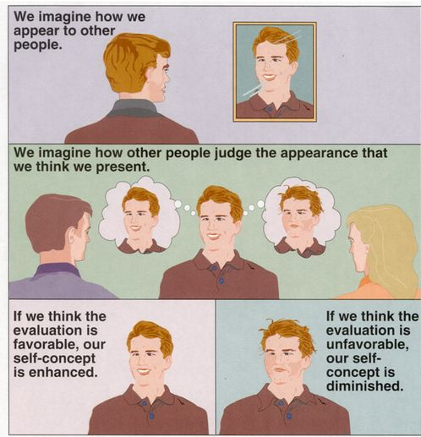
Identities – Focus on Individual self-Structure
Internalization of of cultural meanings attached to identities into one’s self-structure
Carry these identities throughout social interactions – more salient identities are more likely to be enacted
Prominence (how important it is to sense of self)
Commitment (the extent to which one’s social relationships rely on enacting the identity)
E.g. Greek affiliation
Notes:
these internalization theories assume a socialization process through which repeated social interactions lead to the development of personalized identity meanings; these meanings then become incorporated into a sta- ble, trans-situational self-concept.

Slide 11
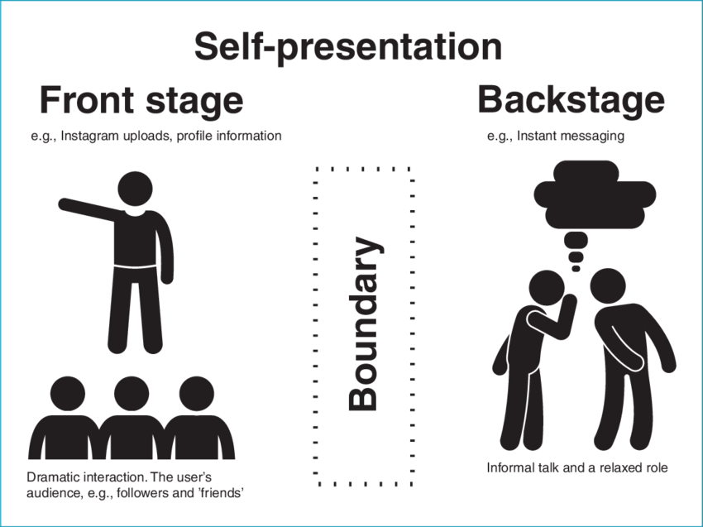
Identities – Focus on Situation
Identity performance is not only determined by individual but by the situational context
features that affect the successful performance or which force the performance of certain identities
ACT falls under this category
Notes:
These theories focus on how consensual cultural meanings associated with identities are imported by actors into local interactions and how situational environments shape the localized meanings of the situation- ally relevant identities. The situation and the culture within which it is embedded are more central than any internalized aspect of the actor.

Slide 12
Main Takeaways
Identities are defined culturally and upheld structurally
Identities we are often enacting or that are important to us are internalized into how we view ourselves
The situational context can affect one’s identity enactment and constrain behavior
Others in the situation
Setting/environment in which situation takes place
Identity resources available

Slide 13
Occupational Identity
Occupational identities are most often role identities
Have specified behavioral expectations (some version of required skills, duties, responsibilities)
Have cultural meanings attached to them
Most working adults spend at least 8 hours a day in situations in which their occupational identity is the presumed identity being enacted, making it at least an identity with high commitment
Although perhaps this is changing with remote work!

Slide 14
Affect Control Theory and Occupational Identity
Reminder…what are the three dimensions of cultural meaning?

Slide 15
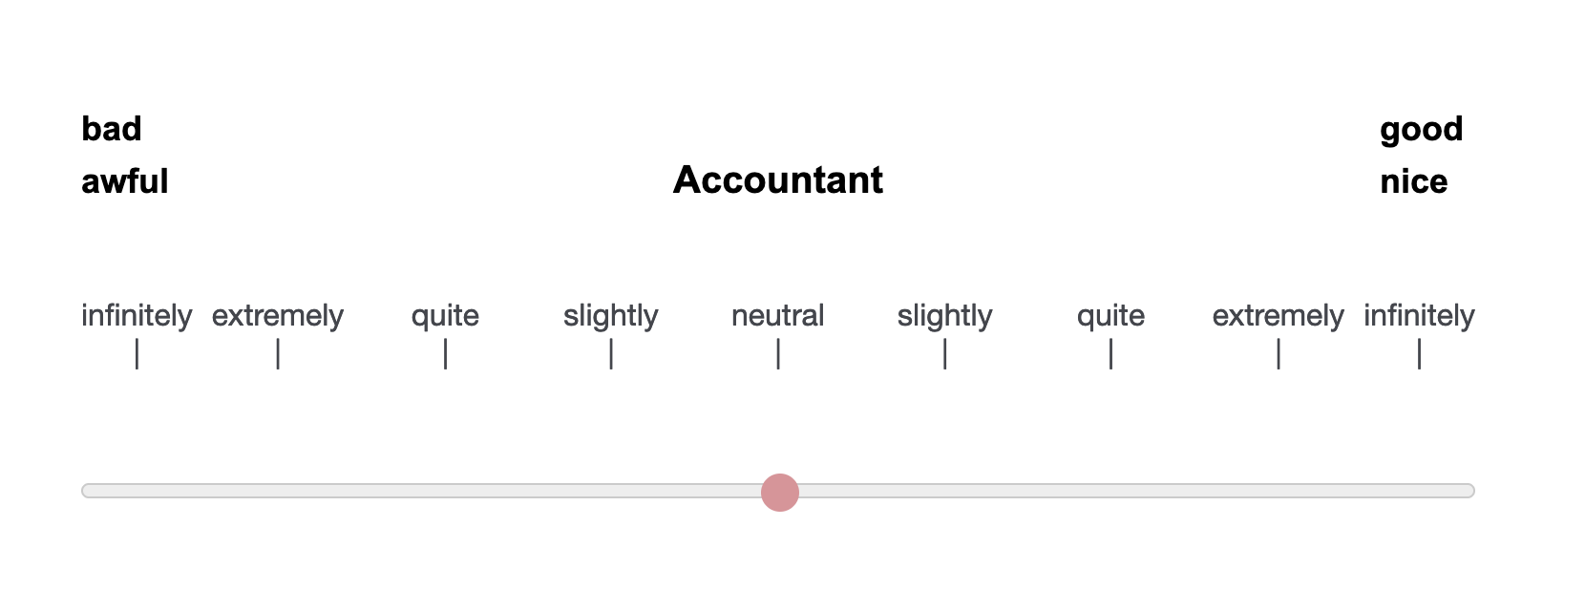
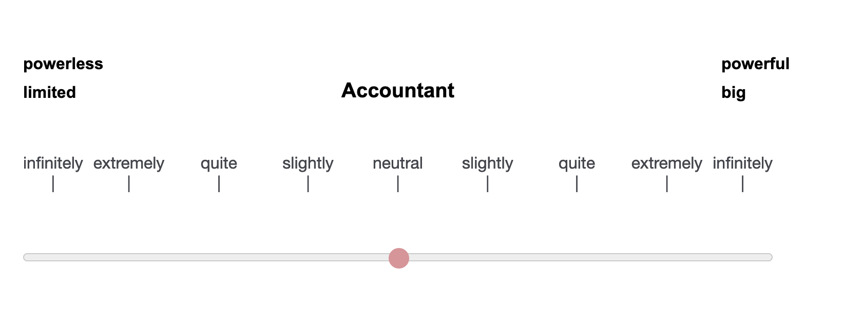
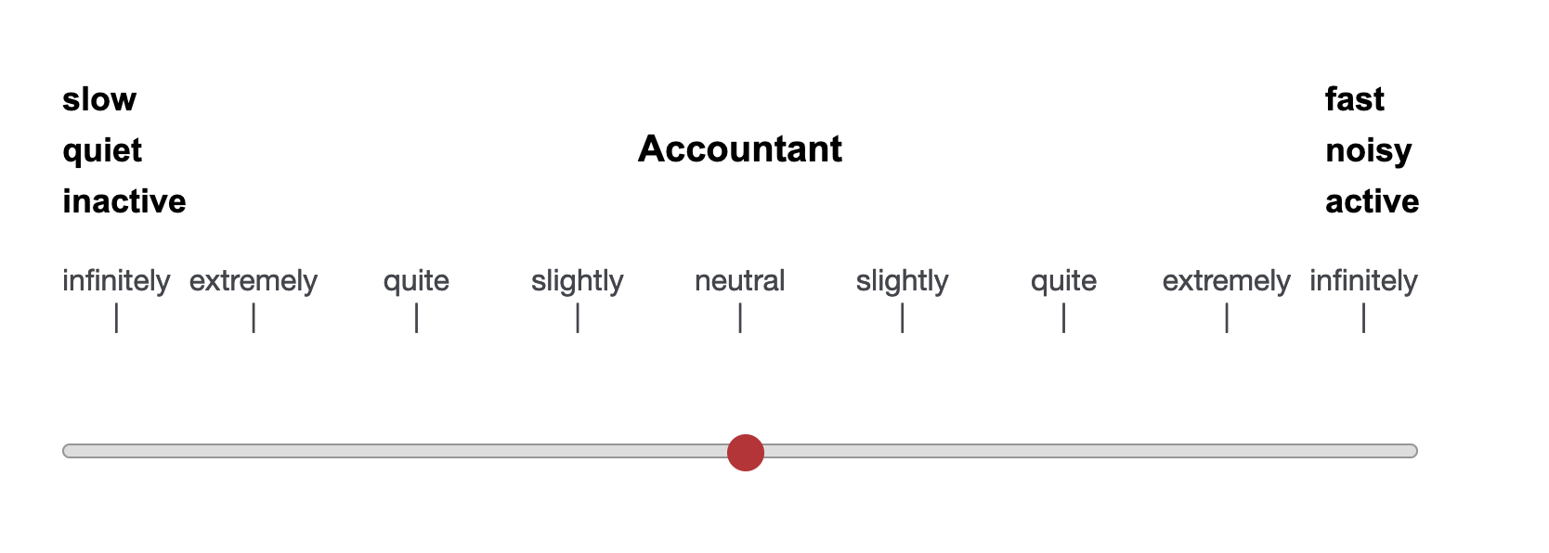
EPA

Slide 16
Multiple Identities
Most people have a number of identities they embody on a semi-regular basis
While the majority of situations evoke a singular identity, some identities are automatically enacted (social identities typically) or evoked by unexpected events!
E.g. Having family and friends mix

Slide 17

Questions?

Slide 18
Activity
Fill out this survey:
https://bit.ly/occ_char
For each occupation, select the top 10 characteristics you think are required for the job. You must select 10 and only 10 characteristics for each job, but you do not have to rank the individual characteristics themselves—simply indicate the 10 most important. You may select the same characteristic for more than one occupation if desired.

Slide 19
Gender Occupational Segregation
Are people unequally distributed across occupational identities?

Slide 20
Discussion – Small Groups
What do you think this exercise has to do with gender?
Write down notes from your discussion

Slide 21
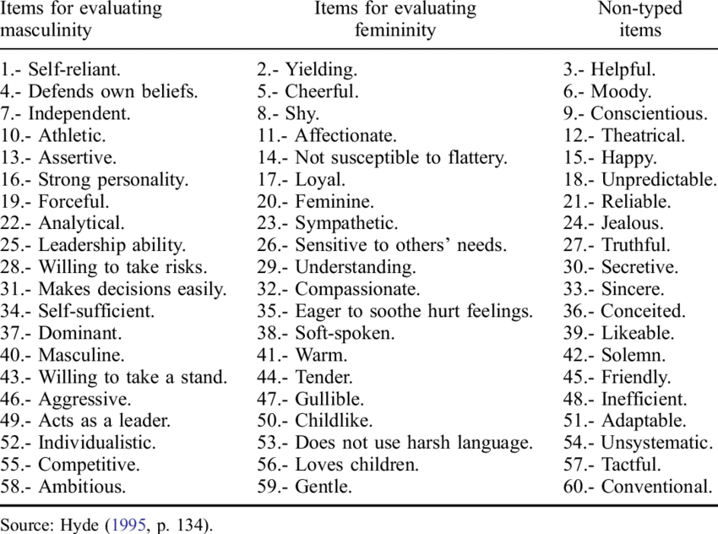
BSRI
The Bem Sex Role Inventory (BSRI) quantifies self-attribution of traits, indicative of gender roles

Slide 22
Results

Slide 23
Comparison to Reading
Mother / father identity versus gender typing
What did the authors do in the reading?

Slide 24
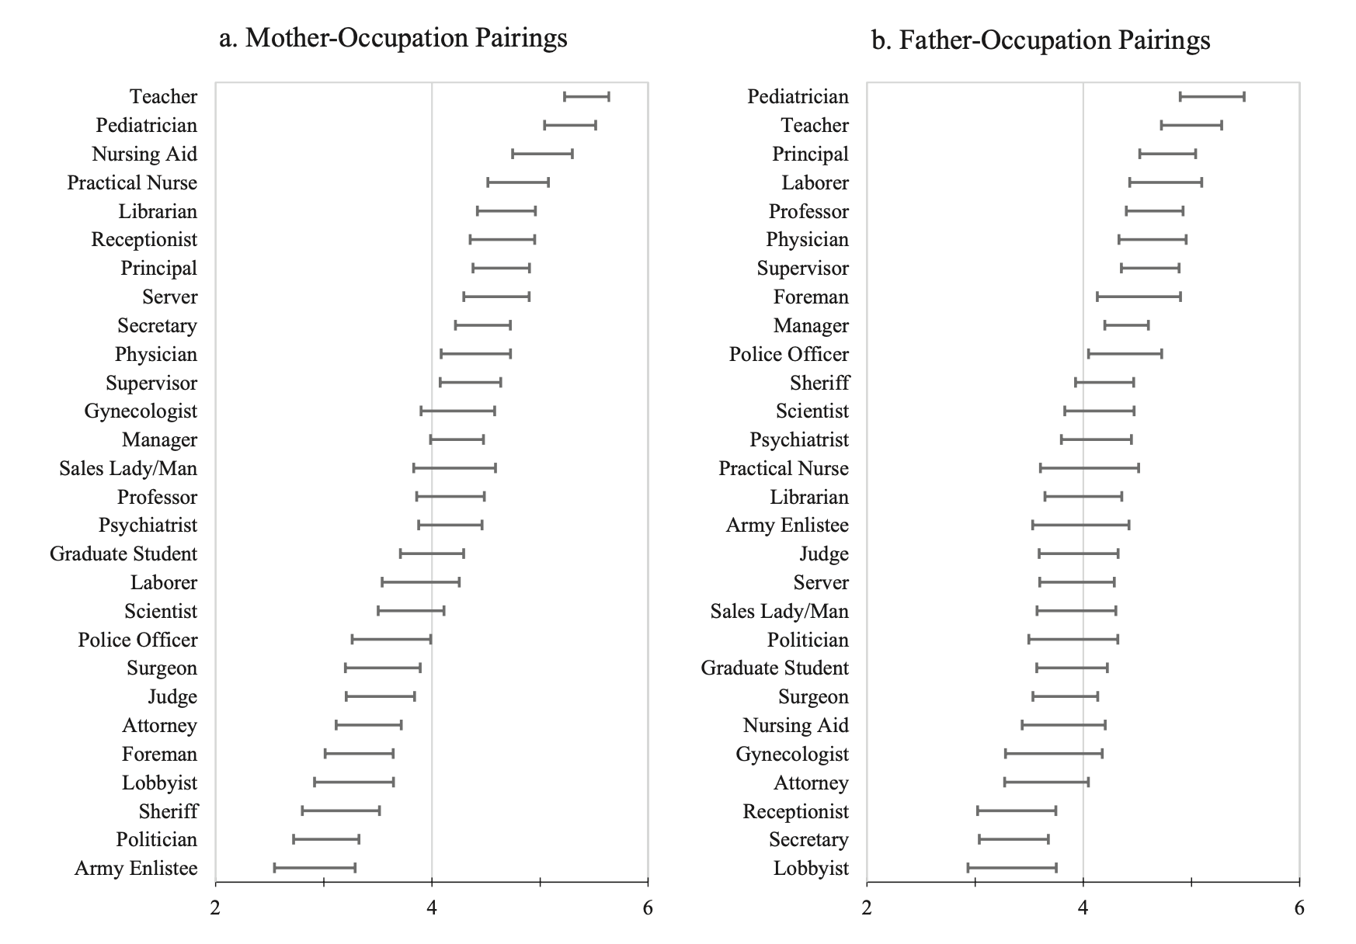
Compatibility

Slide 25
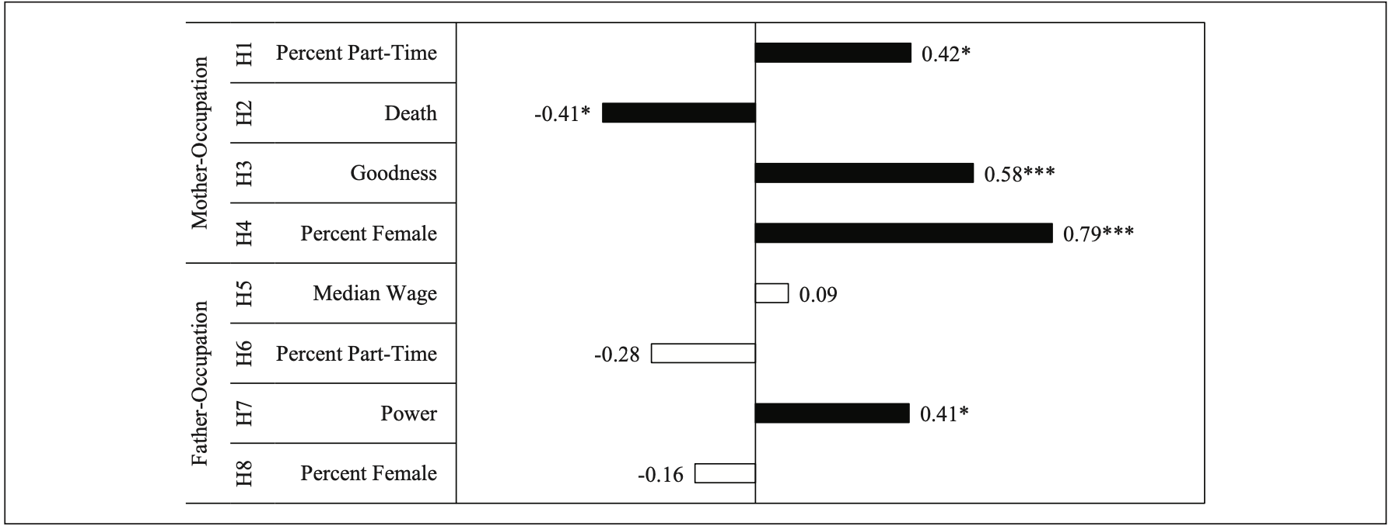
Model of Compatibility

Slide 26
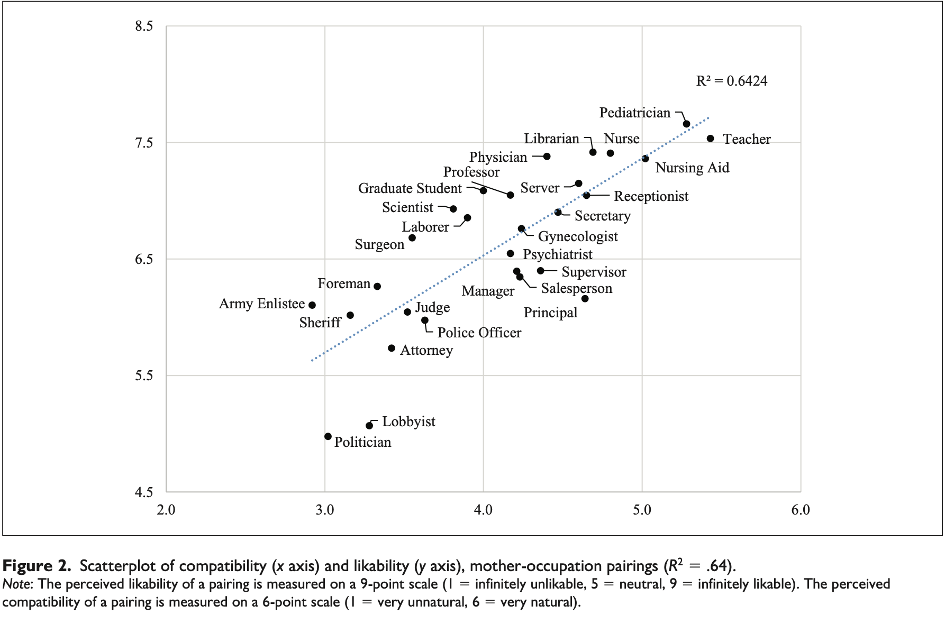
Likeability, (Trustworthy & Sincere & Attentive to Children)

Slide 27
Group Discussion
Are you surprised by these results? Why or why not? If I had asked in the beginning if certain jobs are or should be limited to a certain gender, would you have agreed?

Slide 28
Group Discussion
Why were the occupations so clearly gendered in their characteristics when the goal was simply to choose the most important traits for any person in that job—what does this suggest?

Slide 29
Group Discussion
Imagine a person who possesses all the important characteristics you selected for this job but they are not the gender stereotypical occupant, such as a man who has all the characteristics selected as important for a nurse or a woman who has all the characteristics selected as important for a police officer—is that person perceived or evaluated differently? Why?

Slide 30
Group Discussion
What is gender? How do we define it? Is it reflected well in the characteristics and the binary categories you see reflected here? How might it be connected to other aspects of social location such as race or socioeconomic status?

Slide 31
Summary
Way that we achieve social forms of esteem – likeability, trustworthiness, sincerity, and attentiveness to children, we are expected to abide by cultural expectations for our behavior based on our identities
These behaviors are associated with the division of labor
Reproduction of gendered associations of these occupations and skillsets occurs as individuals continue to:
Be guided into certain pathways
Find fulfillment in gendered occupations
Face opposition when entering occupations that are the opposite gender segregated

Slide 32
Future Exploration
Race distribution across division of labor
Mechanisms that maintain gender segregation
Relationship of gender make up to status hierarchy
Is there an association between percent men and status or material benefits?
What is the causal ordering?

Slide 33
Activity Citation
Adkins, A. M. (2018). Gendering Occupations: An Introductory Exercise for Teaching Reproduction of the Binary Gender System. Teaching Sociology, 46(4), 324–334. https://doi.org/10.1177/0092055X18787601

