Slide 1
Affect Control Theory: Sentiments
Jan 27, 2023

Slide 2
Outline
Affect Control Theory: Sentiments
20 Statements Task
Measuring Culture
​Interact application
Lab!

Slide 3
Imagine you have been asked to answer the question “Who am I?” in the form of 20 statements starting with the phrase “I am …”

Slide 4
Codes
Code | Description | Example
A | Physical characteristics/attributes | I am short
B | Roles, group memberships | I am a grad student. I am a Duke student. I am a friend.
C | Personal characteristics & emotional states | I am compassionate.
D | General more than specific, existential | I am a human.

Slide 5
Discussion
Count up the number of statements that fall into each category
Report your summary here: https://forms.gle/FidxJcw2frzNdFay7
In a small group – 2-3 people, discuss your breakdown – how similar were you in terms of how many A, B, C and D statements you had?
If there are any differences, can you guess as to why?

Slide 6
Identities are the interface between the self and society

Slide 7
What does that mean
Self / self-concept:
how we define ourselves
how we feel about who we are
Identities
Roles or social positions that are socially defined that we can embody to try to actualize our self-concept

Slide 8
Affect Control Theory

Slide 9


Social Entities have
Cognitive meaning
definition
Affective/cultural meaning
how we *feel* about the entity

Slide 10
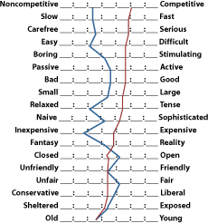
Charles Osgood Semantic Differentials
Notes:
The semantic differential (SD) is a measurement scale designed to measure a person's subjective perception of, and affective reactions to, the properties of concepts, objects, and events by making use of a set of bipolar scales. The SD is used to assess one's opinions, attitudes, and values regarding these concepts, objects, and events in a controlled and valid way. Respondents are asked to choose where their position lies, on a set of scales with polar adjectives (for example: "sweet - bitter", "fair - unfair", "warm - cold"). Compared to other measurement scaling techniques such as Likert scaling, the SD can be assumed to be relatively reliable, valid, and robust.^{[1][2][3]}

Slide 11
Measuring Meaning
Evaluation
Potency
Activity

Slide 12
8 Quadrants
Evaluation | Potency | Activity | Example terms
High | High | High | Firefighter, Winner, brain
High | High | Low
High | Low | High
High | Low | Low
Low | High | High
Low | High | Low
Low | Low | High
Low | Low | Low

Slide 13
8 Quadrants
Evaluation | Potency | Activity | Example terms
High | High | High
High | High | Low | Grandparent, writer
High | Low | High
High | Low | Low
Low | High | High
Low | High | Low
Low | Low | High
Low | Low | Low

Slide 14
8 Quadrants
Evaluation | Potency | Activity | Example terms
High | High | High
High | High | Low
High | Low | High | Baby, toddler, Infant, child
High | Low | Low
Low | High | High
Low | High | Low
Low | Low | High
Low | Low | Low

Slide 15
8 Quadrants
Evaluation | Potency | Activity | Example terms
High | High | High
High | High | Low
High | Low | High
High | Low | Low | Shrimp, doll
Low | High | High
Low | High | Low
Low | Low | High
Low | Low | Low

Slide 16
8 Quadrants
Evaluation | Potency | Activity | Example terms
High | High | High
High | High | Low
High | Low | High
High | Low | Low
Low | High | High | Mobster, gangster, pimp
Low | High | Low
Low | Low | High
Low | Low | Low

Slide 17
8 Quadrants
Evaluation | Potency | Activity | Example terms
High | High | High
High | High | Low
High | Low | High
High | Low | Low
Low | High | High
Low | High | Low
Low | Low | High | Crybaby, telemarketer
Low | Low | Low

Slide 18
8 Quadrants
Evaluation | Potency | Activity | Example terms
High | High | High
High | High | Low
High | Low | High
High | Low | Low
Low | High | High
Low | High | Low
Low | Low | High
Low | Low | Low | Do nothing, deadbeat

Slide 19
Let’s Try it ourselves
https://forms.gle/yvfsi2TnZjHEKyJm6

Slide 20
Interact

Slide 21
Download it:
https://kb-research.ca/interact/

Slide 22
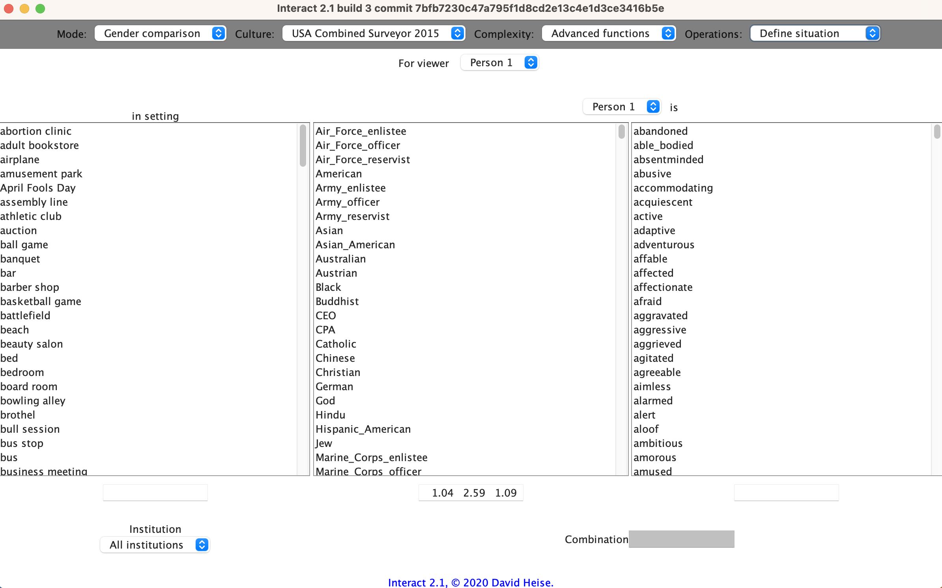
Interact

Slide 23
Interact Structure
Top bar = navigation plane
Can navigate through pages for different functions.
Today and for lab one, we will focus on 2 pages:
One for choosing identities, modifiers/traits, and settings: Define situation
One for choosing behaviors: Define events

Slide 24
Navigation Bar

Slide 25
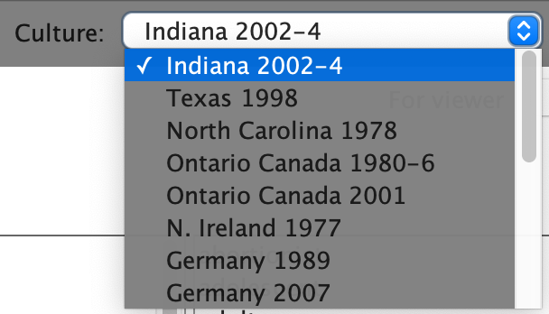
Navigation bar - Culture
How to choose which ACT dictionary you want to get estimates from

Slide 26
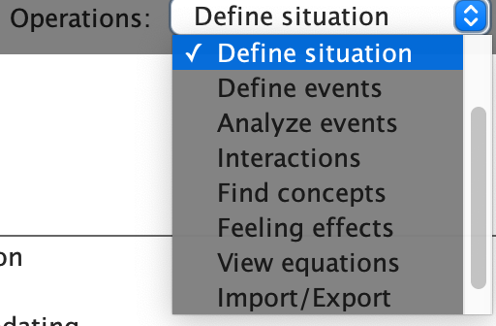
Navigation Bar - Operations
How to choose which type of ACT operations you want to calculate

Slide 27
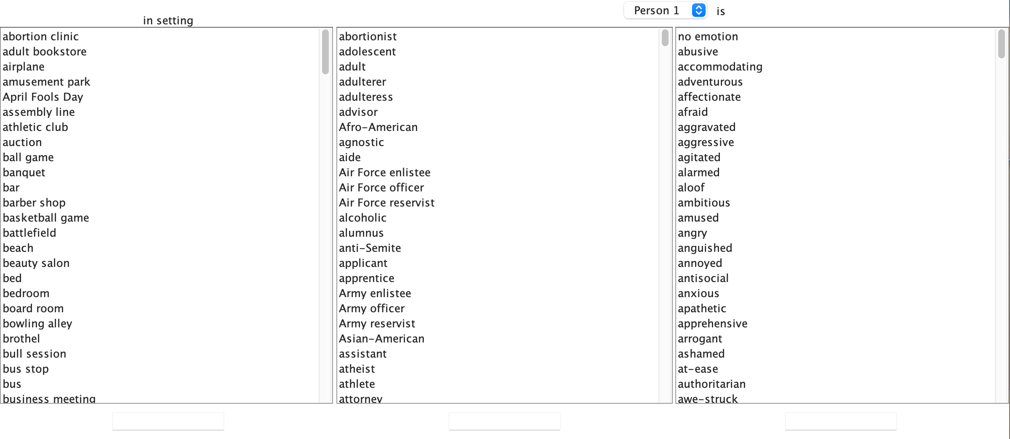
Operations – Define Situations

Slide 28
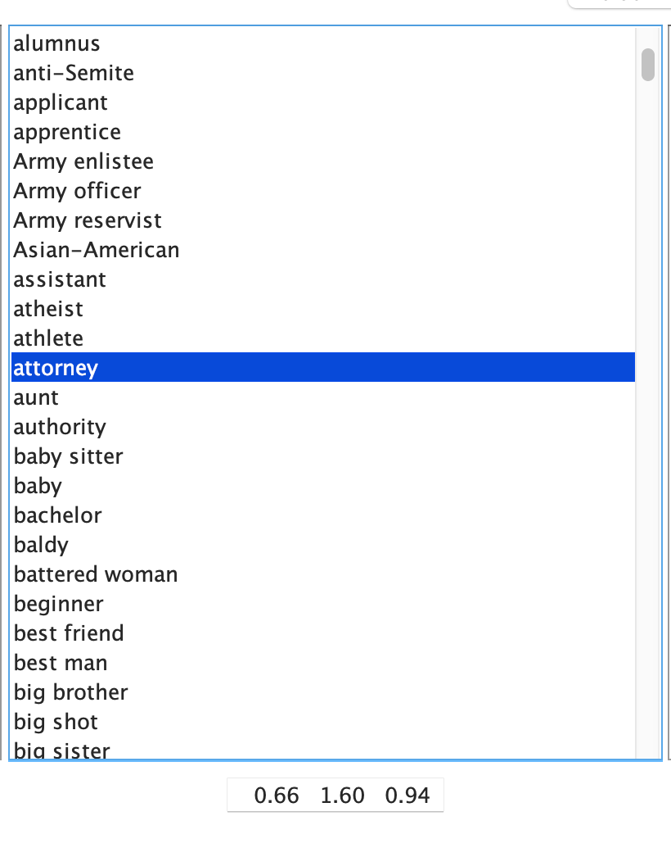
Define Situations
The middle column consists of all identities in the dictionary.
Clicking on one will display the EPA estimates in the bottom box.

Slide 29
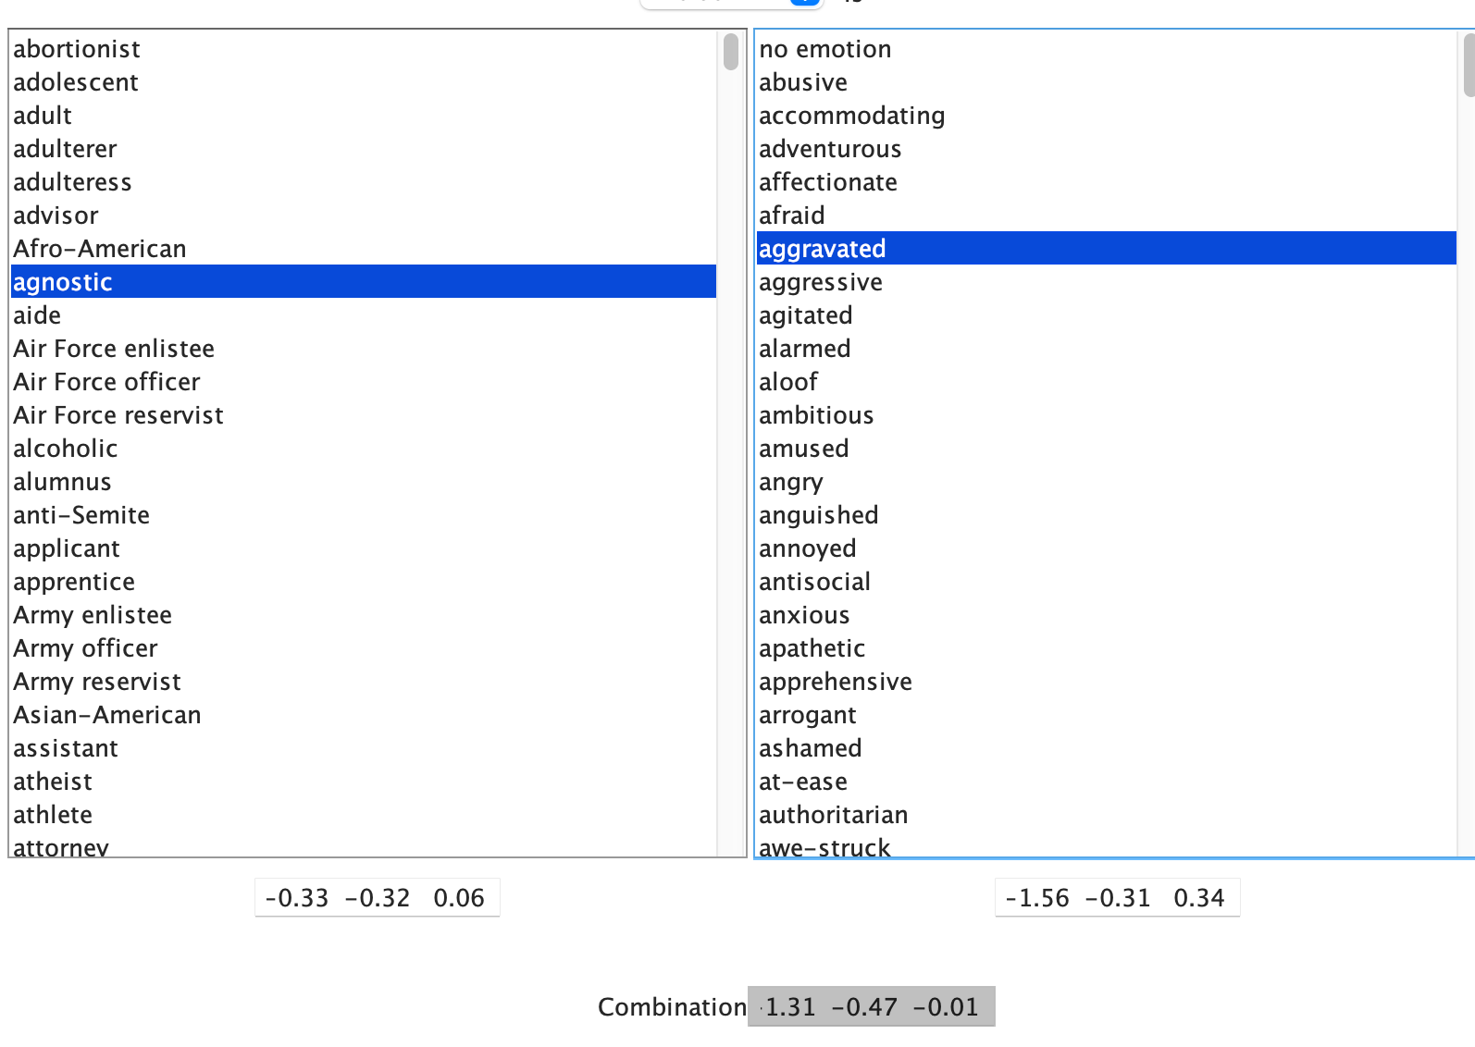
Define Situations
The right column consists of all modifiers/traits in the dictionary.
Clicking on one will display the EPA estimates in the bottom box.
Note: You must select an identity first before selecting a modifier

Slide 30
Define Situations
EPA for agnostic

Slide 31
Define Situations
EPA for aggravated

Slide 32
Define Situations
EPA for
aggravated agnostic

Slide 33
Lab
Spend the rest of class working on the lab
It’s okay to work with each other on part 1
If you have any issues, Prof. Smith-Lovin and I are here to answer your questions and help
You can also come to office hours
Due on February 10 at 8:00 am
Please email to em.k.Maloney@duke.edu

Slide 34
Wednesday Reading updated
Boxed In: Beliefs about the Compatibility and Likability of Mother-Occupation and Father-Occupation Role Combinations

