Slide 1

Maintenance of gender segregation: Self-expression
March 24, 2023

Slide 2
Gender wage gap
Woman
Wages

Slide 3
Gender wage gap
discrimination
Woman
Wages

Slide 4
Gender wage gap
Thorny issue!!!
discrimination
Woman
Wages
occupation

Slide 5
Many different possible pathways…
Direct discrimination
Preferences
Job features
Skills
…etc.

Slide 6
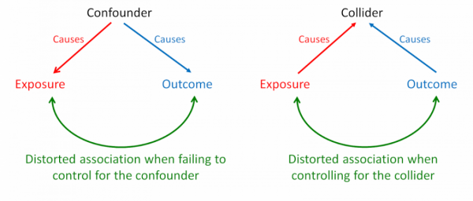
Difficult to determine what percentage of each pathway is the ‘biggest’ contributor
Because of collider bias

Slide 8
How did you decide what you want to do?

Slide 9
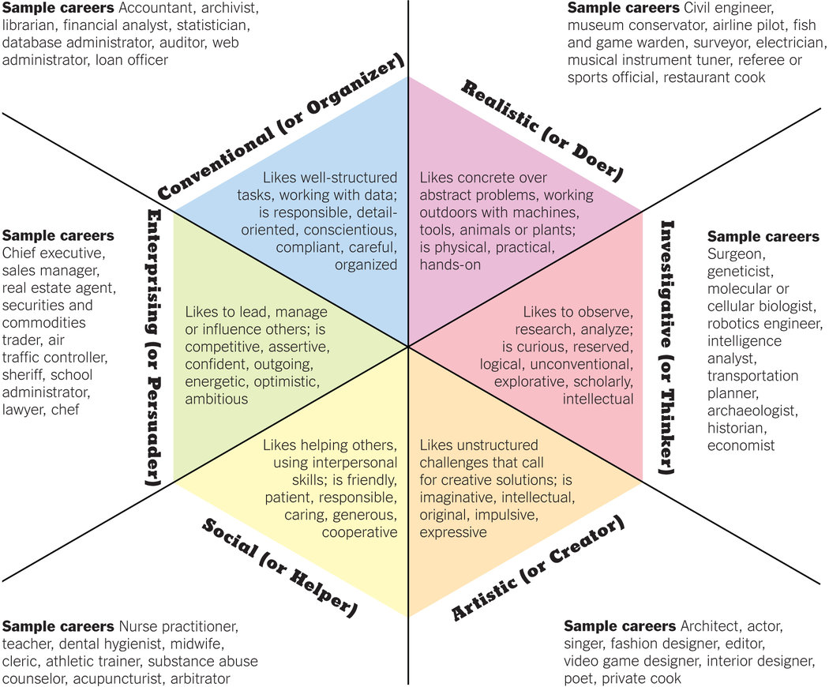
Career tests
Personality – work fulfillment
Career as a way of expressing yourself

Slide 10
Late capitalism college institutions
What are they for?

Slide 11
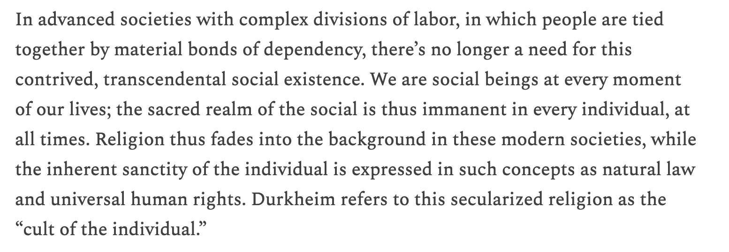
Late capitalism college institutions
What are they for?
Economic reasons
Credential
social capital
Personal reasons
“Finding yourself”
liberal arts ideal
cultural capital
Cult of the individual

Slide 12
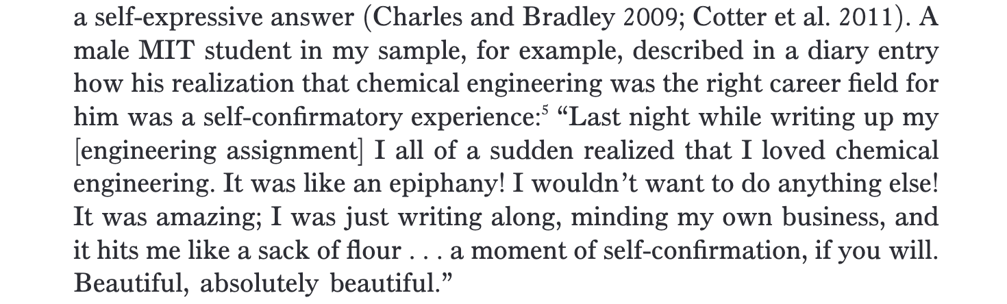
Self-expressive mechanism
People more and more choose jobs as an expression of self
to find fulfillment, not just $
“selling-out”

Slide 13
Gender doesn’t matter?
Traits
Occupation
Pay

Slide 14
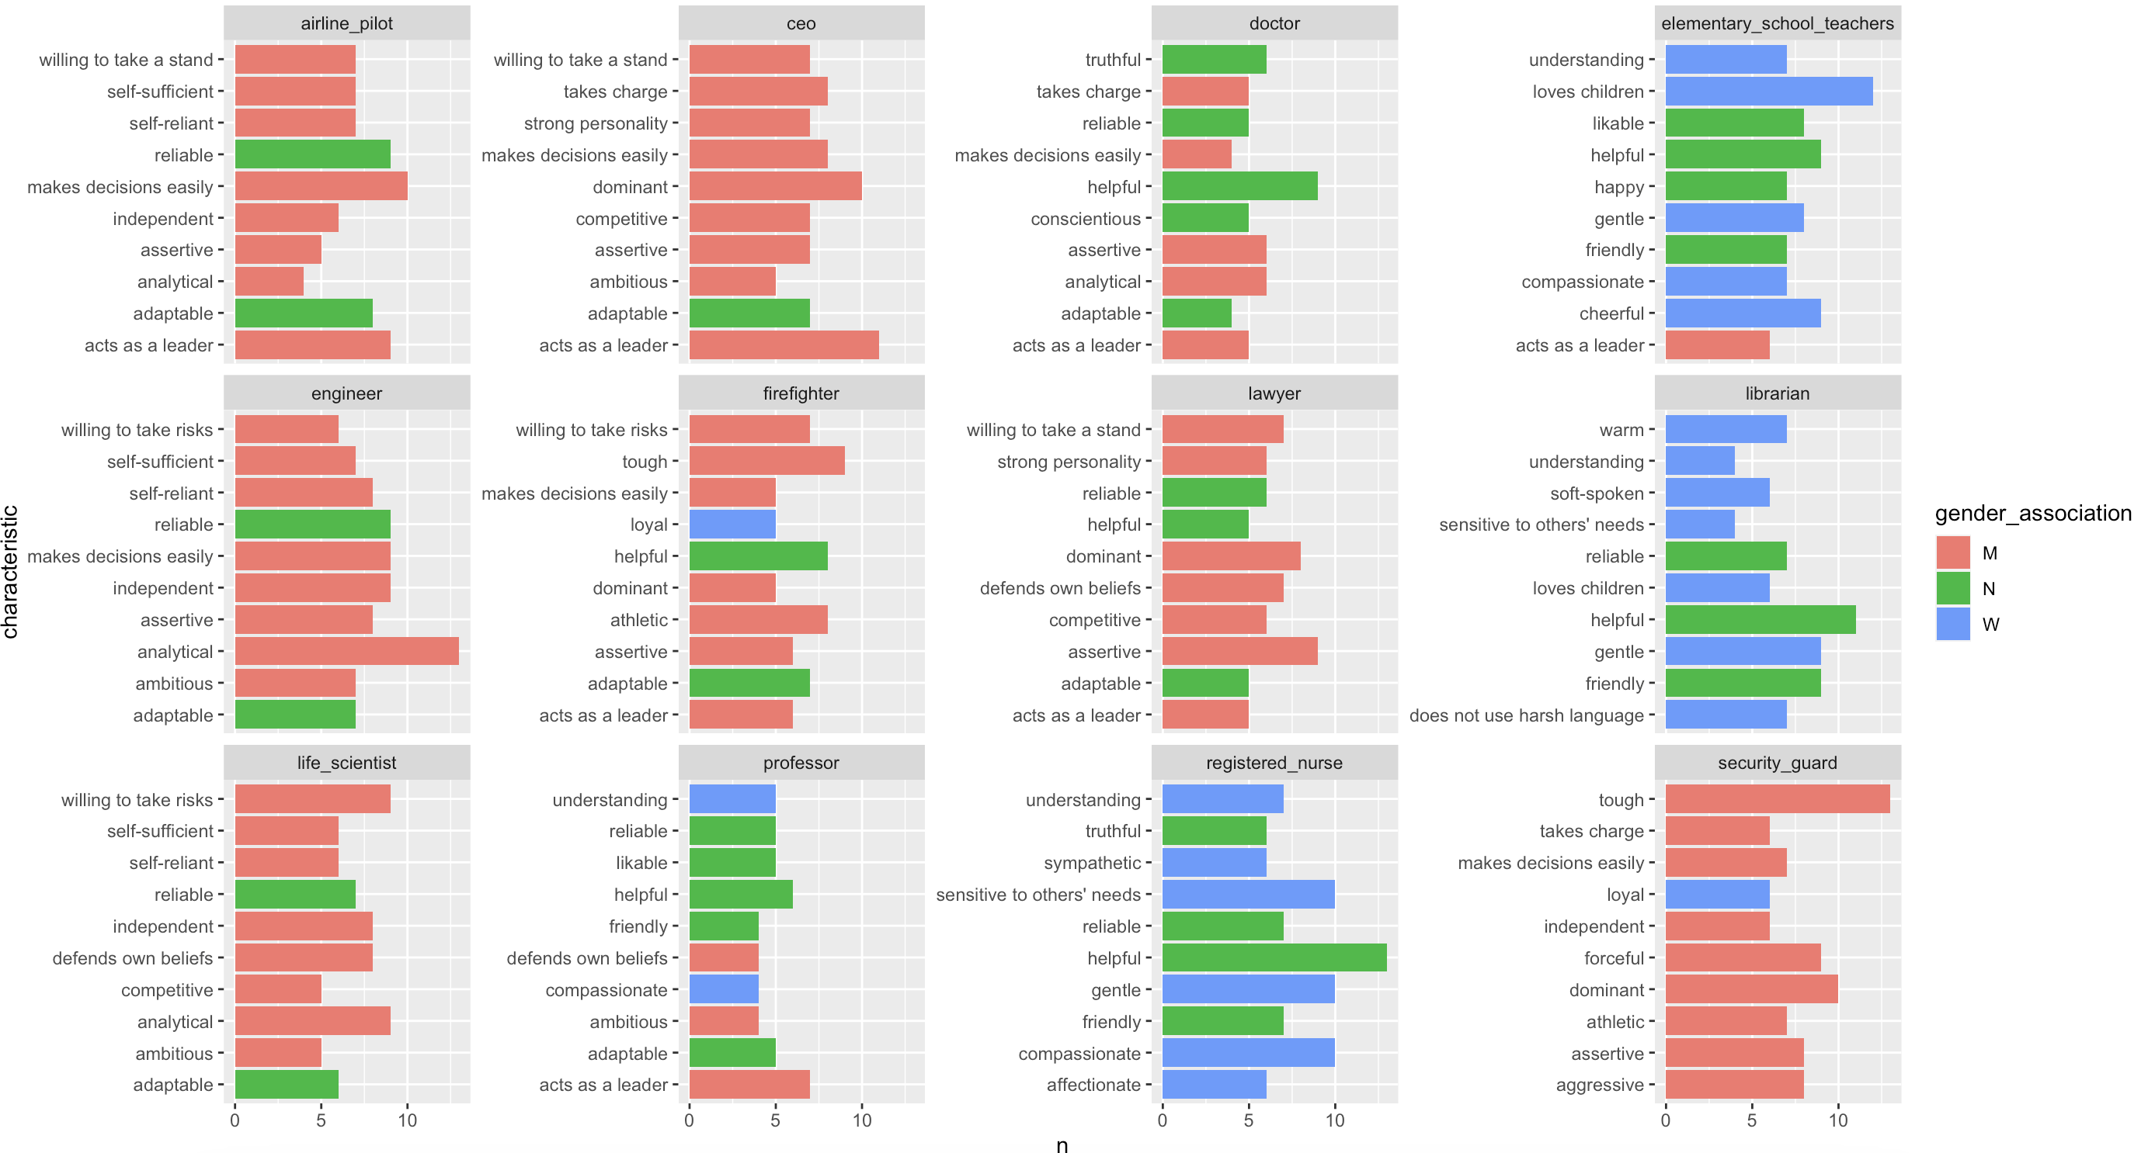
Confounder: traits & characteristics are gendered!

Slide 15
Gender does matter
GENDER
Traits
Occupation
Pay

Slide 16
ACT of Self works with this argument
Self-sentiments – E, P, A estimates of your own self
People choose identities that match self-sentiments

Slide 17
Data
college students from MIT, Olin, Smith, and U Mass-Amherst
multiple wave survey
same individuals, multiple times throughout and after college
18 months after college graduation

Slide 18
Dependent Variable:
Concept:
Measurement:

Slide 19
Dependent Variable:
Concept:
Gender segregation of occupation / higher ed pathway
Measurement:
% of women in occupation or field of study

Slide 20
Independent Variable:
Concept:
Measurement:

Slide 21
Independent Variable:
Concept:
Gendered Self-Conception
Measurement:
Emotional / unemotional
systematic / unsystematic
People-oriented / things-oriented

Slide 22
Independent Variable:
Concept:
Gender beliefs
Measurement:
traditional gender role beliefs
gender category beliefs
gender essentialist beliefs

Slide 23
Independent Variable:
Concept:
Gender schemas:
Measurement:
“wife should take husband’s name”
“I consider myself a feminist”
“women should not let having children stand in their way of having a career”
“women can have a fulfilling life without marrying”
traditional gender role beliefs
gender category beliefs
gender essentialist beliefs

Slide 24
Independent Variable:
Concept:
Gender schemas:
Measurement:
husband / wife scale
others of my gender tend to be (emotional, unsystematic, people-oriented)
traditional gender role beliefs
gender category beliefs
Gender essentialist beliefs

Slide 25
Independent Variable:
Concept:
Gender schemas:
Measurement:
husband / wife scale
others of my gender tend to be (emotional, unsystematic, people-oriented)
traditional gender role beliefs
gender category beliefs
gender essentialist beliefs
I expect men and women to act differently from one another at work
I think men and women adhere to separate but equal notions of justice
occ sex segregation is due to differences in natural talent
some jobs are more suitable for women than men

Slide 26
Controls
controls are confounders
variables that we think affect both the treatment (IV) and outcome (DV)

Slide 27
Controls
controls are confounders
variables that we think affect both the treatment (IV) and outcome (DV)
Or other variables that change the underlying structure of data
Sometimes also broad social variables that we know are important for separating respondents systematically

Slide 28
Controls
Socio-demographic:
race
gender
family income
Confounders:
importance of being wealthy
‘ability’ – GPA, SAT
political ideology

Slide 29
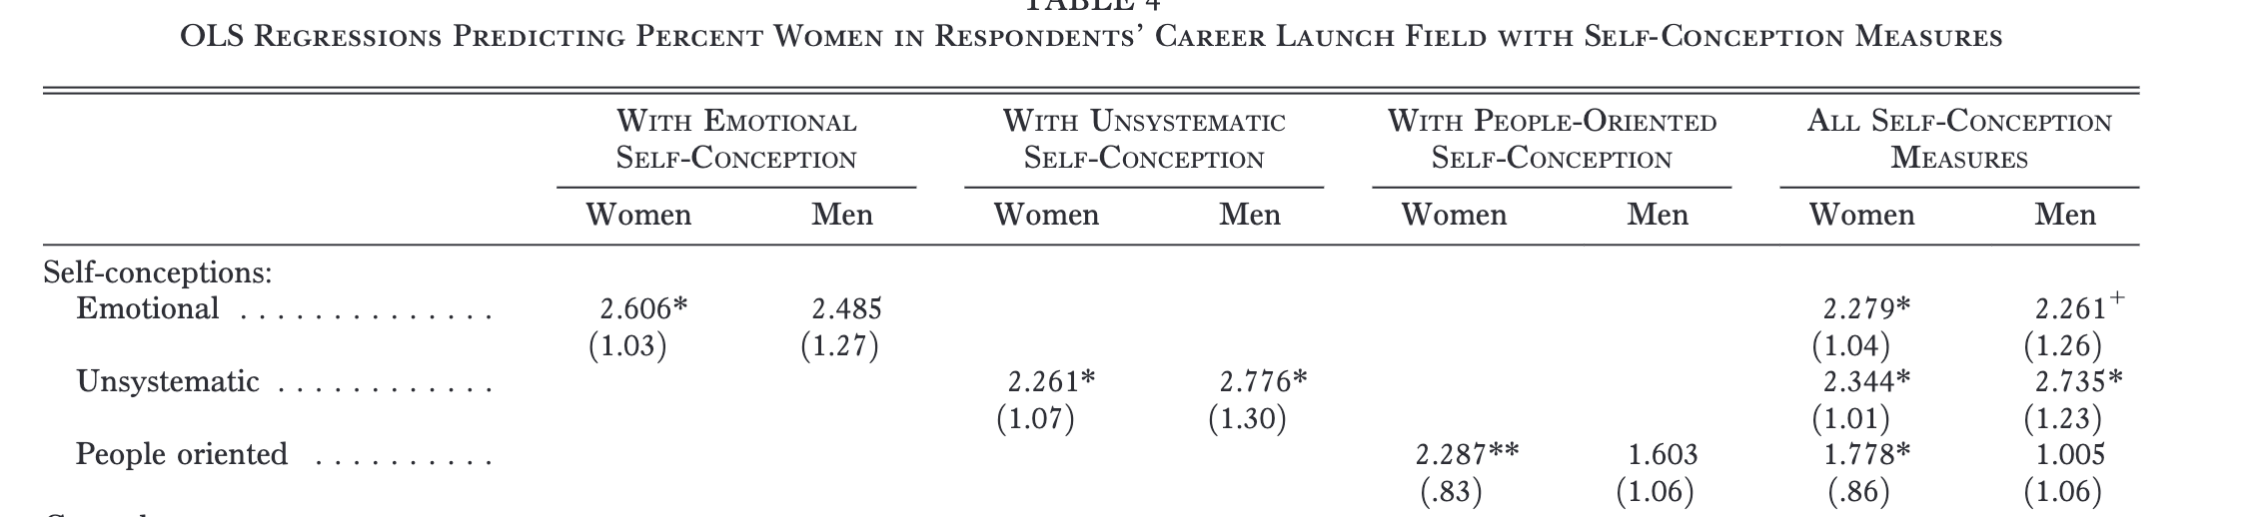
Results

Slide 30
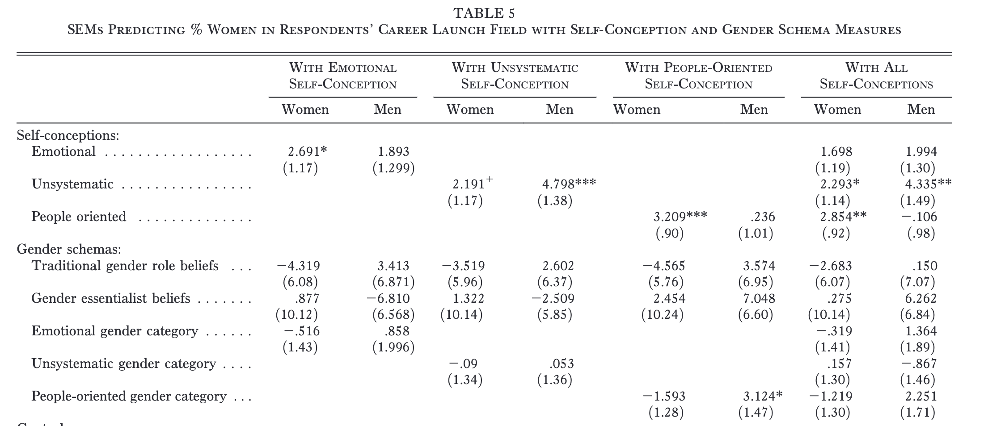
Results

Slide 31
Gender works “invisibly”: By shaping career choices to fit with gendered selves
Because gender (via many pathways) influences the types of traits that individuals are most likely to identify with
and, people are using ‘self-expression’ as a way of choosing jobs
Then, traits influence occupational selection
and people don’t have to identify strongly with traditional gender beliefs to create this outcome

Slide 32
Theoretical implications
reproduction of structural and cultural system:
people who are most gender stereotypical in self-conceptions end up in the most gender segregated occupations
slightly stronger effect for women than men
dovetails with some interesting work on boundary violations of gender for men vs. women
precarious sexuality paper

Slide 33
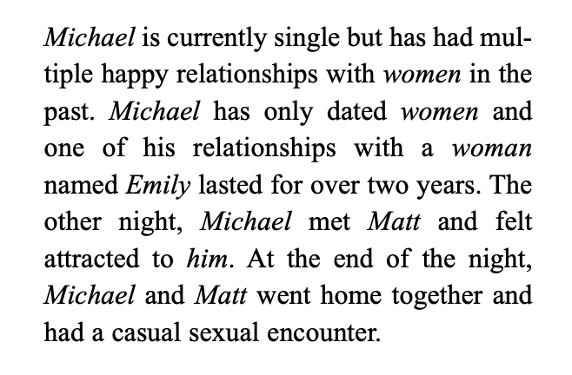
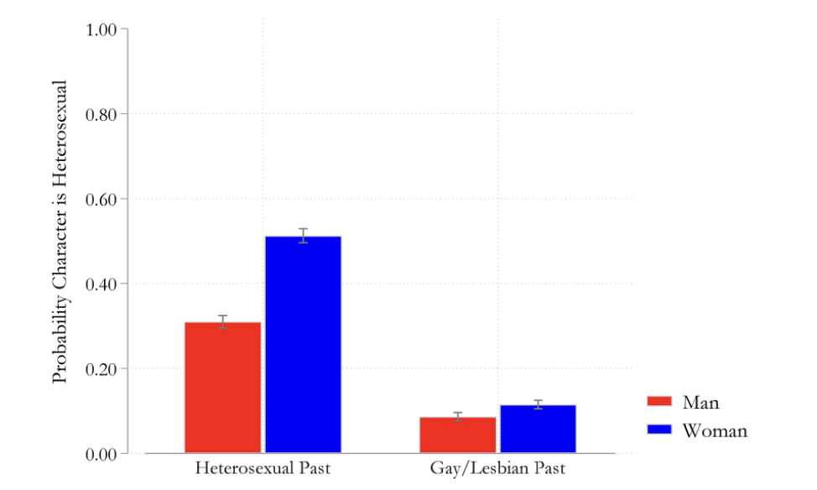
Precarious sexuality

Slide 34
Theoretical implications
reproduction of structural and cultural system:
people who are most gender stereotypical in self-conceptions end up in the most gender segregated occupations
slightly stronger effect for women than men
dovetails with some interesting work on boundary violations of gender for men vs. women
also general societal trends at making women more like men rather than vice versa

Slide 35
Policy implications?

