Slide 1
Occupational Status Operationalization
Jan 25, 2023

Slide 2
Division of Labor
Friday’s activity showed how greater division of labor facilitates:
Coordination
Productivity
Less stress (?)
(wealth) equality
Outstanding questions:
How are social value judgments distributed across the division of labor?
How do we measure those value judgments?
What aspects of status as a concept make measurement difficult?

Slide 3
Outline
Basics of measurement (operationalization)
How do we evaluate our measurement strategies?
Categorizing occupations
Activity
Historical occupational stratification schemes
Class-based measures
Prestige-based measures
Takeaways

Slide 4
Operationalization

Slide 5
Operationalization
Concept
Conceptualization
Operationalization

Slide 6
Example Research Question
What is the impact of the advent of women’s collegiate athletics on women’s educational attainment?

Slide 7
Example Research Question
What is the impact of the advent of women’s collegiate athletics on women’s educational attainment?

Slide 8
Example Research Question
What is the impact of the advent of women’s collegiate athletics on women’s educational attainment?

Slide 9
Operationalization
Education
Educational attainment
Highest degree completed
Notes:
Your theory should also guide your measurement – specifically when you decide which types of variables to use as your basis of measurement

Slide 10
Operationalization
Education
Educational attainment
Number of years of school completed
Notes:
Your theory should also guide your measurement – specifically when you decide which types of variables to use as your basis of measurement

Slide 11
Operationalization
Girls’ athletic participation
Involvement in sports
Type of degree/major choice

Slide 12
Considerations when operationalizing
Theoretical frame should guide (most) decisions
However, we are also constrained by:
Time, money, etc.
some things may be easier to measure than others
at least at first glance
Sometimes operationalization can also happen after measurement of underlying variables
E.g. scales (multiple items) or collapsing existing measures based on theoretical model

Slide 13
Operationalization
Education
Educational attainment
Completed college (yes/no)
Notes:
Your theory should also guide your measurement – specifically when you decide which types of variables to use as your basis of measurement

Slide 14
Variable Types
Nominal
Interval
Ordinal
Ratio

Slide 15
Variable Types - Nominal
Man
Woman
Non-binary

Slide 16
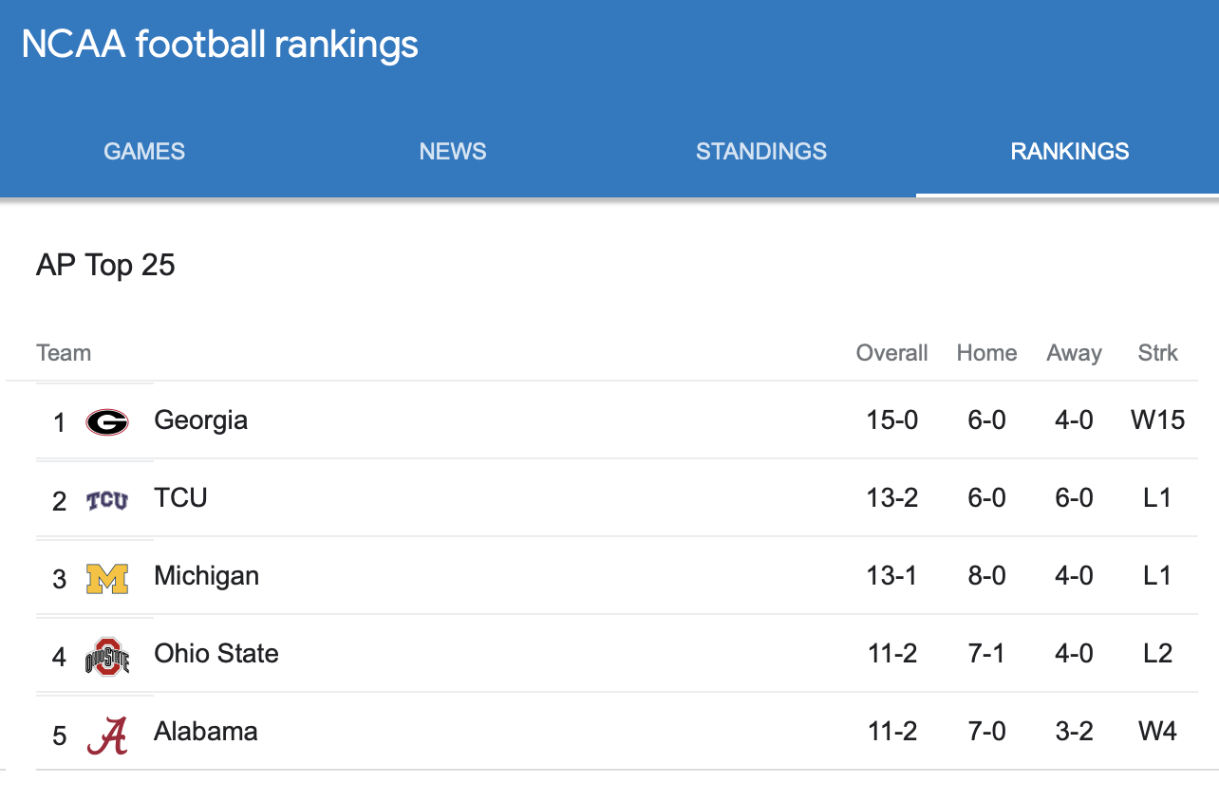
Variable Types - Ordinal

Slide 17





Variable Types - Ordinal
1.
Distance between ranks is not necessarily standard!
2.
3.
4.
5.

Slide 18
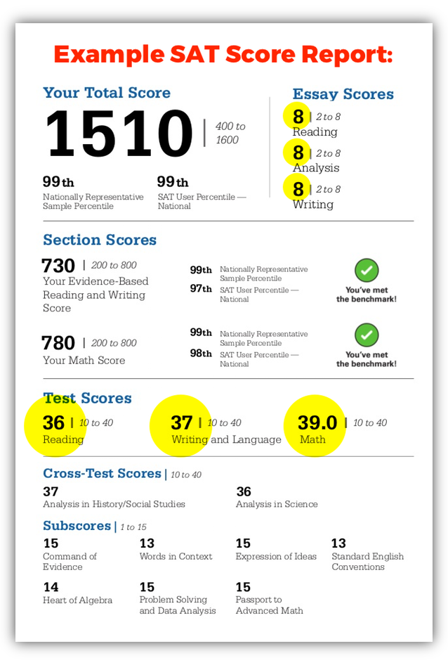
Variable Types - Interval
Equal distance between values
No true zero

Slide 19
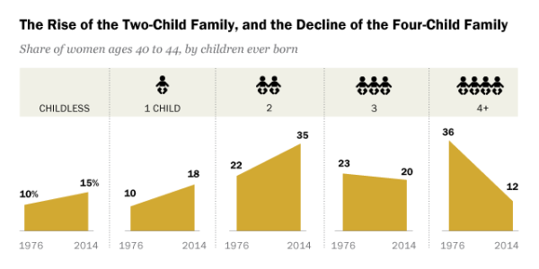
Variable Types - Ratio

Slide 20

Summary
 | Nominal | Ordinal | Interval | Ratio
Categorizes observations into groups
Ranks observations
Equal distances between ranks/positions
True zero is meaningful

Slide 21
Occupational status
Most frequently ends up being:
Ordinal (ranks) or Interval (equal intervals) but sometimes also Ratio (true zero)
Can be either:
Discrete (categories)
ordinal
Continuous (numbers)
Interval/Ratio

Slide 22
Discrete
Mutually Exclusive
No category overlap
Exhaustive
Everything is covered

Slide 23
Discrete
Mutually Exclusive
No category overlap
Exhaustive
Everything is covered

Slide 24
Discrete
Mutually Exclusive
No category overlap
Exhaustive
Everything is covered

Slide 25
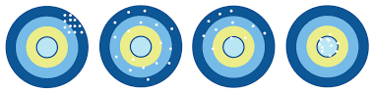
How do we evaluate Our Operationalizations
Validity
Reliability

Slide 26
Validity
Content
Criterion
Face Validity
Construct Validity
Concurrent Validity
Predictive Validity

Slide 27
Validity
Content
Criterion
Face Validity
(“makes sense” test)
Construct Validity
Concurrent Validity
Predictive Validity

Slide 28
Validity
Content
Criterion
Face Validity
Construct Validity
Does our measure reflect our concept?
Is it instead measuring something else?
Concurrent Validity
Predictive Validity

Slide 29
Validity
Content
Criterion
Face Validity
Construct Validity
Concurrent Validity
We expect our measurement to be similar to something already measured well
Predictive Validity

Slide 30
Validity
Content
Criterion
Face Validity
Construct Validity
Concurrent Validity
Predictive Validity
Does our measure predict something we expect it to, given our theoretical frame?

Slide 31
Status
How do we apply these standard measurement strategies to operationalizing occupational status?

Slide 32
Status as a concept
Depending on where you sit within sociology (& social science), status can be an elusive concept to define clearly
Broadly...we have considered up to this point to be a system of assigning social value to social entities
What does value mean in this context?
Which social entities does it apply to and where do we draw the boundaries?
Can status be measured in the same way in occupations as disciplines? Or universities?

Slide 33
Occupations as a field
As division of labor has grown more complex, the number and range of occupations has grown immensely
In the 2022 Occupational Outlook Handbook, lists 832 occupations
Alphabetical Indexes of Industries and Occupations 32,000 job titles
Tend to be based on: industry, skills required for the job,
How do we compare across industries?
Difficult to satisfy all requirements
Mutually exclusive & exhaustive, especially

Slide 34
Hidden Step 1: Organizing Jobs into Occupations
Nominal category
Oftentimes, people rely on standard systems – e.g.
Census/American Community Survey
Department of Labor
Standard Occupational Classification (SOC)
International Standard Classification of Occupations
O*NET
Harder than it sounds

Slide 35
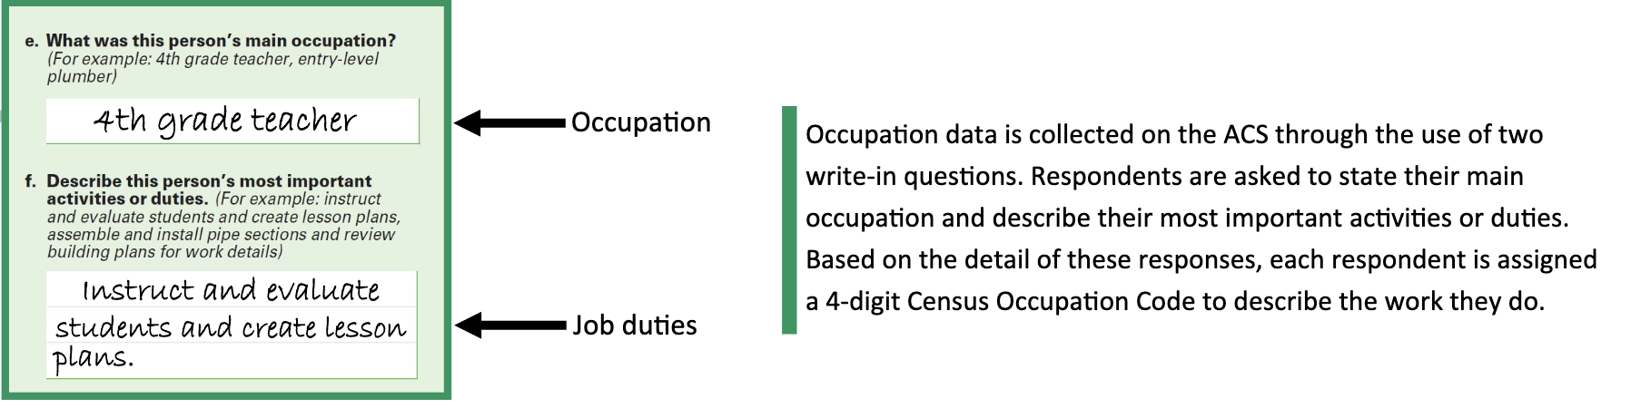
Example of occupational grouping

Slide 36
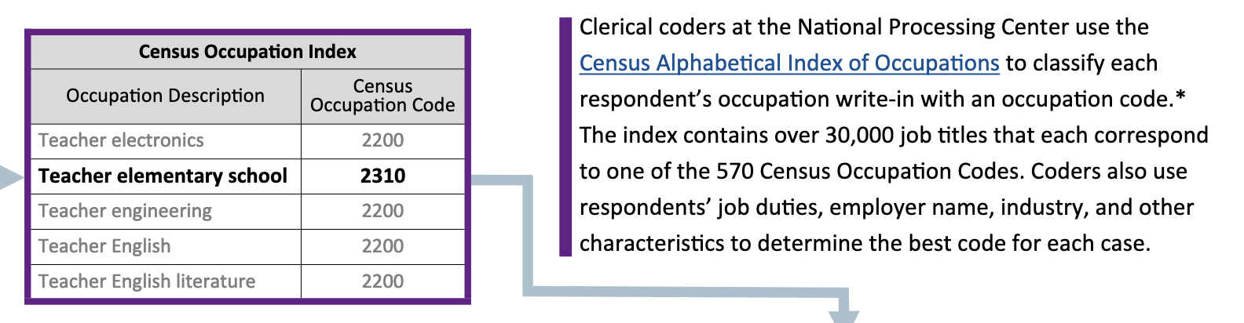
Example of occupational grouping

Slide 37
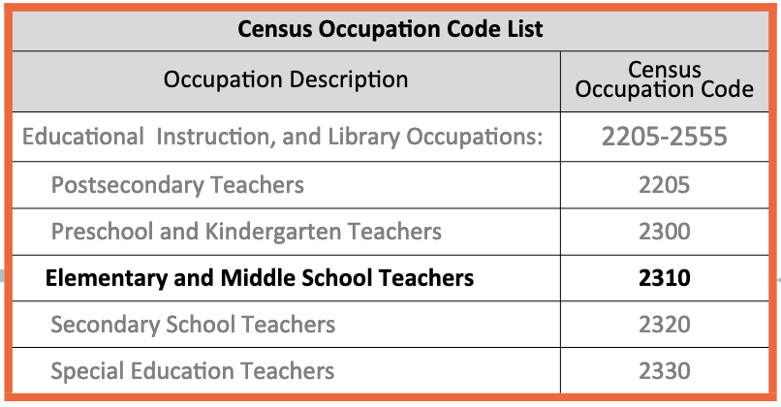
Example of occupational grouping

Slide 38
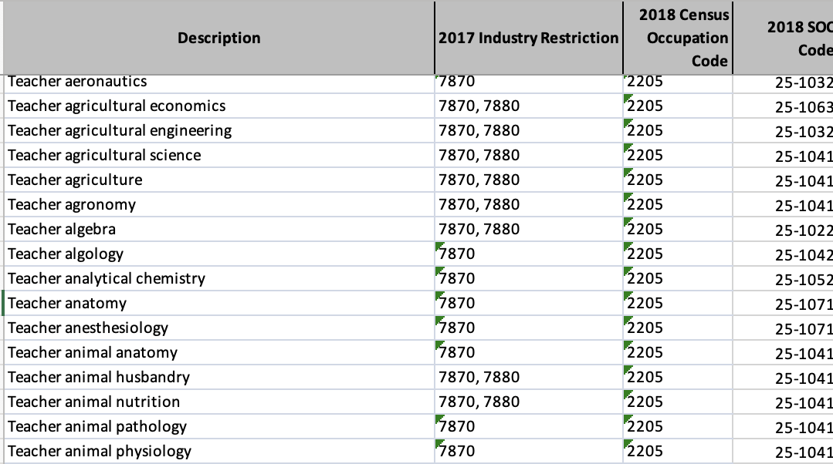
Example of occupational grouping

Slide 39
Activity
https://cascotweb.warwick.ac.uk/#/classification/soc2020

Slide 40
Historical Strategies
Class-based

Slide 41
1. Use concurrent Validity
We expect our target variable and a previously well-measured variable to move together in some capacity
We think that high status occupations must be linked to more education and higher income
So we use some measure of the central tendency of education & income level for people within one occupation
BUT this is backwards causally
and far more class based than status based

Slide 42
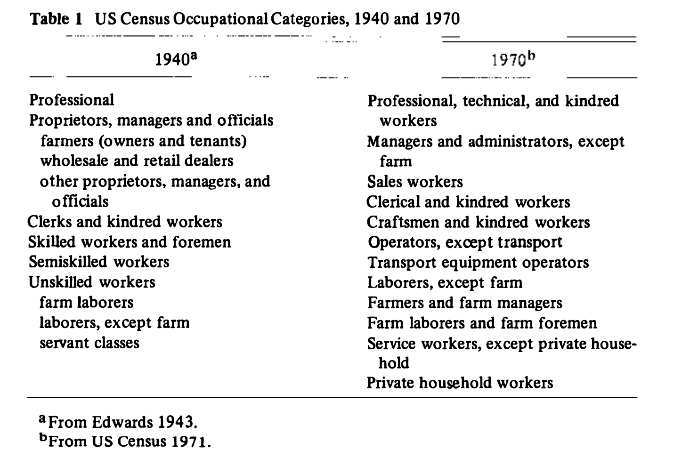
However, it’s fairly common
Education
Skills
Income
Education viewed as indicative status while income equals class
US Census
GB Census

Slide 43
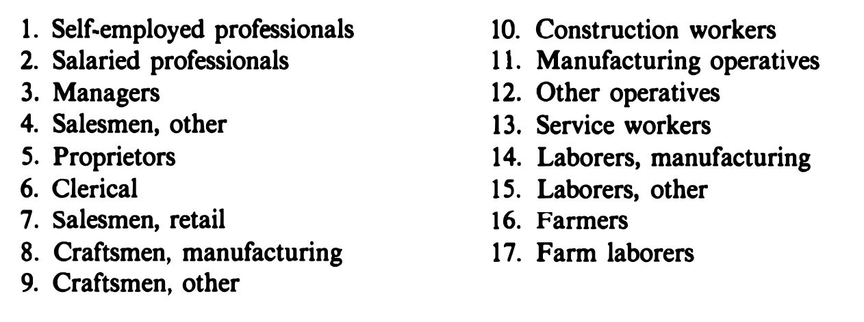
Blau & Duncan
Arranged in descending order of median income and education

Slide 44
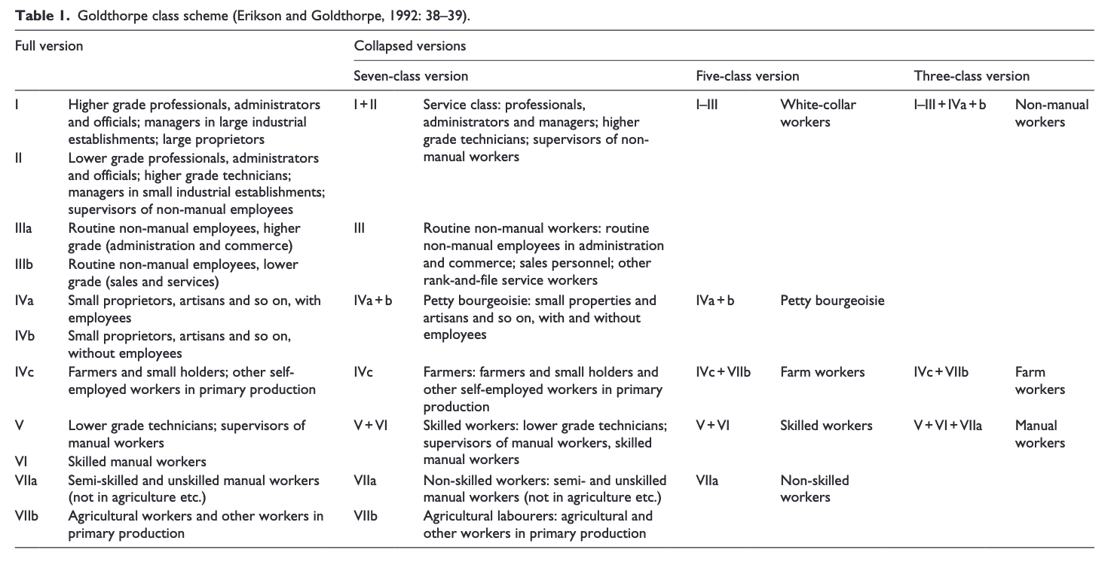
2. Argue that Employment Relations Shape ‘Life Chances’
Erickson-Goldthorpe-Portocarero (EGP)
Market situation
Income
education
Work situation
Authority
control

Slide 45
Other issues
Confounding around education
Some jobs require years of lower pay / training that others do not
E.g. Residency for doctors but not for dentists
Within-class heterogeneity

Slide 46
3. Use A Theoretical Correlate
Weber’s theory suggests that one element of the status order is how it impacts how we relate to other people – who do we:
Associate with
Marry
Befriend/hang out with regularly
Live nearby
Homophily

Slide 47
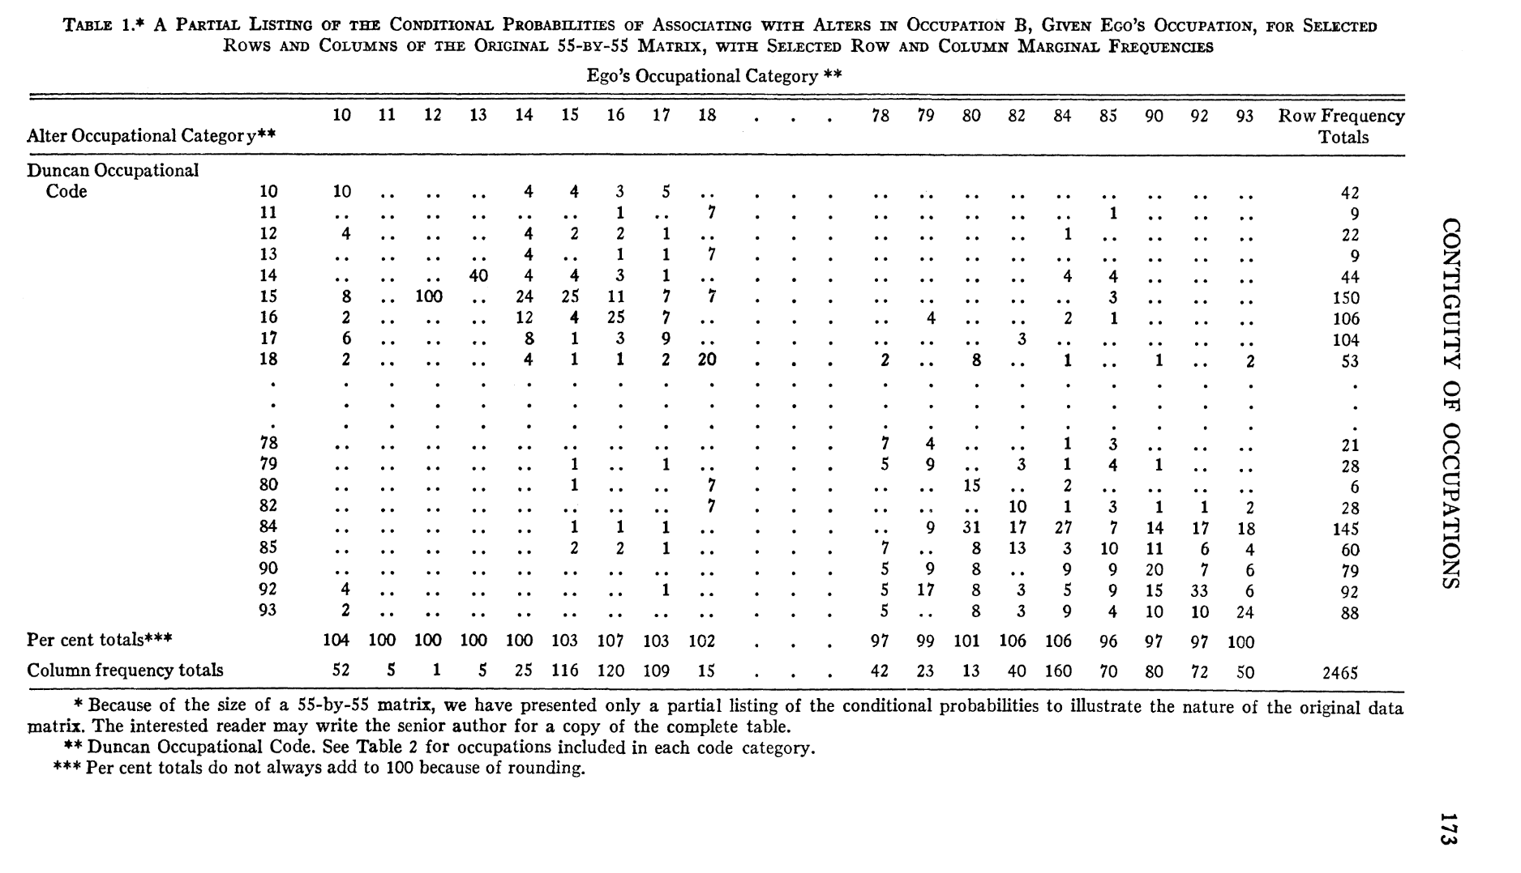
Edward O. Laumann, and Louis Guttman. “The Relative Associational Contiguity of Occupations in an Urban Setting.” American Sociological Review, vol. 31, no. 2, 1966, pp. 169–78. JSTOR, https://doi.org/10.2307/2090902.
Notes:
SSA-I provides a graphic presentation of pairwise interrelationships of a set of objects (here n = 19 time series). Each series i = 1,..., n is represented as a point in a space and the SSA-I technique seeks the (Euclidean) space with minimum dimensions that approximately reproduce
the original correlations rtJ monotonical

Slide 48
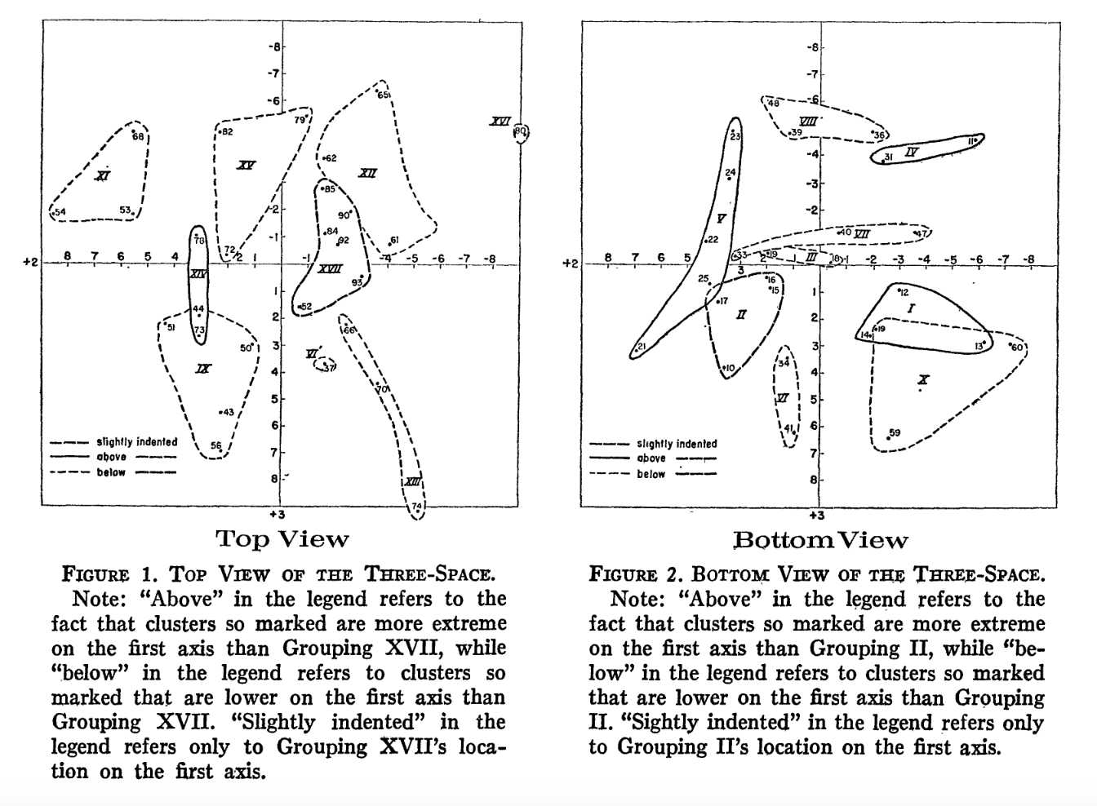

Slide 49
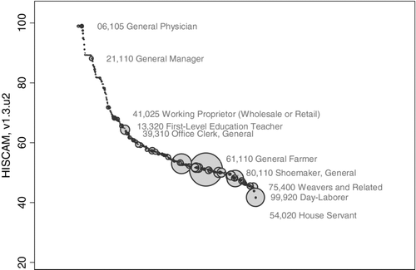
Paul S. Lambert, Richard L. Zijdeman, Marco H. D. Van Leeuwen, Ineke Maas & Kenneth Prandy (2013) The Construction of HISCAM: A Stratification Scale Based on Social Interactions for Historical Comparative Research, Historical Methods: A Journal of Quantitative and Interdisciplinary History, 46:2, 77-89, DOI: 10.1080/01615440.2012.715569

Slide 50
Historical STrategies
Prestige-based

Slide 51
Public Opinion
Class activity on the first day –
Ask people to rank / sort occupations by ‘general standing’ or ‘social standing’

Slide 52
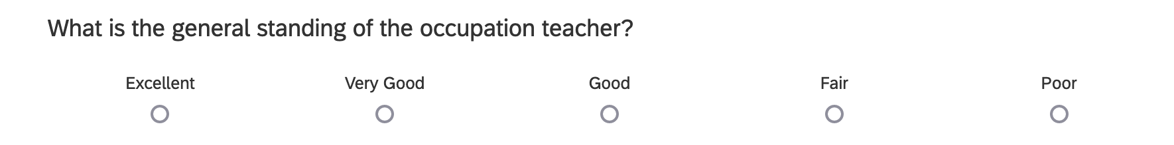
Duncan SEI
Mean scores across respondents
Share of respondents who select excellent or very good

Slide 53
Duncan SEI – Broadening Estimates
SEI = 0.59 * (percent of males > $3500) + 0.55 * (percent males > high school degree) – 6.0
Example – let’s say paralegals were not originally measured:
30% of all male paralegals make more than 3500/year
50% of male paralegals have at least a high school degree
0.59*30 + 0.55*50 -6.0 = 39.2

Slide 54
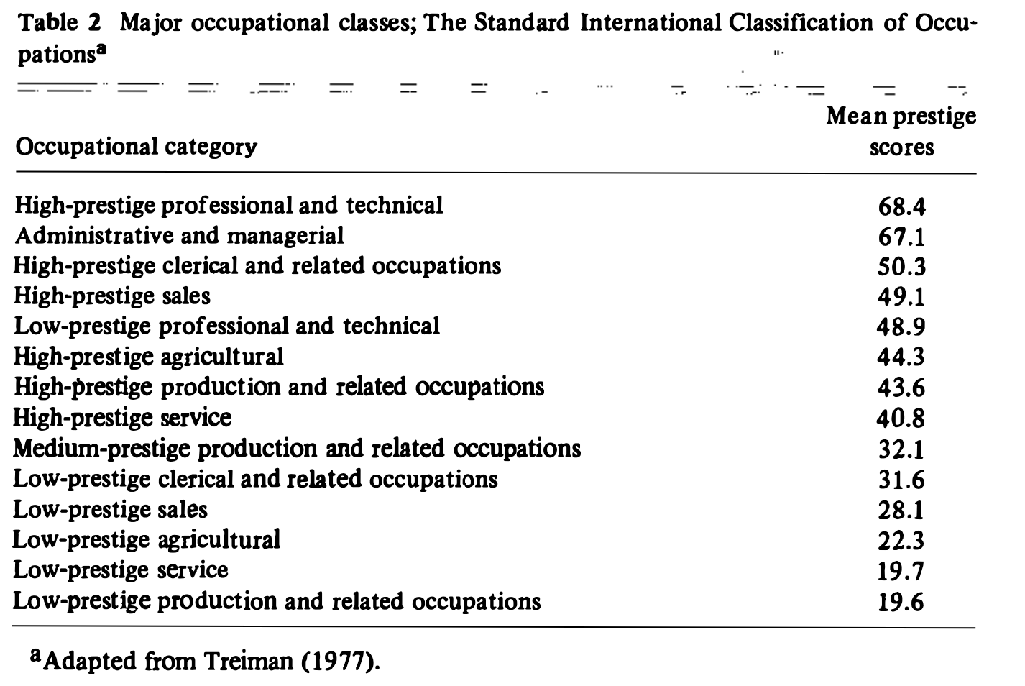
Standard Occupational Prestige Scale (SIOPS)
Collected prestige data from 55 nations
Some nations had several studies (namely U.S. and GB)
Argued very stable across nations
Although did acknowledge was more precise for more industrialized nations

Slide 55

(One) Fundamental difficulty of (a lot) of social science research
What is going on in there???

Slide 56
Criticisms of Public Opinion Measures
Are we sure people are thinking “prestige” and not “is that job desirable?”
Goldthorpe & Hope found scores based on general/social standing roughly equivalent to a combination of ‘standard of life’ measures
Coxen & Jones
Is the distinction important? How bad would this be for our measurement of status given our theory?

Slide 57
Coxon & Jones
Very critical of the precision of public opinion measures
Argue for ‘triangulation’ strategy by using multiple tasks
Pairwise similarity
Given 2 occupations – rate how similar they are
Triadic similarity
Rankings/ratings on several criteria
Free sort

Slide 58
Coxon & Jones
Very critical of the precision of public opinion measures
Argue for ‘triangulation’ strategy by using multiple tasks
Pairwise similarity
Triadic similarity
Given 3 occupations, which 2 are most alike and which 2 are least alike
Rankings/ratings on several criteria
Free sort

Slide 59
Coxon & Jones
Very critical of the precision of public opinion measures
Argue for ‘triangulation’ strategy by using multiple tasks
Pairwise similarity
Triadic similarity
Rankings/ratings on several criteria
Usefulness to society; general standing; prestige and rewards; belief about income
How much you know about the job
Free sort

Slide 60
Coxon & Jones
Very critical of the precision of public opinion measures
Argue for ‘triangulation’ strategy by using multiple tasks
Pairwise similarity
Triadic similarity
Rankings/ratings on several criteria
Free sort
Given a set of occupations, told to organize however they wanted

Slide 61
What happens when we don’t really know what an occupation does?
Reliance on prototypes
Maybe we want to incorporate this uncertainty into our measurement
Which occupations are broadly well-understood and which are not?
Has this changed over time?
e.g. do we have a worse sense broadly of what farmers do now than we did when a larger proportion of society were farmers and/or interacted with farmers regularly?

Slide 62
Science of Science
considerations

Slide 63
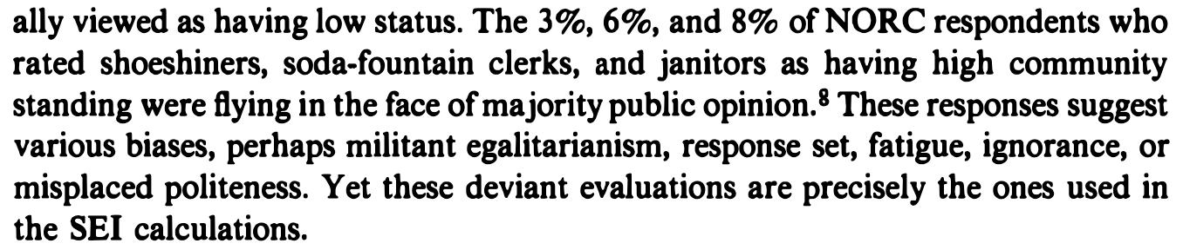
Face Validity

Slide 64
Duncan SEI – Gender Segregation
SEI = 0.59 * (percent of males > $3500) + 0.55 * (percent males > high school degree) – 6.0
Example – let’s say nurses were not originally measured:
80% of all male nurses make more than 3500/year
80% of male paralegals have at least a high school degree
0.59*80 + 0.55*80 -6.0 = 85.2

Slide 65
Purpose of Survey
Hollingshead originally for a study on Social Class and Mental Illness
Impacts the makeup of the occupational sample and thus final rankings & groupings
Includes hostler & railroad conductor but not computer programmer

Slide 66
Handling multiple Jobs?
Most only ask for “primary” job in the past week
How could this bias estimates?

Slide 67
Changes in the Division of Labor
How do we account for creation of new jobs in longitudinal research?
E.g. emergence of ‘consulting’

Slide 68
Resources, People, Time
Sometimes we are constrained by what we have available!

Slide 69
Takeaways

Slide 70
Measurement is Difficult
Often impossible to satisfy every requirement
We do the best we can & are upfront about weaknesses & strengths
Sometimes you may have to make a tradeoff
Prioritize theory
Science is a collective endeavor!

Slide 71
Status / Class Elision
Occupational stratification research has been limited by the lack of both conceptual and operational clarity in separating the ideas of class and status as separate dimensions of social life

Slide 72
Discussion
If we were designing a study on the relationship between occupational status and job satisfaction, which scheme do we think is best to use?
Can also suggest new ways/strategies!

Slide 73
Friday Notes
Bring laptops!
Reading looks like a lot (5 chapters) but they’re short – only about 30 pages substantively
Important to read carefully because we will fairly quickly review before moving into the lab, introduction to the tools of analysis, and application
Come with questions!
I think I am going to change next Wednesday’s reading – will let you know for sure on Friday

