Slide 1

Lit Review + Simulation Game
April 5, 2023

Slide 2
Research Paper Assignments
Methods Plan
March 31
Literature Review
April 12 midnight
Results and Analysis Section
April 19
Largely for us to give you feedback as we go along the process of writing your papers
Incorporating feedback into your final paper will be a consideration
Think of this as a first draft of each section, so by April 19ish you will have an entire draft of your paper

Slide 3
Literature Review
Broad
Narrow
Specific
Broad:
Establish your topic
Explain why it’s important
Provide guideposts for readers throughout the next two sections

Slide 4
Literature Review
Broad
Narrow
Specific
Narrow:
Organize the existing research you established into categories / themes
These themes should be determined by how to best support your argument

Slide 5

Example
RQ: What are the mental health consequences for experiencing racial microaggressions across different industries?
Racial Microaggressions
Mental Health
Industry

Slide 6
Example
RQ: What are the mental health consequences for experiencing racial microaggressions across different industries?
Racial Microaggressions
Mental Health
Section on:
Definition of racial microaggressions
What do we know about the forms in which they take?
Industry

Slide 7
Example
RQ: What are the mental health consequences for experiencing racial microaggressions across different industries?
Racial Microaggressions
Mental Health
Section on:
Definition of mental health you are using for your paper
Why take a sociological perspective to studying mental health?
Industry

Slide 8
Example
RQ: What are the mental health consequences for experiencing racial microaggressions across different industries?
Racial Microaggressions
Mental Health
Section on:
What do we already know about the relationship between racial microaggressions and mental health?
What are the existing dimensions of this relationship?
Industry
what dimensions do you think might have been explored in previous literature?

Slide 9
Example
RQ: What are the mental health consequences for experiencing racial microaggressions across different industries?
Racial Microaggressions
Mental Health
Why do we have reason to believe industry might be important to this relationship?
What dimensions of racial microaggressions might be influenced by industries?
Industry

Slide 10
Example
RQ: What are the mental health consequences for experiencing racial microaggressions across different industries?
Racial Microaggressions
Mental Health
Which industries did you end up using in your simulation table? Highlight them and explain how they capture those dynamics well!
Industry

Slide 11
Example
RQ: What are the mental health consequences for experiencing racial microaggressions across different industries?
Racial Microaggressions
Mental Health
Example -- maybe we know racial microaggressions are more frequent in more technical environments
So we choose industries based on their ‘technical’ attributes
Industry

Slide 12
Literature Review
Broad
Narrow
Specific
Specific:
Identify the gap you are filling with your research
Highlight what has been unanswered/underexplored
This will lead the reader straight into your data and methods section

Slide 13
General Outline
Introduction Paragraph
First sentence captures’ readers attention with statistic/fact
Establishes importance of topic
States purpose of research
II. First Theme (bucket of similar/contradicting findings)
Statement of how some sources are connected
Cited empirical research
Different citation of empirical research
Another common idea in sources
Cited empirical research
Different citation of empirical research
III. Second Theme (bucket of similar/contradicting findings)
Statement of how some sources are connected
Cited empirical research
Different citation of empirical research
Another common idea in sources
Cited empirical research
Different citation of empirical research
IV. Third Theme (optional)
Statement of how some sources are connected
Cited empirical research
Different citation of empirical research
Another common idea in sources
Cited empirical research
Different citation of empirical research
V. Conclusion

Slide 14
Important considerations
In-text citations!
Both when you quote directly and when you paraphrase from a source (or multiple sources)
Organize around your ideas, not just a summary
Summarizing is the first step you did in the annotated bibliographies, then you link the summaries together to construct the main framing of your paper
Helpful to include headings and subheadings to guide the reader through your topics

Slide 15
Questions?

Slide 16
Simulation Game: Positions
Job seeker
Name
College
Major (High / Low value)
Connector
Graduated last year and already have a job
Have connections to both job seekers and employers
Employers
Looking to hire people into entry-level positions
Have a hiring budget they can use however they want to give offers to job seekers

Slide 17
Simulation Game: Rules
You can only talk to people you know (provided on your sheet)
Unless someone else introduces you to someone you don’t know
Employers must interview at least 3 job seekers before they can begin to offer employment
Employers can make hiring decisions on any basis they choose

Slide 18
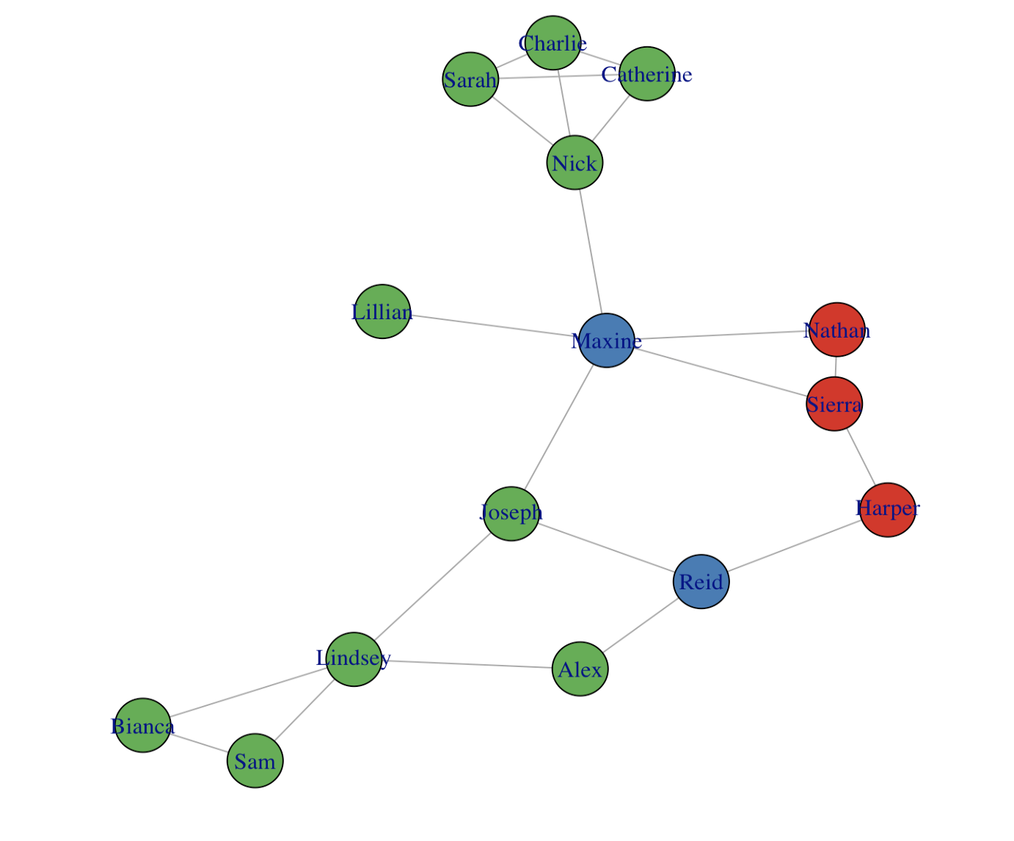

Slide 19
How did inequality emerge in the simulation?
What aspects were notable?
Were you surprised by this outcome?
How does this relate to last week’s reading about cultural capital?
What is the difference between social and cultural capital?
How well do you think this matches the real-world experience of getting jobs?

