Slide 1
Using Affect Control Theory to Measure Occupational Status
Transient Impression & Deflections

Slide 2
What have we learned so far?

Slide 3
1. Class and Status Are Distinct
Class is defined materially by:
one’s position in the economic sphere and
Status is defined culturally by:
to whom we give honor, deference, esteem and
how that determines life chances
is associated with certain life styles

Slide 4
2. Operationalization of Occupational Status has been plagued by the conflation of class and status
Class-based measures being used as stand-ins for status questions
Status-based measures largely being based on public opinion / ranking surveys
Unclear what respondents are thinking of / is it ‘status’ or ‘job desirability’
Difficult to know for sure either way

Slide 5
Where does this leave us?
Class and status are distinct theoretical concepts
Operationalization of occupational status has been plagued by the conflation of class and status
We need to find a way to operationalize occupational status in a way that adheres to the cultural domain

Slide 6
How do we Operationalize Status and Status only?
We need some measurement of culture….

Slide 7
How do we Operationalize Status and Status only?
ACT!

Slide 8
Measuring Meaning
Evaluation
Potency
Activity

Slide 9
EPA Measures Culture Broadly
These dimensions can tell us the broad cultural meaning of the identities, for example that
Nurses (2.67 1.85 1.91) are more good than Lawyers (0.7 2.48 1.24)
Foreman (1.14 2.08 1.94) are more powerful than Librarians (2.39 0.09 -1.62)
But they can only allow us to make comparisons along those three dimensions, and we want to measure a very specific definition of occupational status: degree to which occupational identities are honored and deferred to (Weber!)

Slide 10
Impression Formation
ACT functions at the level of the situation:
we have measurements of the fundamental meanings of these social identities
but to understand social behavior we need to put them in ‘action’ with each other
This process is called impression formation in ACT

Slide 11
How do we model these situations in act?
Actor
Behavior
Object

Slide 12
What do ‘Situations’ look like in ACT?
SETTING
Actor
Behavior
Object

Slide 13
What do ‘Situations’ look like in ACT?
SETTING
Modifier
Actor
Behavior
Object
Modifier

Slide 14
Example
Lawyer
Defers to
Telemarketer

Slide 15
Example
Lawyer
Defers to
Telemarketer
Every element of the event has its own Evaluation, Potency, and Activity

Slide 16
Example
Lawyer
Defers to
Telemarketer
Every element of the event has its own Evaluation, Potency, and Activity
 | Fund.
E | 0.83
P | 2.63
A | 1.75

Slide 17
Example
Lawyer
Defers to
Telemarketer
Every element of the event has its own Evaluation, Potency, and Activity
 | Fund.
E | -0.16
P | 0.43
A | -0.44
Notes:
−.15, .45, −.44

Slide 18
Example
Lawyer
Defers to
Telemarketer
Every element of the event has its own Evaluation, Potency, and Activity
 | Fund.
E | -1.76
P | -1.55
A | 1.76
Notes:
-1.76 -1.55 1.76

Slide 19
After an event is over…Our affective impressions of each element change
And each shifts in response to the event
Lawyer
Defers to
Telemarketer
Every element of the event has its own Evaluation, Potency, and Activity
 | Fund. | Transient
E | 0.83 | -0.08
P | 2.63 | 1.55
A | 1.75 | 1.23
 | Fund. | Transient
E | -0.16 | -0.17
P | 0.43 | 0.74
A | -0.44 | 0.15
 | Fund. | Transient
E | -1.76 | -1.12
P | -1.55 | -1.16
A | 1.76 | 1.21

Slide 20
Lawyer
Lawyer
Defers to
Telemarketer
 | Fundamental Impression | Transient Impression
E | 0.83 | -0.08
P | 2.63 | 1.55
A | 1.75 | 1.23
After the event “Lawyer defers to telemarketer”,
lawyer is seen as:
Less Good (Lower Evaluation)
Less Powerful (Lower Potency)
Less Active (Lower Activity)

Slide 21
Defer To
Lawyer
Defers to
Telemarketer
 | Fund. | Transient
E | -0.16 | -0.17
P | 0.43 | 0.74
A | -0.44 | 0.15
After the event “Lawyer defers to telemarketer”,
the behavior ‘defer to’ is seen as:
About the same in Evaluation
More Powerful
More Active

Slide 22
Telemarketer
Lawyer
Defers to
Telemarketer
 | Fund. | Transient
E | -1.76 | -1.12
P | -1.55 | -1.16
A | 1.76 | 1.21
After the event “Lawyer defers to telemarketer”,
telemarketer is seen as:
More Good (Higher Evaluation)
More Powerful (Higher Potency)
Less Active (Lower Activity)

Slide 23
How Much Did each element move in EPA space?
Squared Euclidean Distance:
Sum of the squared distances between each element’s fundamental sentiment and transient sentiment.
 | Fundamental | Transient
E | 0.83 | -0.08
P | 2.63 | 1.55
A | 1.75 | 1.23
 | Fundamental | Transient
E | -0.16 | -0.17
P | 0.43 | 0.74
A | -0.44 | 0.15
 | Fundamental | Transient
E | -1.76 | -1.12
P | -1.55 | -1.16
A | 1.76 | 1.21

Slide 24
How Much Did each element move in EPA space?
Euclidean Distance:
Sum of the squared distances between each element’s fundamental sentiment and transient sentiment.
 | Fundamental | Transient | Distance
E | 0.83 | -0.08 | -0.91
P | 2.63 | 1.55 | -1.08
A | 1.75 | 1.23 | -0.52
 | Fundamental | Transient | Distance
E | -0.16 | -0.17 | -0.01
P | 0.43 | 0.74 | 0.31
A | -0.44 | 0.15 | 0.59
 | Fundamental | Transient | Distance
E | -1.76 | -1.12 | 0.64
P | -1.55 | -1.16 | 0.39
A | 1.76 | 1.21 | -0.55

Slide 25
How Much Did each element move in EPA space?
Euclidean Distance:
Sum of the squared distances between each element’s fundamental sentiment and transient sentiment
 | Fundamental | Transient | Distance | Distance ^2
E | 0.83 | -0.08 | -0.91 | 0.83
P | 2.63 | 1.55 | -1.08 | 1.67
A | 1.75 | 1.23 | -0.52 | 0.27
 | Fundamental | Transient | Distance | Distance ^2
E | -0.16 | -0.17 | -0.01 | 0.0001
P | 0.43 | 0.74 | 0.31 | 0.096
A | -0.44 | 0.15 | 0.59 | 0.35
 | Fundamental | Transient | Distance | Distance ^2
E | -1.76 | -1.12 | 0.64 | 0.41
P | -1.55 | -1.16 | 0.39 | 0.152
A | 1.76 | 1.21 | -0.55 | 0.30

Slide 26

How Much Did each element move in EPA space?
Euclidean Distance:
Sum of the squared distances between each element’s fundamental sentiment and transient sentiment
 | Fundamental | Transient | Distance ^2
E | 0.83 | -0.08 | 0.83
P | 2.63 | 1.55 | 1.16
A | 1.75 | 1.23 | 0.27
= 2.27
 | Fundamental | Transient | Distance ^2
E | -0.16 | -0.17 | 0.0001
P | 0.43 | 0.74 | 0.096
A | -0.44 | 0.15 | 0.35
= 0.45
 | Fundamental | Transient | Distance ^2
E | -1.76 | -1.12 | 0.41
P | -1.55 | -1.16 | 0.152
A | 1.76 | 1.21 | 0.30
= 0.862

Slide 27
How Much Did each element move in EPA space?
Euclidean Distance:
Sum of the squared distances between each element’s fundamental sentiment and transient sentiment
 | Fundamental | Transient | Distance ^2
E | 0.83 | -0.08 | 0.83
P | 2.63 | 1.55 | 1.16
A | 1.75 | 1.23 | 0.27
= 2.27
 | Fundamental | Transient | Distance ^2
E | -0.16 | -0.17 | 0.0001
P | 0.43 | 0.74 | 0.096
A | -0.44 | 0.15 | 0.35
= 3.6
= 0.45
 | Fundamental | Transient | Distance ^2
E | -1.76 | -1.12 | 0.41
P | -1.55 | -1.16 | 0.152
A | 1.76 | 1.21 | 0.30
= 0.862

Slide 28
In EPA Space, the Squared Euclidean Distance is Called Deflection
Deflection is considered an indication of how likely or unlikely an event is – due to how much the impressions of each element of the event move as a consequence of that event!
Some examples:

Slide 29
In EPA Space, the Euclidean Distance is Called Deflection
Deflection is considered an indication of how likely or unlikely an event is – due to how much the impressions of each element of the event move as a consequence of that event!
Some examples:
High Deflection event –
Doctor Hurts Child has a deflection of 35
Very unexpected

Slide 30
In EPA Space, the Euclidean Distance is Called Deflection
Term | Dimension | Fundamental | Transient | Dist | Squared Dist.
doctor | E | 2.69 | -2.81 | -5.50 | 30.25
doctor | P | 2.94 | 2.12 | -0.82 | 0.68
doctor | A | 0.37 | 0.95 | 0.58 | 0.33
hurt | E | -3.17 | -2.94 | 0.23 | 0.05
hurt | P | 1.06 | 1.46 | 0.40 | 0.16
hurt | A | 0.92 | 0.55 | -0.37 | 0.14
child | E | 1.89 | 0.19 | -1.70 | 2.87
child | P | -1.14 | -1.84 | -0.70 | 0.49
child | A | 1.87 | 1.30 | -0.57 | 0.32

Slide 31
Caution
Deflection != morality
Indicator of likelihood – normality, not necessarily morality
While doctor hurts patient is both high deflection and immoral, other immoral events may be low deflection
Mugger Steals From Loner has a deflection of 3.3

Slide 32
Questions?

Slide 33
Cultural Expectedness as Measurement
Deflection can be used in studies to assess how culturally expected or unexpected a theoretically interesting event is
Validated with experimental studies
This can tell us about norms and the underlying cultural beliefs attached to various social identities
For example, if we’re interested in conceptualizing occupational status how cultural expectations of deference in between occupational identities!

Slide 34
Status As Deference – Freeland and Hoey (2018)
Which occupational identities are expected to defer to other occupational identities?
Construct Actor-Behavior-Object events where:
Occupational identity defers to occupational identity
For every single possible combination of occupational identities in dictionary

Slide 35
Firefighter, Lawyer, telemarketer, Elementary School Teacher
Firefighter defers to firefighter
Firefighter defers to lawyer
Firefighter defers to telemarketer
Firefighter defers to elementary school teacher
Lawyer defers to firefighter
Lawyer defers to lawyer
Lawyer defers to telemarketer
Lawyer defers to elementary school teacher
Telemarketer defers to firefighter
Telemarketer defers to lawyer
Telemarketer defers to telemarketer
Telemarketer defers to elementary school teacher
Elementary school teacher defers to firefighter
Elementary school teacher defers to lawyer
Elementary school teacher defers to telemarketer
Elementary school teacher defers to elementary school teacher

Slide 36
Firefighter, Lawyer, telemarketer, Elementary School Teacher
Actor | Behavior | Object | Deflection
firefighter | defer_to | firefighter | 10.8
firefighter | defer_to | lawyer | 8.16
firefighter | defer_to | telemarketer | 9.42
firefighter | defer_to | elementary_school_teacher | 9.38
lawyer | defer_to | firefighter | 7.16
lawyer | defer_to | lawyer | 4.56
lawyer | defer_to | telemarketer | 3.58
lawyer | defer_to | elementary_school_teacher | 5.23
telemarketer | defer_to | firefighter | 7.98
telemarketer | defer_to | lawyer | 5.13
telemarketer | defer_to | telemarketer | 3.46
telemarketer | defer_to | elementary_school_teacher | 5.9
elementary_school_teacher | defer_to | firefighter | 8.2
elementary_school_teacher | defer_to | lawyer | 5.52
elementary_school_teacher | defer_to | telemarketer | 6.02
elementary_school_teacher | defer_to | elementary_school_teacher | 6.6

Slide 37
Firefighter, Lawyer, telemarketer, Elementary School Teacher
Objects
 | firefighter | lawyer | telemarketer | Elementary School teacher
firefighter | 10.8 | 8.16 | 9.42 | 9.38
lawyer | 7.16 | 4.56 | 3.58 | 5.23
telemarketer | 7.98 | 5.13 | 3.46 | 5.9
Elementary School teacher | 8.2 | 5.52 | 6.02 | 6.6
Actors

Slide 38
Firefighter, Lawyer, telemarketer, Elementary School Teacher
Objects
 | firefighter | lawyer | telemarketer | Elementary School teacher
firefighter | 10.8 | 8.16 | 9.42 | 9.38
lawyer | 7.16 | 4.56 | 3.58 | 5.23
telemarketer | 7.98 | 5.13 | 3.46 | 5.9
Elementary School teacher | 8.2 | 5.52 | 6.02 | 6.6
Actors

Slide 39
Firefighter, Lawyer, telemarketer, Elementary School Teacher
Actor | Behavior | Object | Deflection
firefighter | defer_to | firefighter | 10.8
firefighter | defer_to | lawyer | 8.16
firefighter | defer_to | telemarketer | 9.42
firefighter | defer_to | elementary_school_teacher | 9.38
lawyer | defer_to | firefighter | 7.16
lawyer | defer_to | lawyer | 4.56
lawyer | defer_to | telemarketer | 3.58
lawyer | defer_to | elementary_school_teacher | 5.23
telemarketer | defer_to | firefighter | 7.98
telemarketer | defer_to | lawyer | 5.13
telemarketer | defer_to | telemarketer | 3.46
telemarketer | defer_to | elementary_school_teacher | 5.9
elementary_school_teacher | defer_to | firefighter | 8.2
elementary_school_teacher | defer_to | lawyer | 5.52
elementary_school_teacher | defer_to | telemarketer | 6.02
elementary_school_teacher | defer_to | elementary_school_teacher | 6.6

Slide 40
Firefighter, Lawyer, telemarketer, Elementary School Teacher
Objects
 | firefighter | lawyer | telemarketer | Elementary School teacher | Average
firefighter | 10.8 | 8.16 | 9.42 | 9.38 | 9.44
lawyer | 7.16 | 4.56 | 3.58 | 5.23 | 5.133
telemarketer | 7.98 | 5.13 | 3.46 | 5.9 | 5.62
Elementary School teacher | 8.2 | 5.52 | 6.02 | 6.6 | 6.58
Actors

Slide 41
Firefighter, Lawyer, telemarketer, Elementary School Teacher
Objects
Across our ‘small universe’ of occupational identities, the occupation that is least culturally expected to defer to other occupational identities is firefighter because it has the highest deflection
 | firefighter | lawyer | telemarketer | Elementary School teacher | Average
firefighter | 10.8 | 8.16 | 9.42 | 9.38 | 9.44
lawyer | 7.16 | 4.56 | 3.58 | 5.23 | 5.133
telemarketer | 7.98 | 5.13 | 3.46 | 5.9 | 5.62
Elementary School teacher | 8.2 | 5.52 | 6.02 | 6.6 | 6.58
Actors

Slide 42
We expect low status occupational identities to defer to everyone and high status occupational identities to be unlikely to defer to others
So higher deflection score is higher status

Slide 43
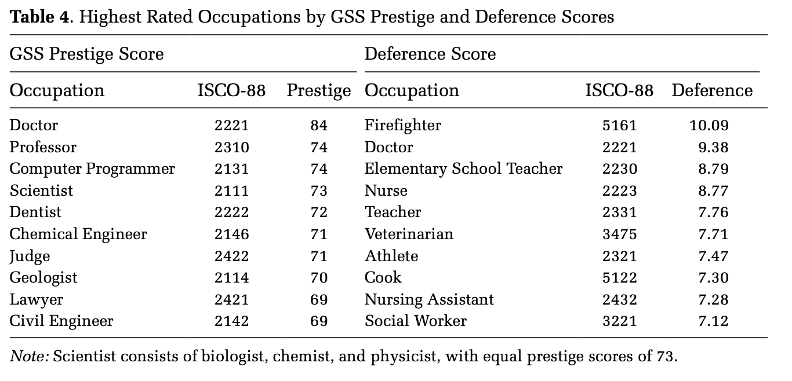
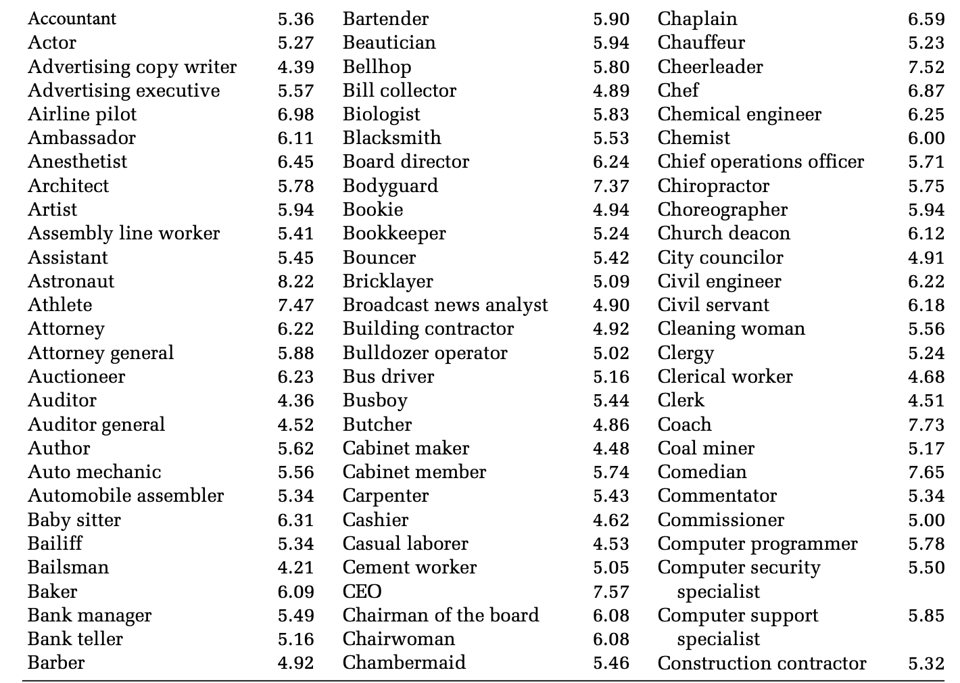
304 Occupations

Slide 44
Questions?

Slide 45
Validity?
Construct:
How well does it match other measurements of the same/similar concept?
Relationship between deference scores and Harris Prestige Poll results
Criterion:
Does the measure predict theoretical correlates well?
How well does EPA score predict measures of workplace outcomes?

Slide 46
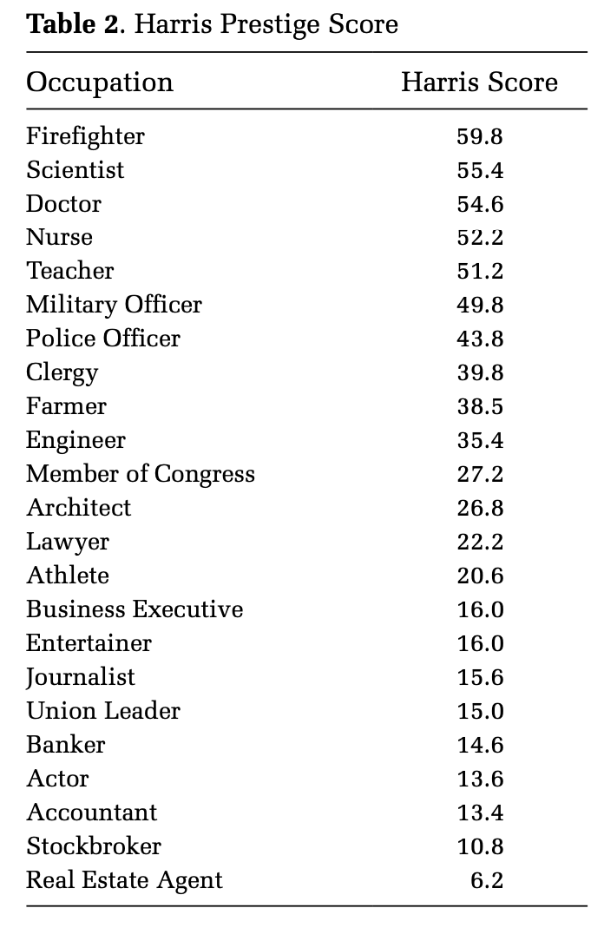
Harris Prestige Polls
“For each [occupation], would you tell me if you feel it is an occupation of very great prestige, considerable prestige, some prestige, or hardly any prestige at all?”
Mean % of respondents who selected ‘very great prestige’

Slide 47
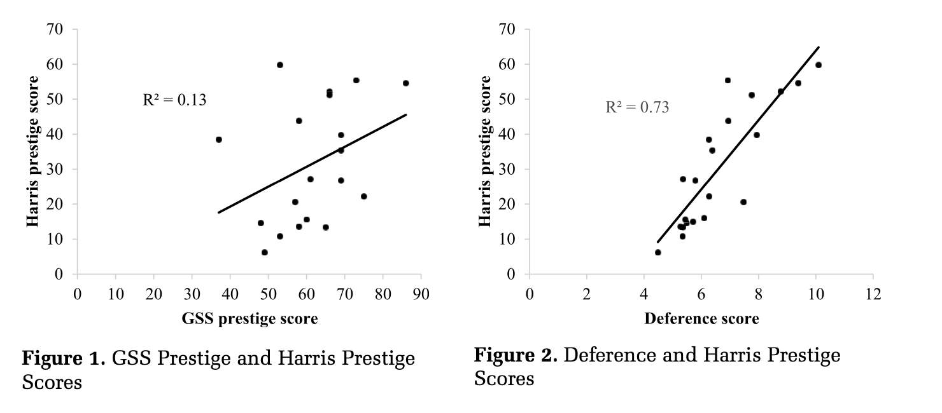
Construct Validity

Slide 48
Criterion Validity – General Social Survey
Attachment to work
Would you continue working if you became rich?
Job satisfaction
On the whole, how satisfied with your job are you?
General happiness
Taken all together, how would you say things are these days?
Workplace respect
At the place where I work, I am treated with respect
Meaningful work
Choosing ‘work that is important and gives a feeling of accomplishment’ as the highest preference for a job

Slide 49
Criterion Validity
Matched respondents’ occupational codes with occupational identities in ACT dictionary
Predicted those dependent variables as a function of:
Deference Score
Controls (Education, Income, Age, Sex, Race)

Slide 50
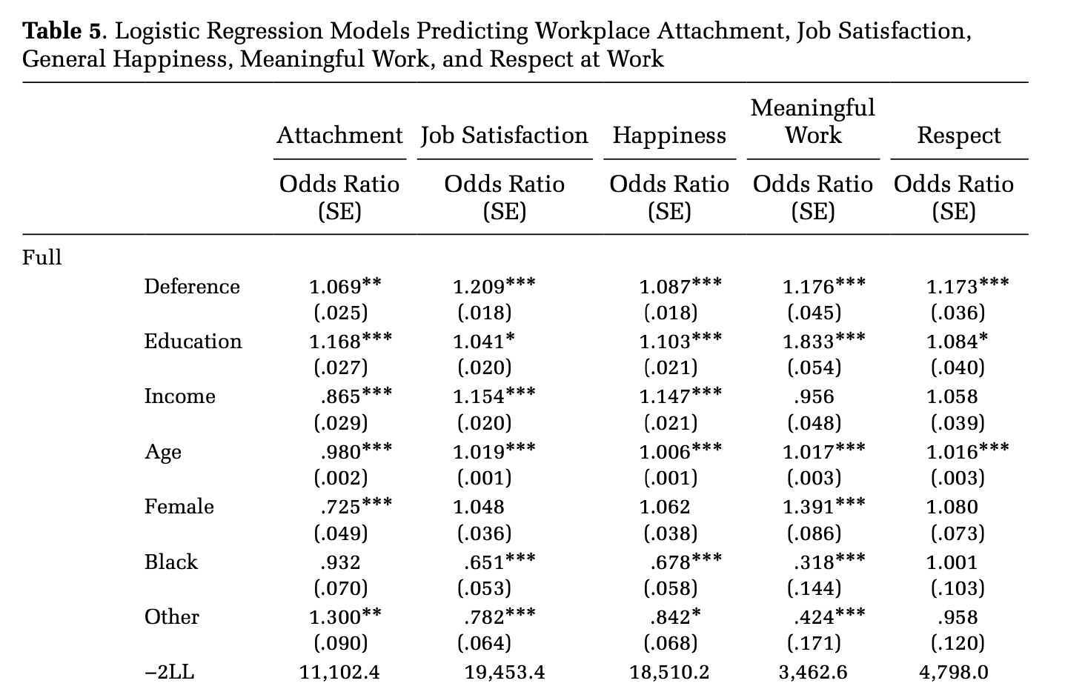
Criterion Validity

Slide 51
Odds Ratios Are the Worst
OR > 1 = positive effect
OR < 1 = negative effect

Slide 52
Odds Ratios Are the Worst
OR > 1 = positive effect
OR < 1 = negative effect

Slide 53
Odds Ratios Are the Worst
The higher the deference score, the more likely a respondent is to report all 5 measures!

Slide 54
Questions?

Slide 55
Discussion
What are the strengths of this measurement strategy?
Weaknesses?
How do you think it would perform with less affective outcomes?

Slide 56
Questions?

