Slide 1
Is the hnRNP A2/B1 protein required for lncRNA-mediated gene silencing?
Knockdown the hnRNP A2/B1 proteins in cancer cells
hnRNP A2/B1
Polycomb 2 Silencing Complex
HOTAIR lncRNA
Determine if loss of hnRNP A2/B1 results in loss of HOTAIR-induced H3K27me3 gene silencing mark
H3K27me3
Silencing of target gene
ChIP-Seq for H3K27me3
MACS2 failed to call good peaks. Program is not designed for broad peaks

Slide 2
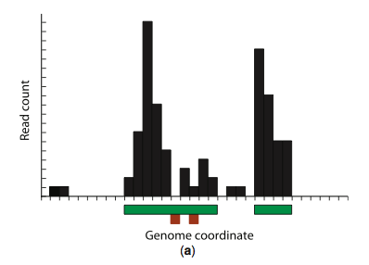
SICER differential analysis of H3K27me3 ChIP-Seq
ChIP-Seq H3K27me3 in cells +/- hnRNPA2/B1 and +/- HOTAIR
Gaps
Align with Bowtie 2
Generate bigwigs and bedgraph files
SICER to identify “islands” of H3K27me3 in each sample
Identified 434 HOTAIR-regulated regions ( >2 fold increased in H3K27me3, with FDR < 0.01)
Identified ~32,000 H3K27me3 regions NOT affected by HOTAIR
BedTools Map to calculate signal at each of these regions
Islands

Slide 3
ggplot2 to plot the resulting data:
ggplot(data, aes(variable,id)) + geom_tile(aes(fill = value)) + scale_fill_gradient(low = "white", high = "dodgerblue4")+theme_bw()+theme(axis.text.y=element_blank(), axis.title.y=element_blank(),axis.ticks.y=element_blank(),legend.position="none",panel.border = element_rect(colour = "black"))
Conclusion: The A2/B1 proteins are required for HOTAIR-induced H3K27me3

Slide 4
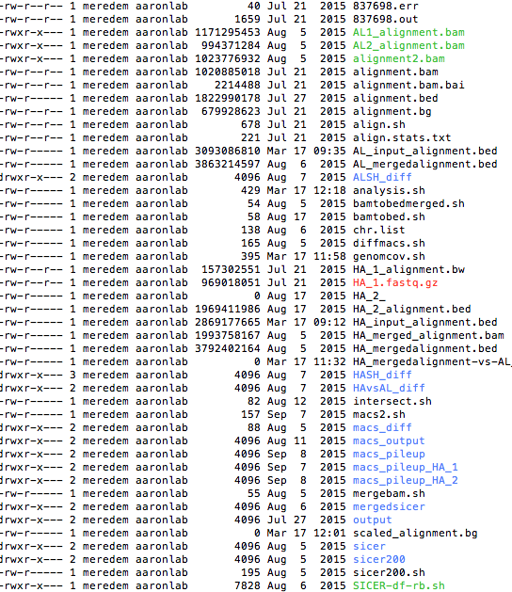
Making reproducible analysis pipeline:
Before:
After
#! /usr/bin/env bash
HA1=/vol1/home/meredem/Millipore_H3K27me3/analysis/alignments/bam_files/HA1_alignment.bam
HA2=/vol1/home/meredem/Millipore_H3K27me3/analysis/alignments/bam_files/HA2_alignment.bam
AL1=/vol1/home/meredem/Millipore_H3K27me3/analysis/alignments/bam_files/AL1_alignment.bam
AL2=/vol1/home/meredem/Millipore_H3K27me3/analysis/alignments/bam_files/AL2_alignment.bam
#Merge the two replicate HA experiments and convert to bed file
samtools merge HA_merged_alignment.bam $HA1 $HA2
bedtools bamtobed -i HA_merged_alignment.bam > HA_merged_alignment.bed
#Merge the two replicate AL experiments and convert to bed file
samtools merge AL_merged_alignment.bam $AL1 $AL2
bedtools bamtobed -i AL_merged_alignment.bam > AL_merged_alignment.bed
# run SICER to find loci with significantly altered H3K27me3 between HA and AL
# using window size of 200, gap size of 1000, E-value of 500 for selecting FDR of 0.01.\
# an effective genome size of 0.74, fragment length of 300, and the hg19 genome.
sh SICER-df-rb.sh HA_merged_alignment.bed AL_merged_alignment.bed 200 1000 500 .01
Raw Data
Analysis
FASTQ
Alignments
bedTools map
SICER
Bam
bigWig
bed
graphs
Results
Input Files
Results

