Slide 1
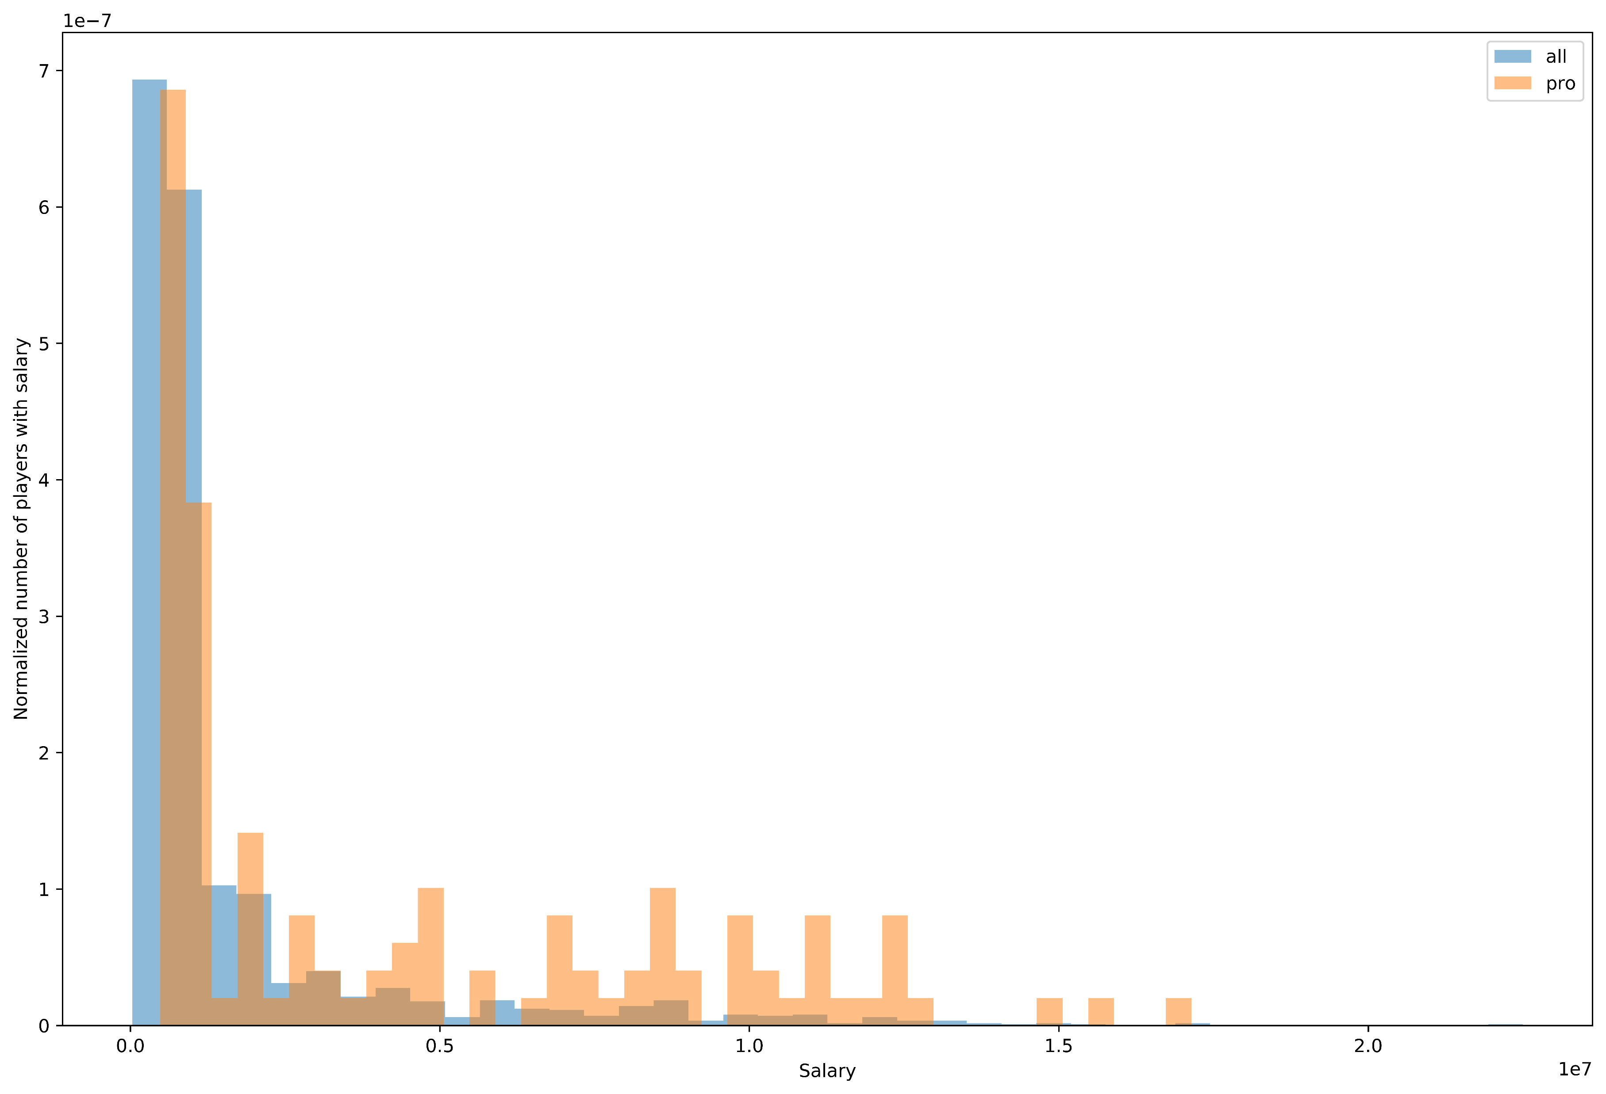
Here are salaries plotted as a normalized histogram for both, as can be deduced from the graph, the average salary for a pro bowl player is slightly higher. Pro bowl players are also more likely to have a higher salary based on the histogram.

Slide 2
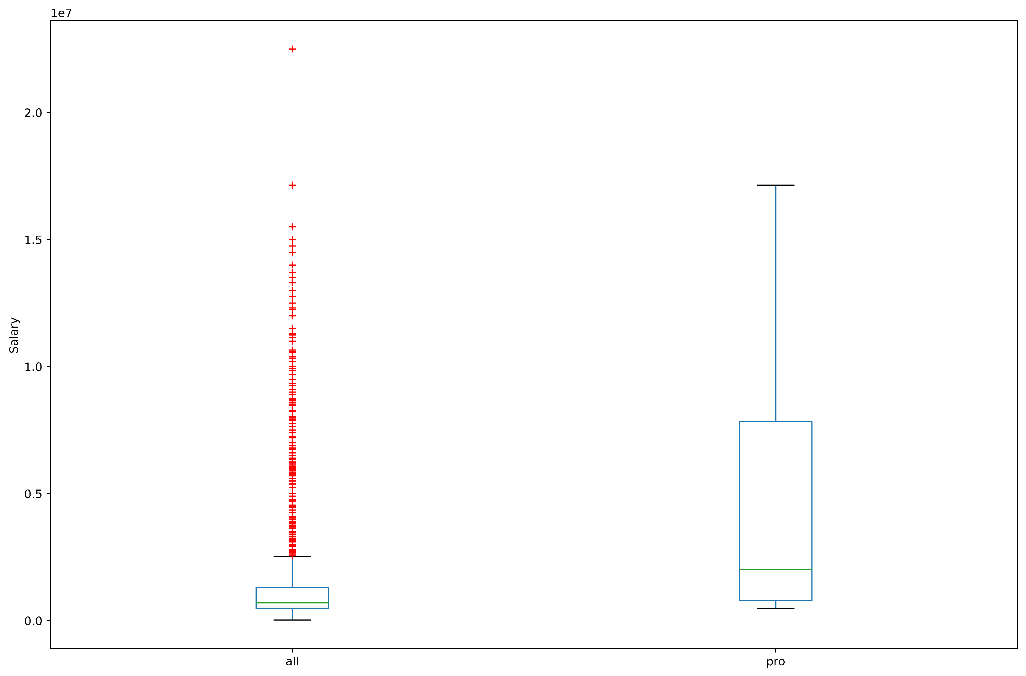
As can be seen from the plot for all players salary, there are many outliers (the different markers) This indicates that 97.5% of all players have salaries below ~$5 million$. However, the pro bowl players have a higher average salary, and generally don't have outliers in terms of salary (a.k.a all salaries are within 2 IQR from the mean).

Slide 3
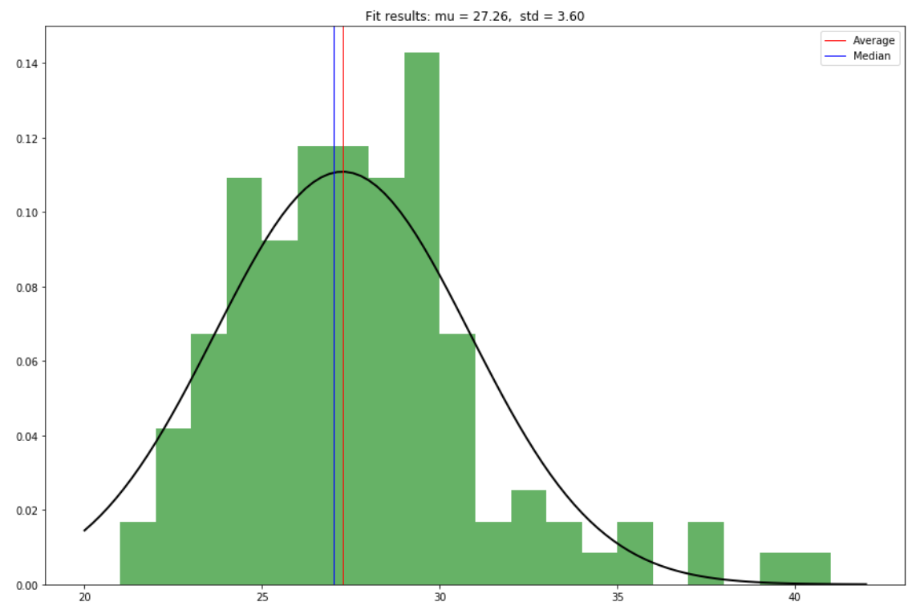
Here is a probability distribution of pro bowl players ages assuming age is a random gaussian variable. The median age is 27, and the average is 27.26

Slide 4
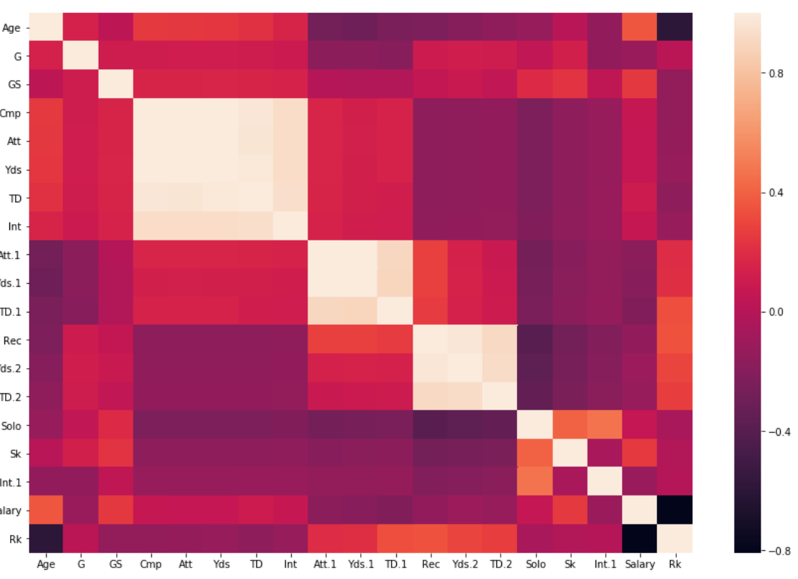
Heatmap for the correlation matrix between all columns for pro bowl players. Yards and completions are very heavily correlated. Surprising to see that ranking is negatively correlated with most other data fields, and pretty uncorrelated to any field. It seems that it correlates a bit to Touchdowns and receptions throughout the season (depending by position of course), but not as much as I would have initially thought.
Key
### ================
+1 heavily correlated<br>
-1 negatively correlated<br>
0 not correlated

Slide 5
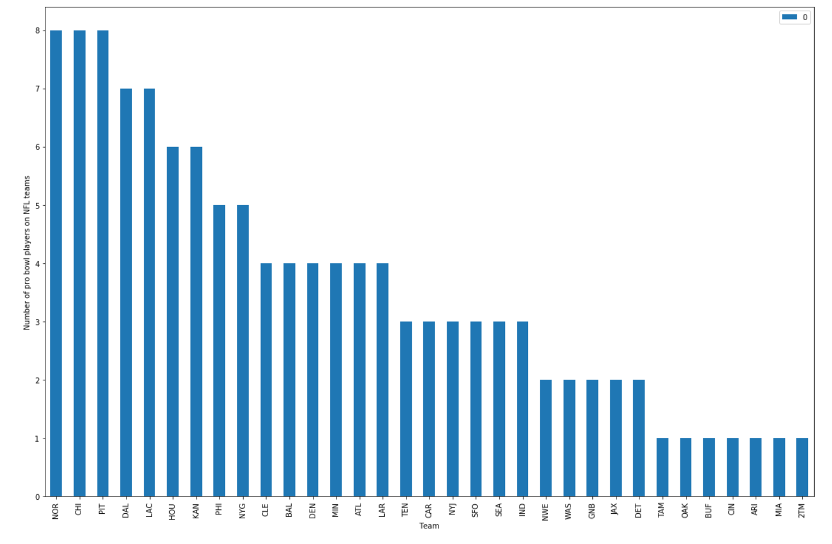
Chart representing how many pro bowl players there were by position in 2019.

