Slide 1
Implementation of a LASSO Regression Model to Improve Protein Chemical Shift Predictions in NMRFx Software
Ellen Koag
Johnson Lab
Structural Biology Initiative
CUNY ASRC

Slide 2
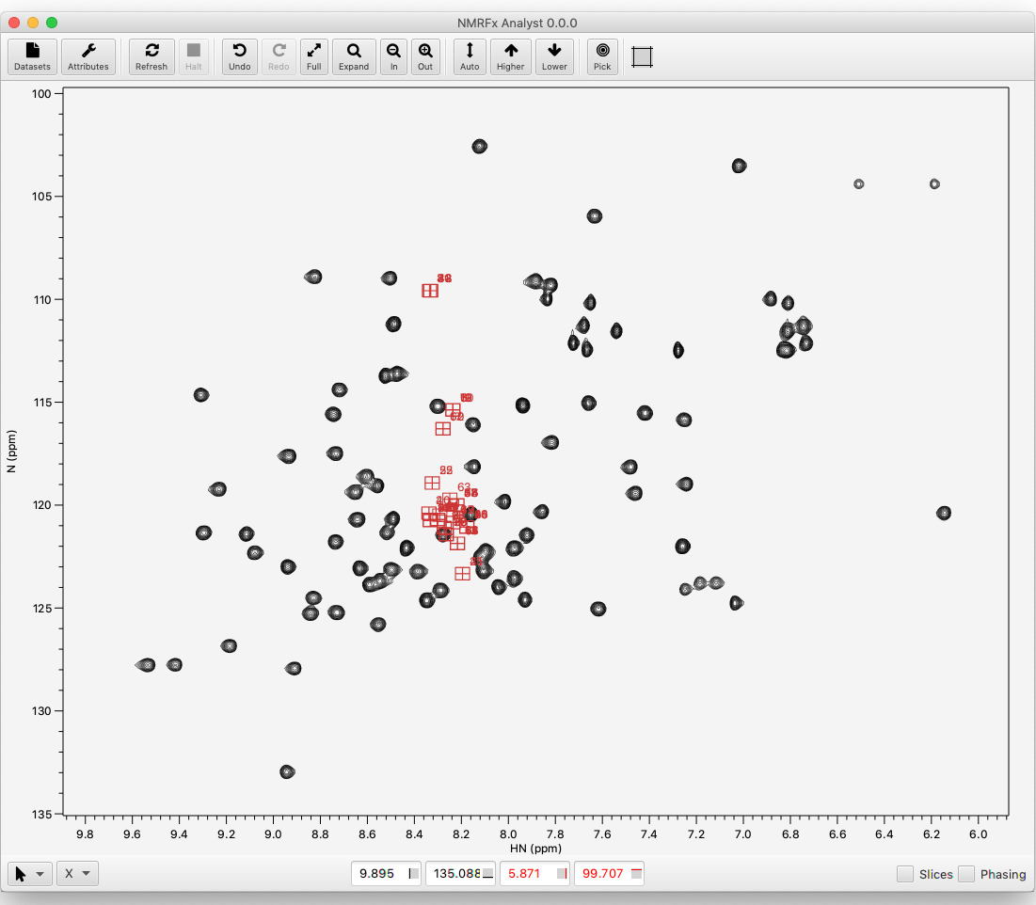


Why We Predict Chemical Shifts
Chemical shifts are exquisitely sensitive to secondary structure and local conformation
Predicted shifts can be useful in solving structures, assigning peaks, and interpreting peak perturbations
Expanding databases = more data to use in prediction models

Slide 3
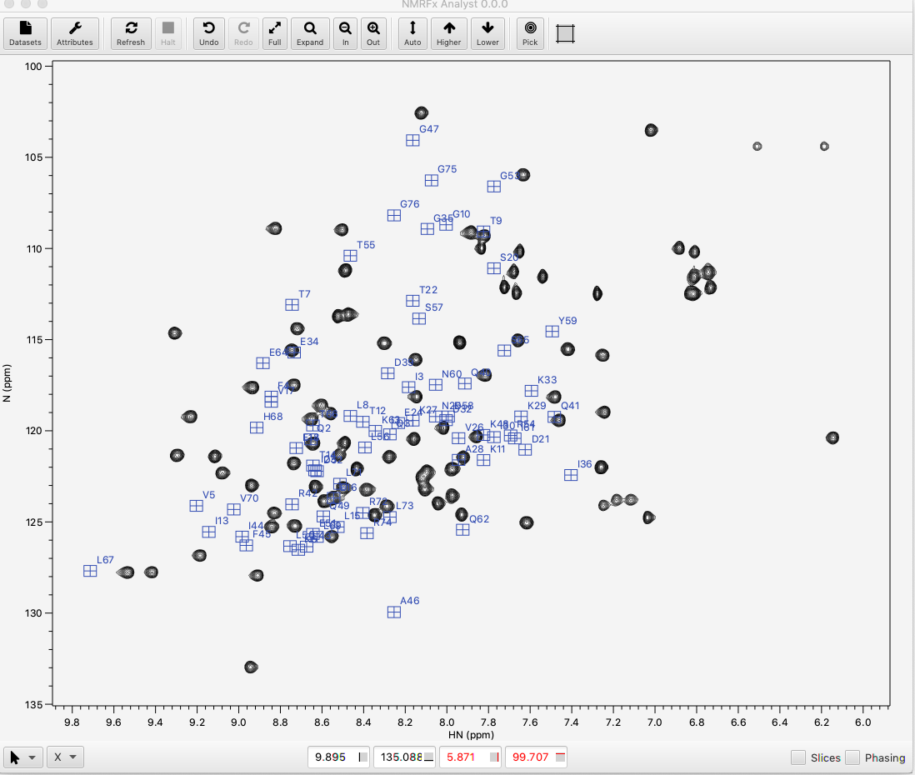
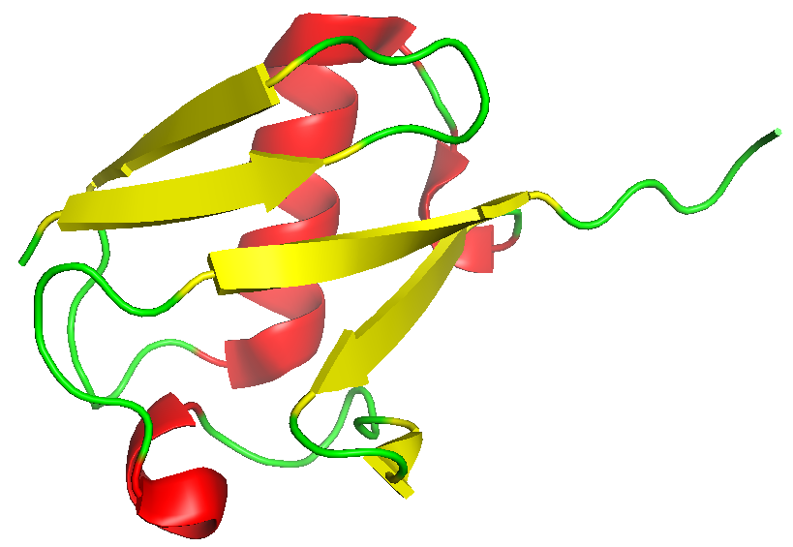
Chemical Shifts Depend on Protein 3D Structure

Slide 4
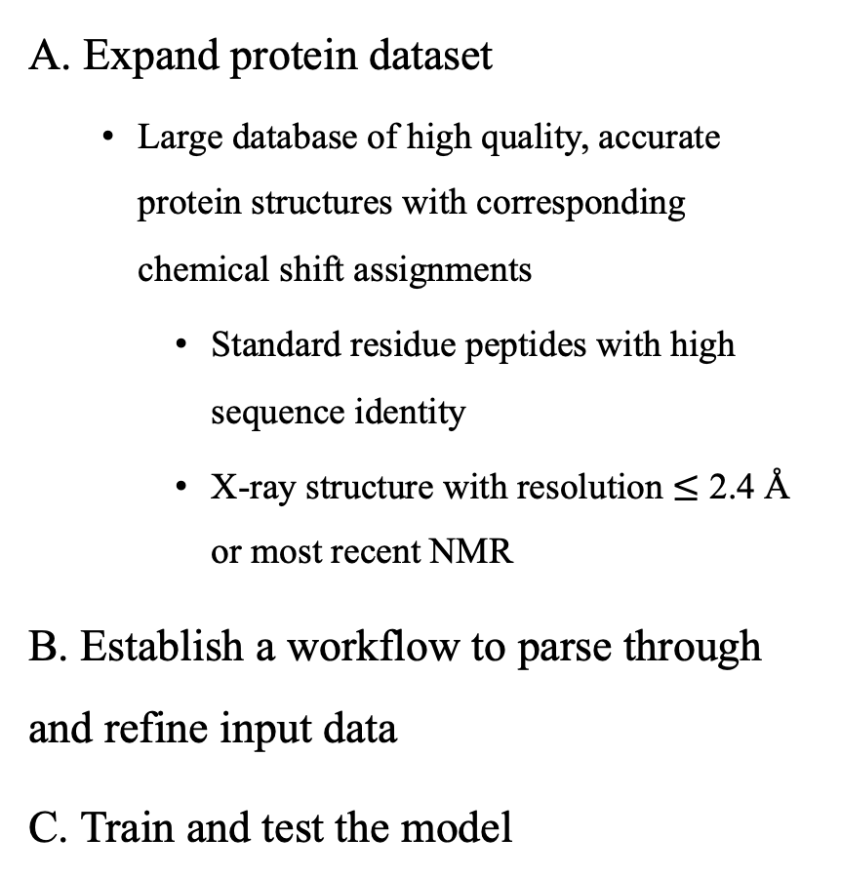
Objectives to Improve Chemical Shift Predictions in NMRFx
A. Expand protein dataset
Large database of high quality, accurate protein structures with corresponding chemical shift assignments
Standard residue peptides with high sequence identity
X-ray structure with resolution $≤$ 2.4 Å or most recent NMR
B. Establish a workflow to parse through and refine input data
C. Train and test the model

Slide 5
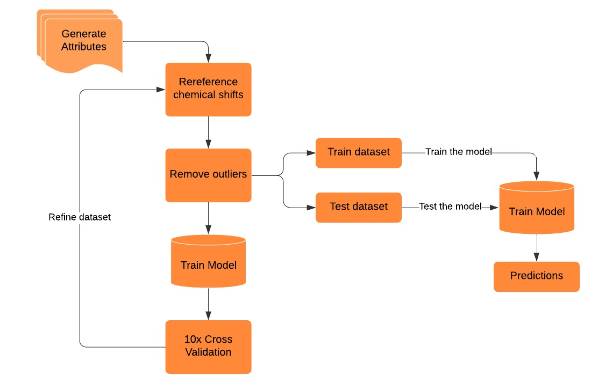
Objectives to Improve Chemical Shift Predictions in NMRFx
A. Expand protein dataset
Large database of high quality, accurate protein structures with corresponding chemical shift assignments
Standard residue peptides with high sequence identity
X-ray structure with resolution $≤$ 2.4 Å or most recent NMR
B. Establish a workflow to parse through and refine input data
C. Train and test the model
A
C
B

Slide 6
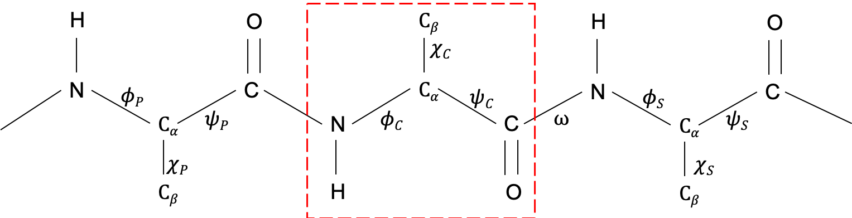
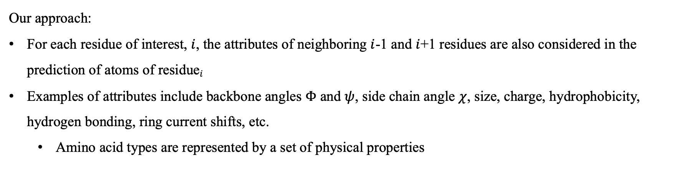



Choosing Features for the Model
Previous residue, $i−1$
Central residue, $i$
Successive residue, $i+1$
Our approach:
For each residue of interest, $i$, the attributes of neighboring $i$-1 and $i$+1 residues are also considered in the prediction of atoms of residue$i$
Examples of attributes include backbone angles $Φ$ and $ψ$, side chain angle $χ$, size, charge, hydrophobicity, hydrogen bonding, ring current shifts, etc.
Amino acid types are represented by a set of physical properties

Slide 7
Translating Physical Properties into Numerical Values
Previous residue, $i−1$
Central residue, $i$
Successive residue, $i+1$
cos(phiC)*ARO_P, sin(phiC)*ARO_P
cos(phiC)*BULK_P, sin(phiC)*BULK_P
cos(phiC)*CHRG, sin(phiC)*CHRG_P
cos(phiC)*HPHB_P, sin(phiC)*HPHB_P
cos(phiC)*PRO_P, sin(phiC)*PRO_P
cos(psiC)*cos(phiC)
cos(psiC)*sin(phiC)
sin(psiC)*cos(phiC)
sin(psiC)*sin(phiC)

Slide 8
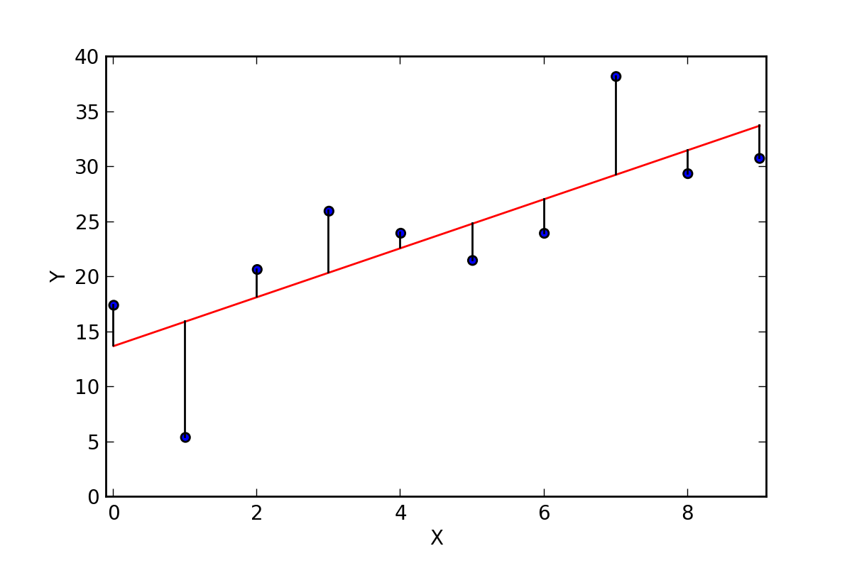
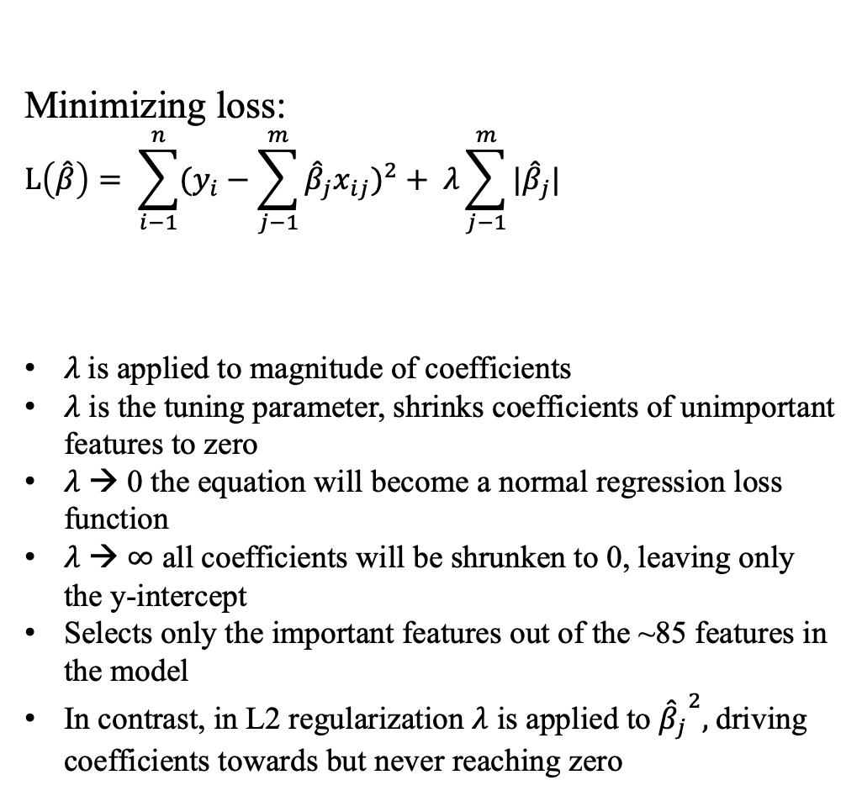

Applying LASSO/L1 Regularization
Linear Regression:
y = b + mx
$\hat{y}=β_{0}+ {\hat{β}}_{1}x_{1}+ {\hat{β}}_{2}x_{2}$ $+ {\hat{β}}_{3}x_{3}+$… $+ {\hat{β}}_{n}x_{n}$
$x_{1}$ … $x_{n}$ are the features
${\hat{β}}_{1}$… ${\hat{β}}_{n}$ are the coefficients
Minimizing loss:
$$L\left(\hat{β}\right)= {\sum_{i−1}^{n}{(y_{i}−\sum_{j−1}^{m}{{\hat{β}}_{j}x_{ij}}})}^{2}+ λ\sum_{j−1}^{m}{|{\hat{β}}_{j}|}$$
$λ$is applied to magnitude of coefficients
$λ$ is the tuning parameter, shrinks coefficients of unimportant features to zero
$λ$ → 0 the equation will become a normal regression loss function
$λ$ → $∞$ all coefficients will be shrunken to 0, leaving only the y-intercept
Selects only the important features out of the ~85 features in the model
In contrast, in L2 regularization $λ$ is applied to ${{\hat{β}}_{j}}^{2},$driving coefficients towards but never reaching zero
OLS
experimental – predicted
Penalty term

Slide 9
Chemical Shift Predictors
Other chemical shift prediction models are highly complex and computationally demanding
They rely on several different software programs to sift through BMRB and PDB data
SPARTA – performs a database search for top 20 homologous tripeptide fragments
SHIFTX – uses various ‘classical equations’ to analyze each attribute in conjunction with hypersurfaces
SHIFTX2 – samples over five machine learning algorithms using ensemble methods, bagging and boosting with regression trees

Slide 10
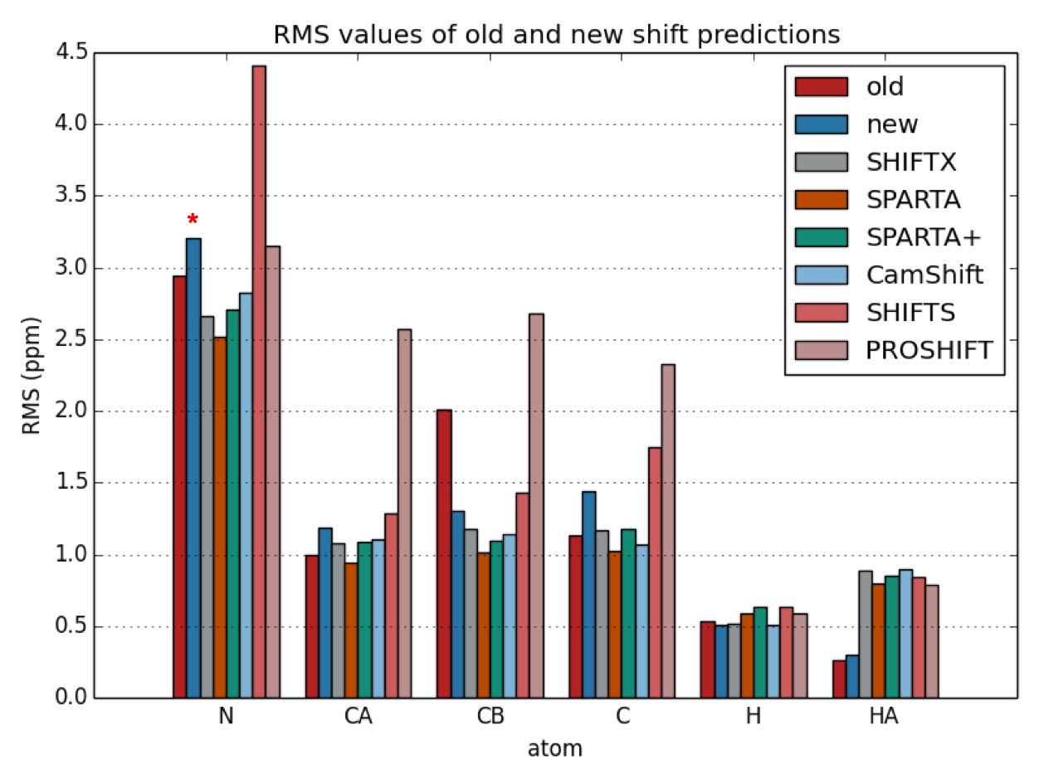
Initial Fit Results Show Need for Further Dataset Refinement
Root Mean Square represents the deviation/error of our fit - the lower, the better
Comparison of model trained on SHIFTX2 dataset and on our own dataset of the same proteins
Model trained on new dataset performed worse on predictions of N, CA, and C atoms
SHIFTX2: Significantly Improved Protein Chemical Shift Prediction, Wishart et al., Journal of Biomolecular NMR 2011
Notes:
Explain rms values, they indicate the error of our fit

Slide 11
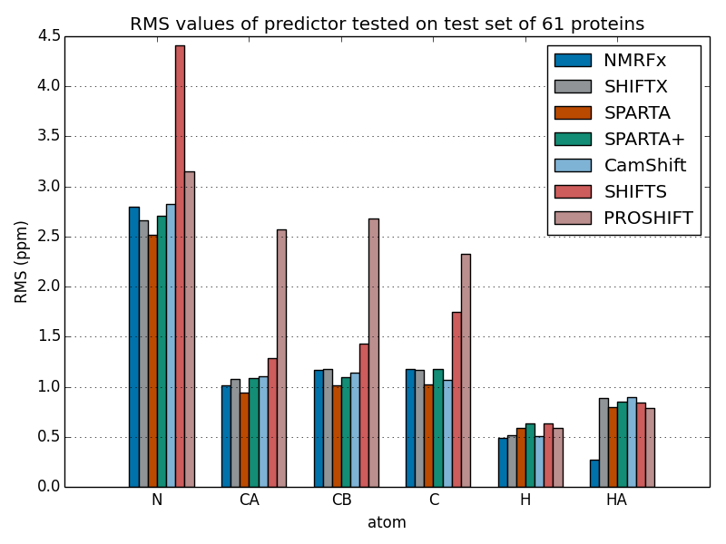
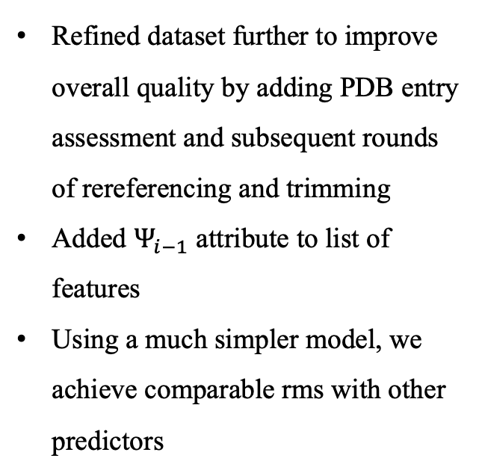
Final Fit Results are Comparable to High Performing Predictors
Refined dataset further to improve overall quality by adding PDB entry assessment and subsequent rounds of rereferencing and trimming
Added $Ψ_{i−1}$ attribute to list of features
Using a much simpler model, we achieve comparable rms with other predictors
SHIFTX2: Significantly Improved Protein Chemical Shift Prediction, Wishart et al., Journal of Biomolecular NMR 2011

Slide 12
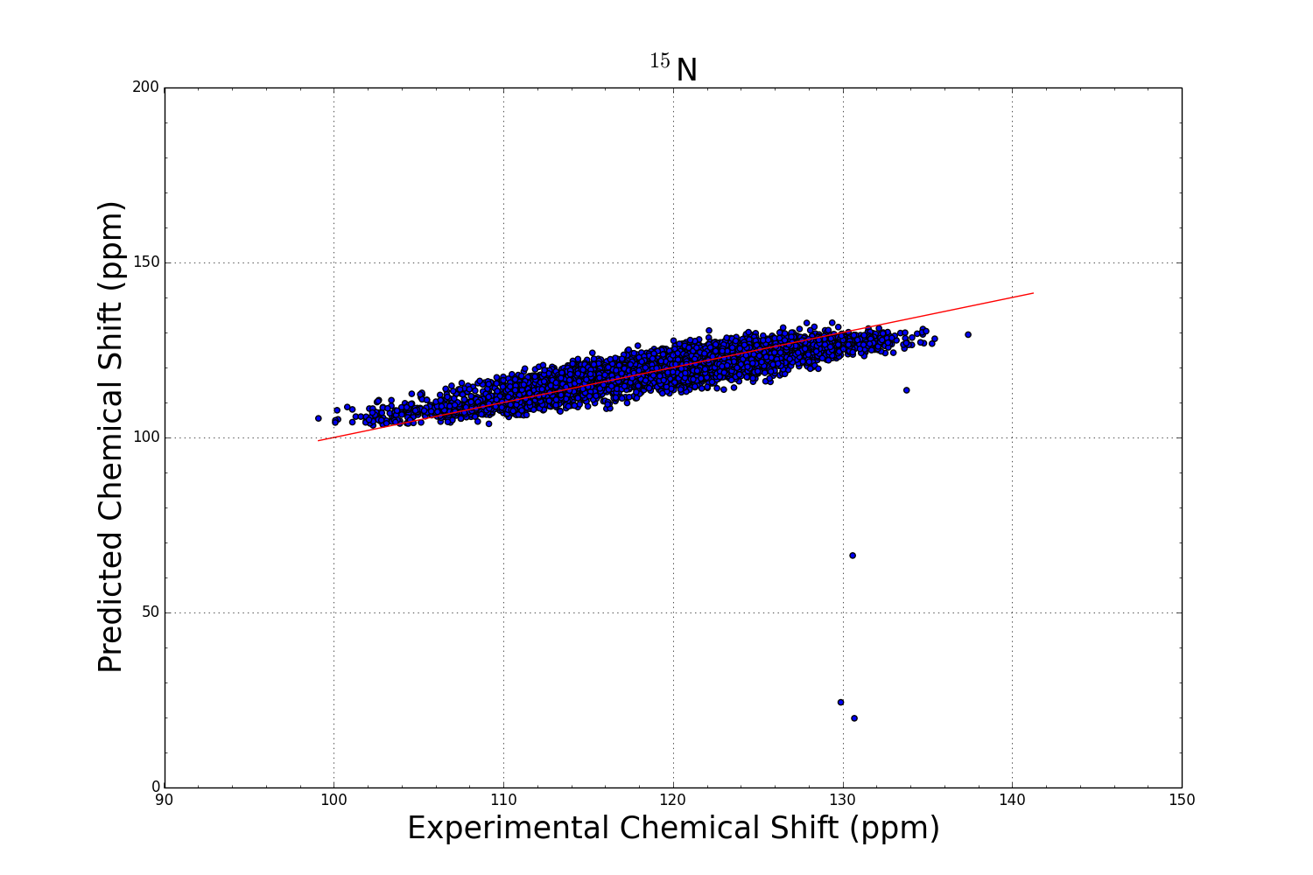
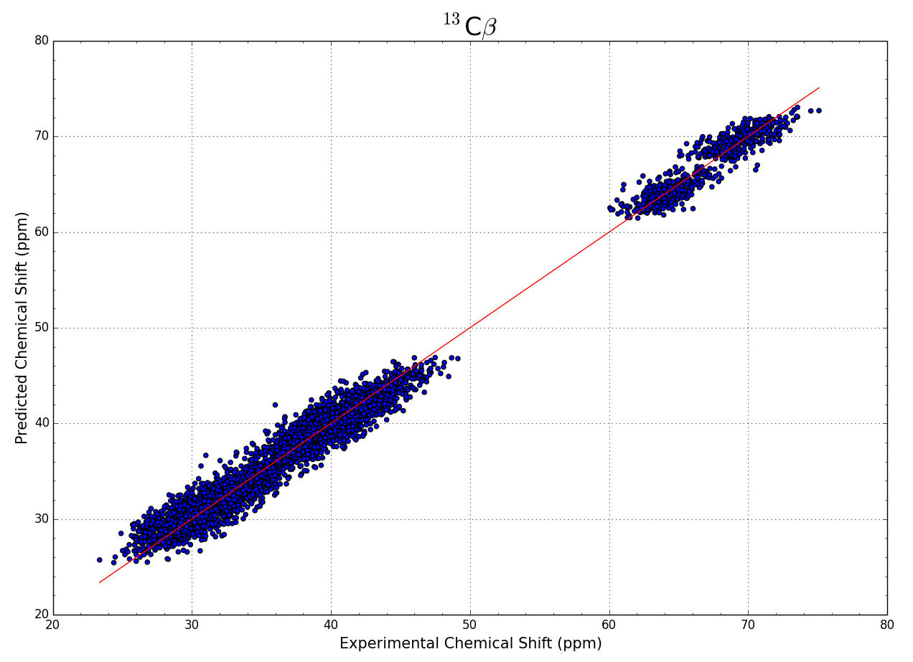
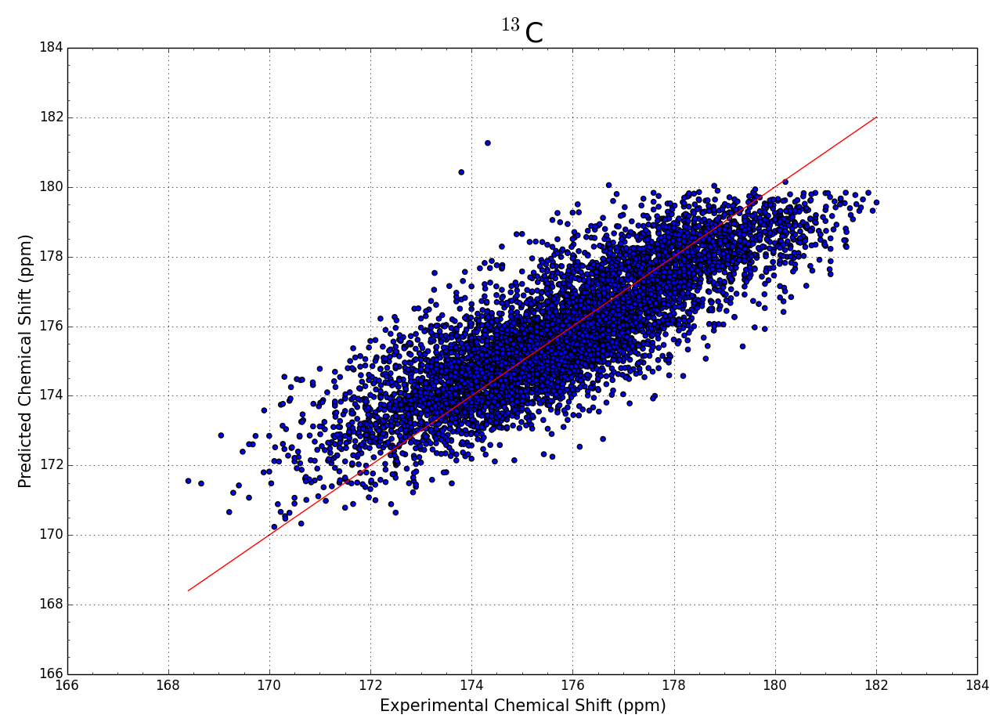
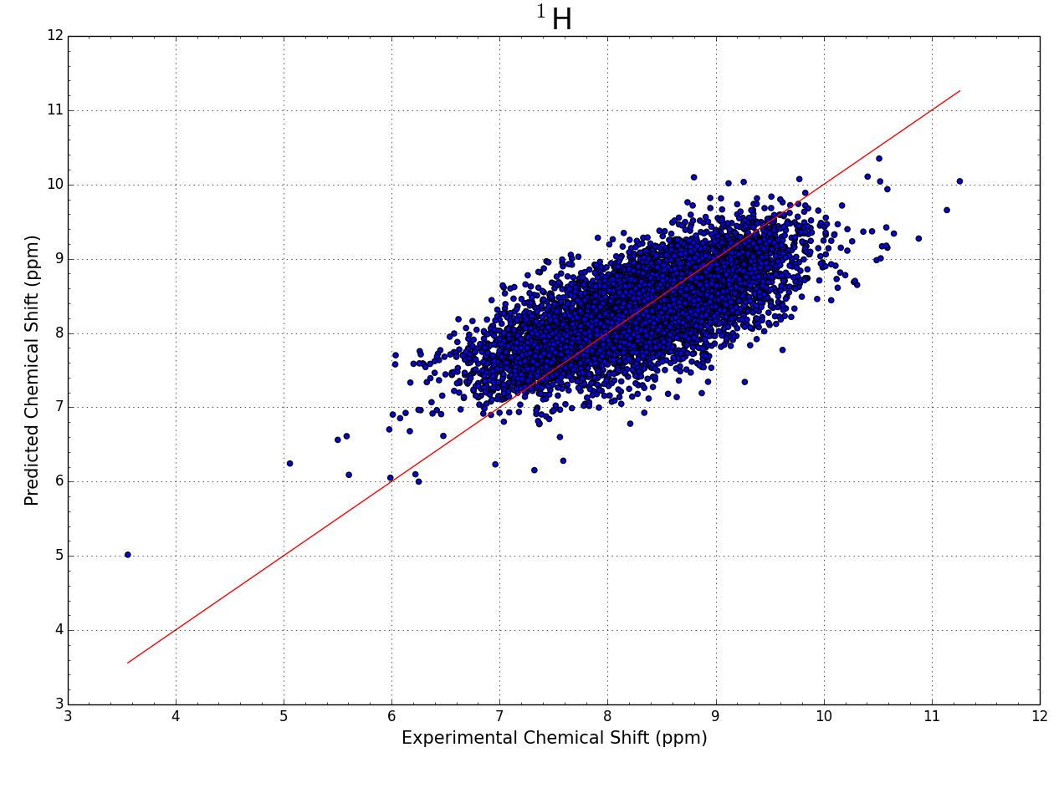
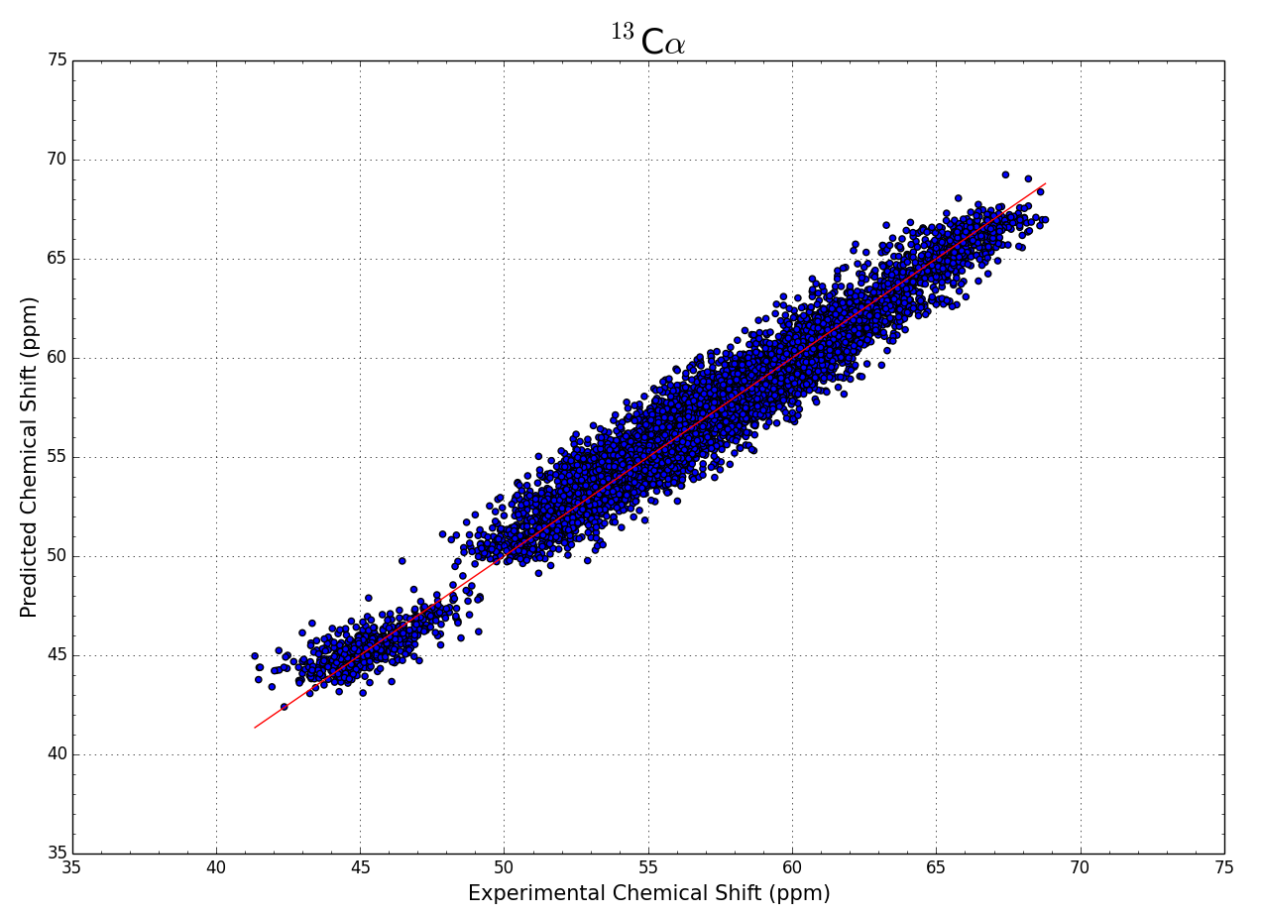
Experimental vs Predicted Shifts
n = 7523
n = 6420
n = 6696
n = 7550
n = 8038

Slide 13
Conclusion
We can achieve reasonably accurate chemical shift predictions using a simple linear regression model
It is embedded directly into NMRFx software
We have developed a set of tools to assess and to extract information from PDB and STAR files
We have gained experience in working with Deep Learning Java libraries such as SMILE and Deeplearning4j

Slide 14
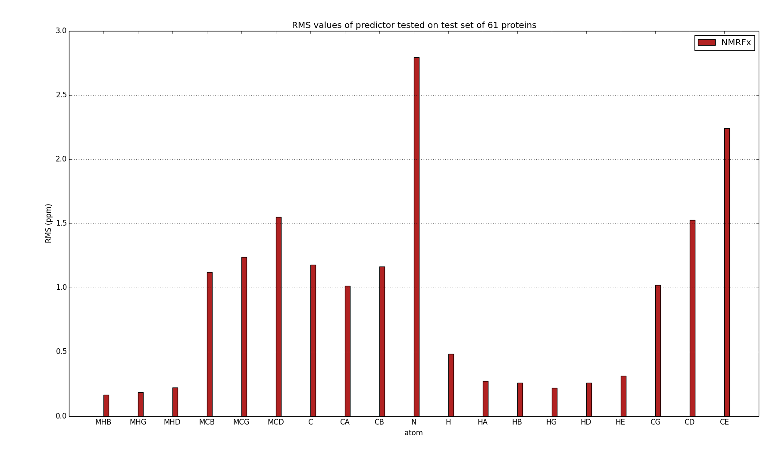
Future Directions
Improving side chain atom shift predictions
Reversing the order – predicting backbone angles from chemical shifts

Slide 15
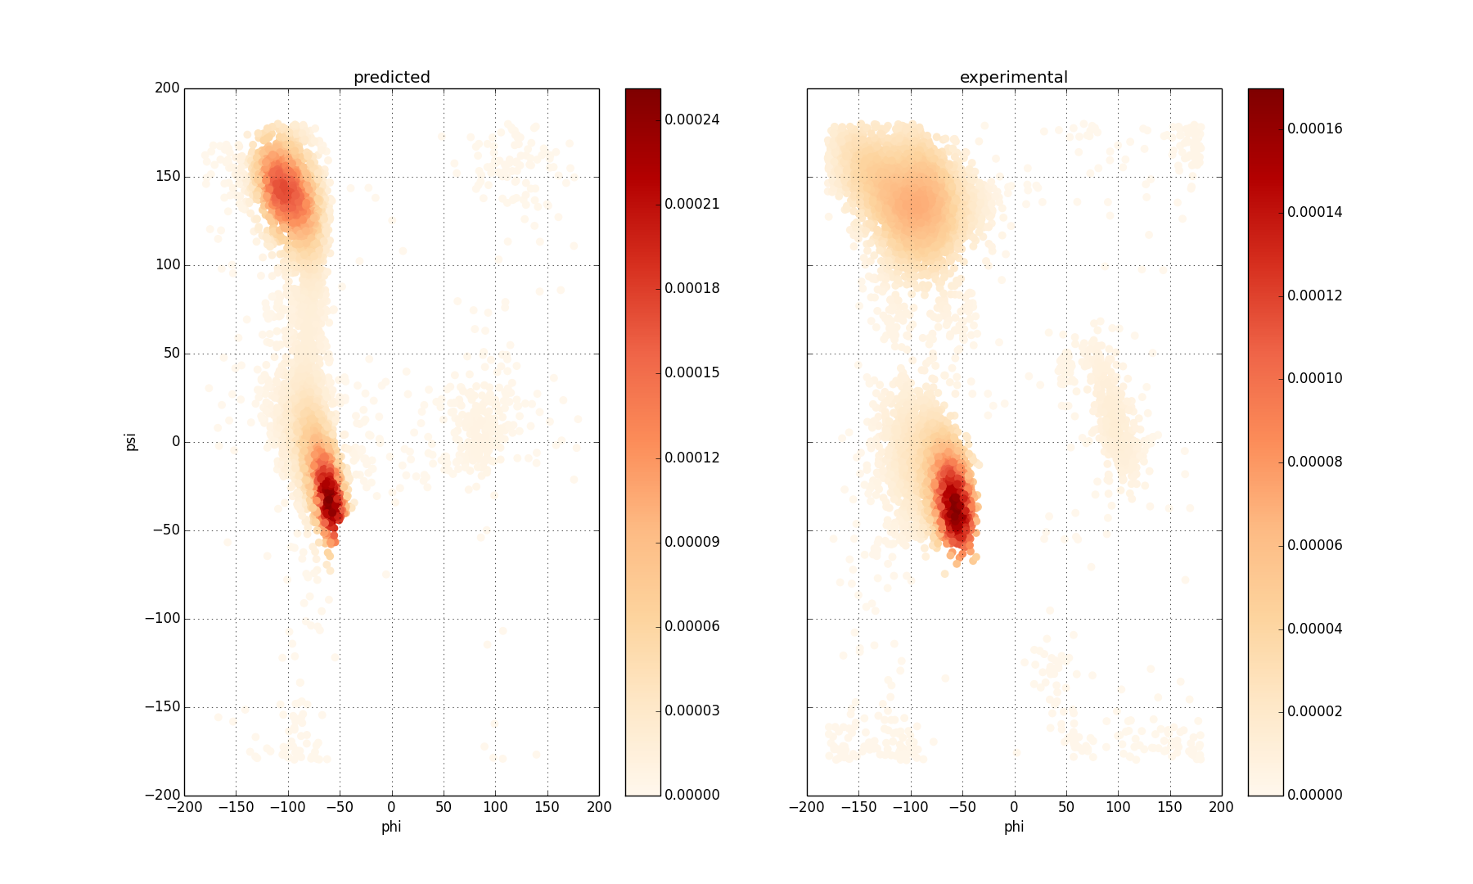
Future Directions
Improving side chain atom shift predictions
Reversing the order – predicting backbone angles from chemical shifts

Slide 16
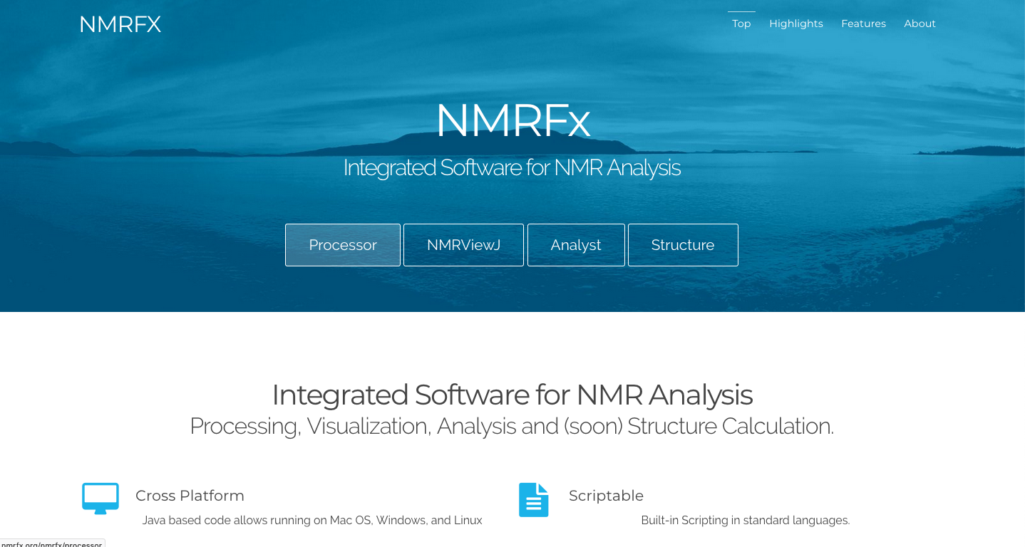
Acknowledgements
Johnson Group
Bruce Johnson
Martha Beckwith
Audrigue Jean-Louis
Teddy Colon
Structural Biology
Initiative
*Special thanks to Emily Armbruster for valuable feedback on this presentation

