Slide 1
Decision Making

Slide 2
Problem Solving
Management science uses a scientific approach for solving management problems
It is used in a variety of organizations to solve many different types of problems
It encompasses a logical mathematical approach to problem solving
Mathematical tools have been used for thousands of years
Quantitative analysis can be applied to a wide variety of problems
One must understand: the specific applicability of the technique, its limitations and its assumptions

Slide 3
Overview of Quantitative Analysis
Scientific Approach to Managerial Decision Making
Consider both Quantitative and Qualitative Factors
Quantitative
Analysis
Meaningful
Information
Raw Data

Slide 4
Analyses
Quant.Analysis
Logic
Historic Data
Marketing Research
Scientific Analysis
Modeling
Problem
Decision
?
Qual. Analysis
Weather
State and federal
legislation
New technological
breakthroughs
Election outcome

Slide 5
Typical Business Decision Aspects
Several, possibly contradictory objectives
Many alternatives
Unevaluated alternatives
Decision may be made by a group
Group member biases
Results can occur in the future
Attitudes towards risk
Need information
Gathering information takes time and expense
Too much information
“What-if” analysis, Scenarios
Trial-and-error experimentation may result in a loss
Experimentation with the real system - only once
Changes in the environment can occur continuously
Time pressure

Slide 6
Decision Making
We spend a significant portion of our time and psychic energy making decisions.
Our decisions shape our lives: who we are, what we are, where we are, how successful we are, how happy we are all derive in large part from our decisions
In order to raise our odds of making a good decision, we have to learn to use a good decision making process – one that gets us to the best solution with a minimal loss of time, energy, money, etc...

Slide 7
Decision Making
Decision making may be defined as:
Intentional and reflective choice in response to perceived needs (Kleindorfer et al., 1993)
Decision maker’s (DM’s) choice of one alternative or a subset of alternatives among all possible alternatives with respect to her/his goal or goals (Evren and Ülengin, 1992)
Solving a problem by choosing, ranking, or classifying over the available alternatives that are characterized by multiple criteria (Topcu, 1999)

Slide 8
Effective Decision Making Process
An effective decision making process will fulfill the following six criteria (Hammond et al., 1999):
It focuses on what’s important
It is logical and consistent
It acknowledges both subjective and objective factors and blends analytical with intuitive thinking
It requires only as much information and analysis as is necessary to resolve a particular dilemma
It encourages and guides the gathering of relevant information and informed opinion
It is straightforward, reliable, easy to use, and flexible

Slide 9
Good Decision Making
A key to good decision making is to provide a structural method for incorporating the information, opinions, and preferences of the various relevant people into the decision making process (Kirkwood, 1997)
A good decision
is based on logic
uses all available resources
evaluates all possible alternatives
utilizes a quantitative method

Slide 10
Basic Concepts
Problems
Variables
Objective
Criteria
Attributes
Alternatives
Participants in the decision making process (problem stakeholders)

Slide 11
Problem
A felt difficulty
A gap or obstacle to be circumvented
Dissatisfaction with a purposeful state
A perception of a variance, or gap, between the present and some desired state of affairs
Three conditions characterise a problem (Evans, 1989):
There are alternate courses of action available from which to choose
The choice of a course of action can have a significant effect on the future
There is some doubt as to which course of action to select

Slide 12
Problem
An undesirable situation that is significant to and may be solvable by some agent, although probably with difficulty (Smith, 1989).
Key elements of this definition:
the gap between preferences and reality,
the importance of remedying this gap,
the expected difficulty of doing so.

Slide 13
Variables
An objective is a statement of something that one desires to achieve
A criterion is a “tool” allowing to compare alternatives according to a particular “significance axis” or a “point of view” (Bouyssou, 1990)
An attribute measures the degree in which an objective is achieved (Keeney, 1996)
An attribute represents the basic characteristic, quality, or efficiency parameter of an alternative (Evren and Ulengin, 1992)
Notes:
Attribute is a tool used for evaluation of alternatives w.r.t. criterion
Objective: decreasing cost
Criterion: cost
Attribute: cost in MTL (quantitative value)

Slide 14
Attributes
Classification: Function type
Benefit attributes
Offer increasing monotonic utility. Greater the attribute value the more its preference
Cost attributes
Offer decreasing monotonic utility. Greater the attribute value the less its preference
Nonmonotonic attributes
Offer nonmonotonic utility. The maximum utility is located somewhere in the middle of an attribute range
Notes:
Benefit: fuel efficiency
Cost: production cost
Nonmon.: blood sugar level in a human body, room temperature in the Office.

Slide 15
Attributes
Classification: construction type
Natural attributes
Those in general use that have a common interpretation to everyone
Constructed (subjective) attributes
Made up of verbal verbal descriptions of pre-described levels
Proxy (indirect) attribute
If measuring the degree of achievement is inadequate, it may be necessary to utilize an indirect measure
Notes:
minimize cost: the attribute “cost measured in TL” is a natural attribute
If a natural attribute does not exist or if it seems to have inappropriate built in value judgments, there are two other possibilities. One is to construct an attribute to measure the associated objective directly. The other is to measure the achievement of the objective indirectly using a proxy attribute
A constructed attribute for public attitudes toward power plant sites:
Attribute level-description of level 1-support, 0-neutrality, -1-controversy, -2-action oriented opposition, -3-strong action oriented opposition
Comfort: 5 very high, 4 high, 3 average, 2 low, 1 very low
Proxy attribute:
Consider decisions involving the control of the effects of sulphur dioxide. One fundamental objective in cities to minimize the damage to historic buildings caused by acid formed by water and sulphur dioxide (acid rain). It is difficult to measure “stone disfiguration”. In this case a proxy attribute defined as the sulphur dioxide concentration measured by parts per million in the vicinity of buildings may be appropriate

Slide 16
Alternative
Alternatives is the set of actions, objects, candidates, decisions... To be explored during the decision process
Alternative set may be defined by:
Listing its members when it is finite and sufficiently small (MADM)
Stating the properties which characterize its elements when it is infinite or finite but too large for an enumeration to be possible (MODM)

Slide 17
Problem Stakeholders
The problem owner
The person or group who has control over certain aspects of the problem situation, in particular over the choice of action to be taken. Most often, the problem owner is the decision maker.
The problem user
Uses the solution and/or executes the decisions approved by the problem owner or decision maker. Has no authority to change the decision
The problem customer
The beneficiary or victim of the consequences of using the solution
The problem solver
Decision Analyst who analyzes the problem and develops a solution for approval by the problem owner
Notes:
A firm has two options: launching a new product or cancelling the project. They have contacted with a consultant firm in order to make the decision.
The problem owner: executive officers
The problem user: professionals in marketing and production department
The problem customer: customers purhasing the goods of the firm
The problem solver: consultants
The same individual may act in different roles:
Assume that you are consifdering the replacement of your current car. You have limited finance and borrowing capacity, a wish list of desirfable and absolutely essential features that the new car should meet,, and a wide choice of options: a range of new cars, as well as, suitable second-hand cars. In this case you are the problem owner, the problem user, the problem customer, and if you are not aided by anyone you will be also problem solver.

Slide 18
Managerial Decision Making
Decision making: the process by which managers respond to opportunities and threats by analyzing options, and making decisions about goals and courses of action.
Decisions in response to opportunities: managers respond to ways to improve organizational performance.
Decisions in response to threats: occurs when managers are impacted by adverse events to the organization.

Slide 19
Types of Decision Making
Programmed Decisions: routine, almost automatic process.
Managers have made decision many times before.
There are rules or guidelines to follow.
Example: Deciding to reorder office supplies.
Non-programmed Decisions: unusual situations that have not been often addressed.
No rules to follow since the decision is new.
These decisions are made based on information, and a manger’s intuition, and judgment.
Example: Should the firm invest in a new technology?

Slide 20
The Classical Model
Classical model of decision making: a prescriptive model that tells how the decision should be made.
Assumes managers have access to all the information needed to reach a decision.
Managers can then make the optimum decision by easily ranking their own preferences among alternatives.
Unfortunately, managers often do not have all (or even most) required information.

Slide 21
The Classical Model
List alternatives
& consequences
Assumes all information
is available to manager
Assumes manager can
process information
Assumes manager knows
the best future course of
the organization
Rank each alternative
from low to high
Select best
alternative

Slide 22
The Administrative Model
Administrative Model of decision making: Challenged the classical assumptions that managers have and process all the information.
As a result, decision making is risky.
Bounded rationality: There is a large number of alternatives and information is vast so that managers cannot consider it all.
Decisions are limited by people’s cognitive abilities.
Incomplete information: most managers do not see all alternatives and decide based on incomplete information.

Slide 23
Why Information is Incomplete
Uncertainty
& risk
Ambiguous
Information
Incomplete
Information
Time constraints &
information costs

Slide 24
Incomplete Information Factors
Incomplete information exists due to many issues:
Risk: managers know a given outcome can fail or succeed and probabilities can be assigned.
Uncertainty: probabilities cannot be given for outcomes and the future is unknown.
Many decision outcomes are not known such as a new product introduction.
Ambiguous information: information whose meaning is not clear.
Information can be interpreted in different ways.

Slide 25
Incomplete Information Factors
Time constraints and Information costs: Managers do not have the time or money to search for all alternatives.
This leads the manager to again decide based on incomplete information.
Satisficing: Managers explore a limited number of options and choose an acceptable decision rather than the optimum decision.
This is the response of managers when dealing with incomplete information.
Managers assume that the limited options they examine represent all options.

Slide 26
Decision Making Process
Structuring the Problem
Constructing the Decision Model
Analyzing (solving) the Problem

Slide 27
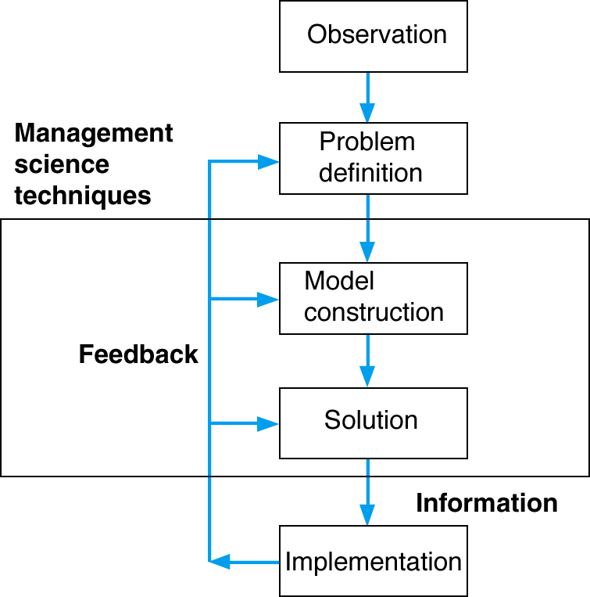
Management Science Process

Slide 28
Approach I
Define the problem
Develop a model
Acquire data
Develop a solution
Test the solution
Analyze the results and perform sensitivity analysis
Implement the results

Slide 29
Define the Problem
All else depends on this
Clear and concise statement required
May be the most difficult step
Must go beyond symptoms to causes
Problems are related to one another
Must identify the “right” problem
May require specific, measurable objectives

Slide 30
Develop the Model
Model: representation of a situation
Models: physical, logical, scale, schematic or mathematical
Models: variables (controllable or uncontrollable) and parameters
Controllable variables ⇒ decision variables
Models must be:
solvable
realistic
easy to understand
easy to modify

Slide 31
Acquire Data
Accurate data is essential (GIGO)
Data from:
company reports
company documents
interviews
on-site direct measurement
statistical sampling

Slide 32
Develop a Solution
Manipulate the model, find the “best” solution
Solution:
practical
implementable
Various methods:
solution of equation(s)
trial and error
complete enumeration
implementation of algorithm

Slide 33
Test the Solution
Must test both
Input data
Model
Determine:
Accuracy
Completeness of input data
collect data from a different sources and compare
Check results for consistency
Do they make sense?
Test before analysis!

Slide 34
Analyze the Results
Understand the actions implied by the solution
Determine the implications of the action
Conduct sensitivity analysis - change input value or model parameter and see what happens
Use sensitivity analysis to help gain understanding of problem (as well as for answers)

Slide 35
Implement the Results
Incorporate the solution into the company
Monitor the results
Use the results of the model and sensitivity analysis to help you sell the solution to management

Slide 36
Approach II
Recognize need for
a decision
Frame the problem
Generate & assess alternatives
Choose among alternatives
Implement chosen
alternative
Learn from feedback

Slide 37
Decision Making Steps
1. Recognize need for a decision: Managers must first realize that a decision must be made.
Sparked by an event such as environment changes.
2. Generate alternatives: managers must develop feasible alternative courses of action.
If good alternatives are missed, the resulting decision is poor.
It is hard to develop creative alternatives, so managers need to look for new ideas.
3. Evaluate alternatives: what are the advantages and disadvantages of each alternative?
Managers should specify criteria, then evaluate.

Slide 38
Decision Making Steps
4. Choose among alternatives: managers rank alternatives and decide.
When ranking, all information needs to be considered.
5. Implement choose alternative: managers must now carry out the alternative.
Often a decision is made and not implemented.
6. Learn from feedback: managers should consider what went right and wrong with the decision and learn for the future.
Without feedback, managers never learn from experience and make the same mistake over.

Slide 39
Evaluating Alternatives
Is the possible course of action:
Legal?
Ethical
Economical?
Practical?

Slide 40
Evaluating Alternatives
Is it legal? Managers must first be sure that an alternative is legal both in this country and abroad for exports.
Is it ethical? The alternative must be ethical and not hurt stakeholders unnecessarily.
Is it economically feasible? Can our organization’s performance goals sustain this alternative?
Is it practical? Does the management have the capabilities and resources to do it?

Slide 41
Modeling in the Real World
Models are complex
Models can be expensive
Models can be difficult to sell
Models are used in the real world by real organizations to solve real problems

Slide 42
Example of Model Construction Problem Definition
Information and Data:
- Business firm makes and sells a steel product
- Product costs $5 to produce
- Product sells for $20
- Product requires 4 tons of steel to make
- Firm has 100 tons of steel
Business problem:
Determine the number of units to produce to make the most profit given the limited amount of steel available.

Slide 43
Example of Model Construction Mathematical Model
Variables: x = number of units (decision variable)
Z = total profit
Model: Z = $20x - $5x (objective function)
4x = 100 tons of steel (resource constraint)
Parameters: $20, $5, 4 tons, 100 tons (known values)
Formal specification of model:
maximize Z = $20x - $5x
subject to 4x = 100

Slide 44
Model Building Break-Even Analysis (1 of 7)
Used to determine the number of units of a product to sell or produce (i.e. volume) that will equate total revenue with total cost.
The volume at which total revenue equals total cost is called the break-even point.
Profit at break-even point is zero.

Slide 45
Model Building Break-Even Analysis (2 of 7) Model Components
Fixed costs (c_{f}) - costs that remain constant regardless of number of units produced
Variable cost (c_{v}) - unit cost of product
Total variable cost (vc_{v}) - function of volume (v) and variable per-unit cost
Total cost (TC) - total fixed cost plus total variable cost
Profit(Z) - difference between total revenue vp (p=price) and total cost:
Z = vp - c_{f} - vc_{v}

Slide 46
Model Building Break-Even Analysis (3 of 7)
Computing the Break-Even Point
The break-even point is that volume at which total revenue equals total cost and profit is zero:
V = c_{f}/(p-c_{v})
Example: Western Clothing Company
c_{f} = $10000
c_{v} = $8 per pair
p = $23 per pair
v = 666.7 pairs, break-even point

Slide 47
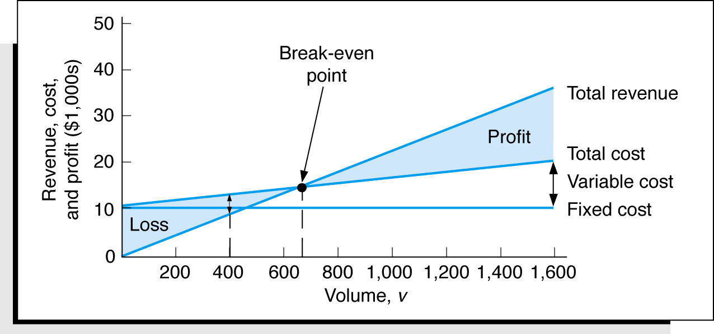
Model Building Break-Even Analysis (4 of 7)
Graphical Solution
Break-even model

Slide 48
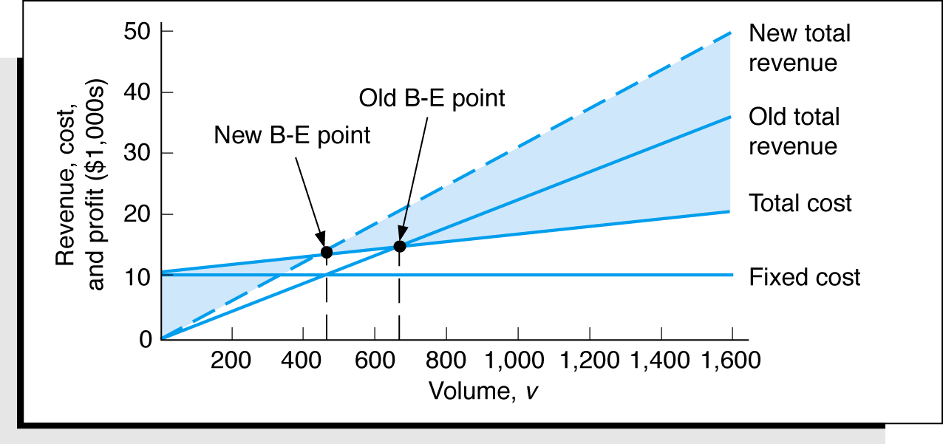
Model Building Break-Even Analysis (5 of 7)
Sensitivity Analysis (price)
Break-even model with a change in price

Slide 49
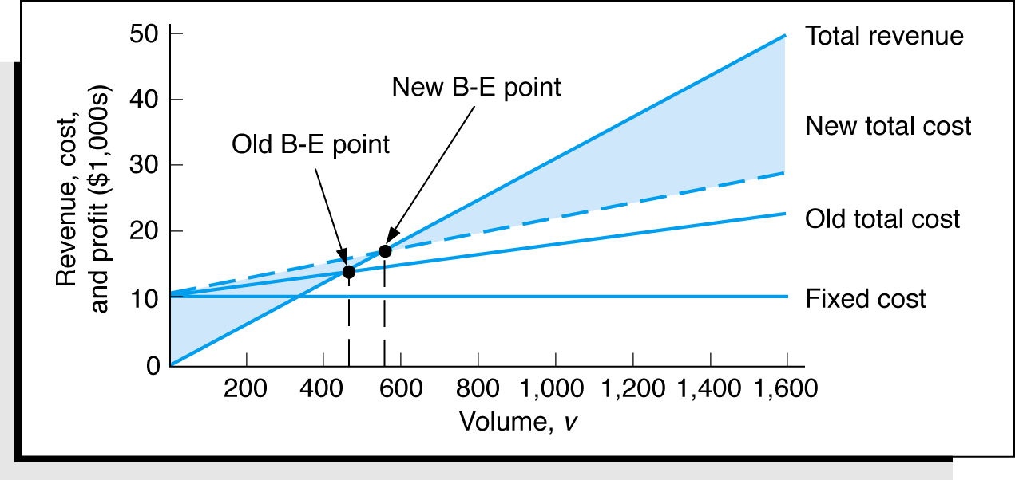
Model Building Break-Even Analysis (6 of 7)
Sensitivity Analysis (variable cost)
Break-even model with a change in variable cost

Slide 50
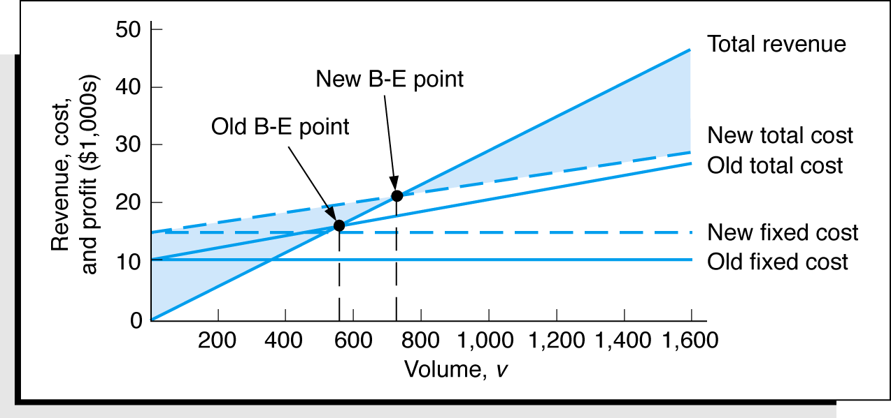
Model Building Break-Even Analysis (7 of 7)
Sensitivity Analysis (fixed cost)
Break-even model with a change in fixed cost

Slide 51
Models Can Help Managers to
Gain deeper insight into the nature of business relationships
Find better ways to assess values in such relationships; and
See a way of reducing, or at least understanding, uncertainty that surrounds business plans and actions

Slide 52
Models
are less expensive and disruptive than experimenting with real world systems
allow “What if” questions to be asked
are built for management problems and encourage management input
enforce consistency in approach
require specific constraints and goals

Slide 53
Models: The Up Side
Accurately represent reality
Help a decision maker understand the problem
Save time and money in problem solving and decision making
Help communicate problems and solutions to others
Provide the only way to solve large or complex problems in a timely fashion

Slide 54
Models: The Down Side
May be expensive and time-consuming to develop and test
Are often misused and misunderstood (and feared) because of their mathematical complexity
Tend to downplay the role and value of nonquantifiable information
Often have assumptions that oversimplify the variables of the real world

Slide 55
Possible Problems in Using Models
Define the Problem
Conflicting viewpoints
Departmental impacts
Assumptions
Develop a Model
Fitting the Model
Understanding the Model
Acquire Input Data
Accounting Data
Validity of Data
Develop a Solution
Complex Mathematics
Only One Answer is Limiting
Solutions become quickly outdated

Slide 56
Possible Problems - Continued
Test the Solution
Identifying appropriate test procedures
Analyze the Results
Holding all other conditions constant
Identifying cause and effect
Implement the Solution
Selling the solution to others

Slide 57
Using Models
Some Suggestions
Use descriptive models
Understand why the managers involved decide things the way they do
Identify managerial and organizational changes required by the model
Analyze each situation in terms of its impact on management
Prepare a realistic cost/benefit analysis of tradeoffs of alternate solutions

Slide 58
Mathematical Models Characterized by Risk
Deterministic models - we know all values used in the model with certainty
Probabilistic models - we know the probability that parameters in the model will take on a specific value

Slide 59
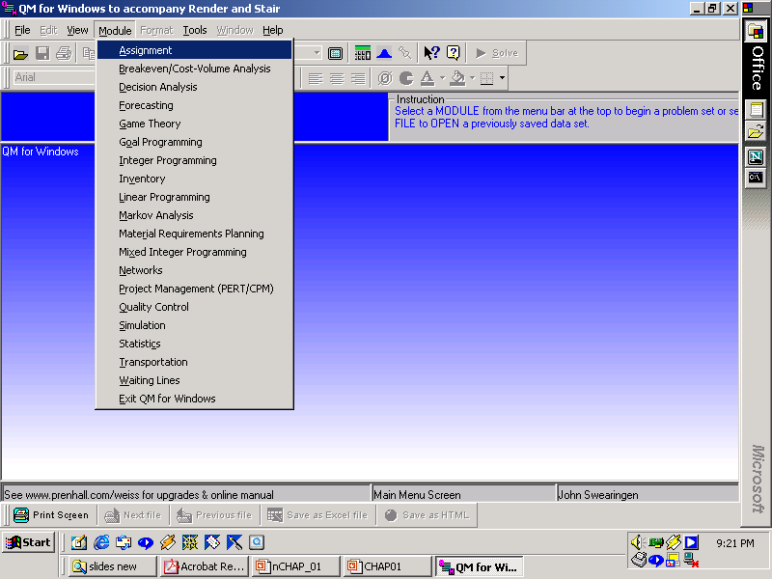
QM For Windows

Slide 60
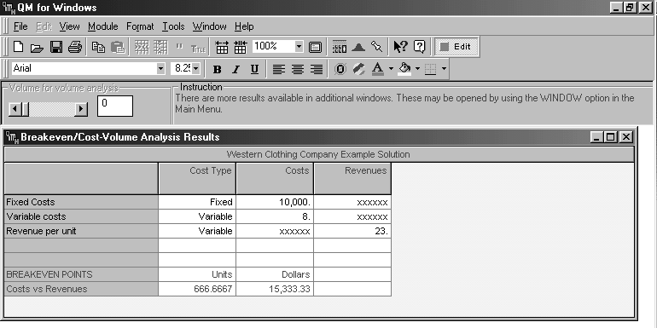
QM For Windows

Slide 61
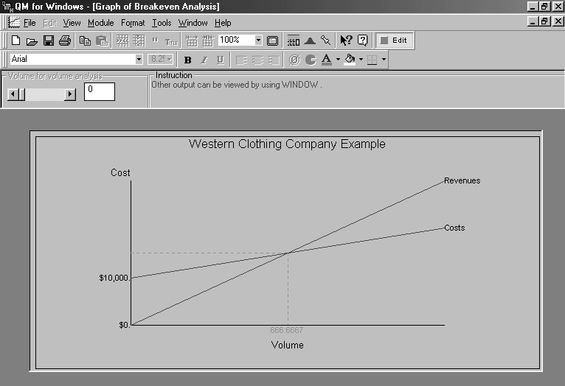
QM For Windows

Slide 62
QA Techniques
Mathematical Programming
Linear Programming
Integer Programming
Graphical analysis
Sensitivity analysis
Transportation
Assignment
Goal Programming
Probabilistic Techniques
Probability and statistics
Decision analysis
Queuing
Network Techniques
Project Management (CPM/PERT)
Network flows
MCDM
Value/Utility based
Interactive
Outranking
simple
Other
Simulation
Forecasting
Inventory
Non linear programming

Slide 63
Characteristics of Techniques
Linear mathematical programming: clear objective; restrictions on resources and requirements; parameters known with certainty.
Probabilistic techniques: results contain uncertainty.
Network techniques: model often formulated as diagram; deterministic or probabilistic.
Forecasting and inventory analysis techniques: probabilistic and deterministic methods in demand forecasting and inventory control.
Other techniques: variety of deterministic and probabilistic methods for specific types of problems.

Slide 64
Business Use of Management Science
Some application areas:
- Project planning
- Capital budgeting
- Inventory analysis
- Production planning
- Scheduling
Interfaces
Omega –
Applications journals

