Slide 1
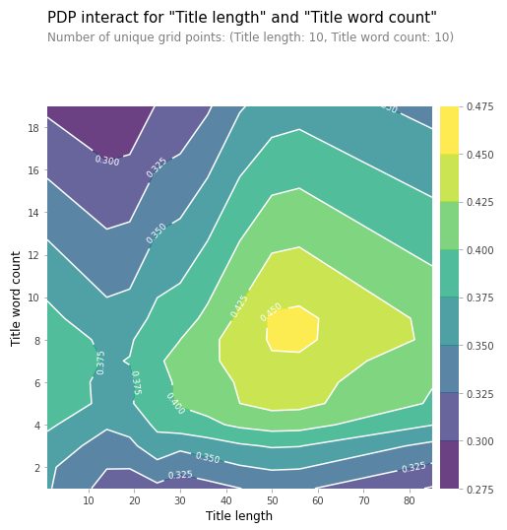
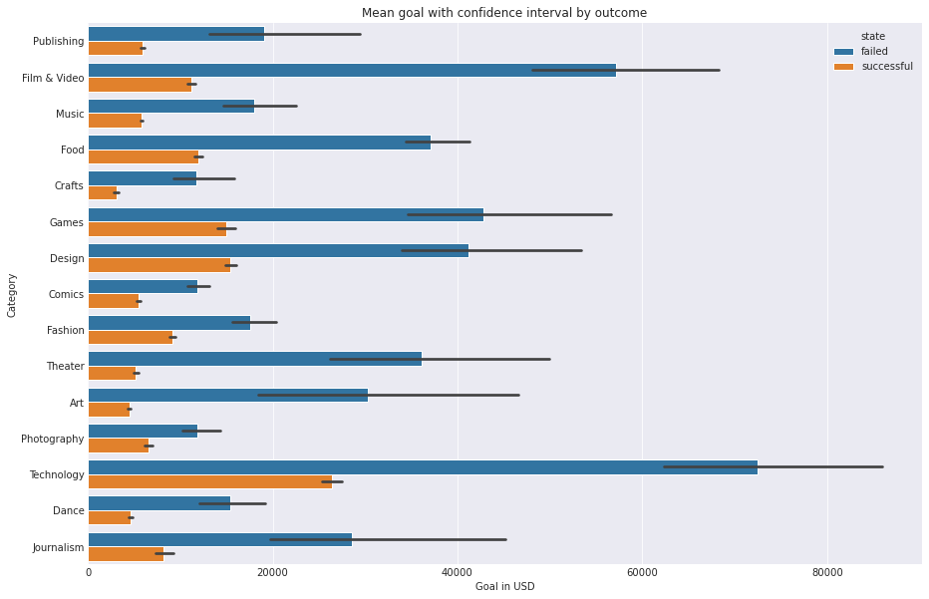
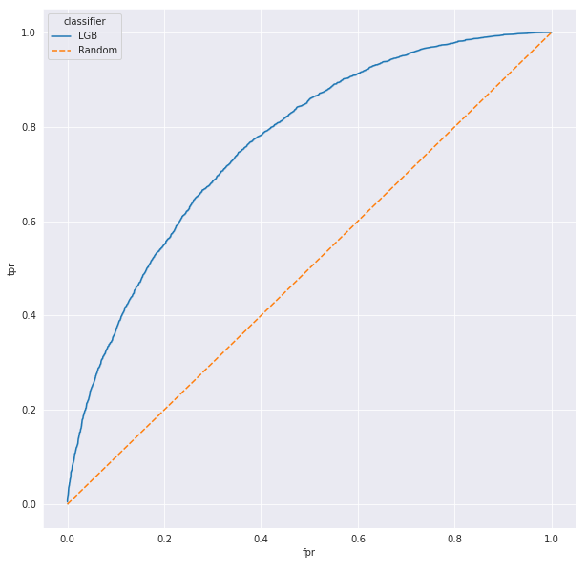
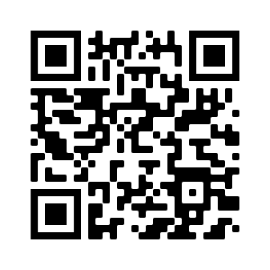
Analysis of Kickstarter projects information to predict possible outcome
Emil Koemets, Karl Hendrik Bachmann, Jakob Univer
INTRODUCTION
RESULTS
Our goal was to find the key elements about making the perfect kickstarter project. Of course the most important thing is having a good project idea, but what if your kickstarter Project gets cancelled just because you had a wrong amount of words in your project title, or you used a wrong currency for your financial goal?
We want to be able to predict, whether the project succeeds or not, based on the title of the project, the category it’s in, currency, goal (how much money the project wants), how many backers the project already has (people who have pledged), the origin country of the project and how much money has already been pledged. And based on that we can also find out the keys of the perfect Project.
Results that we found.
MATERIALS & METHODS
We used Jupyter Notebook for exploring data, feature engineering and modeling. We also used Tableau for some of the data visualisation. We used the CRISP-DM process as much as we can to make our workflow as efficient as possible.
DATA
We got the dataset from a Kaggle competition. It had information about over 370000 projects from Kickstarter. Our dataset is fairly balanced outcome wise 40% of projects reaching its goal and 60% not. This dataset has 15 main categories, the most popular one being Film & Video and making up about 17% of the data. Also it has 159 more specific categories, the mode only making up 5% of the data. Most of the projects were launched in the US and used USD for currency, both of these make up about 80% of the data.
PREPROCESSING
CONCLUSIONS
The dataset only had 3 missing values which were titles. Also there was one currency code which was incorrect since it had more than two-letters and 210 rows were affected by this issue. We created new features from existing ones to make the dataset better for machine learning and looked for interesting patterns in the data.
Conclusions that we can make from the results.
MACHINE LEARNING
We tried two different approaches. Firstly we tried a usual RandomForestClassifier on features category, main_category, currency, country and usd_goal_real. That approach gave an accuracy of 66.5 %. Next we tried making features of the most frequent words in project titles and train a RandomForestClassifier with these features. This approach gave an accuracy of 68.7 %. Lastly we tried a LightLGB classifier which gave an accuracy of 70 %.
REFERENCES
CONTACT
https://www.kaggle.com/kemical/kickstarter-projects
Source code:
jakob.univer@ut.ee
emil.koemets@ut.ee
karl.hendrik.bachmann@ut.ee

