Slide 1
Tau3MuGNNs
Siqi Miao
May 27, 2021

Slide 2
Content
Model Architecture
Experiments
Distributions

Slide 3
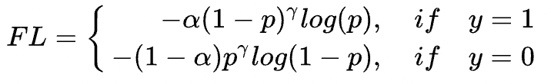
Model Architecture – new
1. Aggregation with softmax aggregator
4. Information Update
LSTM
…
T0
Tn
2. Pooling with node-level attention
5. Imbalanced data with focal loss
Node att.
3. Aggregation with softmax aggregator
Station 1
Hits
Virtual Node

Slide 4
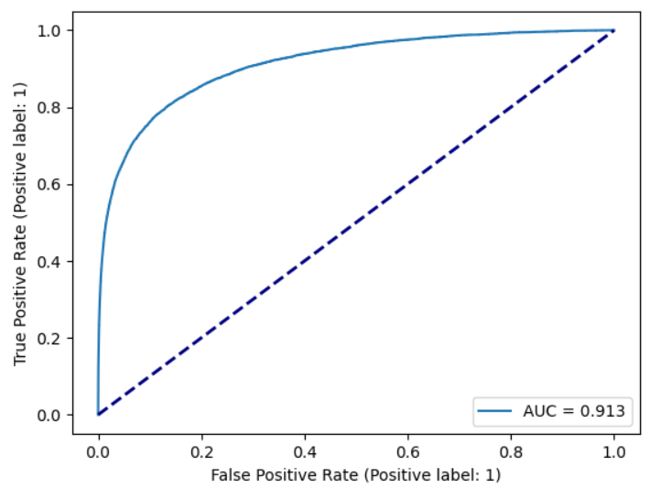
Experiments – metrics
ROC curve of the test set
True Positive Rate (recall)
0.8 recall means 80% tau3mu events can be detected by the model
False Positive Rate (FPR)
0.2 FPR means 20% background events will be predicted as tau3mu events
Generally, we want high recall and low FPR
The tradeoff between the two metrics can be shown in the ROC curve

Slide 5
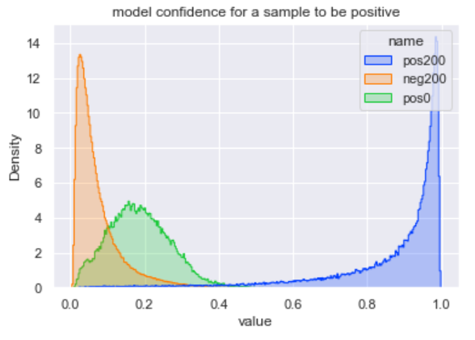
Experiments – current best model
Trained on tau_pu200 & minbias_pu200
Recall: 81%, FPR: 0.1% on the val/test set
Recall: 70%, FPR: 0.01% on the val/test set
AUC: 0.986
Trained for 180 epochs (17 GPU hrs)
Evaluate this model on tau_pu0 & minbias_pu200
AUC: 0.87
Recall: 85%, FPR: 24%
Train on mixed samples
AUC: 0.60

Slide 6
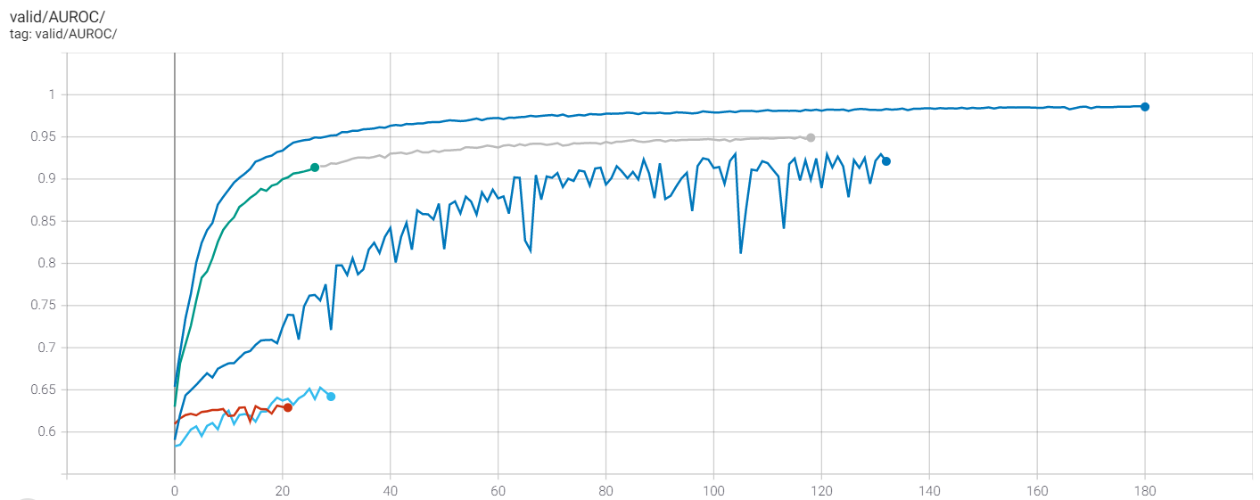
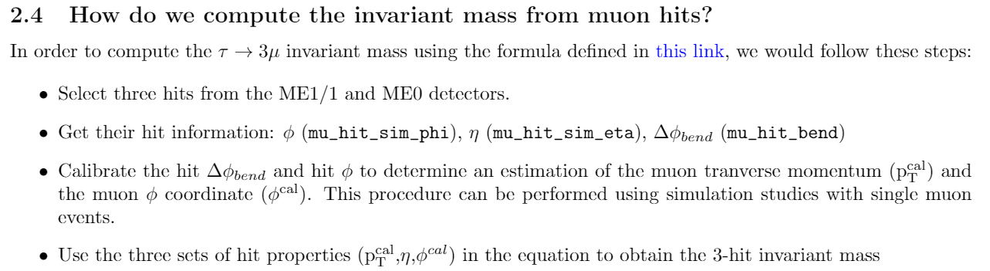
Distributions – important features
all
Bend, eta, phi
Bend, eta
Bend
Eta

Slide 7
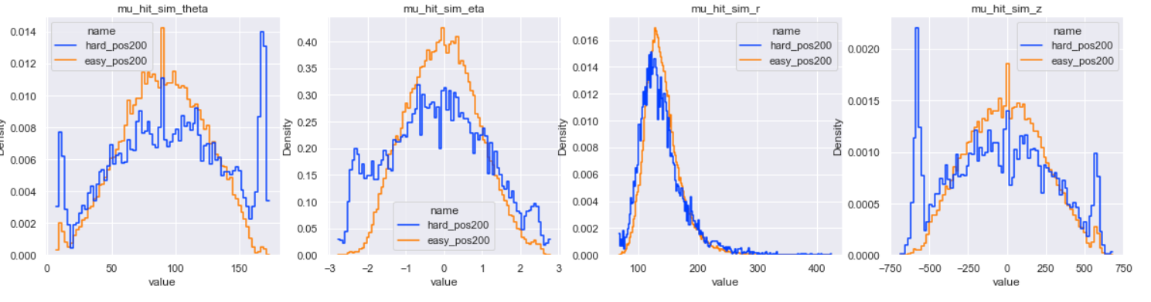
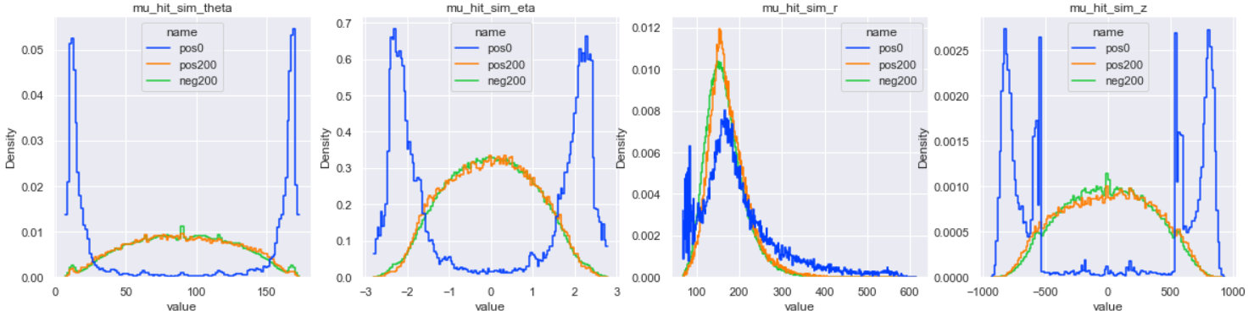
Distributions – easy/hard samples
The model may have learned to select hits with high/low theta/eta/z!

Slide 8
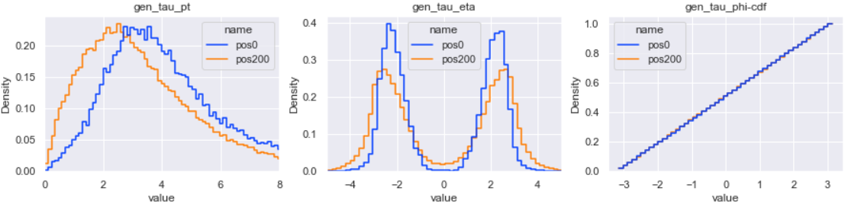
Distributions – pu200 & pu0 – n_mu_hit > 3

Slide 9
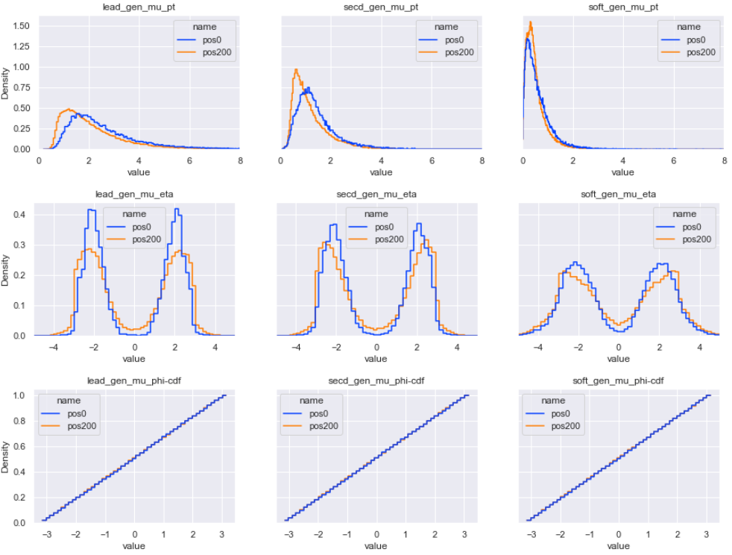
Distributions – pu200 & pu0 – n_mu_hit > 3

Slide 10
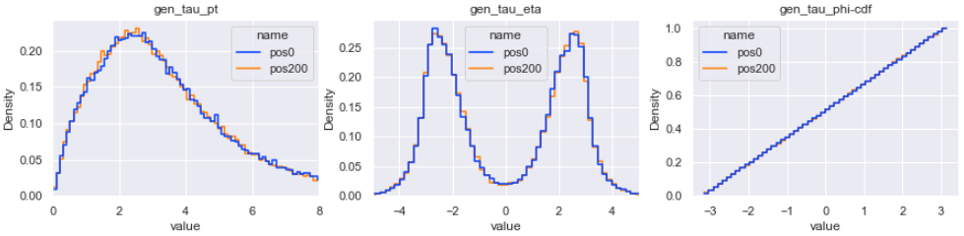
Distributions – pu200 & pu0 – no cut

Slide 11
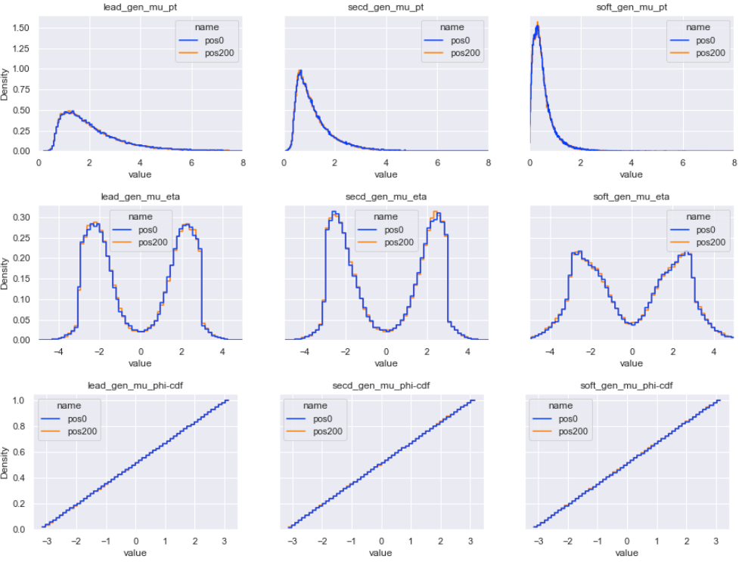
Distributions – pu200 & pu0 – no cut

Slide 12
Distributions – pu200 & pu0
If we set cut on n_mu_hit, pu200 & pu0 have significantly different distributions
When there is no cut, signal hits in pu200 & pu0 may share exact the same distribution

Slide 13
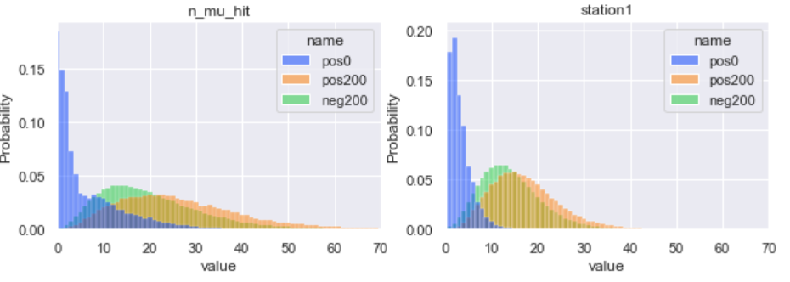
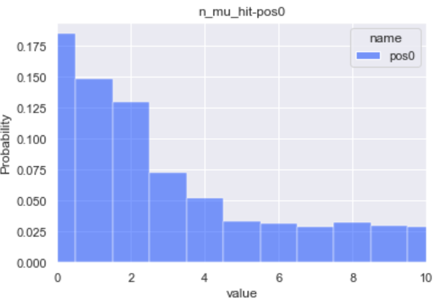
Distributions – pu200 & pu0 – n_mu_hit – no cut
If signal hits in pu0 & pu200 do share the same distribution:
Pu200 may be noisy!
It’s very likely that 17.5% samples in pu200 have no signal hits!
A perfect model may only achieve 82% recall with a low FPR
Coincidentally, our current best model happens to have 81% recall with 0.1% FPR

Slide 14
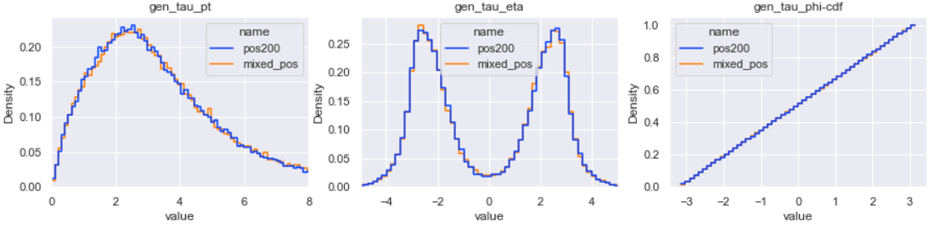
Distributions – pu200 & mixed samples – no cut

Slide 15
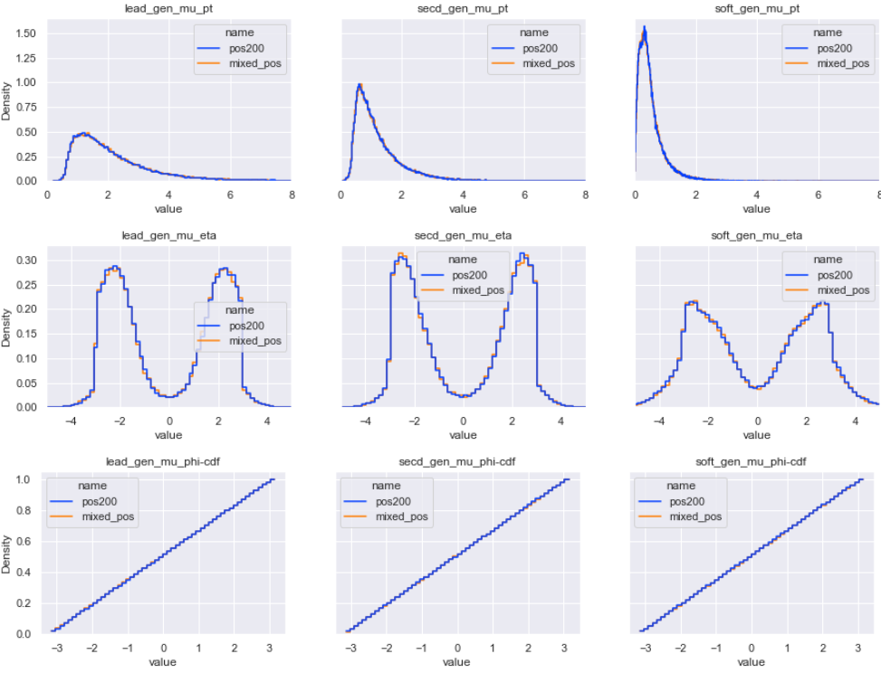
Distributions – pu200 & mixed samples – no cut

Slide 16
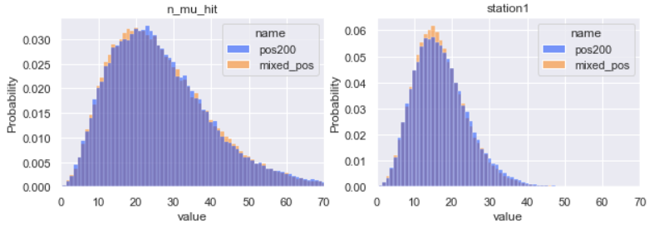
Distributions – pu200 & mixed samples – no cut

Slide 17
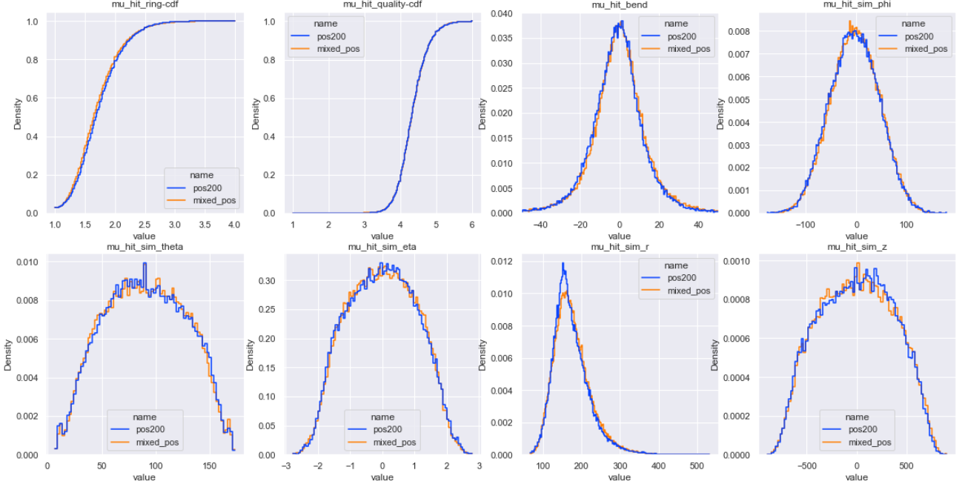
Distributions – pu200 & mixed samples – no cut

Slide 18
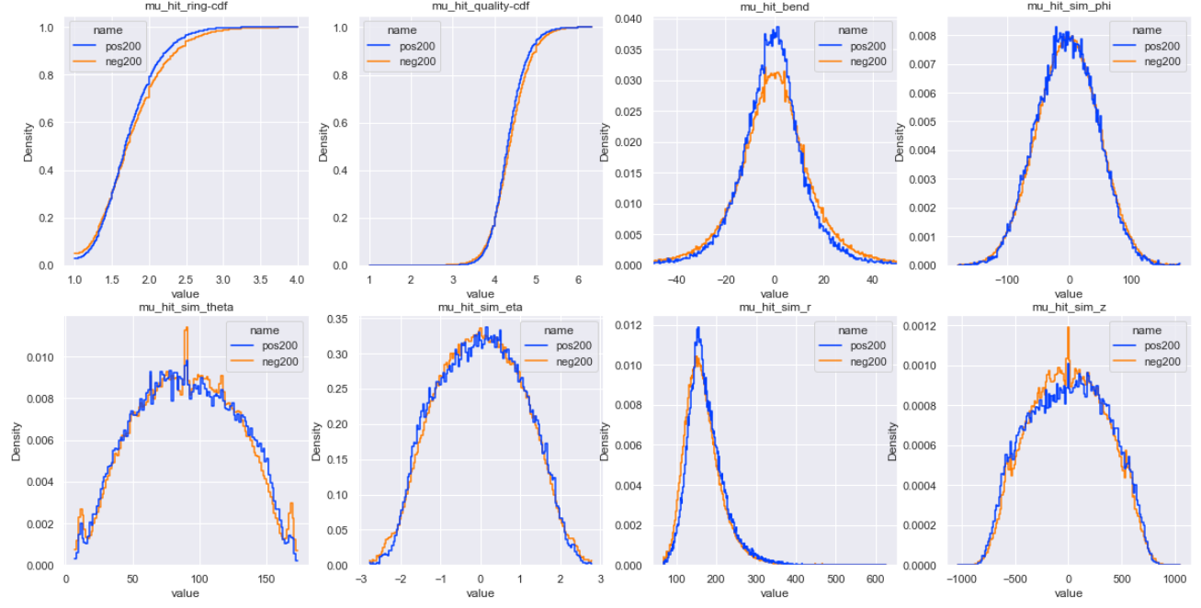
Distributions – pu200 & neg200 – no cut

Slide 19
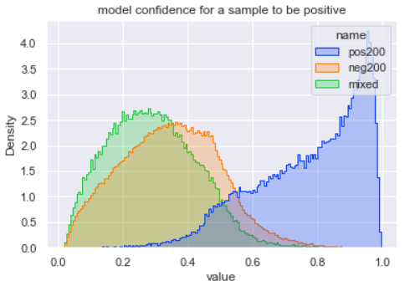
Distributions – pu200 & mixed samples
Pu200 & mixed samples may share very similar distribution
Yet the model can’t perform well when trained on mixed samples!
Mixed samples as positive data, minbias_pu200 as negative data
0.60 AUC
When set kinematic thresholds, can reach ~0.70 AUC
We cannot tell any significant difference between mixed samples and pu200, can a GNN tell?
Tau_pu200 as positive data, mixed samples as negative data
0.940 AUC
There is unobserved significant difference between mixed samples and pu200, and GNNs can tell!

