Slide 1
Tau3MuGNNs
Siqi Miao
June 7, 2021

Slide 2
Content
Model Architecture
Experiments
Distributions

Slide 3
Model Architecture
Station 1
Hits
Node Feature V x 8
Affine
Node Feature V x 128
Skip connection
Virtual Node
GNN Conv1
MLP_1
GNN Conv2
MLP_2
Edge Feature E x 5
Affine
Edge Feature E x 128
LSTM
H: 128
LSTM
H: 128
MLP in
V x 128
Affine
V x 256
BatchNorm
Activation
Dropout
Affine
V x 128
BatchNorm
Activation
Dropout
MLP out
V x 128
16 conv layers -> 1.2m params:
# params in MLP = 16 x (128 x 256 + 256 x 128) = 1m
# params in LSTM = 4 x (2 x 128^2 + 128) = 131k

Slide 4
Model Architecture
Station 1
Hits
Node Feature V x 8
Affine
Node Feature V x 128
Skip connection
Virtual Node
GNN Conv1
MLP (shared)
GNN Conv2
MLP (shared)
Edge Feature E x 5
Affine
Edge Feature E x 128
GRU
H: 128
GRU
H: 128
MLP in
V x 128
Affine
V x 256
InstanceNorm
Activation
Dropout
Affine
V x 256
InstanceNorm
Activation
Dropout
MLP out
V x 128
16 conv layers -> 170k params:
# params in MLP = 128 x 256 + 256 x 128 = 66k
# params in GRU = 3 x (2 x 128^2 + 320) = 100k
AUC_ROC: 0.985 -> 0.968
Recall@0.1%FPR: 0.811 -> 0.579

Slide 5
Experiments – Tau_pu0 & MinBias_pu250
Model trained on Tau_pu200 & MinBias_pu200
w/o attention, can generalize well on both pu0 (~0.88 auc) and pu250 (~0.98 auc)
w/ attention, can generalize well on pu250, but poor on pu0

Slide 6
Experiments – filter soft mu
Most of data will be filtered
Pu200: 77k -> 14k
Pu0: 77k -> 14k
The model overfits the data easily, even with dropout_p = 0.5
0.90 AUC_ROC

Slide 7
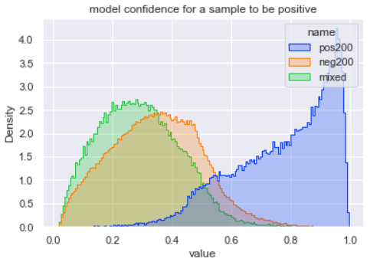
Distributions – pu200 & mixed samples
Pu200 & mixed samples may share very similar distribution
Yet the model can’t perform well when trained on mixed samples!
Mixed samples as positive data, minbias_pu200 as negative data
0.60 AUC
When set kinematic thresholds, can reach ~0.70 AUC
We cannot tell any significant difference between mixed samples and pu200, can a GNN tell?
Tau_pu200 as positive data, mixed samples as negative data
0.940 AUC
There is unobserved significant difference between mixed samples and pu200, and GNNs can tell!
In case I make mistakes, I extract important code in check.py
Function mix is used to mix Tau_pu0 and Minbias_pu200
docker pull siqim/mlg

