Slide 1
Tau3MuGNNs
Siqi Miao
Sep 10, 2021

Slide 2
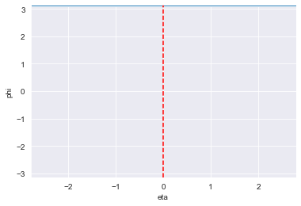
Simple Tree Models Can Work
Insights
If eta/phi is enough, the model could be simplified
We can construct input features with eta/phi info that can be used by traditional classifiers like decision trees, LR, SVM, etc.
Example
Input features
# hits in (-3 < eta < -2) & (3< phi < 2)
# hits in (-3 < eta < -2) & (2< phi < 1)
…

Slide 3
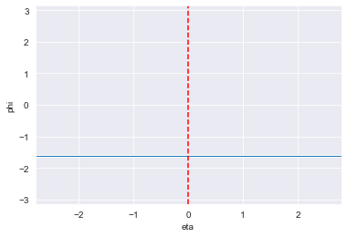
Simple Tree Models Can Work – only phi
Performance on test set
Decision Tree
AUROC: 0.85
Trigger AC Rate: 75.4@1553kHz
Random Forest
AUROC: 0.88
Trigger AC Rate: 76.8@16kHz
Xgboost
AUROC: 0.99
Trigger AC Rate: 80@30kHz
Logistic Regression
Random Guessing
Equal-frequency binning
100 bins in phi
Input features
# hits
…
# hits
GNN with all features
AUROC: 0.99
Trigger Rate: 95@30kHz

Slide 4
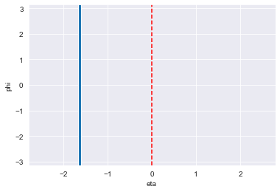
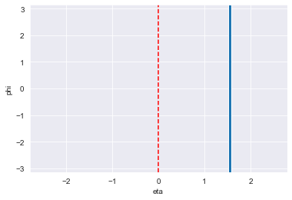
Simple Tree Models Can Work – only eta
Performance on test set
Decision Tree
AUROC: 0.83
Trigger AC Rate: 72.4@1845kHz
Random Forest
AUROC: 0.86
Trigger AC Rate: 71.1@16kHz
Xgboost
AUROC: 0.99
Trigger AC Rate: 78@30kHz
Logistic Regression
Random Guessing
Equal-frequency binning
100 bins in eta
Input features
# hits
…
# hits
GNN with all features
AUROC: 0.99
Trigger Rate: 95@30kHz

Slide 5
Simple Tree Models Can Work – eta & phi
No performance increase
Eta only or phi only can already provide enough info

Slide 6
Simple Tree Models Can Work – extracted rules
Rules can be extracted from Decision Trees
Many branches are too deep (20-50 levels)
These rules could be too complex to show
Example of rules from some shallow branches
Rule 1
# hits = 0 in -1.58 < phi < -1.52 &
# hits > 1 in -2.48 < phi < -2.40 &
# hits > 3 in -1.89 < phi < -1.83 &
# hits > 0 in -2.02 < phi < -1.96
184 out of 188 samples (98%) are signal samples
Rule 2
# hits > 0 in -1.58 < phi < -1.52 &
# hits = 0 in 0.68 < phi < 0.76 &
# hits > 2 in -0.65 < phi < -0.59 &
# hits > 1 in -1.77 < phi < -1.71
162 out of 167 samples (97%) are signal samples
…
There might be some eta/phi symmetry that is highly correlated with the signal

