Slide 1
Tau3MuGNNs
Siqi Miao
May 13, 2021

Slide 2
Content
Model Architecture
Dataset
Experiments

Slide 3
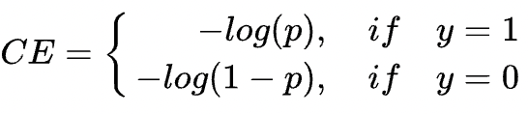
Model Architecture – old
1. Intra-level Aggregation
3. Information Update
Intra-level attention
Intra-level attention
Intra-level attention
Intra-level attention
LSTM
…
T0
Tn
4. Balanced data with cross-entropy loss
2. Inter-level Aggregation
Station 1
Hits
Station 2
Virtual Node
Station 3
Intra-level Edges
Inter-level attention
Inter-level attention
Inter-level attention
Inter-level Edges
Station 4
Global Edges

Slide 4
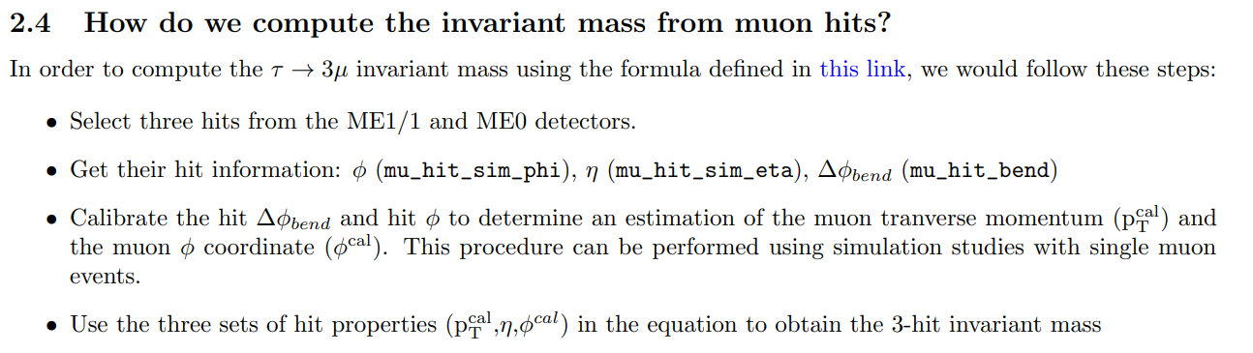
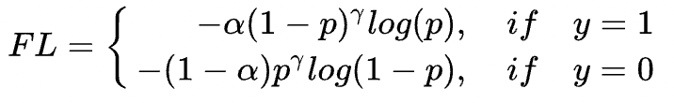
Model Architecture – new
1. Aggregation with edge-level attention
Edge att.
3. Information Update
LSTM
…
T0
Tn
2. Pooling with node-level attention
4. Imbalanced data with focal loss
Node att.
3. Aggregation with edge-level attention
Edge att.
Station 1
Hits
Virtual Node

Slide 5
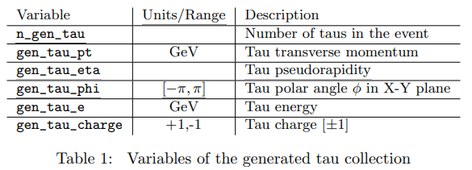
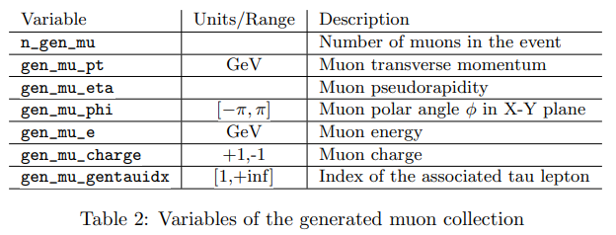
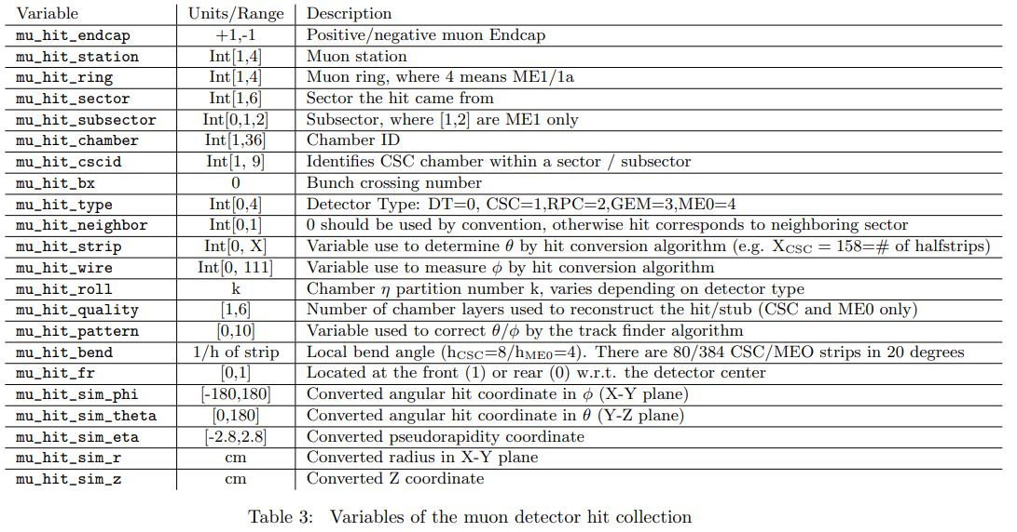
Dataset – overview
DsTau3muPU0
Only Tau3mu event
All features
100k
DsTau3muPU200
Tau3mu event + background events
All features
100k
MinBiasPU200
Only Background events
Only hit features
500k

Slide 6
Dataset – features used
Node Features
ring
quality
bend
sim_phi
sim_theta
sim_eta
sim_r
sim_z
Edge Features
∆ sim_phi
∆ sim_theta
∆ sim_eta
∆ sim_r
∆ sim_z

Slide 7
Dataset – splits
DsTau3muPU0
Only Tau3mu
All features
100k
DsTau3muPU200
Tau3mu + background
All features
100k
MinBiasPU200
Only Background
Only hit features
500k
Train w/o noise
tau = 1 & station = 1 & hits >= 3
# Pos = Tau3muPU0 (33k)
# Neg = MinBiasPU200 (495k)
Train/valid/test
# Pos : # Neg = 0.16
Train w/ noise
tau = 1 & station = 1 & hits >= 3
# Pos = Tau3muPU200 (78k)
# Neg = MinBiasPU200 (495k)
Train/valid/test
# Pos : # Neg = 0.16
 | Train 169k | Valid 36k | Test 323k
# Pos | 23k (70%) | 5k (15%) | 5k (15%)
# Neg | 146k | 31k | 318k
 | Train 394k | Valid 85k | Test 94k
# Pos | 54k (70%) | 12k (15%) | 12k (15%)
# Neg | 340k | 73k | 82k

Slide 8
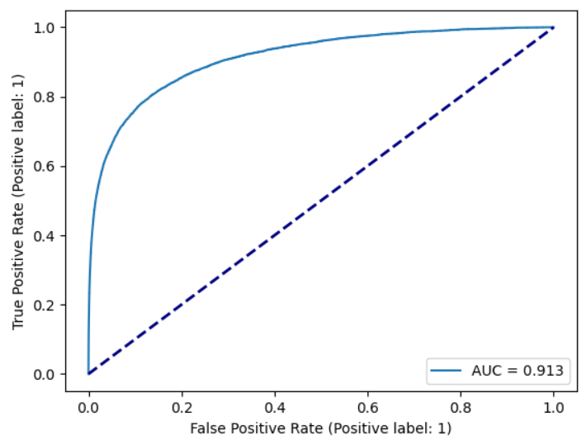
Experiments – metrics
ROC curve of the test set
True Positive Rate (recall)
0.8 recall means 80% tau3mu events can be detected by the model
False Positive Rate (FPR)
0.2 FPR means 20% background events will be predicted as tau3mu events
Generally, we want high recall and low FPR
The tradeoff between the two metrics can be shown in the ROC curve

Slide 9
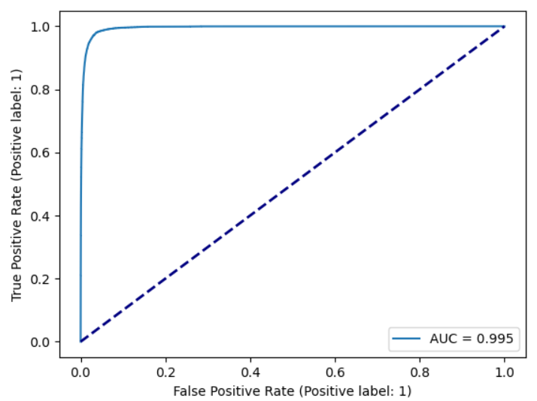
Experiments – train w/o noise
If the exact hit info of the tau3mu event is given, can GNNs solve the problem?
Simpler, no complex combinatorial optimization included
What is the model performance in this case?
AUC: 0.994
Recall: 44.3%, FPR: 0.1%
Upper bound (overall) performance for the model trained w/ noise

Slide 10
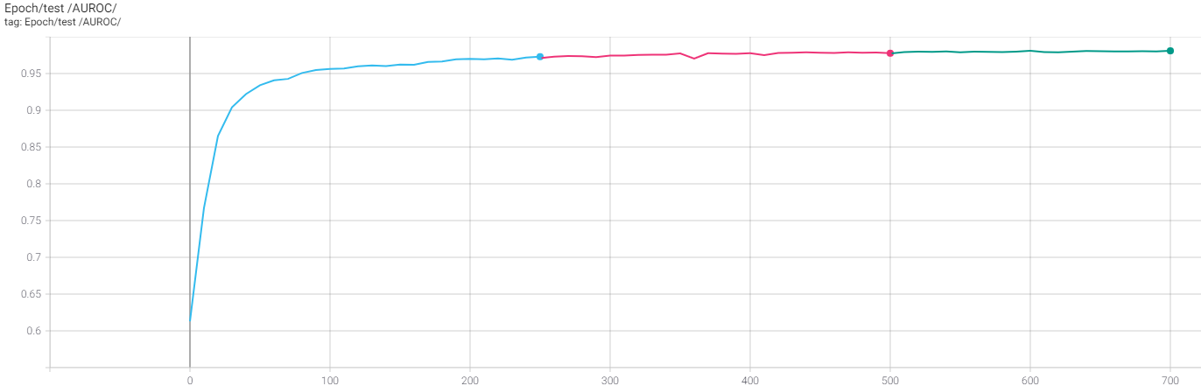
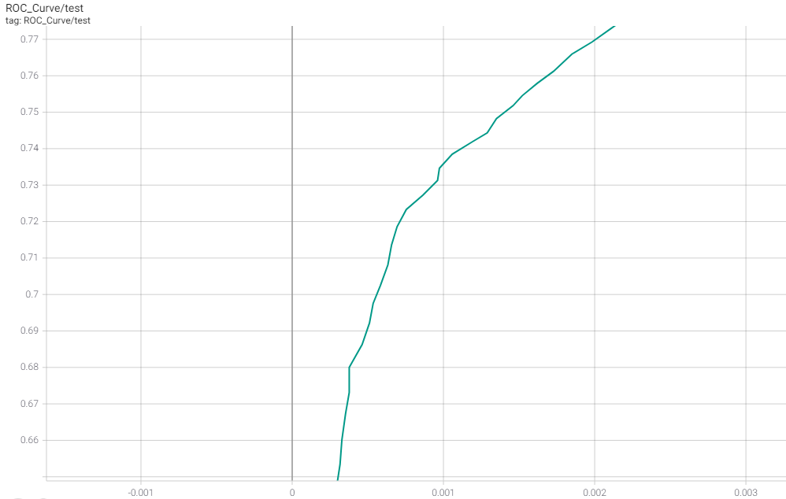
Experiments – train w/ noise
Recall: 73%, FPR: 0.1% on the test set
AUC: 0.981
Trained for 700 epoch
Best performance at ~600th epoch

Slide 11
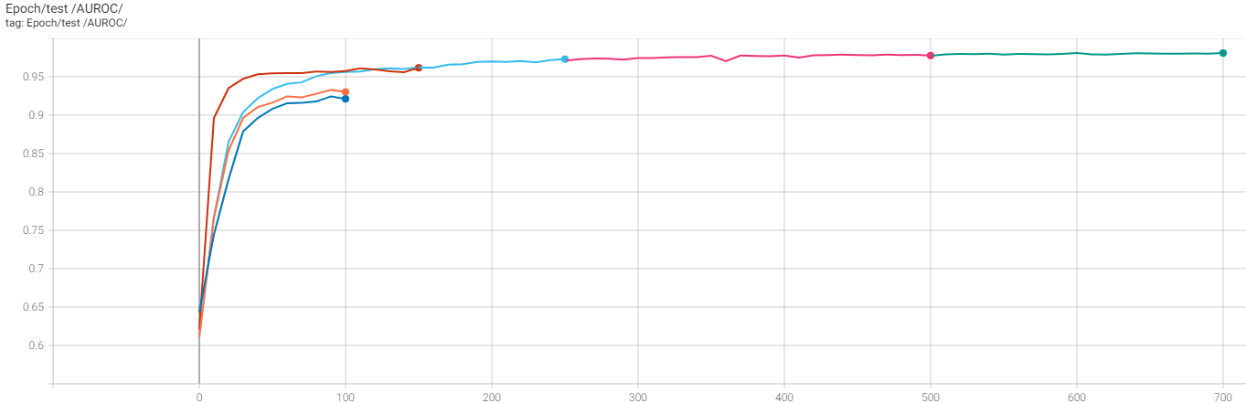
Experiments – train w/ noise
All stations:
Station 1:
Station 1 + Focal Loss + Imbalanced data:
Station 1 + Focal Loss + Imbalanced data + Dropout:

Slide 12
Experiments – train w/ mixed samples
The distribution of the mixed samples may be different from the ground truth
Use a trained model to infer mixed samples = random guessing
Train a model from scratch with mixed samples = random guessing
The idea of node-level attention supervision may still be beneficial
Speed up training process
Reduce # params
Help to interpret models

Slide 13
Experiments – others
Train on PU0, evaluate on PU200 = random guessing
Train on PU200, evaluate on PU0 = random guessing
Train on both PU0 & PU200, evaluate on PU200 = performance downgrade
Train on PU200 with unsupervised node-level attention = similar performance

Slide 14
Experiments – computational costs
One Tesla V100
16 conv layers, 1.7m parameters
55 GPU hrs for training 700 epochs

Slide 15
Experiments – future work
Get more data with ground truth labels for muon hits
Mine hard examples
Try adding info from station 2
Compare distributions between mixed samples and PU200
Try interpreting the model via (unsupervised) node-level attention
Reduce model size

