Slide 1
Tau3MuGNNs
Siqi Miao
June 28, 2021

Slide 2
Content
Interpretability
Regression

Slide 3
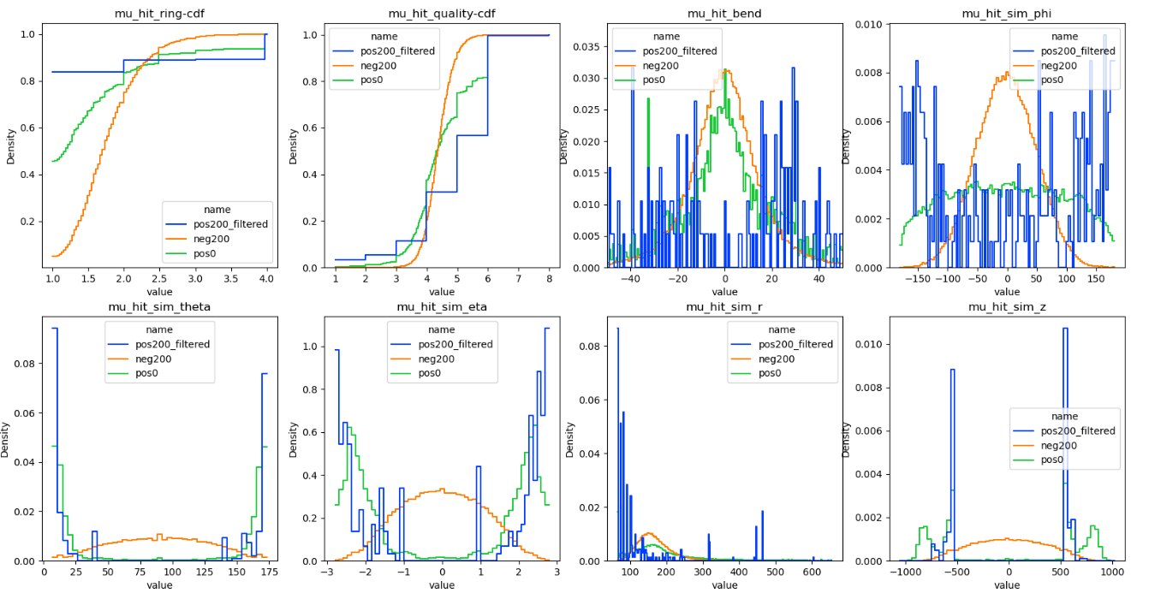
Interpretability
We don’t have a good way to interpret selected hits
Plot event-averaged distributions don’t make sense
Select one hit

Slide 4
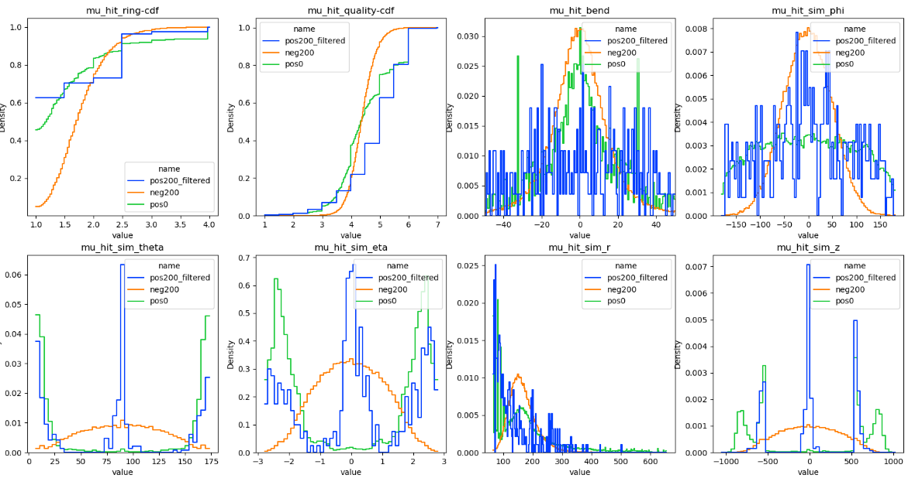
Interpretability
We don’t have a good way to interpret selected hits
Plot event-averaged distributions don’t make sense
Select two hits

Slide 5
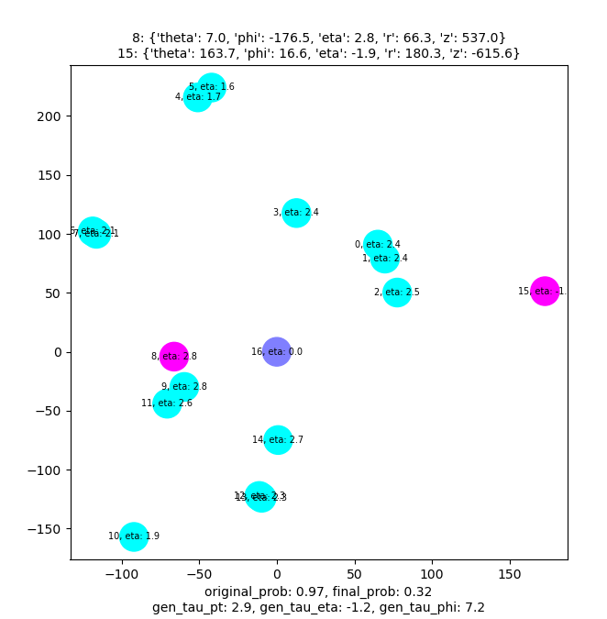
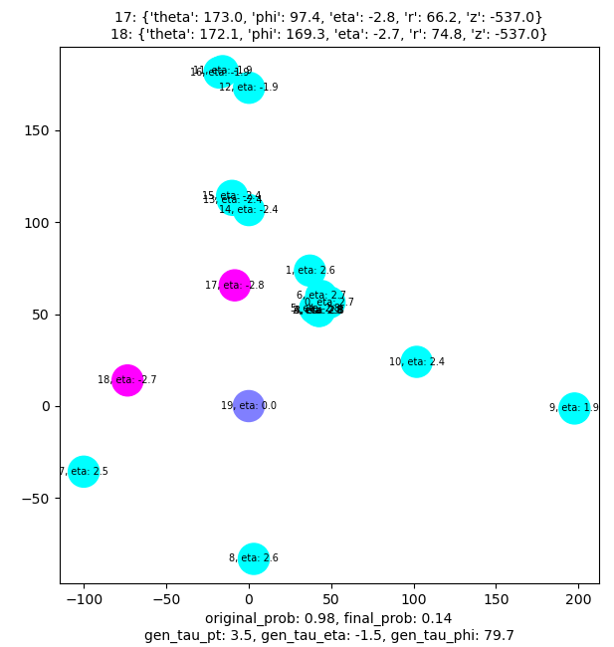
Interpretability -- Exhaustively search
Exhaustively search two/three hits to mask and find the ones that flip the predication the most

Slide 6
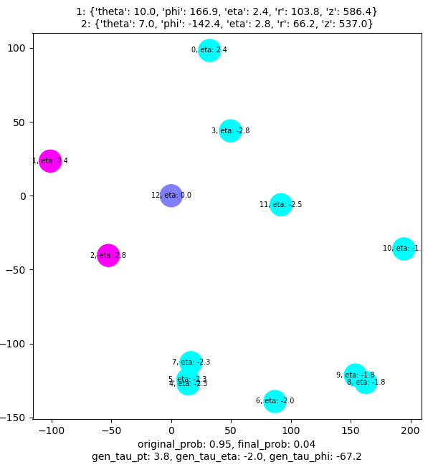
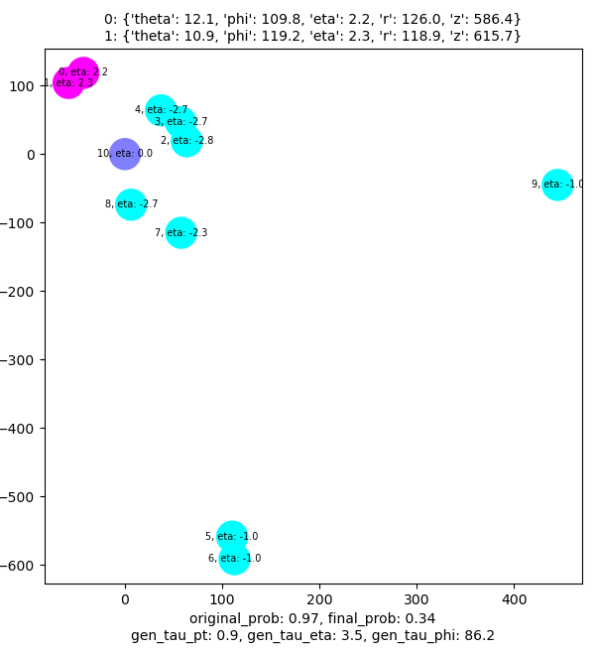
Interpretability -- Exhaustively search
Exhaustively search two/three hits to mask and find the ones that flip the predication the most

Slide 7
Interpretability -- Exhaustively search
Coordinates are computed via phi and r
Cannot flip negative results to be positive via masking nodes!

Slide 8
Interpretability -- BP
Flip predictions via BP
Cannot control the number of masked nodes easily
Randomly initialize a node mask that contains unnormalized scores for all nodes
Use Gubel-softmax trick to obtain hard scores
Mask an edge if any of the two end nodes has been masked
BP to flip prediction results (BCE loss)
Try maximize MI

Slide 9
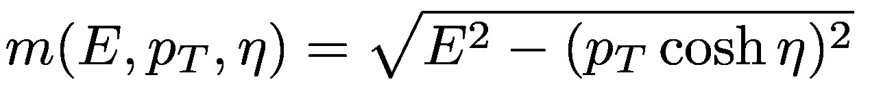
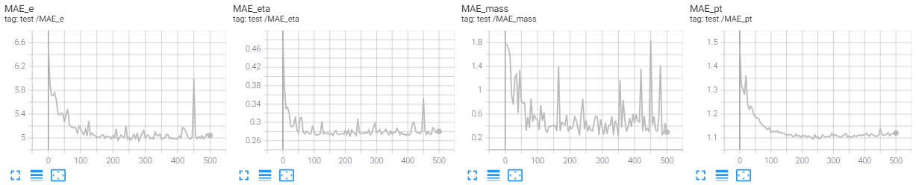
Regression
Train on SingalPU0
Only use hits from station 1 and require having >= 3 hits
Regress tau pt, eta and energy
Compute tau invariant mass by
Train them jointly with huber loss (targets are normalized to 0 mean 1 std)

