Slide 1
Tau3MuGNNs
Siqi Miao
April 29, 2021

Slide 2
Content
Model Architecture
Dataset
Experiments

Slide 3
Model Architecture – overview
1. Intra-level Aggregation
3. Information Update
Intra-level attention
Intra-level attention
Intra-level attention
Intra-level attention
LSTM
…
T0
Tn
2. Inter-level Aggregation
Station 1
Hits
Station 2
Virtual Node
Station 3
Intra-level Edges
Inter-level Edges
Station 4
Global Edges
Inter-level attention
Inter-level attention
Inter-level attention

Slide 4
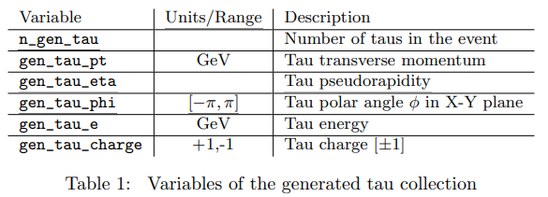
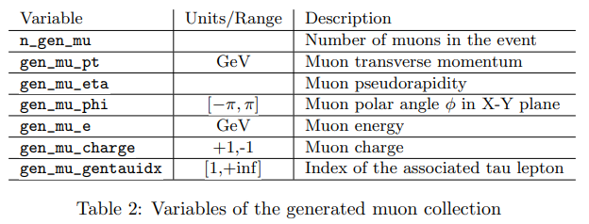
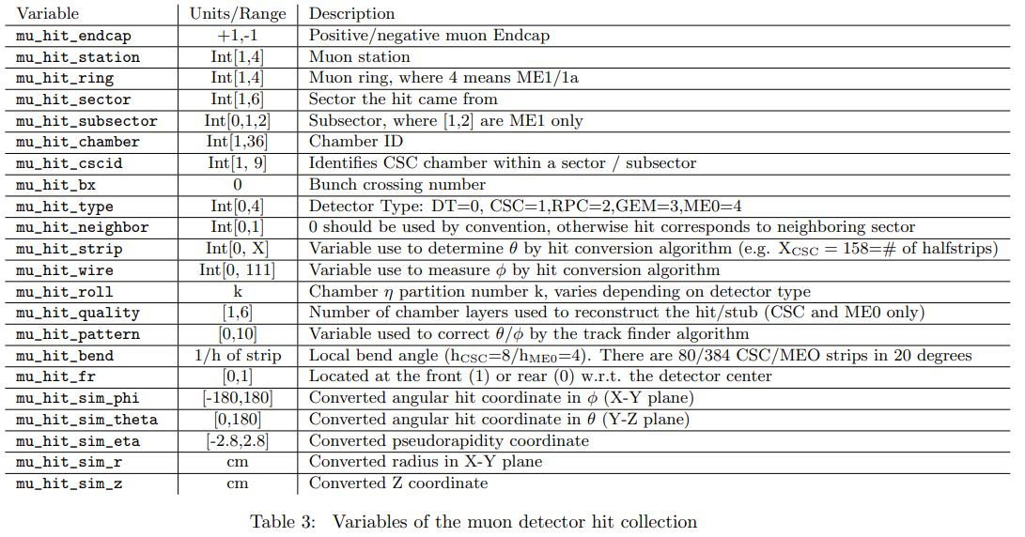
Dataset – overview
DsTau3muPU0
Only Tau3mu event
All features
100k
DsTau3muPU200
Tau3mu event + background events
All features
100k
MinBiasPU200
Only Background events
Only hit features
500k

Slide 5
Dataset – features used
Node Features
station
bend
sim_phi
sim_theta
sim_eta
sim_r
sim_z
Edge Features
∆ sim_phi
∆ sim_theta
∆ sim_eta
∆ sim_r
∆ sim_z

Slide 6
Dataset – splits
DsTau3muPU0
Only Tau3mu
All features
100k
DsTau3muPU200
Tau3mu + background
All features
100k
MinBiasPU200
Only Background
Only hit features
500k
Train w/o noise
mu_hit >= 3 & n_tau = 1
# Pos = Tau3muPU0 (41k)
# Neg = MinBiasPU200 (496k)
Train/valid/test
Train w/ noise
mu_hit >= 3 & n_tau = 1
# Pos = Tau3muPU200 (78k)
# Neg = MinBiasPU200 (496k)
Train/valid/test
 | Train 58k | Valid 12k | Test 467k
# Pos | 29k (70%) | 6k (15%) | 6k (15%)
# Neg | 29k | 6k | 461k
 | Train 108k | Valid 24k | Test 442k
# Pos | 54k (70%) | 12k (15%) | 12k (15%)
# Neg | 54k | 12k | 430k

Slide 7
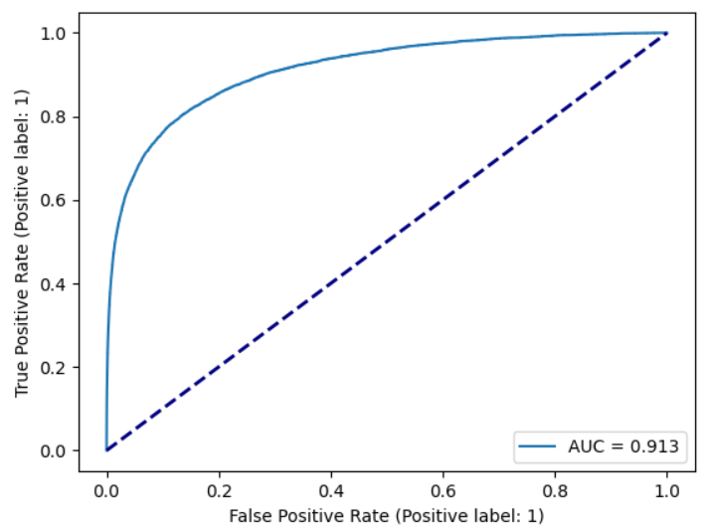
Experiments – metrics
ROC curve of the test set
True Positive Rate (recall)
0.8 recall means 80% tau3mu events can be detected by the model
False Positive Rate (FPR)
0.2 FPR means 20% background events will be predicted as tau3mu events
Generally, we want high recall and low FPR
The tradeoff between the two metrics can be shown in the ROC curve

Slide 8
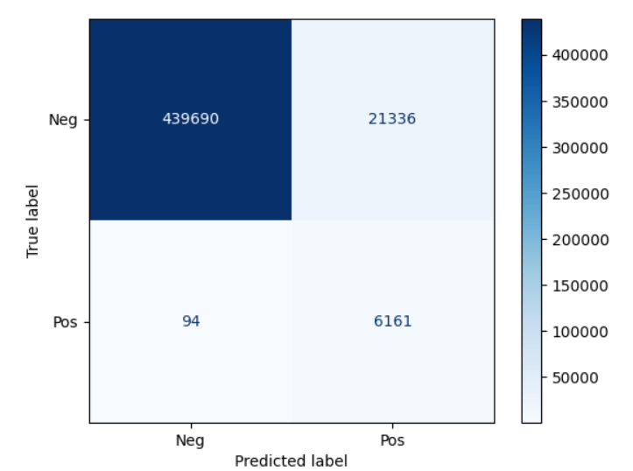
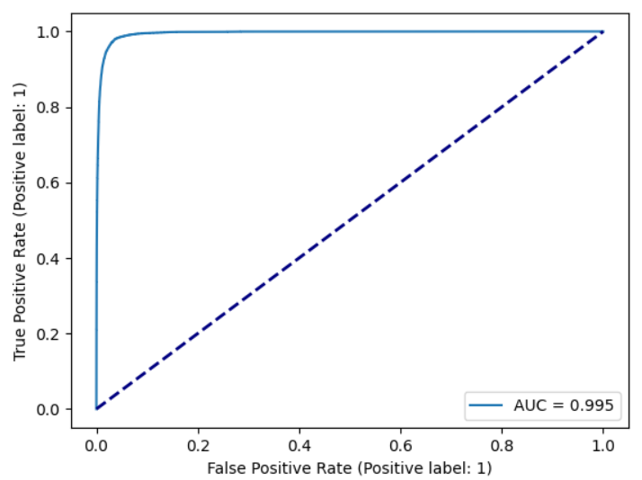
Experiments – train w/o noise
If the exact hit info of the tau3mu event is given, can GNNs solve the problem?
Simpler, no complex combinatorial optimization included
What is the model performance in this case?
Recall: 98%, FPR: 5%
Upper bound performance of the model trained w/ noise
Will different distributions of n_mu_hits produce biased results?
Do not use n_mu_hit as a feature
Do not use summation as a aggregation function in GNNs

Slide 9
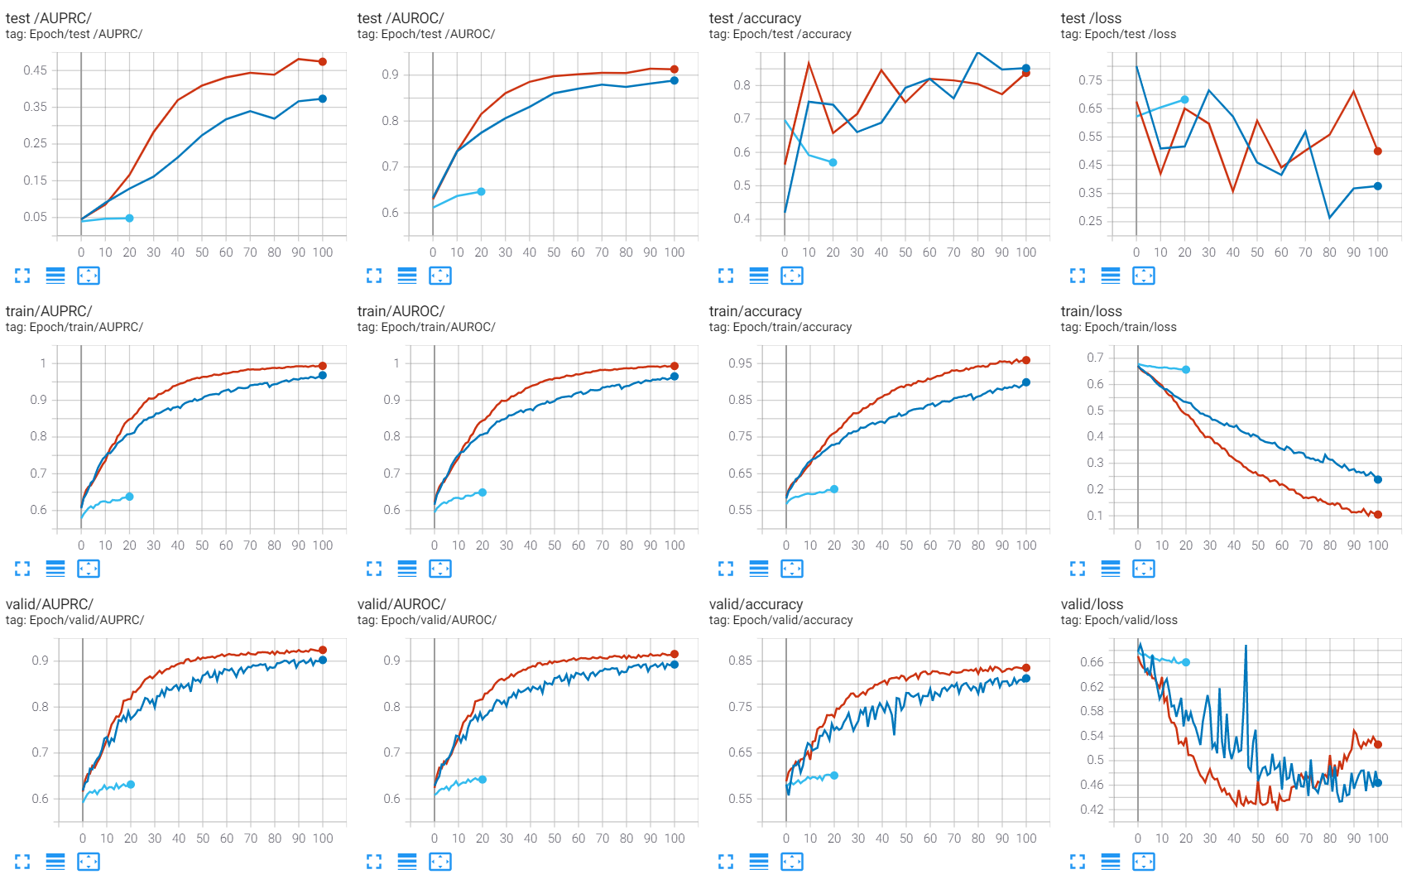
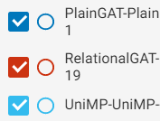
Experiments – train w/ noise
GAT
Relational GAT
UniMP

Slide 10
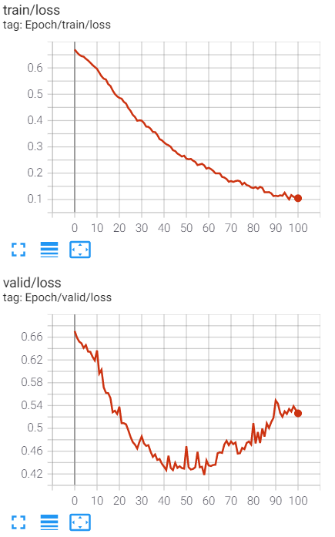
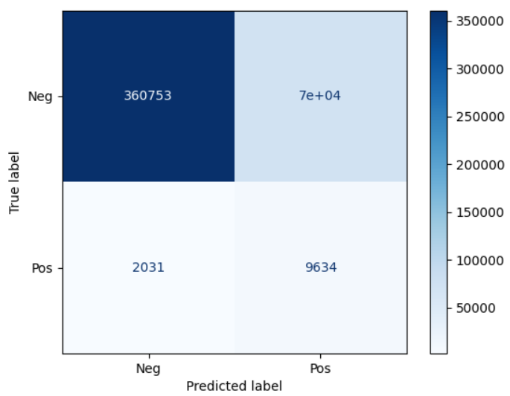
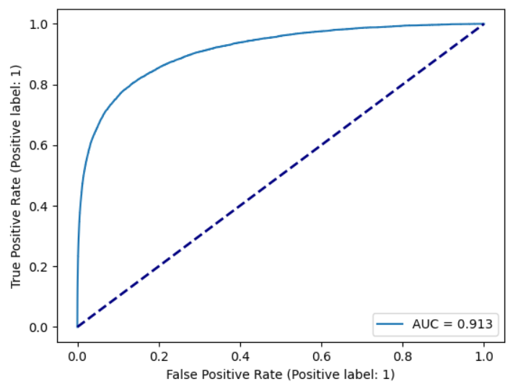
Experiments – train w/ noise
Recall: 82.6%, FPR: 16.3% on the test set
Trained 100 epoch
Overfitted training data after ~40th epoch

Slide 11
Experiments – computational costs
RTX 2080 TI
16 conv layers, 1.7m parameters
1 min 40 sec per epoch, 3 hrs to train 100 epochs

Slide 12
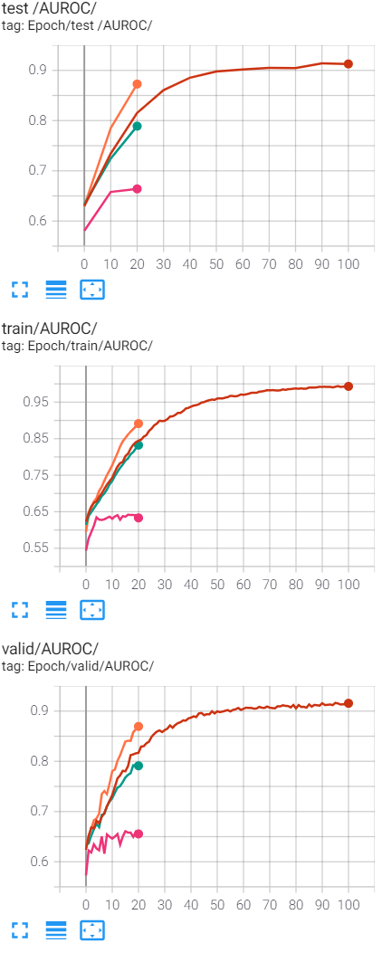
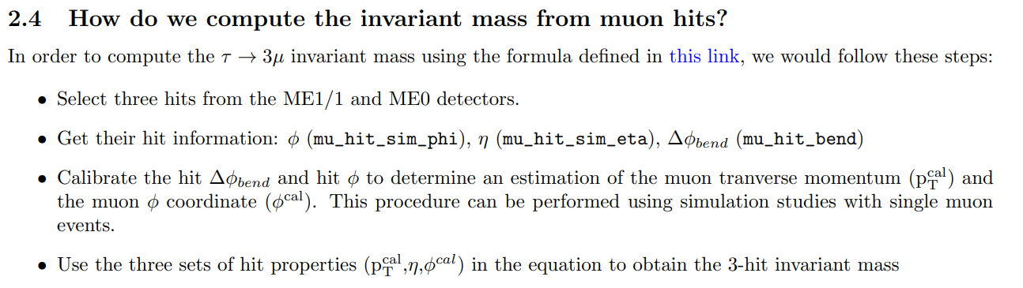
Experiments – potential improvements
Current best model
Only use hits from the CSC detector
No virtual node
Only use hits from station 1 and use mu_hit_ring as a feature

