Slide 1
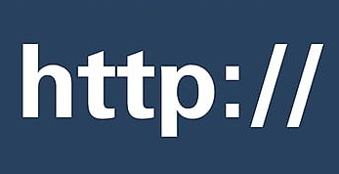
Introduction to web applications and http protocol

Slide 2
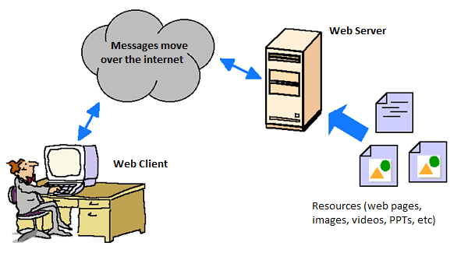
Requesting a page - Overview
A web client (usually in the form of a web browser) makes an HTTP request to a specific web server.
The web server receives the request and sends back the requested document (usually – though not always) in the form of an HTML page.
The web client examines the returned object.
  If the resource is an HTML file, the client parses the file and renders (displays) it on the screen.
  If the resource is a file that the browser “understands” (jpeg images, gif images, mp4 videos, etc), the client will play/display the resource.
  If the resource is a type of file that the client is unable to display (e.g. a Powerpoint presentation), the client will offer you the opportunity of saving it to your computer, or to open it in its native application (e.g. Microsoft PowerPoint).

Slide 3

Requesting a page - Overview

Slide 4

The Protocol: HTTP
Stands for “hypertext transfer protocol”
  (You don’t need to memorize this!)
A protocol is a series of rules and standards that are agreed to by a committee or organization.
For the web, HTTP is the protocol used that enables effective communication between web clients and web servers.

Slide 5
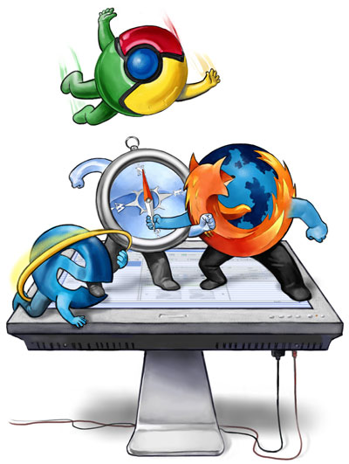
HTTP Client
(the web browser)
Also known as: Web Client or Web Browser
Software that is used to:
  generate HTTP requests
  send those requests to an HTTP server
  interpret the HTTP response that is provided by the server
From Wikipedia:
  An HTTP client uses HTTP to connect to a web server over the Internet to transfer documents or other data. The most well known types of HTTP Clients include web browsers.
By http client, we are almost always referring to a web browser
  Examples: Internet Explorer, Firefox, Safari, Chrome, etc

Slide 6
HTTP Server
This is software (a program). It is not a computer.
  However, you do need a computer to run the http server software!
  That being said, because the computer running the server software is typically dedictated exclusively to that task, we frequently call the computer the server, even though that is not technically correct.
  HTTP server software is entirely different software than HTTP client software.
The web server software:
  “listens” for incoming requests from HTTP clients
  “parses” (reads & interprets) that request
  sends out an http response
  Typically, this response includes sending a document or other resource back to the web client (aka ‘http client’)
Examples of http server software:
  Apache, Google Web Server, Internet Information Services

Slide 7
Overview: How to set up a web server
Have a computer to act as a ‘server’ with a big enough hard-drive to store all the pages you want to make available on the web.
Ensure your computer is connected to the internet
Install web server software (e.g. Apache web server)
  Configure the web server (takes a little bit of know-how)
Copy any documents and resources you wish to make available from your local computer to the web server.
  This requires ‘FTP’ (discussed later)

Slide 8
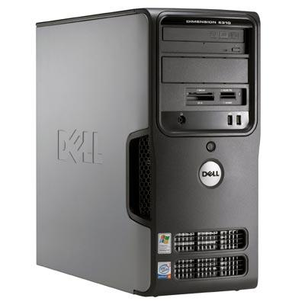
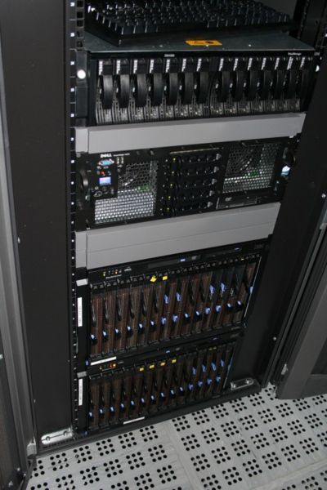
Server computer
Have a computer to act as a ‘server’ to send pages along when requested:
A server can be any computer capable of connecting to the internet and running server-software.
The busier the site, the more powerful the computer.
A server can be as simple as your desktop/laptop, or as complex as a rack of high-end dedicated computers.
Busy sites (e.g. Google, Microsoft) will have multiple redundant computers running server software all over the world.

Slide 9
The Server Software
Software that sits there and patiently listens for imcoming HTTP requests.
Once a request comes in, the server responds by sending back an HTTP response along with the requested resource.
  The resource might be a web page (html file), video, PDF, PowerPoint document, etc
Several software companies publish web server software
  Some of the better known server software programs include:
    Apache HTTP Server
    Microsoft IIS (Internet Information Services)
    Google’s GWS (Google Web Server)

Slide 10
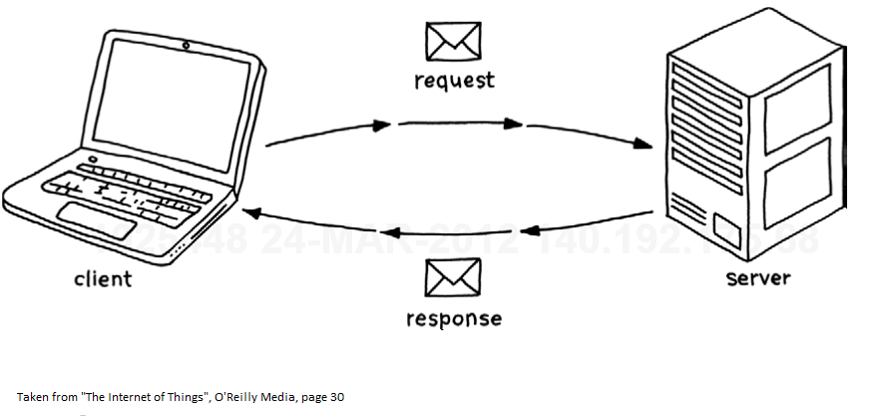
The Request/Response Process

Slide 11
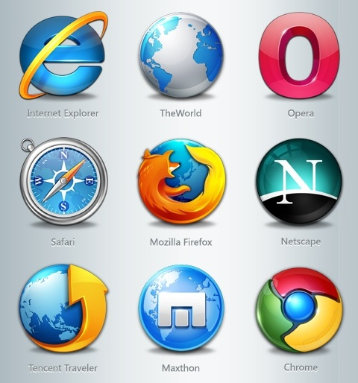
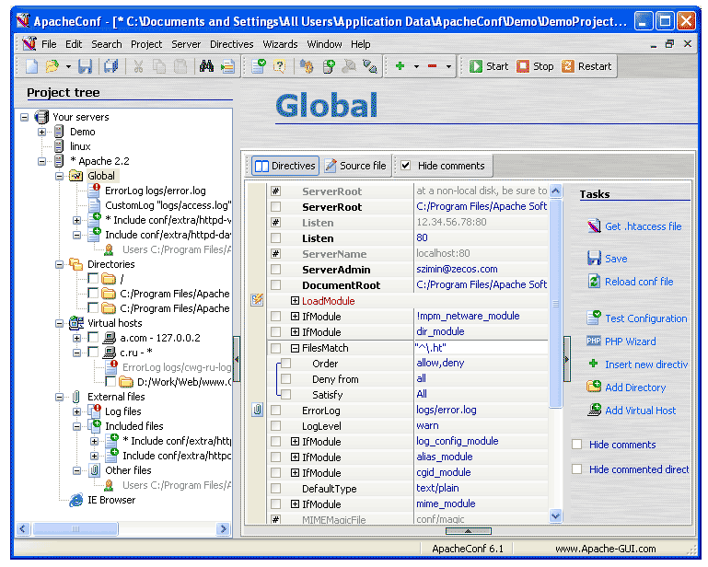
Client sends a request to the server.
Server sends a response back to the client.

Slide 12
The HTTP Request object
When you type a URL, say, for the syllabus of this course, your HTTP client (browser) creates something called an ‘HTTP request’
This request is routed (via a mechanism we will ignore for now) over the internet to an HTTP server that is connected to the internet
  For the class web page, this server lives somewhere in downtown Chicago
The HTTP request contains all kinds of information that the server may need to know:
  The name of the document being requested
  The time the request was made
  The “return address” (the internet address of the http client)
  The type/name of the http client (e.g. Pocket Safari for iPhone)
  etc

Slide 13
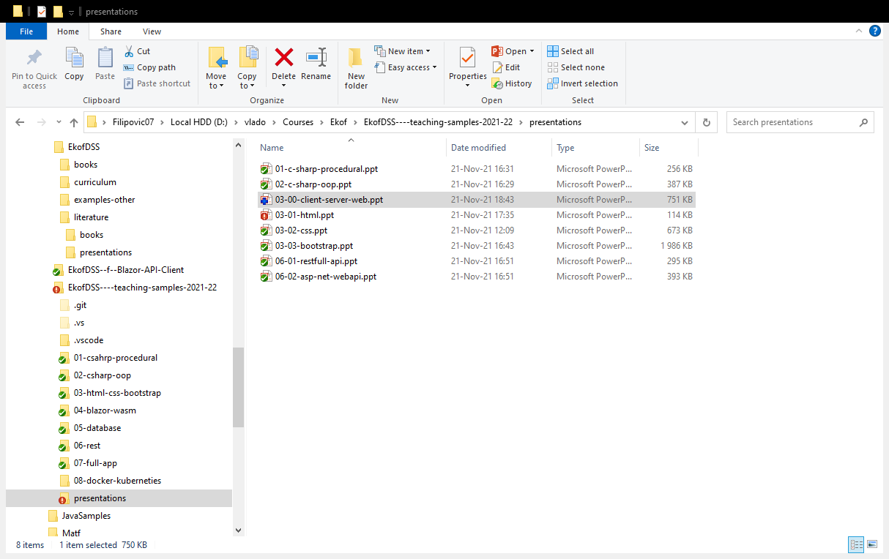
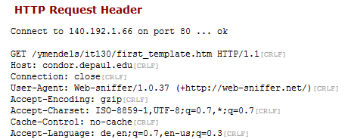
Example of an http request header:
I would like to retrieve the file first_template.htm
The URL to this file is:
  http://condor.depaul.edu/ymendels/130/first_template.htm
  The name of this web server is ‘condor.depaul.edu’
  The request file is ‘first_template.htm’
  The file is stored in a folder called ‘ymendels’ and a subfolder called ‘130’.
When I type the URL into my client, you can see part of the http request that is generated here:

Slide 14
The HTTP Response object
Once the server has received and parsed the http request, it answers by generating an http response. This response includes:
  a status line: e.g. ‘OK’ or ‘ERROR-404’
  a header with information such as the type of document being returned (JPG, MPG, HTML, etc)
  This is also packaged with the actual document that was requested. This document is commonly, but by no means always an ‘html’ document.
    It can be other things such as an image, a PPT file, etc

Slide 15
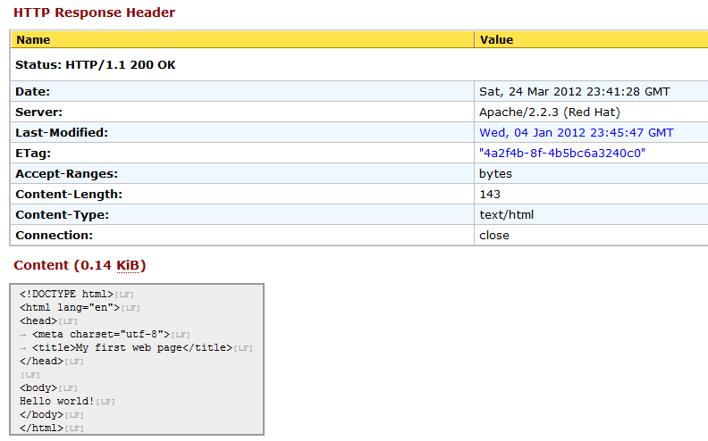
Example of an http request and response:
2. The HTTP Response
Here is what comes back:

Slide 16
404-Error
If the web server is unable to find the requested resource, it will generate a message with the error code 404 indicating that there was an error and that the request could not be fulfilled.
The error may say something like “HTTP 404” or “Error 404” or something similar.
A common way to encounter a 404 error is when there is a typo in the URL:
http://condor.depaul.edu/ymendels/130/intro_to_htttp.htm
(note the extra ‘t’)

Slide 17
Anatomy of a URL
http://www.math.rs/files/130/intro_to_html.ppt
The request finds its way to the math.rs domain
Within the domain, the request is navigated to a specific server named ‘www’
On the condor server, look for a folder called ‘files’
Within the folder files, look for a subfolder called ‘130’
Within that folder, look for a file called ‘intro_to_html.ppt’

Slide 18
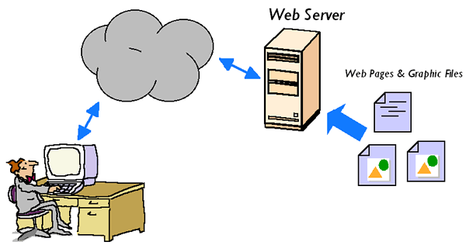
Thanks for your attention!
Slide <number>

