Slide 1

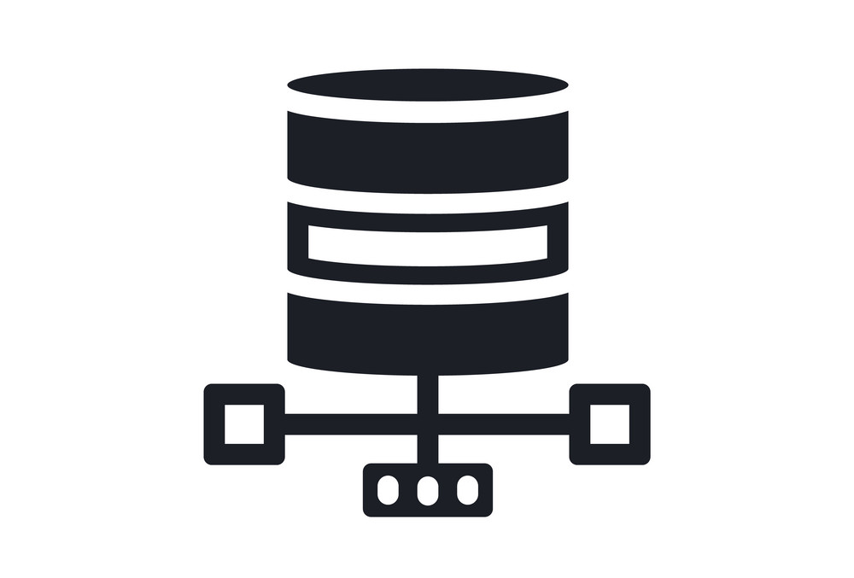
Introduction to database and relational model

Slide 2
General scheme of presentation
What is a database and what is a DBMS.
Different database models:
  Hierarchical
  Network
  Relational
  Object
The relational databases
  Fundamental concepts.
  Different activities
  Entity & relations models
- <number> -
Notes:
Presentation title

Slide 3
What is a database and what is a DBMS
A database can be viewed as
On or more files
A set of structured data
The database is managed by a DBMS. In most cases it‘s a server (exception: Ms-Access).
A DBMS can manage one or more databases.
It is possible to create links between databases.
- <number> -
Notes:
Presentation title

Slide 4
DBMS responsabilities
The responsabilities of a DBMS are:
To manage the data and the definitions of the data structures (meta data).
To manage the security.
To manage the data integrity.
To give access to client applications.
To manage isolation between transactions.
...
- <number> -
Notes:
Presentation title

Slide 5
Databases models
Different models exist :
Hierarchical : nodes of data (set of fields/value) with parent-child relations forming a hierachical tree : a child may have only one parent
Network : nodes of data with relations between any nodes : it forms a network : a child may have many parents. In hierachical and network databases to retrieve a node you have to navigate through relations.
Relational : tables of data. A table is a set of records having the same structure and the same meaning (entities of the same type). A record is composed of fields; each field has a value. A one to one or one to many relation is modelized as a data field.
Object/Relational Model : extension to the relational model to work with objects.
...
- <number> -
Notes:
Presentation title

Slide 6
Relational model
Values are atomic (we can‘t access only to a part of a value)‏
The sequence of rows is insignificant
In the different rows of the same table, the column values have the same type (the type is defined for the column)‏
The sequence of columns is insignificant
On each table you have to define a primary key (on a single column or on many). The primary key identifies the record. Values in primary key should be unique. Values in column participating to a primary key can‘t be null.
On each table you may define indexes (on a single column or on many). Searches with creteria related to indexes are more efficient.
- <number> -
Notes:
Presentation title

Slide 7
Relational data bases – fundamental concepts
Data stored in tables.
Tables formed of rows and columns.
Primary keys.
Surrogate.
Foreign keys.
Integrity constraints.

Slide 8
Database objects
Schemas : collection of tables, indexes and views
Tables : storage structure
Views : stored select SQL
Indexes : definition of indexation
- <number> -
Notes:
Presentation title

Slide 9
Primary key, surrogate key
A primary key is the field that will identify each record in a table.
A surrogate key is an artificial column added to a relation to serve as a primary key:
  Often supplied by the DBMS (usage of a sequence)
  Short, numeric and never changes – an ideal primary key!
  Has technical values that are meaningless to users
  Normally hidden in forms and reports

Slide 10
Surrogate key, foreign keys
  You will use a surrogate key either for optimization reasons (less data, quick access) or when you have no “natural” key.
  A foreign key in a table is an identifier of a record of another table (in the table X, the foreign key on the table Y contains values of the primary key of the table Y). In other words, a foreign key is the primary key of one relation that is placed in another relation to form a link between the relations

Slide 11
Referential integrity constraint
A referential integrity constraint is a statement that limits the values of the foreign key to those already existing as primary key values in the corresponding relation

Slide 12
Activities related to the usage of relational databases.
Design : data modeling, data definition (meta-data) with SQL or with a tool
Usage : data manipulation (SQL insert, update, delete) and retrieval (SQL select).
Administration : security management, performance management, data integrity.
Such activities are not always allocated to different people.
- <number> -
Notes:
Presentation title

Slide 13
Data modeling - Entity-relationship model
The entity & relationship model is a way to represent structures and links that can be stored in a relational database. It is a tool for conceptualisation; it is used mainly during the analysis stage.
An entity set is a group of entities having the same type (= a table). The definition of this type is part of the definition of the entity set.
An entity is a flat structure (set of fields) holding the characteristics of a concrete thing (for examples a person, a training session) or of an abstract thing (for examples a knowledge, an objective). (= a table row)‏
A relation defines the possibility to create links between two or more entities.
An entity-relationship model can be represented by textual expressions or by graphs.
To transform an entity-relationship model into a database model, entities are mapped to tables, relations are mapped as supplementary fields of entities tables or as separated tables.
- <number> -
Notes:
Presentation title

Slide 14
Entity-relation graphs
Main represented elements are:
Entities sets
Attributes
Relations between entity sets
Cardinality of such relations.
- <number> -
Notes:
Presentation title

Slide 15
Relations cardinality
Cardinality means “count,” and is expressed as a number.
Maximum cardinality is the maximum number of entity instances that can participate in a relationship.
Minimum cardinality is the minimum number of entity instances that must participate in a relationship.
There are three types of maximum cardinality:
  One-to-One [1:1]
  One-to-Many [1:N]
  Many-to-Many [N:M]

Slide 16
ONE-TO-ONE Relationship
Example: AUTOMOBILE and REGISTRATION
VIN_NUM | MAKE | MODEL | YEAR
REG_NUM | ADRESS | STATUS
May become
VIN_UM | MAKE | MODEL | YEAR | REG_NUM | ADDRESS | STATUS
or
VIN_NUM | MAKE | MODEL | YEAR | REG_NUM
REG_NUM | ADRESS | STATUS
or
MAKE | MODEL | YEAR | VIN_NUM
VIN_NUM | REG_NUM | ADRESS | STATUS

Slide 17
ONE-TO-MANY Relationship
Example: EMPLOYEE and DEPARTMENT (one department, many employees, one employee, only one department)
EMP_NUM | NAME | GRADE
DEP_NUM | NAME | ADRESS
becomes
EMP_NUM | NAME | GRADE | DEP_NUM
DEP_NUM | NAME | ADRESS

Slide 18

MANY-TO-MANY Relationship
Example: STUDENT and COURSE (many students in one course, many courses, per one student)
STUD_ID | NAME | YEAR
COURSE_ID | NAME | LEVEL
becomes
NAME | YEAR | STUD_ID
COURSE_ID | NAME | LEVEL
STUD_ID | COURSE_ID

Slide 19
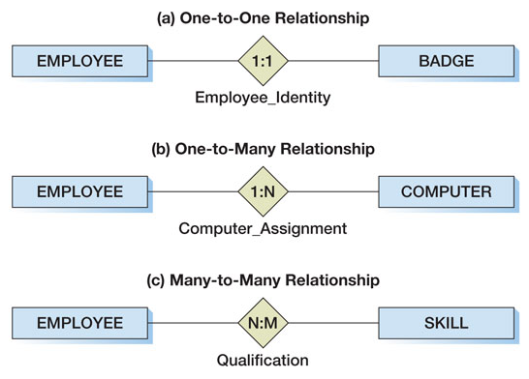
Relations – graphical representation of max cardinality

Slide 20
Relations – min cardinality
Minimums are generally stated as either zero or one:
  IF zero [0] THEN participation in the relationship by the entity is optional, and no entity instance must participate in the relationship.
  IF one [1] THEN participation in the relationship by the entity is mandatory, and at least one entity instance must participate in the relationship.

Slide 21
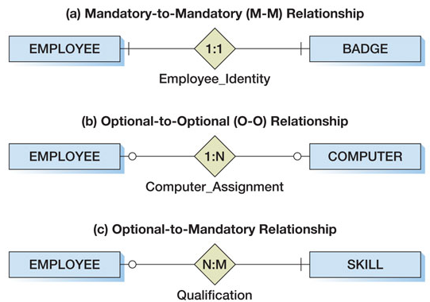
Relations – graphical representation of min cardinality

Slide 22
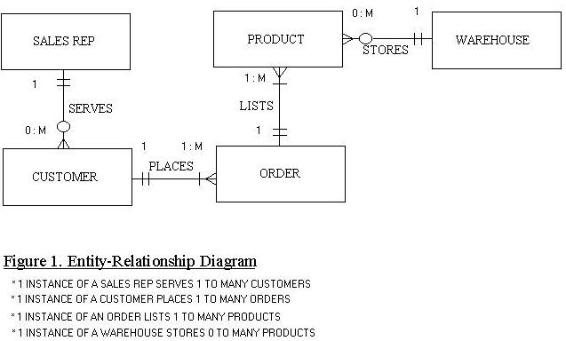
Data Modeling – Crow's Foot representation
- <number> -
Notes:
Presentation title

Slide 23
Data modeling - Logical vs Physical Model
The logical model is created as support of the design phase. Normally, the designer will work on the logical model to obtain a normalized form (the normalization process is explained here after).
The physical model directly represents what will be created (tables and relations) in the database.
The main difference are:
In the physical model all “many to many” relations are represented via an intermediary table.
In the logical model, foreign keys are not shown.
Physical considerations may cause the physical data model to be quite different from the logical data model (de-normalization).
- <number> -
Notes:
Presentation title

Slide 24
Example of a logical model
Person
House
name
age
sex
owns
cadastralNumber
street
number
city
country
number of rooms
- <number> -
Notes:
Presentation title

Slide 25
Example of a physical model
Person
PersonHouseRel
House
name
age
sex
personName
cadastralId
country
cadastralId
street
number
city
country
number of rooms
- <number> -
Notes:
Presentation title

Slide 26
Normalization forms
Normalization = respect of guide lines. Enforce the data consistence (no redundant data).
1 NF: each field has a single value, we can’t have a variable number of fields in two records of the same table.
2 NF: 1NF + a non-key field must give an information (a fact) related to the key, as the whole key, and nothing but the key.
3 NF: 2NF + a non-key field can not be an information related to another non-key field
4 NF: 3NF + a table should not contain two multi-valued facts about an entity.
…
- <number> -
Notes:
Presentation title

Slide 27
1NF
Each field has a single value, we can’t have a variable number of fields in two records of the same table.
Bad example:
PersonName
Age
Children
Gaston
65
Benoit,Françoise
André
47
Alice, Pascal, Eloïse
- <number> -
Notes:
Presentation title

Slide 28
1NF
Each field has a single value, we can’t have a variable number of fields in two records of the same table.
Bad example:
PersonName
Age
Child1
Child2
Child3
Child4
Child5
Gaston
65
Benoît
Françoise
Null
Null
Null
André
47
Alice
Pascal
Eloïse
Null
Null
- <number> -
Notes:
Presentation title

Slide 29
1NF
Each field has a single value, we can’t have a variable number of fields in two records of the same table.
A possible solution:
table2
table1
FatherName
Child
PersonName
age
Gaston
Benoît
Gaston
65
Gaston
Françoise
André
47
André
Alice
André
Pascal
André
Eloïse
- <number> -
Notes:
Presentation title

Slide 30
2NF
2 NF: A non-key field must give an information (a fact) related to the key, as the whole key, and nothing but the key.
Bad example:
Headquarters
Company
Country
NbEmpl
Currency
CW
BE
450
Euro
CW
GB
50
GBP
CW
LU
60
Euro
- <number> -
Notes:
Presentation title

Slide 31
2NF
2 NF: A non-key field must give an information (a fact) related to the key, as the whole key, and nothing but the key.
A possible solution:
Headquarters
Countries
Company
Country
NbEmpl
Country
Currency
BE
Euro
CW
BE
450
GB
GBP
CW
GB
50
LU
Euro
CW
LU
60
- <number> -
Notes:
Presentation title

Slide 32
3NF
A non-key field can not be an information related to another non-key field
Bad example:
Countries
Country
Currency
Roundup
BE
Euro
0.01
GB
GBP
0.01
LU
Euro
0.01
- <number> -
Notes:
Presentation title

Slide 33
3NF
A non-key field can not be an information related to another non-key field
A possible solution:
Countries
Currencies
Country
Currency
Currency
Roundup
BE
Euro
Euro
0.01
GB
GBP
GBP
0.01
LU
Euro
- <number> -
Notes:
Presentation title

Slide 34
4NF
A table should not contain two multi-valued facts about an entity.
Bad example:
EmployeeId
skill
Language
awe
C
FR
awe
Java
EN
awe
SQL
Null
xyz
Accounting
EN
- <number> -
Notes:
Presentation title

Slide 35
4NF
A table should not contain two multi-valued facts about an entity.
A possible solution:
EmployeeId
skill
EmployeeId
Language
awe
C
awe
FR
awe
Java
awe
EN
awe
SQL
awe
Null
xyz
Accounting
xyz
EN
- <number> -
Notes:
Presentation title

Slide 36
Thanks for your attention!
Slide <number>

