Slide 1
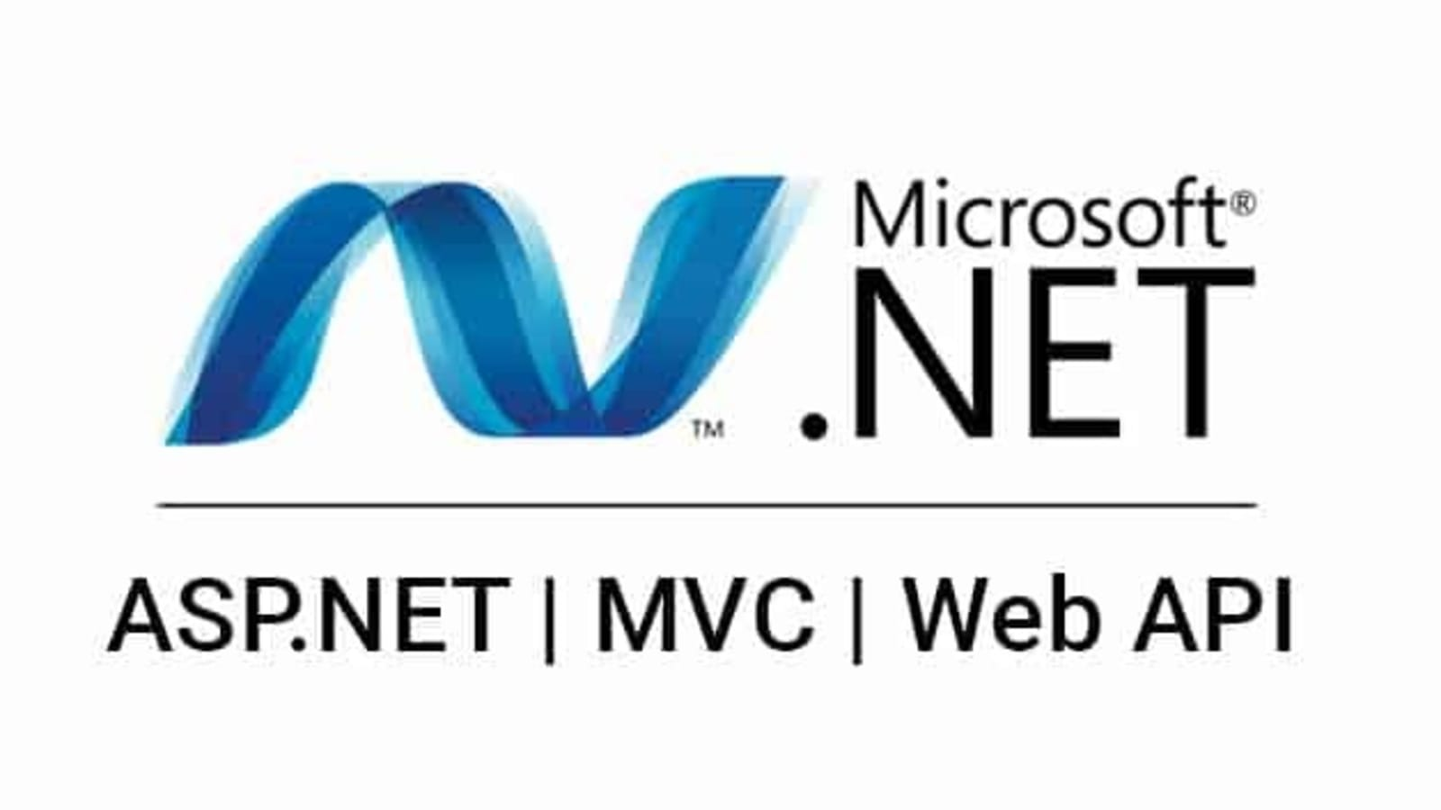
An introduction to ASP .NET WebAPI

Slide 2

The .NET Framework
Overview
VB
C++
C#
JScript
…
Visual Studio.NET
Common Language Specification
ASP.NET: Web Services
And Web Forms
Windows
forms
ADO.NET: Data and XML
Base Class Library
Common Language Runtime
Notes:
OPTIONAL SLIDE, USE IF AUDIENCE HAD NO PREVIOUS EXPOSURE TO .NET
KEY MESSAGE:
The .NET Framework is a complete set of technologies that makes it easy to create the next generation of applications. And VS.NET is the set of tools that takes advantage of this infrastructure.
SLIDE SCRIPT:
The .NET framework exposes numerous classes to the developer. These classes allow the development of rich client applications and Web based applications alike. In the above slide these classes have been divided into 4 areas.
ASP.NET provides the core Web infrastructure such as Web Forms for UI based development and Web Services for programmatic interface development,
User interface development on the Windows platform can be done using Windows Forms
ADO.NET and XML provide the functionality for data access.
Finally, the core base classes provide infrastructure services such as security, transaction management etc.
SLIDE TRANSISTION: Common Language Runtime

Slide 3
ASP .Net and C#
Easily combined and ready to be used in WebPages.
Powerful
Fast
Most of the works are done without getting stuck in low level programming and driver fixing and …

Slide 4
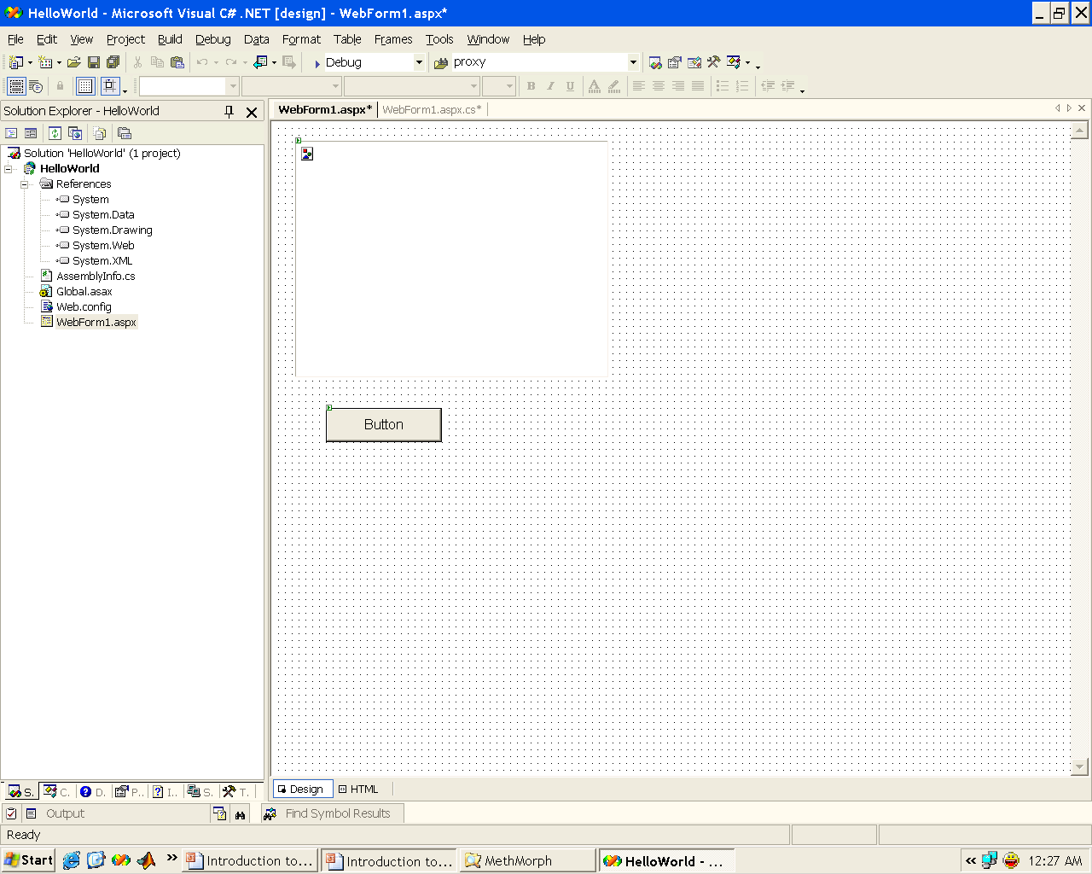
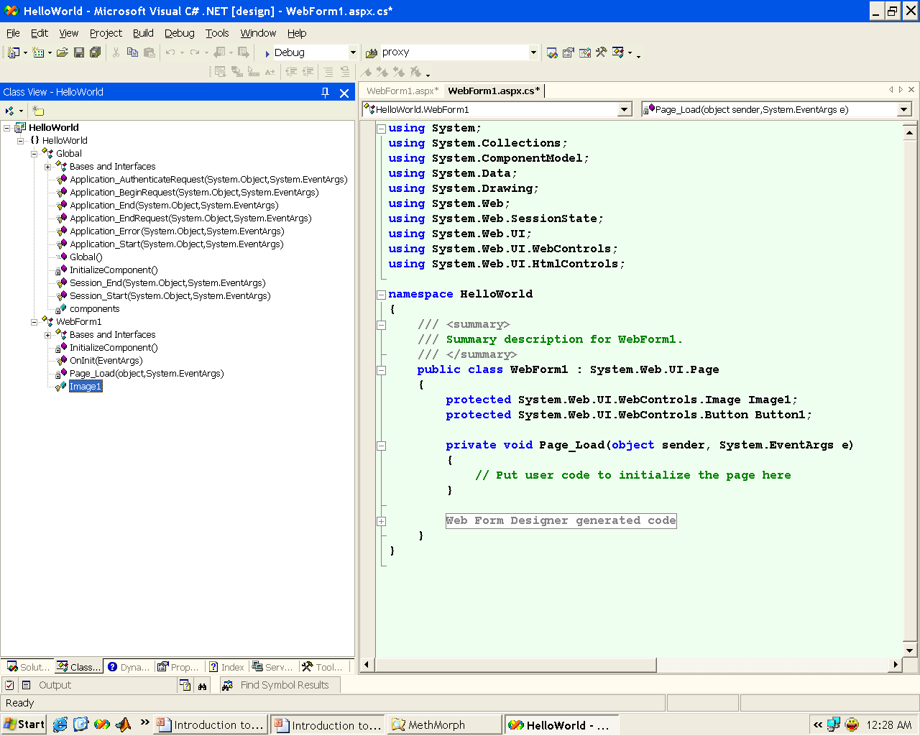
An ASP.Net Simple Start

Slide 5
Summary
C# builds on the .NET Framework component model
New language with familiar structure
  Easy to adopt for developers of C, C++, Java, and Visual Basic applications
Fully object oriented
Optimized for the .NET Framework

Slide 6
Thanks for your attention!
Slide <number>

