Slide 1

Introduction to
SQL

Slide 2
General scheme of presentation
  SQL
    Introduction, history, concepts
    DML
    DDL
    DCL
    Advanced topics:
- <number> -
Notes:
Presentation title

Slide 3
SQL - Introduction
Structural Query Language is a standardized language for Databases. Basically, It’s a declarative language (not procedural).
SQL is born in 1974 (called SEQUEL). SQL has been standardized in different versions (see next slide) by ANSI and ISO.
The implementations of SQL for the different RDBMS (Oracle, Sybase, SQL Server, Ms-Access, mySQL) are not always standard.
As many languages, SQL is defined by a dictionary and a grammar.
In this training session, we will use the SQL92 syntax (SQL2).
- <number> -
Notes:
Presentation title

Slide 4
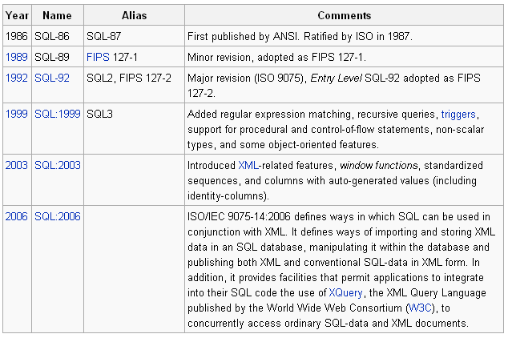
SQL history
Extract of http://en.wikipedia.org/wiki/SQL
- <number> -
Notes:
Presentation title

Slide 5
SQL
SQL is composed of different sub-languages:
DDL : data definition language
DML : data manipulation language and transaction control
DCL : data control language, definition of rights
To learn those languages, we first have to cover some items:
naming
data types
literal values (constants)‏
functions
- <number> -
Notes:
Presentation title

Slide 6
SQL Naming
You will mainly define names for
Table & views
Table fields & aliases
There are some naming limits (it may differ from a DB to another):
Usable chars : [A-Z] for the first char, [A-Z0-9_] for next chars
Length of names : 30 chars for Oracle and DB2 fields names
Character case in not significant.
You can’t use reserved names (tokens of the SQL language).
You should respect supplementary constraints in naming:
Public conventions: for example, do not prefix names of fields with the name of the table.
Specific conventions.
- <number> -
Notes:
Presentation title

Slide 7
SQL Naming limitations.
For DB2, see http://publib.boulder.ibm.com/infocenter/db2luw/v8/index.jsp?topic=/com.ibm.db2.udb.doc/admin/r0001029.htm
For Oracle,
  Field and table names can not contain spaces or symbols (except “_”).
  Field and table names are limited to 30 characters.
  Oracle doesn’t distinguish the character upper/lower cases.
  Name pattern : “[A-Z][A-Z0-9_]{0,29}”
- <number> -
Notes:
Presentation title

Slide 8
SQL – Data types
For Oracle, see http://download.oracle.com/docs/cd/B19306_01/server.102/b14200/sql_elements001.htm#i54330
Main data types:
CHAR(len): fixed-length string
VARCHAR2: variable-lengh string
NUMBER(precision,scale): decimal or float number. Precision = total number of digits. Scale = number of digits after the decimal.
DATE : calendar date (in Oracle, this type will include the time).
TIMESTAMP: Date and time
INTERVAL : interval of time
BLOB: Binary large object
- <number> -
Notes:
Presentation title

Slide 9
SQL – constants (literals)‏
For Oracle, see http://download.oracle.com/docs/cd/B19306_01/server.102/b14200/sql_elements003.htm#i11223
Numeric constants: written as usually; for example : 123 or -1245.63
String constants: enclosed in simple quotes; for example ‘hello world’. If you have to include a simple quote in your string, you have to write two consecutive simple quotes; for example : ‘I can’’t do it!’
Date constants: DATE ‘yyyy-mm-dd’; example : DATE ‘2001-12-13’. There is no syntax for a date literal with a time, you may use the “TO-DATE” function to convert a string; for example: TO_DATE('98-DEC-25 17:30','YY-MON-DD HH24:MI')
Timestamp constants: TIMESTAMP ‘yyyy-mm-dd HH:MM:SS’
; example TIMESTAMP ‘2007-01-01 12:34:56'
Interval literal: INTERVAL ‘n[-n]’ [(YEAR|MONTH)] [‘(‘n’)’] [TO MONTH]. Example: INTERVAL '123-2' YEAR(3) TO MONTH
- <number> -
Notes:
Presentation title

Slide 10
Pseudo columns
Oracle pseudo columns
See http://download.oracle.com/docs/cd/B19306_01/server.102/b14200/pseudocolumns.htm#i1014965
ROWID: identifier of the current row, not supported by DB2
ROWNUM: sequential number of the current row, not supported by DB2
Sequence.CURRVAL: current value of a sequence
Sequence.NEXTVAL: next value of a sequence
SYSDATE: current date
Hierarchical Query Pseudocolumns
Difference between Oracle and DB2 SQL, see http://www.fornera.com/helpdesk/db2SurvivalGuide.html
- <number> -
Notes:
Presentation title

Slide 11
SQL built-in functions
SQL defines standard functions. Each RDBMS may offer additional functions (and sometimes doesn’t include all the standard functions).
We may distinguish different types of functions:
Get context info: current_time, current_date, current_timestamp, current_user, session_user, system_user. (not covered by Oracle)‏
Aggregate functions: max, min, count, avg, sum
Functions to manipulate strings: char_length (length in Oracle), position(starting_string IN search_string) (instr in Oracle), substring(substr for Oracle), lower, upper, concatenate (concat for Oracle), trim, …
Date & time functions: year, month, day, hour, minute, second, …
Mathematics functions: sin, cos, ceil, floor, log, ln,…
Conversion of types: cat (expression as type)‏
- <number> -
Notes:
Presentation title

Slide 12
SQL built-in functions, some source of information
SQL standard functions:
http://oreilly.com/catalog/sqlnut/chapter/ch04.html
http://db.apache.org/derby/docs/10.2/ref/rrefsqlj55788.html
DB2 functions:
http://publib.boulder.ibm.com/infocenter/db2v7luw/index.jsp?topic=/com.ibm.db2v7.doc/db2s0/db2s0521.htm
Oracle functions:
http://www.ss64.com/orasyntax/functions.html
http://www.acs.ilstu.edu/docs/oracle/server.101/b10759/functions001.htm
http://www.techonthenet.com/oracle/functions/
Comparison of functions available on different SGBD:
http://sqlpro.developpez.com/cours/sqlaz/fonctions/
- <number> -
Notes:
Presentation title

Slide 13
Where we are in the SQL part of our training
  SQL
    Introduction
    DML
    DDL
    Access control
    Miscellaneous
- <number> -
Notes:
Presentation title

Slide 14
SQL - DML
Select : select rows of one table or of two or more related tables.
Insert : insert a new row in a table.
Delete : delete one or more rows in a table.
Update : update one or more rows in a table.
- <number> -
Notes:
Presentation title

Slide 15
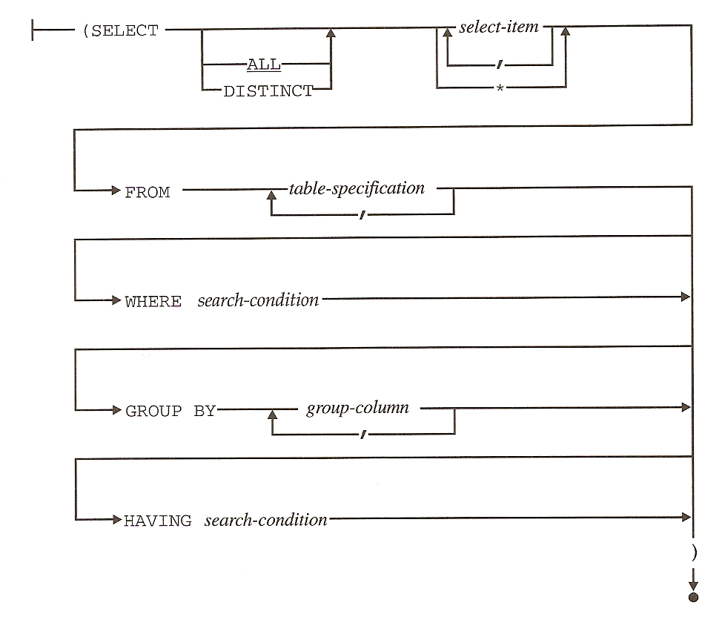
SQL DML – Query syntax
- <number> -
Notes:
Presentation title

Slide 16
SQL DML - Query
Full syntax : see http://www.acs.ilstu.edu/docs/Oracle/server.101/b10759/statements_10002.htm#i2065646
Structure of our presentation on the queries:
Simple queries
Ordering results (order by)‏
Sub-queries
Distinct results
Aggregations
Multi-tables queries
- <number> -
Notes:
Presentation title

Slide 17
Where we are in the SQL part of our training?
  SQL
    Introduction
    DML
      Select
        Simple queries
        Ordering results (order by)‏
        Sub-queries
        Distinct results
        Aggregations
        Multi-tables queries
        Pivots
      Insert
      Delete
      update
    DDL
    Access control
    Miscellaneous
- <number> -
Notes:
Presentation title

Slide 18
SQL DML - Query
Main elements of the syntax of a simple query:
select selectList from tableName where clause
Some examples:
select * from cld01;
select NOMCLI, TELPRI from cld01;
select NOMCLI, TELPRI from cld01 where TELPRI not like ' %';
- <number> -
Notes:
Presentation title

Slide 19
SQL SIMPLE QUERY – select list
selectList = “*” or “fieldName (, fieldName)*” or function(fieldName) or calculation expression or a literal.
“fieldName” is here the name of one of the fields defined in the target table or the name of a pseudo field.
You may defined aliases for column names, syntax: fieldListElement as aliasName
Examples:
select NOMCLI, TELPRI, ROWNUM from cld01
select '++', NOMCLI, SUBSTR(NOMCLI,1,1) from cld01
select NOMCLI, SUBSTR(NOMCLI,1,1) as ini from cld01
Trick: to see the fields defined in a table, use “desc tableName”.
- <number> -
Notes:
Presentation title

Slide 20
SQL SIMPLE QUERY – select list - operators
In SQL select list and in SQL clauses, you may use some operators:
mathematical operators: +, -, *, /, %
string concatenation: ||
Examples:
select DATMAJ-DATCRT as daysBeforeCreationAndLastUpdt, DATCRT, DATMAJ, NOMCLI from cld01
select nomcli || ‘ ‘ || prncli as nomprncli from cld01

Slide 21
SQL SIMPLE QUERY – where clause
Where clause = WHERE condition ( (AND|OR) condition )?
Simple Condition = (NOT)? fieldName operator ( fieldName | litteralValue )?
Operators:
Comparison: =, <>, <, >, <=, >=
Range test: testExpr (NOT)? BETWEEN lowValExpr AND highValExpr
Pattern matching condition: LIKE pattern
  wildcards chars: ‘%’, _ - You may use an escape char but you have to define it.
- <number> -
Notes:
Presentation title

Slide 22
SQL SIMPLE QUERY – where clause ...
Examples:
select NOMCLI from cld01 where NOMCLI LIKE 'D_s%‘
select NOMCLI from cld01 where NOMCLI LIKE '%\_%' ESCAPE '\'
select DATCRT, NOMCLI from cld01 where DATMAJ-DATCRT =0
- <number> -
Notes:
Presentation title

Slide 23
SQL SIMPLE QUERY – where clause …
To test a “null” value; use “is null” expression or “is not null” or “not fieldName is null”.
Example:
select NOMCLI from cld01 where NOMCLI is null
- <number> -
Notes:
Presentation title

Slide 24
SQL SIMPLE QUERY – where clause …
To group conditions, you will use “and” or “or” operators and parenthesis to modify default priority in the order of evaluation of operators.
Example:
select mnecli, nomcli, nomalp from CLD01 where (mnecli like 'R%' or nomcli like 'R%') and length(NOMCLI)=9;
- <number> -
Notes:
Presentation title

Slide 25
SQL SIMPLE QUERY – ordering results
Syntax: select … order by expression (, expression (ASC|DESC)?)*
Examples:
select mnecli, nomcli, nomalp from CLD01 order by nomalp;
select nomalp from CLD01 order by DATCRT DESC, DATMAJ;
- <number> -
Notes:
Presentation title

Slide 26
Where are we in the SQL part of our training?
  SQL
    Introduction
    DML
      Select
        Simple queries
        Ordering results (order by)‏
        Sub-queries
        Distinct results
        Aggregations
        Multi-tables queries
        Pivots
      …
    …
- <number> -
Notes:
Presentation title

Slide 27
SQL Query & sub-queries
SELECT … WHERE fieldName IN (SELECT fieldName from …)‏
SELECT … WHERE fieldName NOT IN (SELECT fieldName from …)‏
SELECT … WHERE (NOT)? EXISTS (SELECT …)‏
SELECT … WHERE fieldName comparisonOp (SELECT fieldName from …)‏
SELECT ... WHERE fieldName comparisonOp (ANY|ALL) (SELECT fieldName from ...)‏
Examples:
select nomalp from CLD01 where length(nomalp) = (select max(length(nomalp)) from CLD01)‏
select count(*) from CLD01 where numcli not in( select numcli from CLD02)‏
select count(*) from CLD01 x where exists( select * from CLD02 where numcli=x.numcli)‏
- <number> -
Notes:
Presentation title
select nomalp from CLD01 where length(nomalp) = (select max(length(nomalp)) from CLD01)‏
: returns the nomapl having the max length of all nomapl fields
select count(*) from CLD01 where numcli not in( select numcli from CLD02)‏
: returns the number of client having no address
select count(*) from CLD01 where numcli in( select numcli from CLD02)‏
: returns the number of client having an address
select count(*) from CLD01 x where exists( select * from CLD02 where numcli=x.numcli)‏
: returns the number of client having an address
select count(*) from CLD01 x where not exists( select * from CLD02 where numcli=x.numcli)‏
: returns the number of client having no address

Slide 28
SQL Query - select on hierarchical data
Syntax:
Select … from … connect by <referencedField> = PRIOR <referencingField> START WITH predicat

Slide 29
SQL Query - Distinct results
Syntax: select distinct …
Examples:
select distinct devref from CLD01
select distinct codbic, numprc from CLD01
- <number> -
Notes:
Presentation title
select distinct devref from CLD01
: returns the list of currencies used by our clients
select distinct codbic, numprc from CLD01
: returns the identifiers of banks of our clients

Slide 30
Where we are in the SQL part of our training?
  SQL
    Introduction
    DML
      Select
        Simple queries
        Ordering results (order by)‏
        Sub-queries
        Distinct results
        Aggregations
        Multi-tables queries
        Pivots
      …
    …
- <number> -
Notes:
Presentation title

Slide 31
SQL Query - Aggregations
General Syntax: select … from … group by …. (having condition)‏
In the field list and in the “having” condition, you have to use aggregation functions except for the fields on which the group is formed.
You may group on several columns.
You may add a condition to filter groups with the “having condition”.
- <number> -
Notes:
Presentation title
select devref,count(*) from CLD01 group by devref
: returns the number of clients for each used currencies.
Monact = total assets of the consolidated group
Nbremp = number of employees.

Slide 32
SQL Query - Aggregations
Examples:
select devref, count(*) from CLD01 group by devref
select devref, count(*) as c from CLD01 group by devref order by c
select devref, max(monact) as M, sum(monact) as S, (max(monact)/ sum(monact)*100) as R from CLD01 group by devref having sum(monact)<>0
select devref, nbremp, max(monact) as M, count(*) as c from CLD01 group by devref,nbremp having (sum(monact)<>0 )and (nbremp>1)‏
select devref, max(nbremp), max(monact) as M, count(*) as c from CLD01 where nbremp > 1 group by devref having (sum(monact)<>0 )‏
- <number> -
Notes:
Presentation title
select devref,count(*) from CLD01 group by devref
: returns the number of clients for each used currencies.
Monact = total assets of the consolidated group
Nbremp = number of employees.

Slide 33
SQL Query – Aggregate functions defined in SQL
SQL defines some aggregate functions:
AVG : average of values, only for numeric types
COUNT : number of values
MAX : maximum value
MIN : minimum value
SUM : sum of values, only for numeric types
Null values are ignored in aggregate functions. In oracle, you mask ask to consider null values with a NVL function (by example avg(nvl(sold,0)) ).
With the count function, you may use the “count(*)” syntax to count the number of rows.
If you want to eliminate duplicates values before the execution of the aggregate function, you will use the syntax “fct(distinct fieldName)”.
- <number> -
Notes:
Presentation title
select devref,count(*) from CLD01 group by devref
: returns the number of clients for each used currencies.
Monact = total assets of the consolidated group
Nbremp = number of employees.

Slide 34
SQL Query – Aggregate functions defined in Oracle
Oracle has the aggregate functions defined in SQL.
Oracle have added other aggregate functions:
First : first value
Last : last value
stddev : standard deviation
median : mean value
…
- <number> -
Notes:
Presentation title
select devref,count(*) from CLD01 group by devref
: returns the number of clients for each used currencies.
Monact = total assets of the consolidated group
Nbremp = number of employees.

Slide 35
SQL Query – usage of aggregate functions
You may use aggregate functions in SQL queries having no “group by” clause. You have then a group composed of all records returned by your select.
Example:
select count(*), sum(SOLPCD) from CCD01
- <number> -
Notes:
Presentation title
select devref,count(*) from CLD01 group by devref
: returns the number of clients for each used currencies.
Monact = total assets of the consolidated group
Nbremp = number of employees.

Slide 36
Where we are in the SQL part of our training?
  SQL
    Introduction
    DML
      Select
        Simple queries
        Ordering results (order by)‏
        Sub-queries
        Distinct results
        Aggregations
        Multi-tables queries
        Joins
        Unions
        Pivots
      …
    …
- <number> -
Notes:
Presentation title

Slide 37
SQL Multi-tables queries (joins & unions)‏
Joins : rows of the result set have fields coming from two (or more) tables.
cartesian product (or cross join): it produces n * m rows (with n= number of rows of table 1, m = number of rows of table 2).
equi-join: returns only rows combining rows of the two tables having same values in fields participating to the relation.
left outer-join: all records of the left table are present in the result set even if the right table has no corresponding record (in this case, the fields coming from the right table have null values).
right outer join: all records of the right table are present in the result set even if the left table has no corresponding record (in this case, the fields coming from the left table have null values).
Unions: rows returned by two select with the same structure are added.
- <number> -
Notes:
Presentation title

Slide 38
SQL joins
Select … from tbl1, tbl2
We obtain n * m rows (where n=number of rows of tbl1 and m=number of rows of tbl2) with the sum of fields of tbl1 and tbl2.
Seldom used as it.
Select … from tbl1, tbl2 where tbl1.fieldX=tbl2.fieldY
We obtain related rows of tbl1 and of tbl2 with the sum of fields of tbl1 and tbl2.
Example :
select * from CLD01,CCD01 where CCD01.numcli = CLD01.numcli
- <number> -
Notes:
Presentation title

Slide 39
SQL outer join
As in inner join, we join 2 tables and we select all records of the first table and corresponding records of the second table. But here, if no corresponding records exists in the second table we nevertheless return a result record where fields from the second table receive the null value.
Example, for Oracle:
select * from CCD01,CCD51 where CCD01.natenc=CCD51.natenc(+)
The “(+)” expression is placed just after the name for with records will be “added”(with null values) to form the result set.

Slide 40
Where are we in the SQL part of our training?
  SQL
    Introduction
    DML
      Select
        Simple queries
        Ordering results (order by)‏
        Sub-queries
        Distinct results
        Aggregations
        Multi-tables queries
        Joins
        Unions
      …
    …
- <number> -
Notes:
Presentation title

Slide 41
SQL select – combination of sets: Union, intersection, difference
We may ask the SQL engine to combine rows of different queries:
Union: combination of two or more queries; we add rows of different queries giving compatible fields.
Intersect : combination of two or more queries; we keep common rows of different queries giving compatible fields.
Except (standard SQL), minus (Oracle)‏; we keep only rows returned by the first query and not by the second.
- <number> -
Notes:
Presentation title

Slide 42
SQL select – combination of sets: Union
Union: combination of two or more queries; we add rows of different queries giving compatible fields.
Syntax:
SELECT … UNION (ALL)? SELECT …
Example:
select 'NoAdress' ST, numcli from CLD01 X where numcli not in( select numcli from CLD02) union select 'withAdresses' ST, numcli from CLD01 X where numcli in( select numcli from CLD02) order by 1
- <number> -
Notes:
Presentation title

Slide 43
SQL select – combination of sets: intersection
Intersect : combination of two or more queries; we keep common rows of different queries giving compatible fields.
Syntax: SELECT … INTERSECT SELECT …
Example:
select numcli from CLD01 intersect select numcli from CLD02
- <number> -
Notes:
Presentation title

Slide 44
SQL select – combination of sets: difference
Except (standard SQL), minus (Oracle): we keep only rows returned by the first query and not by the second.
Syntax: SELECT … EXCEPT/MINUS SELECT …
Example:
select numcli from CLD01 minus select numcli from CLD02
- <number> -
Notes:
Presentation title

Slide 45
Where are we in the SQL part of our training?
  SQL
    Introduction
    DML
      Select
        Simple queries
        Ordering results (order by)‏
        Sub-queries
        Distinct results
        Aggregations
        Multi-tables queries
        Pivots
      …
    …
- <number> -
Notes:
Presentation title

Slide 46
SQL – select - pivots
Pivots are often used to create reports.
A group of rows is transformed to produce a single row with values of a field of the original rows used as columns in the result set and a second field of the original rows used as value of one of the created columns.
Original record-set:
fields used to form groups
field used to produce new columns
field used to populate new columns

Slide 47
SQL – select – pivots - Example
We have a table giving the revenue of different companies for different periods (year and quarter). You should like to create a report showing a table with a line by company and by year and a column for each quarter (in the cell we have to store the revenue).
Company | Year | Quarter | Revenue
BMW | 2001 | Q1 | 125
BMW | 2001 | Q2 | 110
BMW | 2001 | Q3 | 130
BMW | 2001 | Q4 | 140
IBM | 2001 | Q1 | 500
IBM | 2001 | Q2 | 300
IBM | 2002 | Q2 | 400
Company | Year | Q1 | Q2 | Q3 | Q4
BMW | 2001 | 125 | 110 | 130 | 140
IBM | 2001 | 500 | 300
IBM | 2002 | 400
Select * from (SELECT company, A.year, quarter, revenue
FROM awe_COMPREV A
) PIVOT (
SUM(revenue) FOR quarter IN ('Q1','Q2','Q3','Q4')
)

Slide 48
Where are we in the SQL part of our training?
  SQL
    Introduction
    DML
      Select
        Simple queries
        Ordering results (order by)‏
        Sub-queries
        Distinct results
        Aggregations
        Multi-tables queries
        Pivots
      Insert
      Delete
      update
    DDL
    Access control
    Miscellaneous
- <number> -
Notes:
Presentation title

Slide 49
SQL DML - INSERT
Two different syntaxes:
SQL INSERT INTO tableName ( fieldName (, fieldName)* ) VALUES ( literal (, literal )* )‏
SQL INSERT INTO tableName ( fieldName (, fieldName)* ) select ...
Examples:
insert into AWE_COMPREV (company,year,quarter,revenue) values('BMW', 2001, 'Q1',125);
insert into AWE_COMPREV values('BMW', 2001, 'Q1',125);
insert into AWE_COMPREV2 select * from AWE_COMPREV;
- <number> -
Notes:
Presentation title

Slide 50
SQL DML - DELETE
Syntax:
DELETE FROM tableName ( WHERE ... )?
Example:
delete from AWE_COMPREV2 where company='IBM';
- <number> -
Notes:
Presentation title

Slide 51
SQL DML - UPDATE
Update the content of one or more fields of all/selected records.
Syntax:
UPDATE tableName SET fieldName = expression ( , fieldName = expression )* ( WHERE ... )?
Examples:
update AWE_COMPREV2 set revenue = revenue * 1.25;
update AWE_COMPREV2 set revenue = revenue * 1.25, COMPANY='BMW-BE' where company='BMW';
- <number> -
Notes:
Presentation title

Slide 52
Were are we in the SQL part of our training?
  SQL
    Introduction, history, concepts
    DML
      Select
      Insert
      Delete
      Update
    DDL
    DCL
    Advanced topics
- <number> -
Notes:
Presentation title

Slide 53
SQL - DDL
With DDL, Data Definition Language, we can create
Schemas
Tables with constraints
Constraints
Domains for values (not supported by Oracle, we have to use user defined types instead).
- <number> -
Notes:
Presentation title

Slide 54
SQL DDL
Create/drop/alter table
Create/drop view
Create/drop index
Create/drop schema
Create/drop/alter domain
- <number> -
Notes:
Presentation title

Slide 55
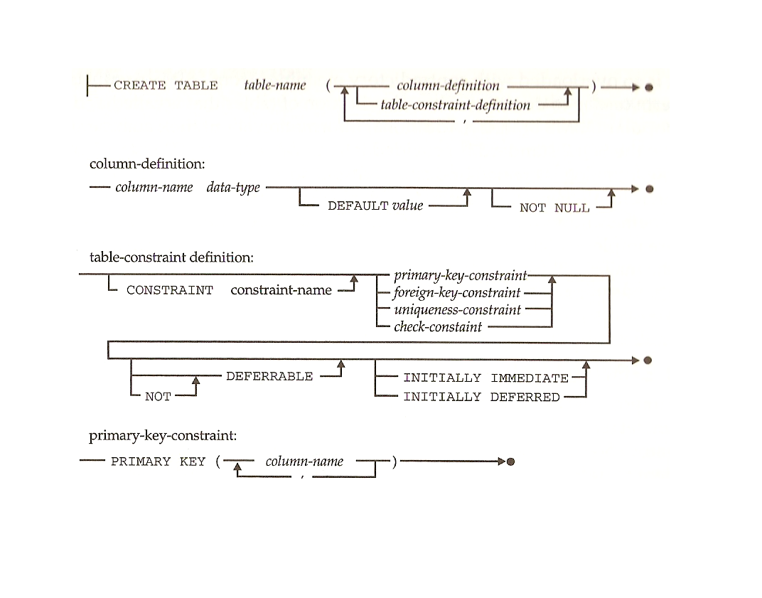
SQL DDL – Create table syntax
- <number> -
Notes:
Presentation title

Slide 56
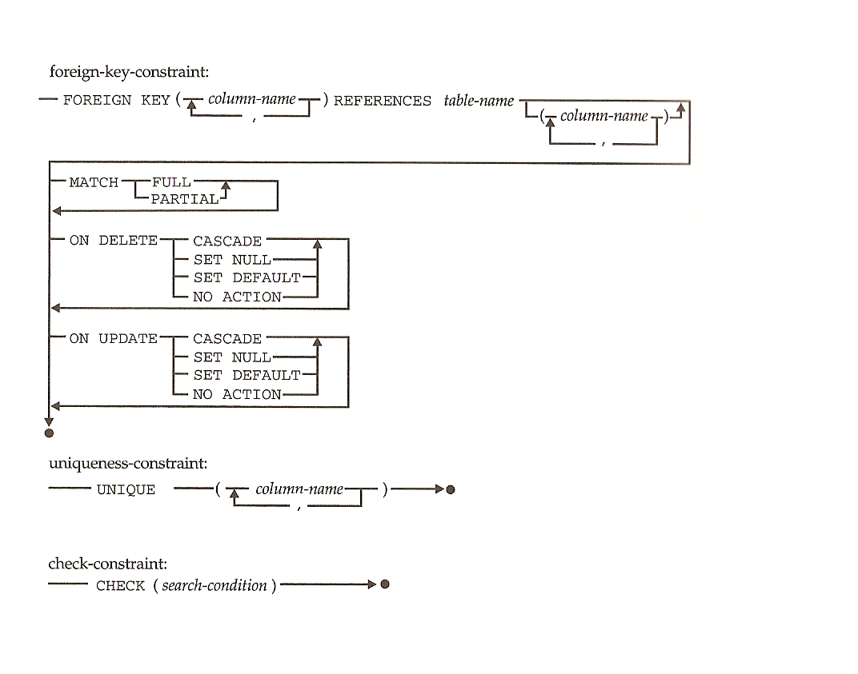
SQL DDL Create table syntax ...
- <number> -
Notes:
Presentation title

Slide 57
SQL DDL – create table …
Create a table based on the structure of a select and populate the table with the data returned by the query
create table tableName ( fieldsList) as select …

Slide 58
SQL DLL - Create table - examples
create table employee(name varchar2(100), age int, salary number, primary key (name)) ;
create table employeeAddr(emp_name varchar2(100), country varchar2(30), city varchar2(30), street varchar2(200), house_number int, foreign key (emp_name) references employee)
create table cld01_1973 as select * from cld01 where datnai like '1973%';

Slide 59
SQL DDL – Create view
Syntax:
CREATE VIEW viewName (
columnName1,
columnName2,
…
) AS
sqlSelectStatement
Example:
create view AWE_COMP_YEAR_REV as select company,year,sum(revenue) as yearRev from AWE_COMPREV group by company,year;
- <number> -
Notes:
Presentation title

Slide 60
Create Synonyms
Synonyms are not defined in the SQL standard but supported by Oracle and DB2
Syntax:
create synonym synonym-name for object;
Example:
create synonym AWE for ppk.AWE_COMPREV;

Slide 61
Create sequences
Sequences are not defined in standard SQL but supported by Oracle and DB2.
Syntax:
CREATE SEQUENCE name
( INCREMENT BY increment_value )?
( MINVALUE minimum_value )?
( MAXVALUE maximum_value )?
( START WITH start_value )?
( CACHE cache_value )?
( CYCLE )?
Example:
CREATE SEQUENCE AWE_SEQ INCREMENT BY 2 START WITH 100;
select AWE_SEQ.NEXTVAL from DUAL;

Slide 62
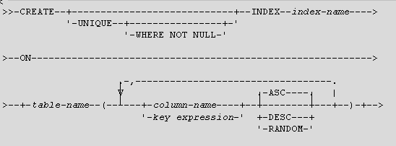
Create index
The create/drop index statements are not part of the standard SQL but are used by Oracle and DB2.
Ask the creation of an index on one or more fields of a table. You may specify an uniqueness constraint.
Basic syntax:

Slide 63
Were are we in the SQL part of our training?
  SQL
    Introduction, history, concepts
    DML
    DDL
    DCL
    Advanced topics:
- <number> -
Notes:
Presentation title

Slide 64
SQL DCL – Access control
The SQL norm defines some security concepts:
Each user receives privileges on database objects.
Privileges are allowed actions : select, delete, insert, update, reference (the right to add a reference to a row) , grant (the right to pass your rights)
Privileges are given or removed using the SQL grant/revoke instructions.
Privileges are given to individual users or to everybody (PUBLIC).
When you create a new table, you are the owner of this table and not any other user has access to it. Of course, you may give privileges to other users.
Your DB provider may have added some features. Usually, we will find ways to give rights to group of users instead to individual users.

Slide 65
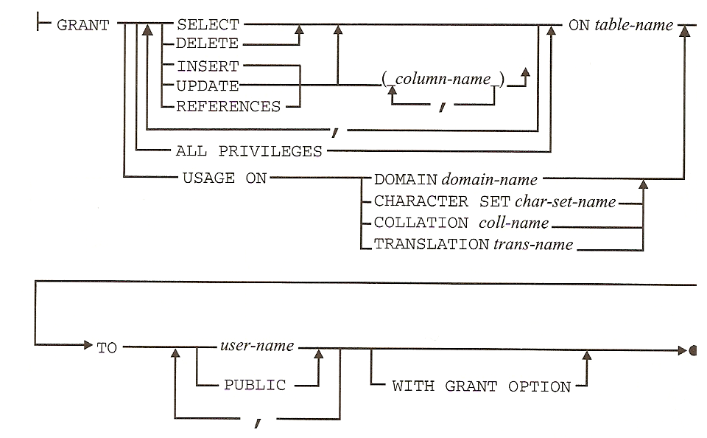
SQL DCL - Grant
- <number> -
Notes:
Presentation title

Slide 66
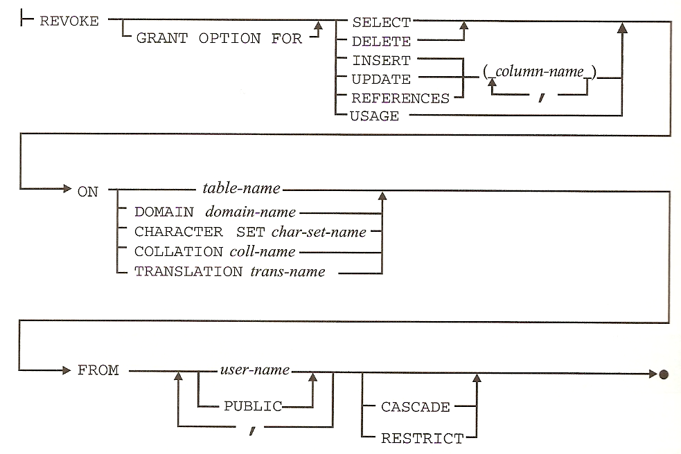
SQL DCL - Revoke
- <number> -
Notes:
Presentation title

Slide 67
Security in Oracle
Privileges are of two types:
Object privileges associated to existing DB objects
System privileges not associated to existing DB objects
  Create session
  Create table
  Create sequence
  Create view
  …
You can see the list of defined system privileges with:
select name from system_privilege_map;

Slide 68
Security in Oracle
To facilitate rights management, Oracle has defined the notion of role (creation: “create role <roleName>”). Rights are given to roles using the SQL grant/revoke instruction.
Each user receives on or more roles (“grant <roleName> to <userName>”).
Predefined roles; some roles are defined automatically when the administrator creates a new database:
connect, with the following privileges: create session, alter session, create synonym, create view, create database link, create table, create cluster and create sequence.
resource, with the following privileges: create table , create cluster, create sequence, create trigger, create procedure, create type, create indextype and create operator.
dba with all privileges.

Slide 69
Were are we in the SQL part of our training?
  SQL
    Introduction, history, concepts
    DML
    DDL
    DCL
    Advanced topics:
      Transactions
      Isolation levels
      Locking
      Trigger
      System catalogue
      Programming with SQL
- <number> -
Notes:
Presentation title

Slide 70
Transactions
Different users use concurrently different sessions. A single user can have more than one session.
A transaction is a sequence of SQL statements that the RDBMS treats as a single unit of work
In each session, the user can use successive transactions (you can use only one transaction at the same time in the same session). A transaction is finished by a “commit” or a “rollback”. You can also use savepoint/rollback to savepoint to isolate parts of the transaction with the possibility to “undo” only effects of statements in those parts. A savepoint is a marker within a transaction that allows for a partial rollback
The session can be configured to work in “auto-commit” mode (On Oracle, with SQL Plus, you modify the mode with the command “SET AUTOCOMMIT (ON|OFF)” .
Isolation levels & explicit locking will give the behavior of concurrent sessions concerning the not-committed modifications of the data.

Slide 71
Transactions – ACID properties
A transaction should guarantees some properties:
Atomicity: each transaction is validated (or invalidated) as a all.
Consistency: a consistent result is obtained a the end of the transaction.
Isolation: effects of other concurrent transactions are not visible on each individual transaction.
Durability : effects of each transaction are stored when the transaction is validated.

Slide 72
SQL – Transaction control
Commit
Rollback
Savepoint <name>
Rollback to savepoint <name>
Set transaction
- <number> -
Notes:
Presentation title

Slide 73
Necessity of isolation levels
Isolations levels offer different answers to possible problems related to the concurency of different transactions:
Dirty read : you read data not already commited by concurrent transactions.
Non-repeatable read : in the same transaction, when you do two times the same select, you can obtain different results in already read records due to committed updates from other transaction.
Phantom read: in the same transaction, when you do two times the same select with a where clause, you can obtain more records due to the insertion of new records from other transactions.
- <number> -
Notes:
Presentation title

Slide 74
Isolation levels defined in SQL
Serializable: the upper isolation level; no dirty read, no non-repeatable read, no phantom read.
Repeatable read: only phantom reads are possible.
Read commited: non repeatable reads and phantom reads are possible.
Read uncommitted: dirty reads, non-repeatable reads, phantom reads are possible.

Slide 75
Isolation levels in Oracle
For a full explaination, see http://www.acs.ilstu.edu/docs/Oracle/server.101/b10743/consist.htm
In Oracle, the default isolation level is « read commited ».
Oracle supports only the two of the four isolation levels defined in SQL: read committed and serializable.
Oracle defines a new isolation level: read only .
You can modify the isolation level of your current transaction:
SET TRANSACTION ISOLATION LEVEL READ COMMITTED;
SET TRANSACTION ISOLATION LEVEL SERIALIZABLE;
SET TRANSACTION READ ONLY;
You can also modify the isolation level of all subsequent transactions of your session:
ALTER SESSION SET ISOLATION_LEVEL SERIALIZABLE;
ALTER SESSION SET ISOLATION_LEVEL READ COMMITTED;
- <number> -
Notes:
Presentation title

Slide 76
Isolation level in DB2
Extracts of http://www.craigsmullins.com/bp4.htm
DB2 supports a variation of the standard isolation levels.
In DB2 you can specify the following four isolation levels: cursor stability (CS), repeatable read (RR), read stability (RS), and uncommitted read (UR).
Cursor stability is the DB2 implementation of the SQL standard read committed isolation level.
A higher level of integrity is provided with repeatable read. Under an RR isolation level all page locks are held until they are released by a COMMIT (or ROLLBACK), whereas with CS read-only page locks are released as soon as another page is accessed. Repeatable read is the default isolation level if none is specified at BIND time.
An RR page locking strategy is useful when an application program requires consistency in rows that may be accessed twice in one execution of the program, or when an application program requires data integrity that cannot be achieved with CS.
The third isolation level provided by DB2 is read stability (RS). Read stability is similar in functionality to the RR isolation level, but a little less. A retrieved row or page is locked until the end of the unit of work; no other program can modify the data until the unit of work is complete, but other processes can insert values that might be read by your application if it accesses the row a second time.
Finally, we come to the last, and most maligned isolation level, uncommitted read (UR). The UR isolation level provides read-through locks, also know as dirty read or read uncommitted. Using UR can help to overcome concurrency problems. When you're using an uncommitted read, an application program can read data that has been changed but is not yet committed.
- <number> -
Notes:
Presentation title

Slide 77
SQL Locking
Automatically in function of the isolation level.
Explicitly through:
  Select … from … for update
  LOCK TABLE <table_name> IN <lock_mode> MODE [NOWAIT | WAIT <seconds>];
  The lock remains until you close the current transaction.
- <number> -
Notes:
Presentation title

Slide 78
Triggers
A trigger defines a set of actions that are performed in response to an insert, update, or delete operation on a specified table. When such an SQL operation is executed, the trigger is said to have been activated.
CREATE TRIGGER <name> <action> ON <table_name> <operation> <triggered_action>
Example:
CREATE TRIGGER NEW_HIRED
AFTER INSERT ON EMPLOYEE
FOR EACH ROW
UPDATE COMPANY_STATS SET NBEMP = NBEMP+1;

Slide 79
System catalog
The meta data used by the RDBMS to store information about your tables, your views, your rights, … are consultable through different tables or views:
DBMS | Tables | Columns | Users | Views | Privileges
Oracle | user_catalog | user_tab_columns | all_users | user_views | user_tab_privs
 | user_tables | all_tab_columns |  | all_views | User_col_privs
 | all_tables |  |  |  | User_sys_privs
 | user_synonyms
DB2 | Schemata | columns | dbauth | Views | Schemaauth
 | Tables |  |  | viewdep | Tabauth
 | References |  |  |  | Colauth
 | keycoluse

Slide 80
Were are we in the SQL part of our training?
  SQL
    Introduction, history, concepts
    DML
    DDL
    DCL
    Advanced topics:
      Transactions
      Isolation levels
      Locking
      Trigger
      System catalogue
      Programming with SQL
- <number> -
Notes:
Presentation title

Slide 81
Programming with SQL
Using direct SQL statements through a tool (for example va SQL PLUS).
Using embedded SQL in an host language (for example SQL orders embedded in C code).
Using SQL with an API (for example, via ODBC or JDBC).
Using SQL instructions in stored procedures (for example, in PL/SQL for Oracle) – such procedures can be launched by triggers or by API calls.

Slide 82
Stored procedures
Stored procedures are written in a programming language and executed by the RDBMS .
Oracle can load and execute stored procedures written in PL/SQL or in Java.
DB2 has his own language similar to PL/SQL for stored procedures
The main advantage of using stored procedures is to limit the network traffic and by this way to obtain good performances.
A second advantage is the possibility to create a separated layer (separated from the client application) hiding the knowledge of the data structure.
Stored procedures can be executed by triggers, by SQL queries (via PL/SQL functions), by API calls.

Slide 83
PL/SQL - Introduction
PL/SQL is a procedural language with variables, constants, operators, conditional execution, loops, …
A PL/SQL block has the following general form:
DECLARE
…
BEGIN
…
EXCEPTION
…
END;
A zone to declare variables and constants, a zone for normal instructions, a zone to trap exceptions.

Slide 84
PL/SQL – example 1 – calculation of a factorial
declare
n number;
f number;
begin
n := 5;
f := 1;
loop
f := f * n;
n := n-1;
exit when n=1;
end loop;
dbms_output.put_line('fact(5)=' || to_char(f));
end;

Slide 85
PL/SQL – example 2 – a function converting a number of days into a date in the format “yyyymmdd”.
function conv_jour_duree(nbr number) return char
is
annee number;
mois number;
jour number;
rest number;
nbrabs number;
begin
nbrabs:=abs(nbr);
annee:=trunc(nbrabs/360);
rest:=mod(nbrabs,360);
mois:=trunc(rest/30);
jour:=mod(rest,30);
return trim(to_char(annee,'0999'))||trim(to_char(mois,'09'))||trim(to_char(jour,'09'));
end;

Slide 86
PL/SQL – example 3 – a procedure with a cursor
procedure displayFirstAccounts as
cursor curs is
SELECT CLD01.NOMCLI, CLD01.PRNCLI, CCD01.DEVCPT, CCD01.SOLCRA, CCD01.TYPCPT
FROM CLD01,CCD01
WHERE (CCD01.TYPCPT='01') and ( CLD01.NUMCLI = CCD01.NUMCLI)
ORDER BY CCD01.DEVCPT, CCD01.SOLCRA DESC;
rec curs%ROWTYPE;
prevDevCPT CCD01.DEVCPT%TYPE;
nb INTEGER;
begin
nb := 0;
prevDevCPT:=' ';
for rec in curs
loop
if (prevDevCPT <> rec.DEVCPT) then
nb:=0;
prevDevCPT:=rec.devcpt;
DBMS_OUTPUT.put_line('=========');
else
nb:=nb+1;
if (nb <= 5)then
DBMS_OUTPUT.put_line(
rec.NOMCLI || ','||
rec.PRNCLI || ',' ||
rec.SOLCRA || ',' ||
rec.DEVCPT || ',' ||
rec.TYPCPT
);
end if;
end if;
end loop;
end;
Notes:
Presentation title
This example displays the five first account with the biggest amount by currency.

Slide 87
References
To write these slides, I have taken some content of :
the Companion Website for Database Processing: Fundamentals, Design, and Implementation, 10th Edition: http://wps.prenhall.com/bp_kroenke_database_10/30/7927/2029396.cw/index.html
SQL the complete reference. Ed Osborne. James R.Groff & Paul N.Weinberg.

Slide 88
What have we covered during this training session?
What is a database and what is a DBMS.
Different database models:
  Hierarchical
  Network
  Relational
The relational databases
  Fundamental concepts.
  Different activities
  Entity & relations models
  SQL
    DML
    DDL
    DCL
  Advanced topics

Slide 89

Thanks for your attention!
Slide <number>

