Slide 1
ESSIG - Embedded system simulator generator
Ruud Harmsen
Ewoud Kohl van Wijngaarden
Wilfried van Asten
Mark Florisson

Slide 2
PUrpose
Automatically generate a simulator from a description
Describe ISA
Hook up a debugger

Slide 3
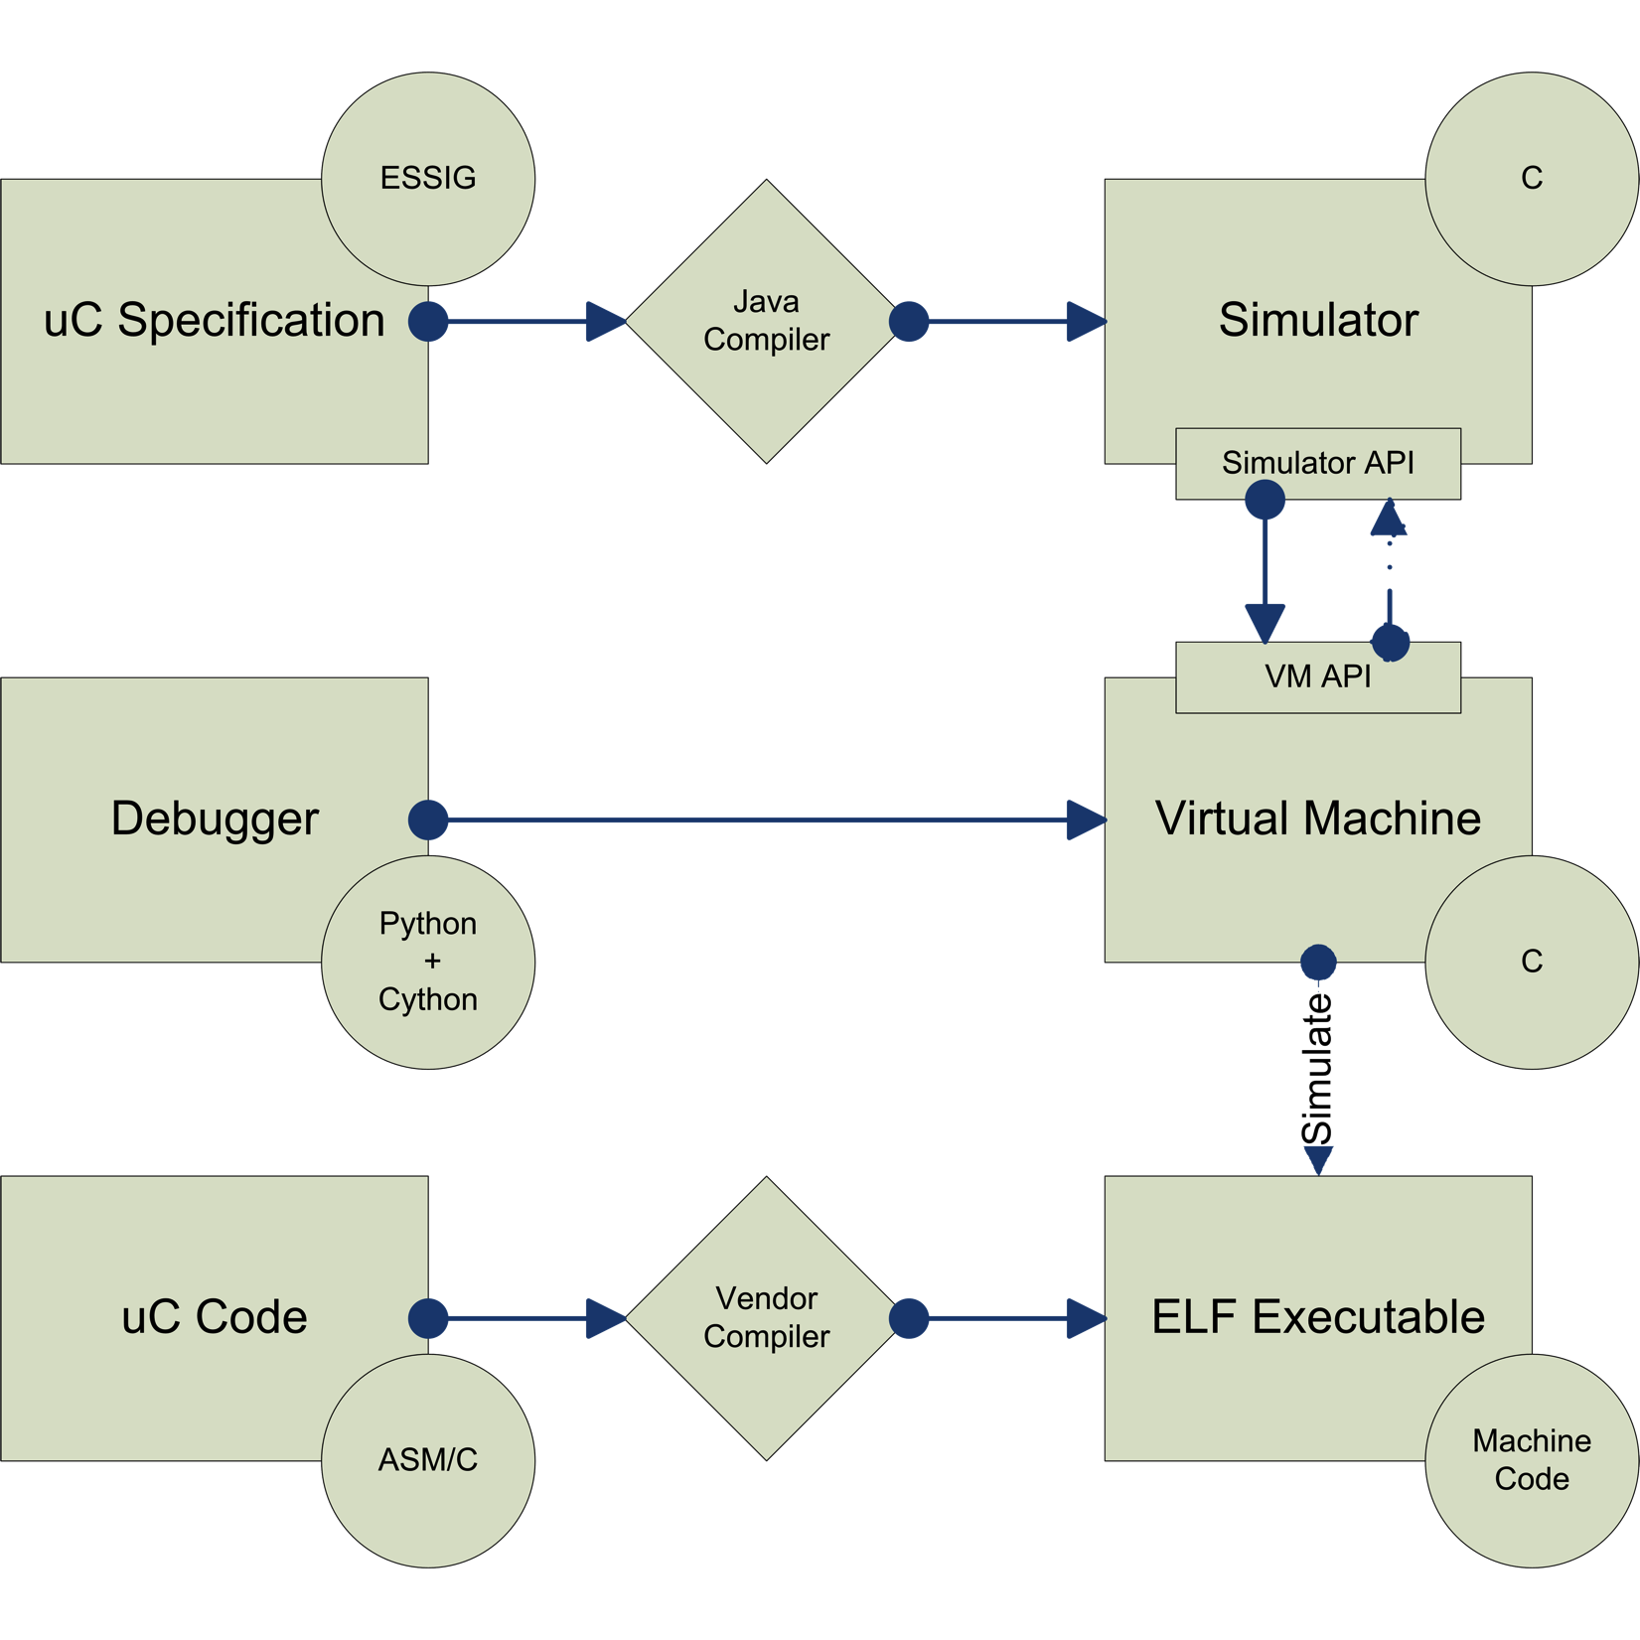
Overview

Slide 4
Grammar stuff

Slide 5
Overview generated C code?
List of instruction handlers, etc
Maybe compare piece of grammar to generated C code (perhaps after running GNU indent on it)

Slide 6
Atmel Atmega 16
Partly implemented
<details hier>

Slide 7
VM
Code is static
Contains functions like vm_step, vm_break, vm_cont, etc
Keeps state of microcontroller
List of diffs (optional)

Slide 8
Vm state code

Slide 9
Debugger
Uses the public (exposed) API of the VM
Initializes VM and runs programs from CLI
Step, reverse step, examine memory, registers, etc

Slide 10
Steps
Load ELF executable
Copy loadable segments into VMState
Disassemble instructions (for constant time handler lookup)
Start execution

Slide 11
Extensibility
Plugins in Python
  Plugins can specify interrupts that should occur
Interrupt setting and handling (in C)
  Highly specific to the chosen MCU

Slide 12
Demo run

