Slide 1


Membangun Masa Depan
Aplikasi Hybrid
Dengan #IGNSDK

Slide 2


Memulai IGNSDK

Slide 3
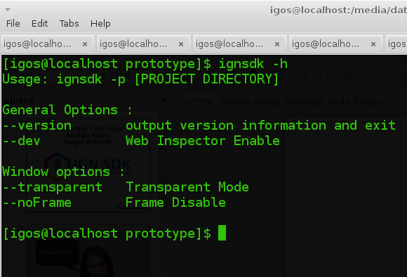
INTERPRETER

Slide 4

https://github.com/anak10thn/ignsdk-qt
directory_project.ign
IGNSDK
$ignsdk -p directory_project.ign
Standalone Executable

Slide 5
Run
$ignsdk -p hallo.ign
Interpreter
Option
Project Directory

Slide 6
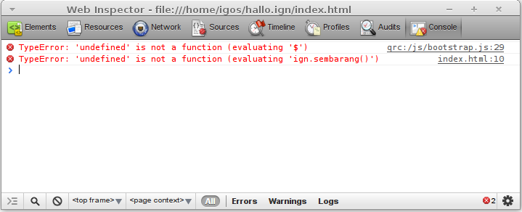
Debug Mode
$ignsdk -p hallo.ign -d

Slide 7
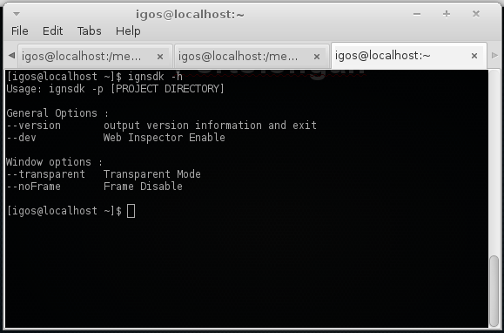
Pertolongan
$ignsdk -h

Slide 8
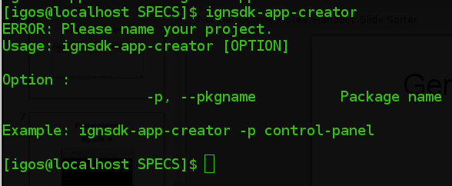
Generate Project Directory

Slide 9
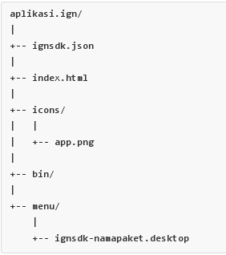
Project Directory Hirarki

Slide 10
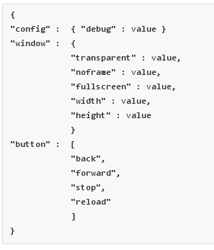
IGNSDK Manifest

Slide 11
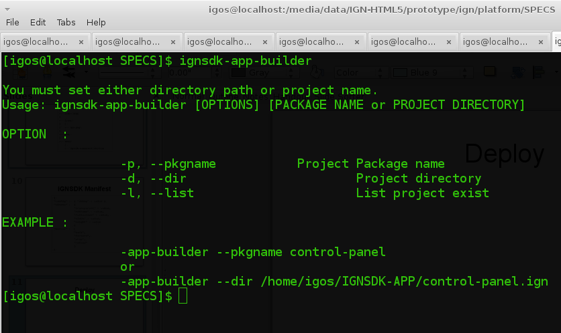
Deploy

Slide 12
Dokumentasi

Slide 13
https://github.com/anak10thn/ignsdk-qt/wiki

Slide 14
Cara berkontribusi

Slide 15
https://github.com/anak10thn/ignsdk-qt

Slide 16

Ada Pertanyaan?

