Slide 1
EPAM DIPLOMA
NHL APPLICATION
By:
Evgenii Kolganov
Jan’2022
CONFIDENTIAL | © 2022 EPAM Systems, Inc.

Slide 2
Application

Slide 3
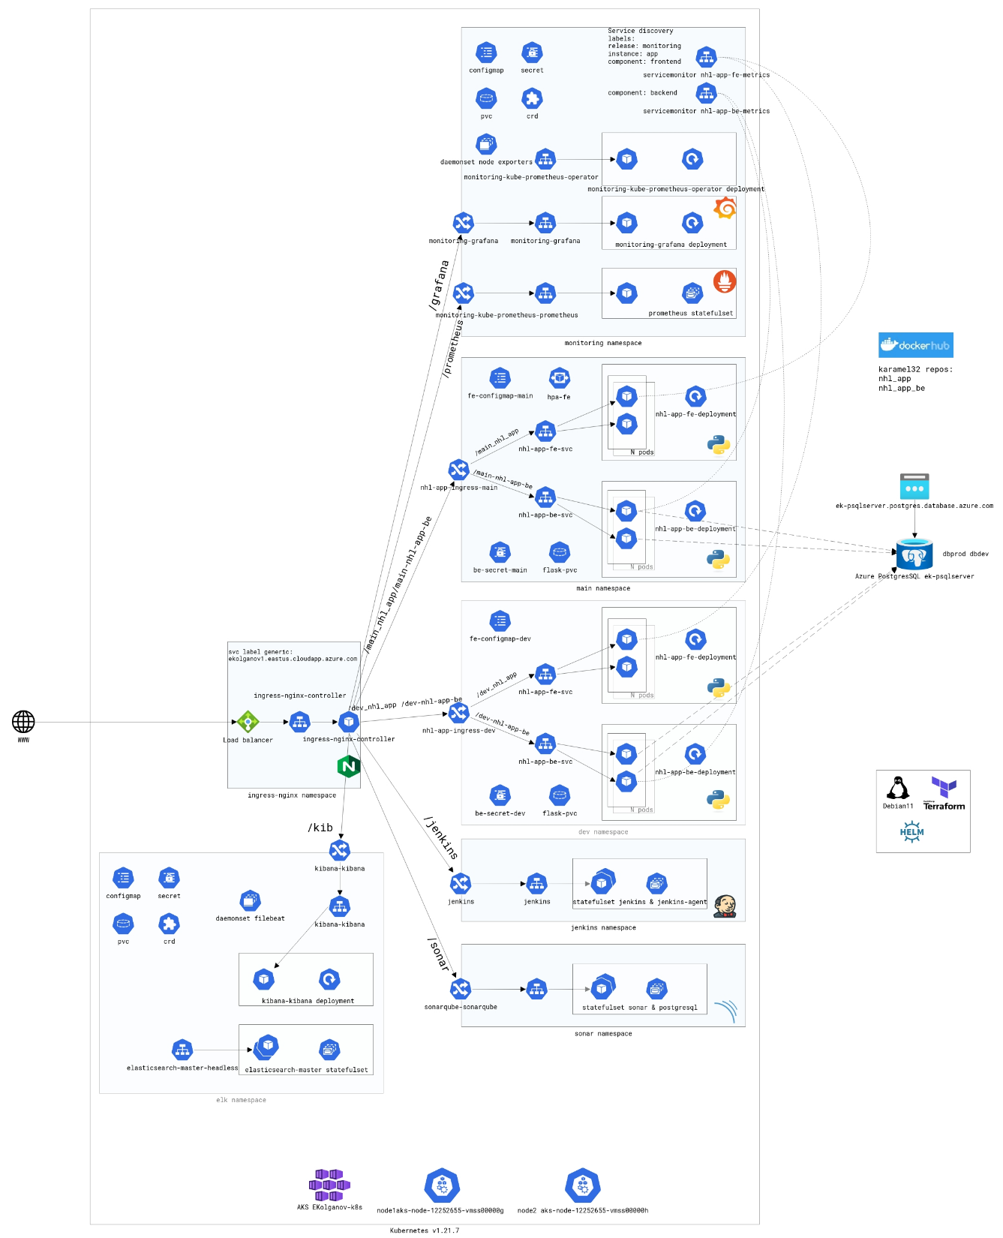
Infrastructure
Control machine:
Debian11 + Helm + Terraform
Terraform
Touch scheme:
https://app.cloudskew.com/viewer/573afb6b-f0f4-44a8-baa0-9608f479302b

Slide 4
Pipeline

Slide 5
Monitoring

Slide 6
Cost efficiency

Slide 7
DEMO Q&A

