Slide 1
Using the Catalytic Deactivation Python Code
Elsa Koninckx

Slide 2
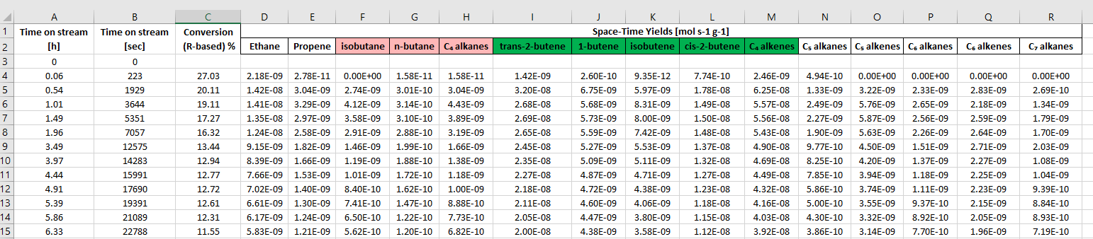
Inputs
A & B always hold time data. The important column is B. This is the “x” column I use to match “y” data. Likewise, your time units for B should match your “y” units. (A is just being carried around, can fill in with whatever time units you want)
I always assume column C has conversion data. This is mainly just to print conversion on different axis. Can replace with a species (ex. Starting material STY) , but will show up on own axis.
You can have as many or as few species fit as you want... theoretically
I grab all units / labels from these locations. Please update these if you change your units / species.

Slide 3
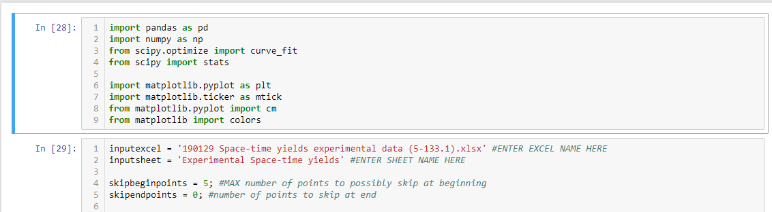
Code
Copy and paste the name of the excel file and the excel tab sheet.
Output will appear as NEW file: the original input excel name appended with “ – Modeled” at the end and in tab “Yields Modeled”. You can change this in the code if you want.
You can change the maximum number of skipped initial / final points to reduce initial/final time artifacts or scattering. If unsure, it might be best to leave the defaults.

Slide 4



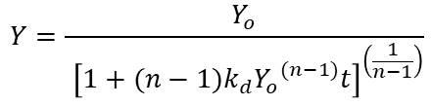

Code
If max y < 10⁻⁴, rescale max y value to 1
Hyperbolic (multi-site)
$$\frac{dN_{p}}{dt}=k{\left(N_{o}−N_{p}\right)}^{n}$$
$$Y=\frac{Y_{o}}{{ \left[1+(n−1)k_{d}{Y_{o}}^{(n−1)}t\right]}^{\left(\frac{1}{n−1}\right)}}$$
Round ≤ 5
Crop additional initial point
No
Round +1
Criteria
R² > 0.97
Yes
Round > 5
Exponential (single-site)
$$\frac{dN_{p}}{dt}=k\left(N_{o}−N_{p}\right)$$
$$Y=Y_{o}e^{{−k}_{d}t}$$
$$k=k_{d}$$
Undo scaling on parameters
Save Parameters and Graph

Slide 5
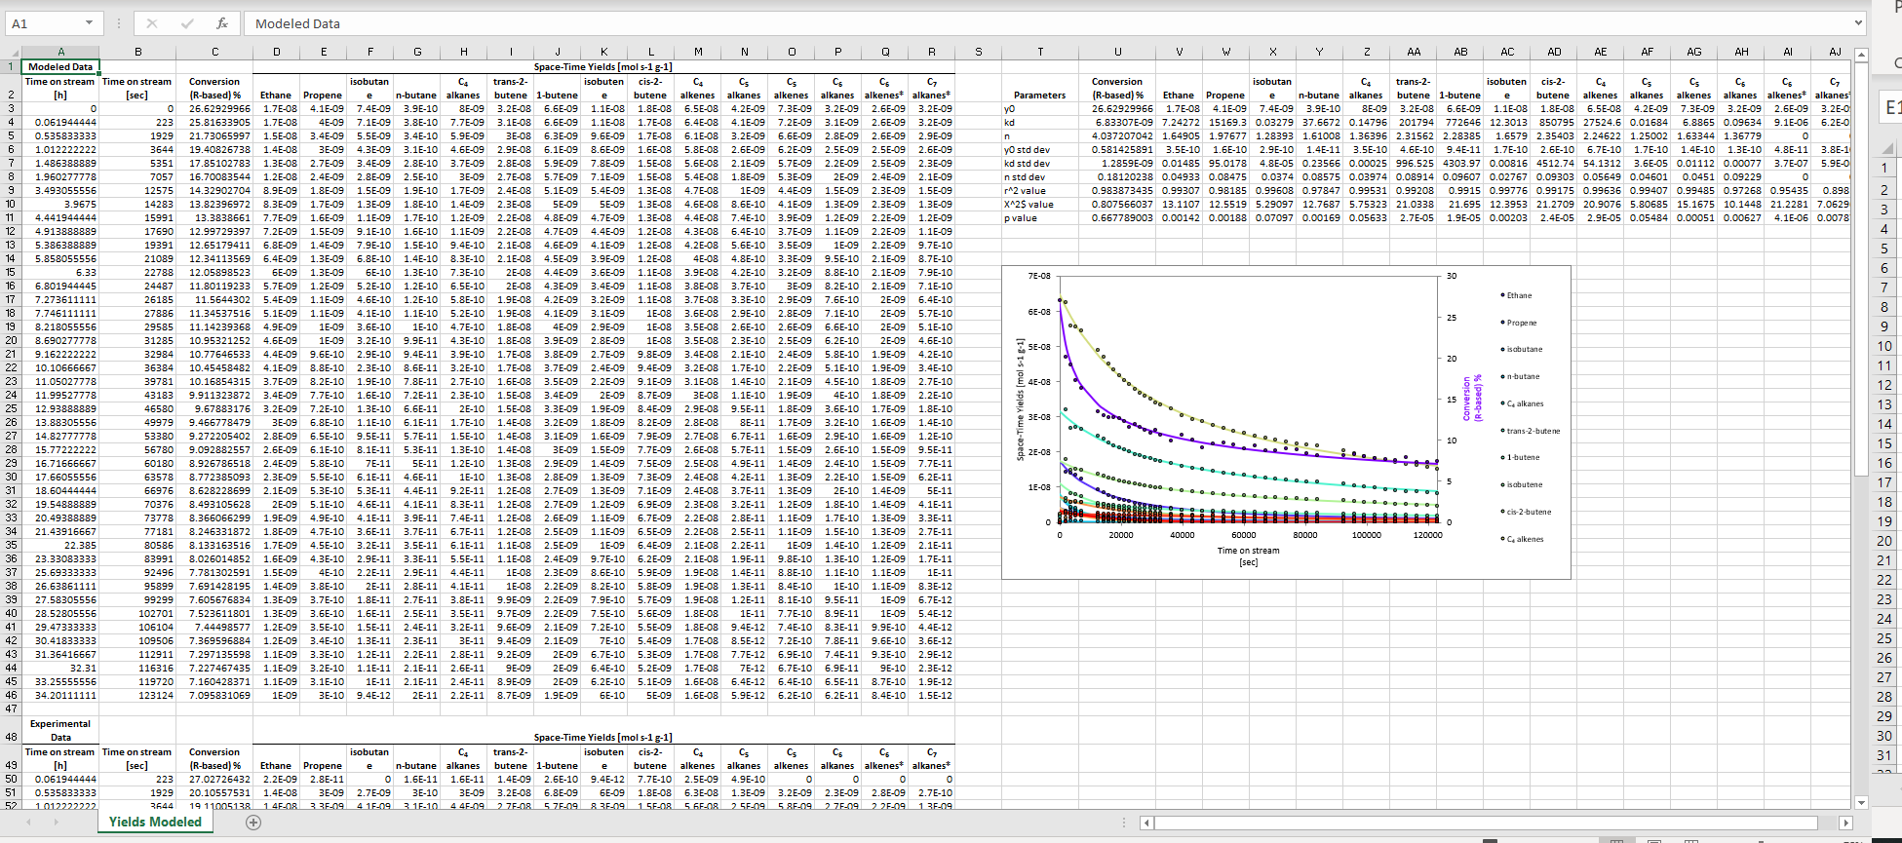
Output – recommend just moving the tab to your original excel file
Modeled points. If there is a “*” at the end of the name, the exponential decay function (single site) was used to fit. Otherwise, hyperbolic (multi) was used.
Original Experimental data
Fitted parameters, standard deviation, and Chi / p values. “*” apply here too.
Automatically plots experimental points with modeled lines in excel. Feel free to change the axis for better views. Doesn’t always default to the best things.

