Slide 1

Brain Tumor detection
and Localization
Presentation
CS661A: BIG DATA VISUAL ANALYTICS

Slide 2
Abstract
Brain tumor at an early stage is very important and also difficult task to identify. Brain tumor extraction, its analysis and Medical image processing are challenging tasks because brain image is complicated.
1
2
Segmentation plays a very important role in the medical image. In that way MRI (magnetic resonance imaging) has become a useful medical diagnostic tool for the diagnosis of brain & other medical images.
In this project, we are trying to visualize the tumor in a three dimensional way inside the brain from the MRI scans, give the approximate weight of tumor and classify them to their type.
3

Slide 3
Brain tumor classification
Brief about types
Malignant brain tumors, also known as brain cancer, are tumors that grow and spread rapidly, invading nearby tissues and potentially spreading to other parts of the body.
Benign brain tumors, on the other hand, are non-cancerous growths that typically grow slowly and do not spread to other parts of the body.
Glioma is a type of brain tumor that arises from the supportive cells (glial cells) of the brain.
Meningiomas are tumors that develop in the meninges, which are the protective membranes that surround the brain and spinal cord.
Meningiomas are usually slow-growing and are often benign, although they can occasionally be malignant.
Metastasis refers to the spread of cancer cells from one part of the body to another. Brain metastases are tumors that have originated in another part of the body and have spread to the brain
Brain tumor
malignant
benign
Glioma
Meningioma
Metastasis

Slide 4
Assistance to doctors
Automatic brain tumor segmentation is one such task which will assist and help improving doctors and radiologists accuracy in detecting and delineating the tumor sub-type.
Some Applications
Progression of tumor
It is highly desirable as it will help doctors learn about the prognostic factors and monitor the progression of the tumor and plan for treatment.
Time saving
Also task of manual segmentation is rigorous, time-consuming for doctors.
Easy to understand
Three dimensional visualization becomes easy to understand not only for doctors but for common people also.

Slide 5



Visualization toolkit
VTK is open source software for manipulating and displaying scientific data.It comes with tools for 3D rendering, a suite of widgets for 3D interaction, and extensive 2D plotting capability.
Libraries used
Insight Segmentation and Registration Toolkit
ITK provides with an extensive suite of software tools for image analysis. ITK used for segmentation, and registration of scientific images in two, three, or more dimensions.
matplotlib
Matplotlib is a comprehensive library for creating static, animated, and interactive visualizations in Python. In this project matplotlib was used for pie chart

Slide 6
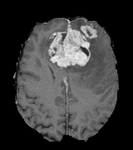
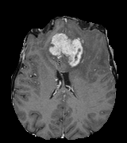
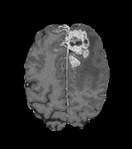
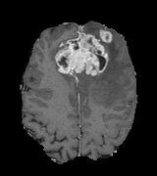
Analysis of Dataset
The dataset that we are using is BRATS_HG0015_T1C.mha. The BRATS (Multimodal Brain Tumor Segmentation Challenge) dataset is a publicly available dataset of brain MRI scans that is used for research purposes. It contains MRI scans of affected brain. Following are some of the pictures we obtained from the dataset.
Dataset contains 176 such images.The BRATS_HG0015_T1C dataset specifically refers to the T1-contrast enhanced image for the patient HG0015 in the BRATS dataset. This image is a 3D volume consisting of 240 axial slices, each with a resolution of 240x240 pixels. The T1-contrast enhanced modality is useful for identifying enhancing regions of the tumor, which can help with tumor grading and treatment planning.

Slide 7
Modules
2.
The image is thresholded using intensity thresholding, where the tumors have high intensity values, tumor pixels are marked as foreground (1) and non-tumor pixels as background (0)
1.
The connected components in the binary mask, which represent separate tumor regions, are labeled to assign a unique label to each connected component.
Component Labeling
Binarization
4.
3.
Sliders that allow the user to update various parameters, such as brain opacity, tumor mask color intensity, and parameters related to the connected components filters.
The labeled connected components are filtered based on their size, roundness, and size again
Interactive User Interface
Component Filtering

Slide 8
Binarize the image
The "base_image" is rescaled using the "itk.RescaleIntensityImageFilter" class, which maps the intensity values of the input image to a new intensity range. The "Input" parameter is set to "base_image", and the "OutputMinimum" and "OutputMaximum" parameters are set to 0 and 255, respectively.
A binary image is generated from the rescaled image using the "itk.ThresholdImageFilter" class. The "Input" parameter is set to the rescaled image, and the "Lower" parameter is set to 102, indicating that all pixels with intensity values lower than 102 will be set to 0, and pixels with intensity values equal to or greater than 102 will be set to 1.

Slide 9
Connected component Labeling
Connected component analysis is performed on the binary image using the "itk.ConnectedComponentImageFilter" class. The "Input" parameter is set to the binary image. This filter identifies connected regions of non-zero pixels in the binary image and assigns a unique label to each connected component.
The output of these steps is stored in the a variable, which presumably contains the connected components of the binary image after thresholding.

Slide 10
Connected component Filtering
A function is applied to each filter on the connected components of the input image using the ITK library's LabelShapeKeepNObjectsImageFilter class. The filtered image at each step is stored in a list.
The LabelShapeKeepNObjectsImageFilter class keeps the N largest or smallest connected components of an image, based on a specified attribute. The attr argument specifies the attribute to filter on, such as "NumberOfPixels" or "Flatness". The n argument specifies the number of objects to keep after the filter is applied.
The morpho_filters function returns a list of images, where each image is the result of applying a specific filter from the input filters list to the previous image in the list. The final image in the list is the result of applying all the filters to the original input image.

Slide 11
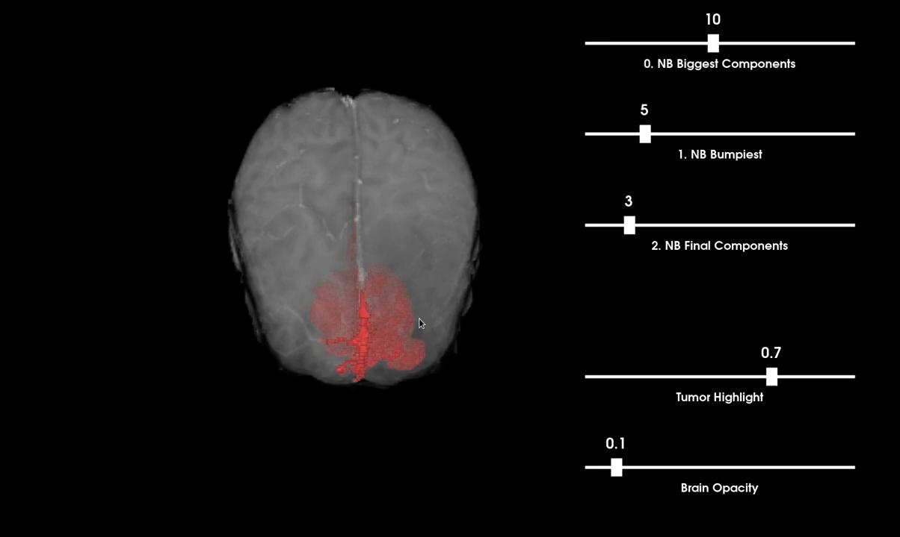
Interactive UI

Slide 12
Some Insights
Given that we have binarized the data and classified into two categories- background as 0 (non-tumor) and foreground as 1 (tumor), there is a possibility to calculate the percentage and mass of the tumor
Number of voxels in tumor-cell are compared to the number of voxels in non-tumor cells to get the percentage. Taking average mass of tumor to be 1500g, we can get the approximate mass of the tumor.
Localization : from the MRI scans we label the X and Y axis , detect the tumor based on intensity and then give the coordinate of tumor.
Based on the location, we can predict what type of brain tumor it might be.

Slide 13
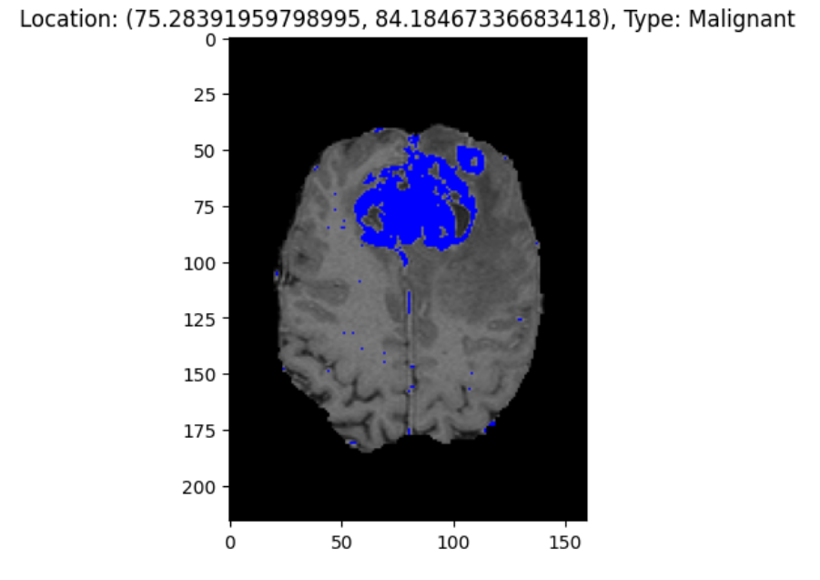
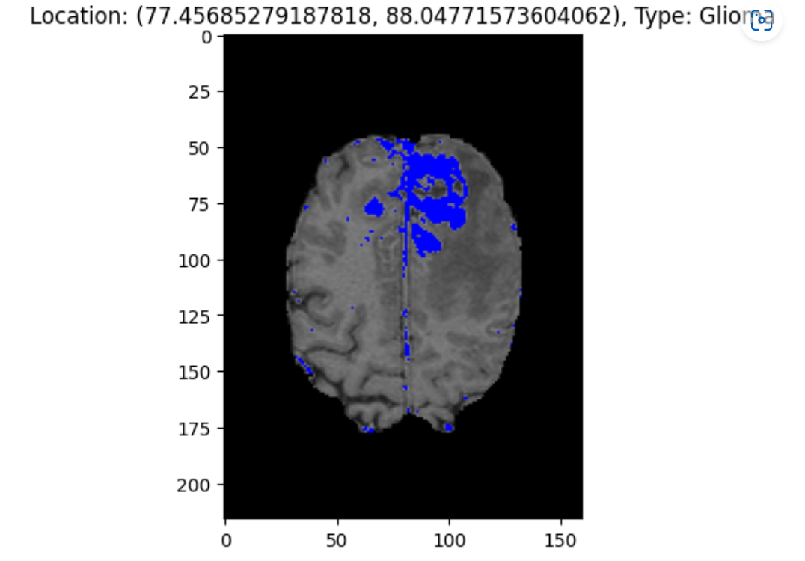
Tumor classification

Slide 14
0.39%
Percentage of tumor cells in the brain.
0.71g
Approximate mass of tumor
Glioma
Type of brain tumor

Slide 15
Blood vessels connected to tumor
There still are some blood vessels connected to the tumors -> they can probably be removed with a morphological opening.
Limitations and Scope of improvement.
May not work for all types.
This approach may not work well for all brain tumors. As the project is not tested for a significant amount of data we can not say that it will work for all types of brain tumors.
2D slice view can be added
2D slice view can be shown at the other side of the window where user can click on it to get X, Z coordinates from the click and the Y coordinate from the current index of the slice.
More details on the location of tumor
More precise location of brain tumor can make it further easy for doctors to analyse it.

Slide 16
Timeline Page
8th March, 23
11th April, 23
20 April,23
21st April,23
Project proposal
Project discussion with mentor.
Completion of project
Presentation and submission

Slide 17
References
Tumor segmentation:
https://journals.plos.org/plosone/article?id=10.1371/journal.pone.0284418
VTK Python Examples:
https://kitware.github.io/vtk-examples/site/Python/
ITK functions :
https://itk.org/Doxygen/html/group__Functions.html
https://itk.org/Doxygen/html/classitk_1_1LabelShapeKeepNObjectsImageFilter.html
Matplotlib:
https://www.w3schools.com/python/matplotlib_pie_charts.asp

Slide 18
Credits
Abhishek Kumar Pathak(22111002)
Sonam(22111057)
Taneya Soni(22111062)
Yash Uttamchandani (22111070)

