Slide 1
Face Recognition
Big Data Content Analytics
September 2019

Slide 2

The Case: Face Recognition in check in process

Slide 3
Target
After 9/11, significant progress has been made in developing and using face recognition systems in airports as US, Canadian and British Governments sponsored evaluations and challenge problems to ameliorate the error rate and thus improve systems’ performance.
Our model will be trained to identify similarity of the images taken at an airport gate (check in phase) with an existing database of images captured at an earlier point. This database could be images from sources like passport or another document.
So, next time you go to the airport you might experience something different as part of the security process: A machine scanning your face to recognize you and eventually verify you.

Slide 4
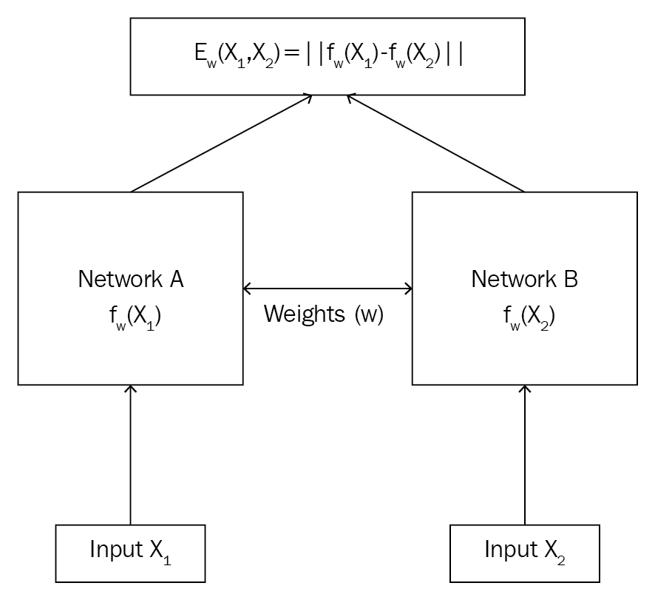
Why Siamese model?
One shot learning technique
Fewer data points. In fact only one training example per class is required.
Thus, siamese model for face recognition:
Time efficient
Low cost

Slide 5






The Dataset
Labeled Faces in the Wild database with 13,233 images of faces collected from the web.
To train our model we used only 100 images.

Slide 6
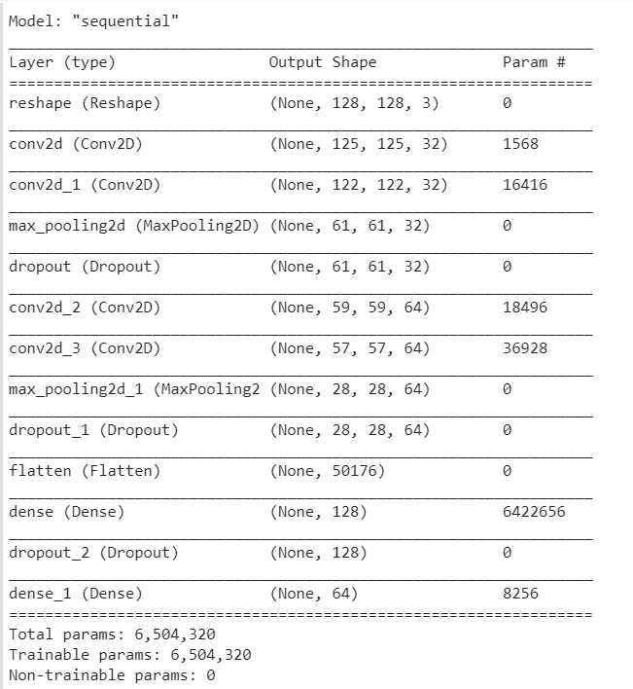
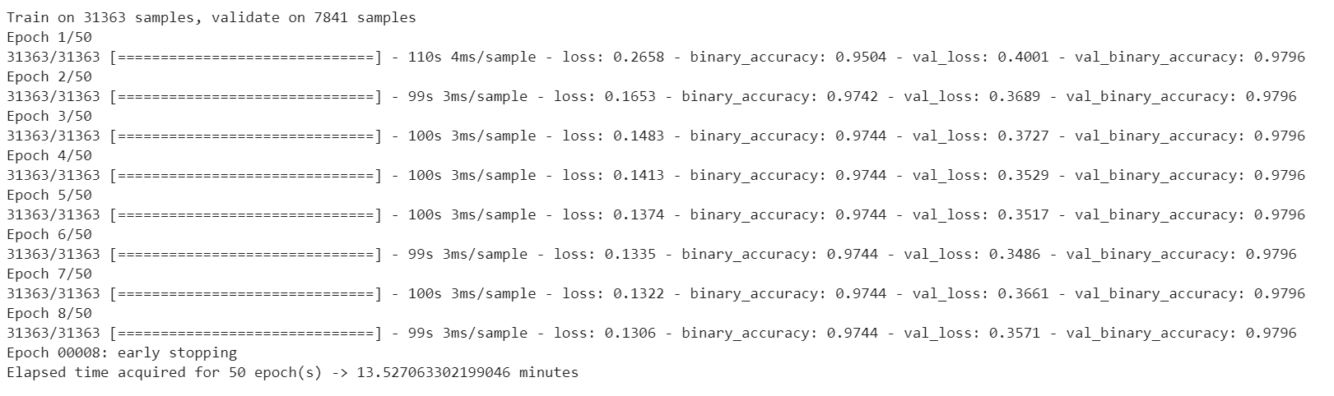
The Methodology
Training samples: 100 folders of 1 image
Epochs: 50
Batch Size : 256

Slide 7
Building the Model
Convolution layers: The convolution layer is the main building block of a convolutional neural network. It comprises of a set of independent filters. Each filter is independently convolved with the image and we end up with n (n represents the number of filters).
Pooling layer: Its function is to progressively reduce the spatial size of the representation to reduce the number of parameters and computation in the network. Pooling layer operates on each feature map independently. The most common approach used in pooling is max pooling. The FC is the fully connected layer of neurons at the end of CNN. Neurons in a fully connected layer have full connections to all activations in the previous layer.
Activation function: In our case the activation function that we used is the ReLu function, A(x) = max(0,x). The ReLu function gives an output x if x is positive and 0 otherwise.
Finally, we compile the model using Adam optimizer and loss function binary crossentropy.

Slide 8
Results

Slide 9
The Team
Gkliati Argyro
Konsolaki Eleni
Member
Business Economics & Finance
Business Economics & Finance
Background
Responsible for the business case, the dataset, the implementation of the code and the methodology
Role

Slide 10
Thank you!

