Slide 1
Consistent Training Environments in the Cloud
Jukka Nousiainen
Kalle Happonen

Slide 2
Problem:
“I need 20 similar virtual machines for my training next week.”
“Oh, and the same training should be run in {select other European country} in 3 months.”

Slide 3
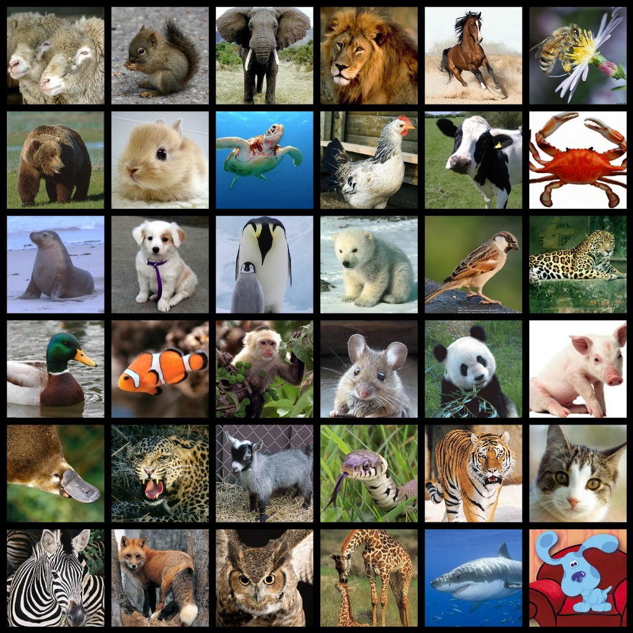

Slide 4


Slide 5
Images/Snapshots:
Pros:
Easy to understand.
Quite easy to create.
Guaranteed consistency.
Cons:
Can be very hard to transfer to (other) clouds.
Clouds might not accept user-defined images.
A bit hard to share and version.

Slide 6
Configuration mgmt:
(don't worry, it's really not as hard as it sounds)
Pros:
Very little dependencies.
Works against Any VM (TM).
Small size, easy to share and collaborate.
Cons:
Requires some pre-knowledge.
Requires some tools (e.g. ansible).

