Slide 1
Chapter 4: Informed Heuristic Search
ICS 171 Fall 2006

Slide 2
Summary
Heuristics and Optimal search strategies
  heuristics
  hill-climbing algorithms
  Best-First search
  A*: optimal search using heuristics
  Properties of A*
    admissibility,
    monotonicity,
    accuracy and dominance
    efficiency of A*
  Branch and Bound
  Iterative deepening A*
  Automatic generation of heuristics

Slide 3
Problem: finding a Minimum Cost Path
Previously we wanted an arbitrary path to a goal or best cost.
Now, we want the minimum cost path to a goal G
  Cost of a path = sum of individual transitions along path
Examples of path-cost:
  Navigation
    path-cost = distance to node in miles
      minimum => minimum time, least fuel
  VLSI Design
    path-cost = length of wires between chips
      minimum => least clock/signal delay
  8-Puzzle
    path-cost = number of pieces moved
      minimum => least time to solve the puzzle

Slide 4
Best-first search
Idea: use an evaluation function f(n) for each node
  estimate of "desirability"
  Expand most desirable unexpanded node
Implementation:
Order the nodes in fringe in decreasing order of desirability
Special cases:
  greedy best-first search
  A* search

Slide 5
Heuristic functions
8-puzzle
8-queen
Travelling salesperson

Slide 6
Heuristic functions
8-puzzle
  W(n): number of misplaced tiles
  Manhatten distance
  Gaschnig’s
8-queen
Travelling salesperson

Slide 7
Heuristic functions
8-puzzle
  W(n): number of misplaced tiles
  Manhatten distance
  Gaschnig’s
8-queen
  Number of future feasible slots
  Min number of feasible slots in a row
Travelling salesperson
  Minimum spanning tree
  Minimum assignment problem

Slide 8
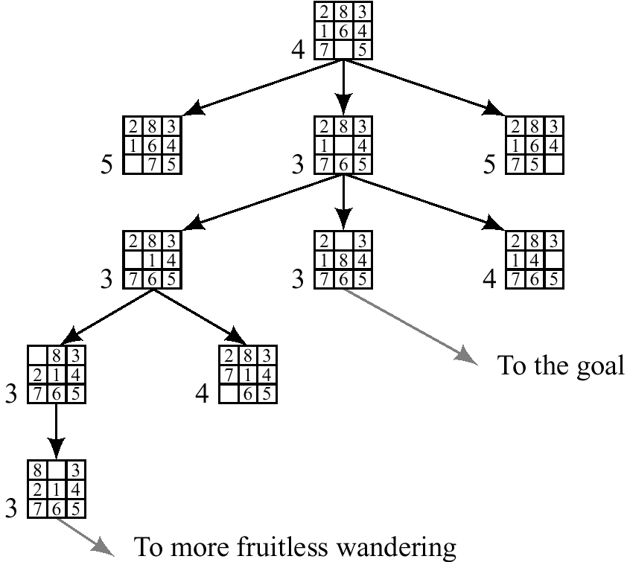
Best first (Greedy) search: f(n) = number of misplaced tiles

Slide 9
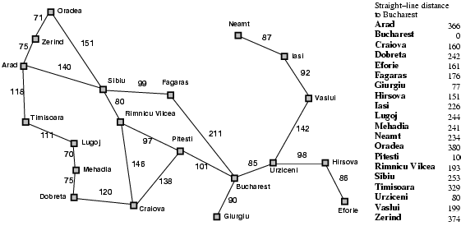
Romania with step costs in km

Slide 10
Greedy best-first search
Evaluation function f(n) = h(n) (heuristic)
= estimate of cost from n to goal
e.g., h_{SLD}(n) = straight-line distance from n to Bucharest
Greedy best-first search expands the node that appears to be closest to goal

Slide 11

Greedy best-first search example

Slide 12
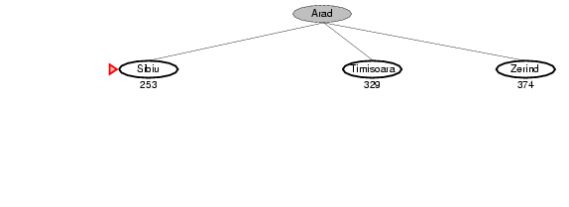
Greedy best-first search example

Slide 13
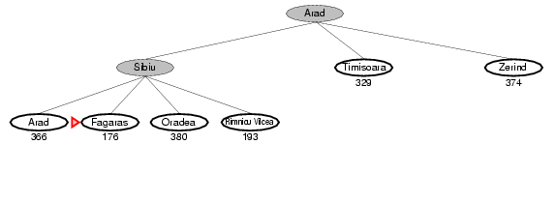
Greedy best-first search example

Slide 14
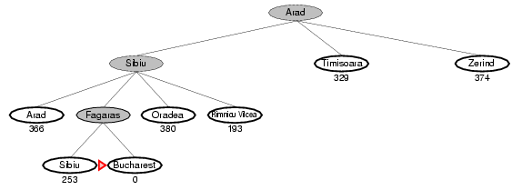
Greedy best-first search example

Slide 15
Problems with Greedy Search
Not complete
Get stuck on local minimas and plateaus,
Irrevocable,
Infinite loops
Can we incorporate heuristics in systematic search?

Slide 16
A* search
Idea: avoid expanding paths that are already expensive
Evaluation function f(n) = g(n) + h(n)
g(n) = cost so far to reach n
h(n) = estimated cost from n to goal
f(n) = estimated total cost of path through n to goal

Slide 17

A* search example

Slide 18
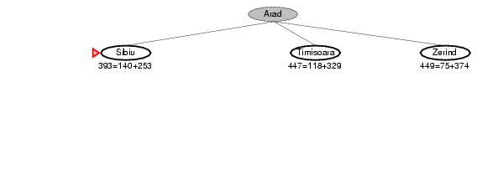
A* search example

Slide 19
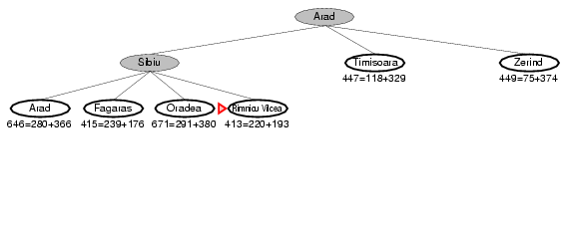
A* search example

Slide 20
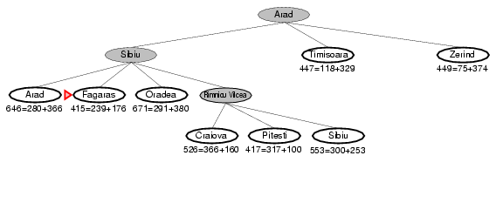
A* search example

Slide 21
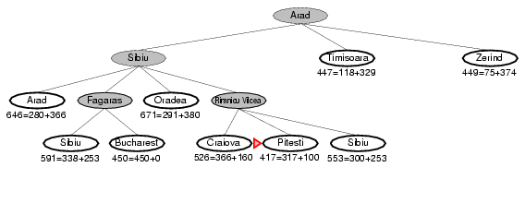
A* search example

Slide 22

A* search example

Slide 23
A*- a special Best-first search
Goal: find a minimum sum-cost path
Notation:
  c(n,n’) - cost of arc (n,n’)
  g(n) = cost of current path from start to node n in the search tree.
  h(n) = estimate of the cheapest cost of a path from n to a goal.
  Special evaluation function: f = g+h
f(n) estimates the cheapest cost solution path that goes through n.
  h*(n) is the true cheapest cost from n to a goal.
  g*(n) is the true shortest path from the start s, to n.
If the heuristic function, h always underestimate the true cost (h(n) is smaller than h*(n)), then A* is guaranteed to find an optimal solution.

Slide 24
Admissible heuristics
A heuristic h(n) is admissible if for every node n,
h(n) ≤ h*(n), where h*(n) is the true cost to reach the goal state from n.
An admissible heuristic never overestimates the cost to reach the goal, i.e., it is optimistic
Example: h_{SLD}(n) (never overestimates the actual road distance)
Theorem: If h(n) is admissible, A* using TREE-SEARCH is optimal

Slide 25
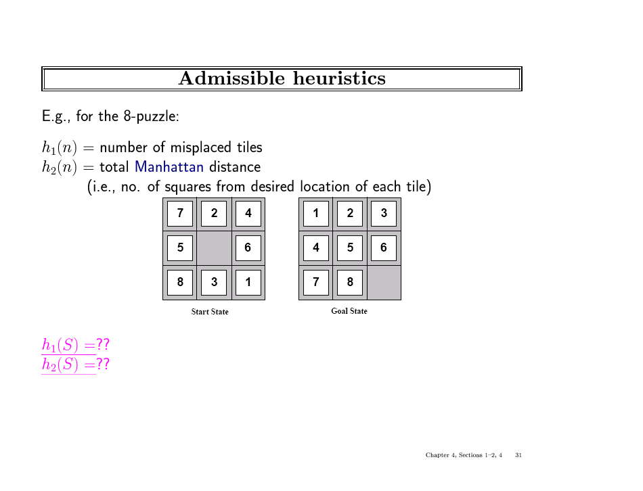

Slide 26
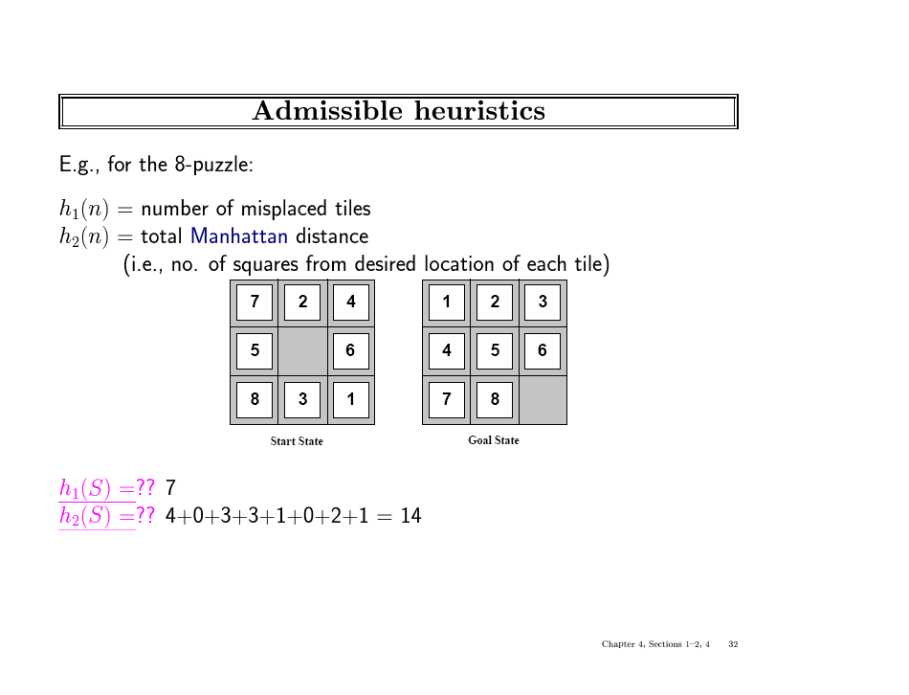

Slide 27
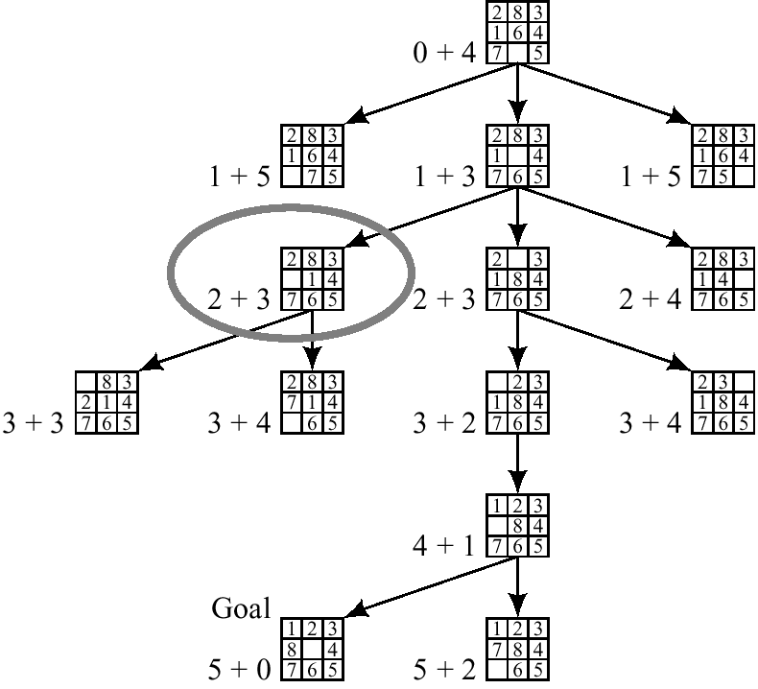
A* on 8-puzzle with h(n) = w(n)

Slide 28
Algorithm A* (with any h on search Graph)
Input: a search graph problem with cost on the arcs
Output: the minimal cost path from start node to a goal node.
  1. Put the start node s on OPEN.
  2. If OPEN is empty, exit with failure
  3. Remove from OPEN and place on CLOSED a node n having minimum f.
  4. If n is a goal node exit successfully with a solution path obtained by tracing back the pointers from n to s.
  5. Otherwise, expand n generating its children and directing pointers from each child node to n.
    For every child node n’ do
      evaluate h(n’) and compute f(n’) = g(n’) +h(n’)= g(n)+c(n,n’)+h(n)
      If n’ is already on OPEN or CLOSED compare its new f with the old f and attach the lowest f to n’.
      put n’ with its f value in the right order in OPEN
  6. Go to step 2.

Slide 29
1
4
A
B
C
2
S
2
5
G
5
3
2
4
D
E
F
A
10.4
B
C
6.7
4.0
11.0
G
S
8.9
3.0
6.9
D
E
F

Slide 30
Example of A* Algorithm in action
S
5 + 8.9 = 13.9
2 +10.4 = 12..4
A
D
3 + 6.7 = 9.7
B
D
4 + 8.9 = 12.9
7 + 4 = 11
8 + 6.9 = 14.9
C
E
E
6 + 6.9 = 12.9
Dead End
B
F
10 + 3.0 = 13
11 + 6.7 = 17.7
G
13 + 0 = 13

Slide 31
Behavior of A* - Completeness
Theorem (completeness for optimal solution) (HNL, 1968):
  If the heuristic function is admissible than A* finds an optimal solution.
Proof:
  1. A* will expand only nodes whose f-values are less (or equal) to the optimal cost path C* (f(n) less-or-equal c*).
  2. The evaluation function of a goal node along an optimal path equals C*.
Lemma:
  Anytime before A* terminates there exists and OPEN node n’ on an optimal path with f(n’) <= C*.

Slide 32
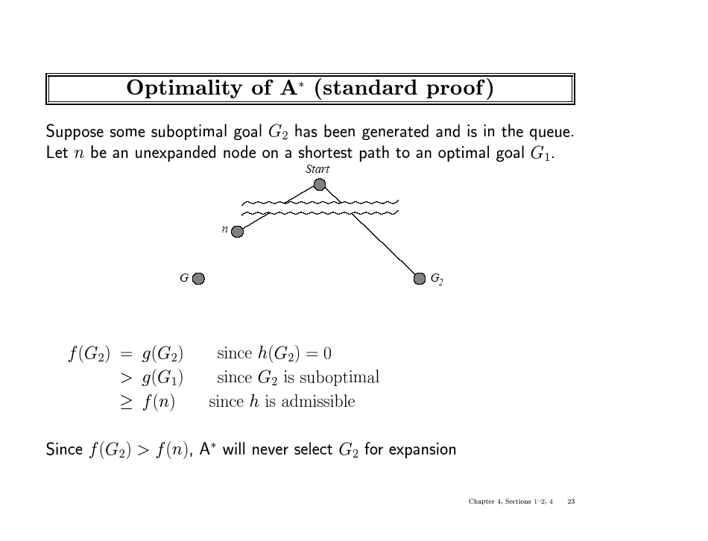

Slide 33
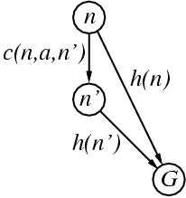
Consistent heuristics
A heuristic is consistent if for every node n, every successor n' of n generated by any action a,
h(n) ≤ c(n,a,n') + h(n')
If h is consistent, we have
f(n') = g(n') + h(n')
= g(n) + c(n,a,n') + h(n')
≥ g(n) + h(n)
= f(n)
i.e., f(n) is non-decreasing along any path.
Theorem: If h(n) is consistent, A* using GRAPH-SEARCH is optimal

Slide 34
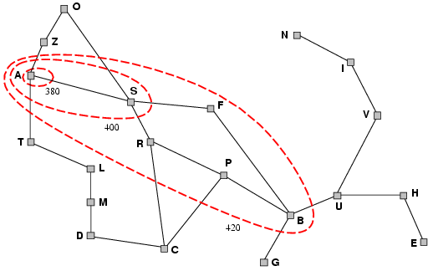
Optimality of A* with consistent h
A* expands nodes in order of increasing f value
Gradually adds "f-contours" of nodes
Contour i has all nodes with f=f_{i}, where f_{i} < f_{i+1}

Slide 35
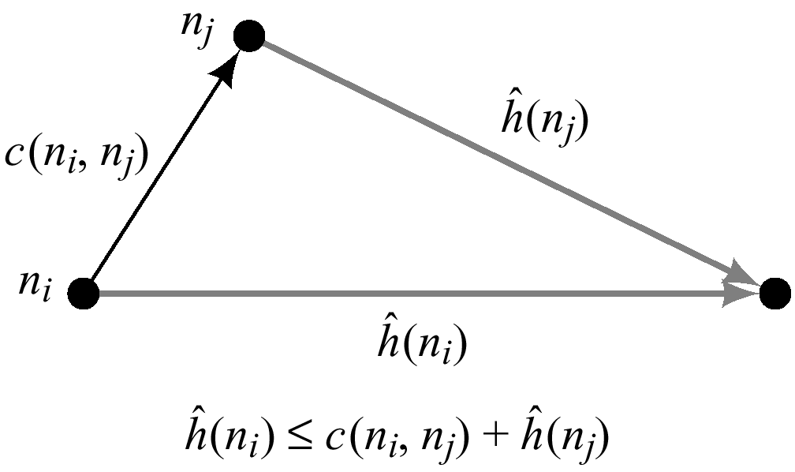
Summary: Consistent (Monotone) Heuristics
If in the search graph the heuristic function satisfies triangle inequality for every n and its child node n’: h^(ni) less or equal h^(nj) + c(ni,nj)
when h is monotone, the f values of nodes expanded by A* are never decreasing.
When A* selected n for expansion it already found the shortest path to it.
When h is monotone every node is expanded once (if check for duplicates).
Normally the heuristics we encounter are monotone
  the number of misplaced ties
  Manhattan distance
  air-line distance

Slide 36
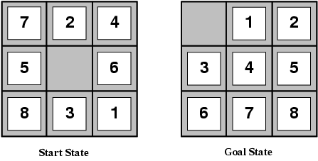
Admissible heuristics
E.g., for the 8-puzzle:
h₁(n) = number of misplaced tiles
h₂(n) = total Manhattan distance
(i.e., no. of squares from desired location of each tile)
h₁(S) = ?
h₂(S) = ?

Slide 37
Admissible heuristics
E.g., for the 8-puzzle:
h₁(n) = number of misplaced tiles
h₂(n) = total Manhattan distance
(i.e., no. of squares from desired location of each tile)
h₁(S) = ? 8
h₂(S) = ? 3+1+2+2+2+3+3+2 = 18

Slide 38
Dominance
If h₂(n) ≥ h₁(n) for all n (both admissible)
then h₂ dominates h₁
h₂ is better for search
Typical search costs (average number of nodes expanded):
d=12 IDS = 3,644,035 nodes
A*(h₁) = 227 nodes
A*(h₂) = 73 nodes
d=24 IDS = too many nodes
A*(h₁) = 39,135 nodes
A*(h₂) = 1,641 nodes

Slide 39
Complexity of A*
A* is optimally efficient (Dechter and Pearl 1985):
  It can be shown that all algorithms that do not expand a node which A* did expand (inside the contours) may miss an optimal solution
A* worst-case time complexity:
  is exponential unless the heuristic function is very accurate
If h is exact (h = h*)
  search focus only on optimal paths
Main problem: space complexity is exponential
Effective branching factor:
  logarithm of base (d+1) of average number of nodes expanded.

Slide 40
Effectiveness of A* Search Algorithm
Average number of nodes expanded
d IDS A*(h1) A*(h2)
2 10 6 6
4 112 13 12
8 6384 39 25
12 364404 227 73
14 3473941 539 113
20 ------------ 7276 676
Average over 100 randomly generated 8-puzzle problems
h1 = number of tiles in the wrong position
h2 = sum of Manhattan distances

Slide 41
Properties of A*
Complete? Yes (unless there are infinitely many nodes with f ≤ f(G) )
Time? Exponential
Space? Keeps all nodes in memory
Optimal? Yes
A* expands all nodes having f(n) < C*
A* expands some nodes having f(n) = C*
A* expands no nodes having f(n) > C*

Slide 42
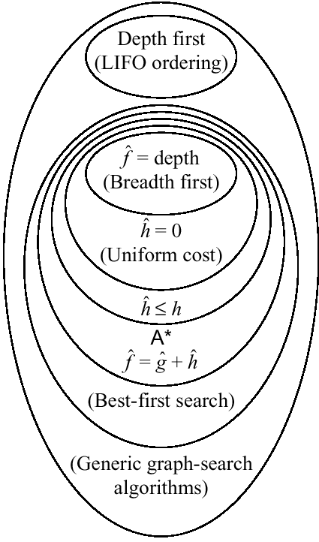
Relationships among search algorithms

Slide 43
Pseudocode for Branch and Bound Search
(An informed depth-first search)
Initialize: Let Q = {S}
While Q is not empty
pull Q1, the first element in Q
if Q1 is a goal compute the cost of the solution and update
L <-- minimum between new cost and old cost
else
child_nodes = expand(Q1),
<eliminate child_nodes which represent simple loops>,
For each child node n do:
evaluate f(n). If f(n) is greater than L discard n.
end-for
Put remaining child_nodes on top of queue in the order of their evaluation function, f.
end
Continue

Slide 44
Properties of Branch-and-Bound
Not guaranteed to terminate unless has depth-bound
Optimal:
  finds an optimal solution
Time complexity: exponential
Space complexity: linear

Slide 45
Iterative Deepening A* (IDA*)
(combining Branch-and-Bound and A*)
Initialize: f <-- the evaluation function of the start node
until goal node is found
  Loop:
    Do Branch-and-bound with upper-bound L equal current evaluation function
    Increment evaluation function to next contour level
  end
continue
Properties:
  Guarantee to find an optimal solution
  time: exponential, like A*
  space: linear, like B&B.

Slide 46
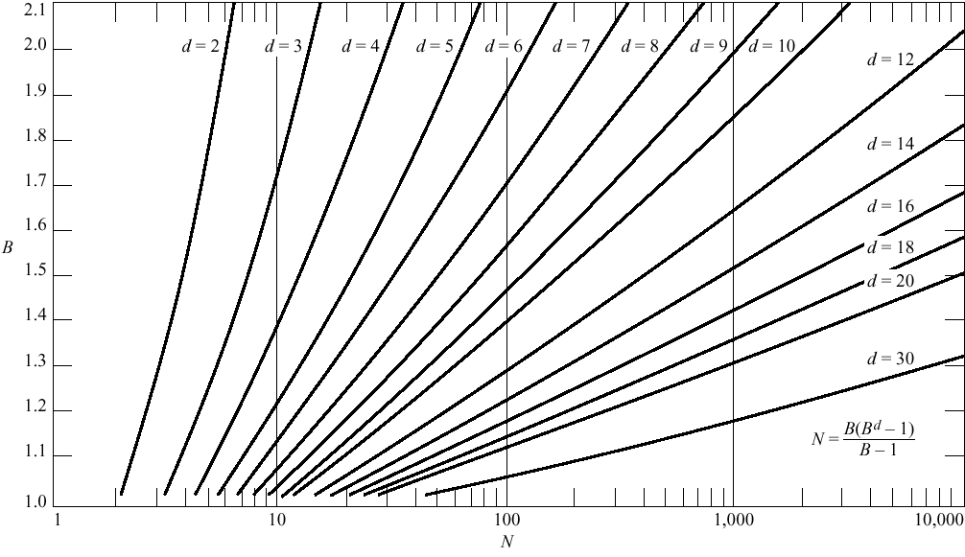

Slide 47
Inventing Heuristics automatically
Examples of Heuristic Functions for A*
  the 8-puzzle problem
    the number of tiles in the wrong position
      is this admissible?
    the sum of distances of the tiles from their goal positions, where distance is counted as the sum of vertical and horizontal tile displacements (“Manhattan distance”)
      is this admissible?
  How can we invent admissible heuristics in general?
    look at “relaxed” problem where constraints are removed
      e.g.., we can move in straight lines between cities
      e.g.., we can move tiles independently of each other
Notes:
Class 10/12 should start here

Slide 48
Inventing Heuristics Automatically (continued)
How did we
  find h1 and h2 for the 8-puzzle?
  verify admissibility?
  prove that air-distance is admissible? MST admissible?
Hypothetical answer:
  Heuristic are generated from relaxed problems
  Hypothesis: relaxed problems are easier to solve
In relaxed models the search space has more operators, or more directed arcs
Example: 8 puzzle:
  A tile can be moved from A to B if A is adjacent to B and B is clear
  We can generate relaxed problems by removing one or more of the conditions
    A tile can be moved from A to B if A is adjacent to B
    ...if B is blank
    A tile can be moved from A to B.

Slide 49
Generating heuristics (continued)
Example: TSP
Finr a tour. A tour is:
  1. A graph
  2. Connected
  3. Each node has degree 2.
Eliminating 2 yields MST.

Slide 50
Relaxed problems
A problem with fewer restrictions on the actions is called a relaxed problem
The cost of an optimal solution to a relaxed problem is an admissible heuristic for the original problem
If the rules of the 8-puzzle are relaxed so that a tile can move anywhere, then h₁(n) gives the shortest solution
If the rules are relaxed so that a tile can move to any adjacent square, then h₂(n) gives the shortest solution

Slide 51
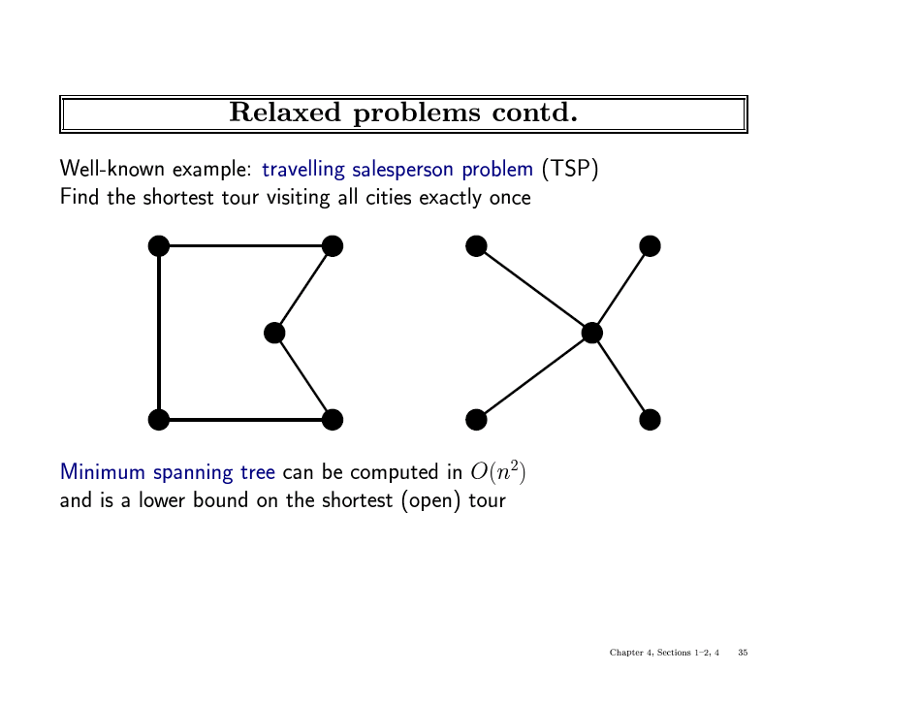

Slide 52
Automating Heuristic generation
Use Strips representation:
Operators:
  Pre-conditions, add-list, delete list
8-puzzle example:
  On(x,y), clear(y) adj(y,z) ,tiles x1,…,x8
States: conjunction of predicates:
  On(x1,c1),on(x2,c2)….on(x8,c8),clear(c9)
Move(x,c1,c2) (move tile x from location c1 to location c2)
  Pre-cond: on(x1.c1), clear(c2), adj(c1,c2)
  Add-list: on(x1,c2), clear(c1)
  Delete-list: on(x1,c1), clear(c2)
Relaxation:
1. Remove from prec-dond: clear(c2), adj(c2,c3) → #misplaced tiles
2. Remove clear(c2) → manhatten distance
3. Remove adj(c2,c3) → h3, a new procedure that transfer to the empty location a tile appearing there in the goal

Slide 53
Heuristic generation
The space of relaxations can be enriched by predicate refinements
Adj(y,z) iff neigbour(y,z) and same-line(y,z)
The main question: how to recognize a relaxed problem which is easy.
A proposal:
  A problem is easy if it can be solved optimally by agreedy algorithm
Heuristics that are generated from relaxed models are monotone.
Proof: h is true shortest path I relaxed model
  H(n) <=c’(n,n’)+h(n’)
  C’(n,n’) <=c(n,n’)
  → h(n) <= c(n,n’)+h(n’)
Problem: not every relaxed problem is easy, often, a simpler problem which is more constrained will provide a good upper-bound.

Slide 54
Improving Heuristics
If we have several heuristics which are non dominating we can select the max value.
Reinforcement learning.

Slide 55
Local search algorithms
In many optimization problems, the path to the goal is irrelevant; the goal state itself is the solution
State space = set of "complete" configurations
Find configuration satisfying constraints, e.g., n-queens
In such cases, we can use local search algorithms
keep a single "current" state, try to improve it
Constant space. Good for offline and online search

Slide 56
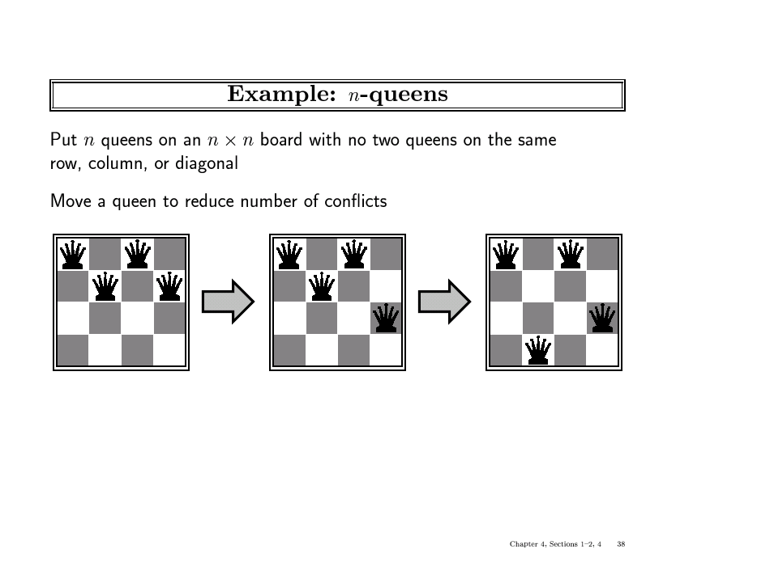

Slide 57
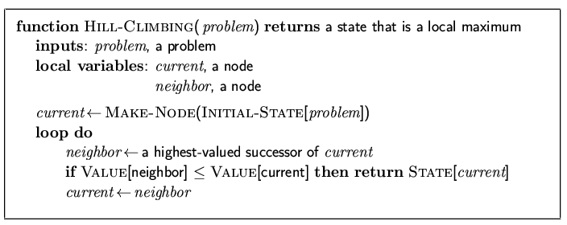
Hill-climbing search
"Like climbing Everest in thick fog with amnesia"

Slide 58
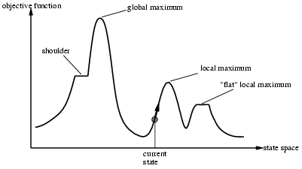
Hill-climbing search
Problem: depending on initial state, can get stuck in local maxima

Slide 59
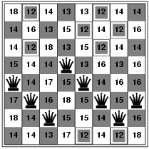
Hill-climbing search: 8-queens problem
h = number of pairs of queens that are attacking each other, either directly or indirectly
h = 17 for the above state

Slide 60
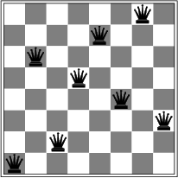
Hill-climbing search: 8-queens problem
A local minimum with h = 1

Slide 61
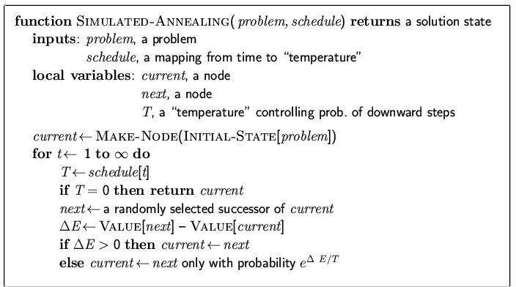
Simulated annealing search
Idea: escape local maxima by allowing some "bad" moves but gradually decrease their frequency

Slide 62
Properties of simulated annealing search
One can prove: If T decreases slowly enough, then simulated annealing search will find a global optimum with probability approaching 1
Widely used in VLSI layout, airline scheduling, etc

