Slide 1

A Practical Introduction to CSCS HPC Infrastructure
CSCS User Lab Day, Hochschule Luzern, September 9th 2019
Luca Marsella, CSCS

Slide 2

Outline of the Presentation
User Policies
Data retention
Fair usage
Resources
Filesystems
Computing
Running Jobs
The Slurm scheduler
Best practices
Troubleshooting
Documentation and list of FAQ
How to submit a support request
CSCS office building in Lugano
A Practical Introduction to CSCS HPC Infrastructure
2
Notes:
2

Slide 3
User Policies

Slide 4
General Policies
The code of conduct outlines proper practices:
Access to Source Codes: you agree to make codes available for support
Scientific Advisory Committee: committee members must not be contacted
Acknowledgements: you must acknowledge the use of CSCS resources in all publications related to your production with reference to the “project ID ###”
User Regulations define basic guidelines:
Accounts are personal and sharing them is forbidden
ETH Zurich Acceptable Use Policy for Telematics Resources (“BOT”)
Access to CSCS resources may be revoked to users violating the policies
A Practical Introduction to CSCS HPC Infrastructure
4

Slide 5
Data Retention Policies
Data backup for active projects:
Data in users and project folders is backed up (past 90 days)
Data recovery is also possible with daily snapshots (past 7 days)
Data will be removed 3 months after the expiration of the project
As soon as a project expires:
Data backup is disabled immediately
No data recovery after the final data removal
No backup for data in scratch:
No recovery in case of accidental data loss
No recovery of data deleted due to the cleaning policy
A Practical Introduction to CSCS HPC Infrastructure
5

Slide 6
Fair Usage Policies
Slurm:
The job scheduler is a shared resource among users submitting jobs
Do not submit large numbers of jobs and commands at the same time
We will be forced to kill jobs and limit new submissions
Login nodes:
Running applications on login nodes is not allowed
Submit your simulations with the Slurm scheduler on compute nodes
Heavy processes running on login nodes will be terminated
A Practical Introduction to CSCS HPC Infrastructure
6

Slide 7
Resources

Slide 8
How to access the systems
You should have already obtained an account at CSCS
The front end Ela is accessible via ssh as ela.cscs.ch:
It provides a minimal Linux environment
You can ssh the computing systems from Ela
You can start an External Data Transfer with GridFTP from/to CSCS
Please note the following:
No programming environments on the front end system
User scratch space is not accessible from Ela
$ ssh ela.cscs.ch
$ ssh daint.cscs.ch
A Practical Introduction to CSCS HPC Infrastructure
8
Notes:
8

Slide 9
Filesystems
 | /scratch (Piz Daint) | /scratch (Clusters) | /users | /project | /store
Type | Lustre | GPFS | GPFS | GPFS | GPFS
Quota | Soft quota 1 M files | None | 10 GB/user 100K files | Maximum 50K files/TB | Maximum 50K files/TB
Expiration | 30 days | 30 days | Account closure | End of the project | End of the contract
Data Backup | None | None | 90 days | 90 days | 90 days
Access Speed | Fast | Fast | Slow | Medium | Slow
Capacity | 8.8 PB | 1.4 PB | 86 TB | 4.7 PB | 3.6 PB
Soft quota:
Soft quota on scratch to prevent excessive loads on the Lustre filesystem
Quota reached: warning at submit time, no job submission allowed
A Practical Introduction to CSCS HPC Infrastructure
9

Slide 10
/scratch filesystem
Fast workspace for running jobs:
Designed for performance rather than reliability
Cleaning policy: files older than 30 days deleted daily
No backup: transfer data after job completion
Performance of Piz Daint scratch (Lustre filesystem):
Soft quota on inodes (files and folders) to avoid large numbers of small files
Occupancy impacts performance:
> 60%: we will ask you to remove unnecessary data immediately
> 80%: we will free up disk space manually removing data
All CSCS systems provide a scratch personal folder:
the variable $SCRATCH points to the user space
A Practical Introduction to CSCS HPC Infrastructure
10

Slide 11
/users and /project storage
Shared parallel filesystems based on the IBM GPFS software:
Accessible from the login nodes using native GPFS client
Storage space for datasets, shared code or configuration scripts
Better performance with larger files (archive small files with tar)
Users are NOT supposed to run jobs here:
The emphasis is on reliability over performance
All directories are backed up with GPFS snapshots
No cleaning policy until 3-months after the end of the project
Environment variables pointing to personal folders:
$HOME points to /users/$USER
$PROJECT points to /project/<group_id>/$USER
A Practical Introduction to CSCS HPC Infrastructure
11

Slide 12
Computing Resources
Computing time on Cray systems accounted in node hours:
Resources assigned over three-months windows
Quotas reset on April 1st, July 1st, October 1st and January 1st
Use thoroughly the quarterly compute budget within the time frame
Unused resources in the three-months periods cannot be recovered
Check your budget in the current allocation window:
Group usage - sbucheck
reports group usage across the various systems
Daily usage - monthly_usage
monthly_usage --individual usage per group member
Overview of resources with the Account and Resources Tool
Check the details on the dedicated page of the User Portal
A Practical Introduction to CSCS HPC Infrastructure
12

Slide 13
Piz Daint Specifications
Model | Cray XC50/XC40
XC50 Compute Nodes (Intel Haswell processor) | Intel® Xeon® E5-2690 v3 @ 2.60GHz (12 cores, 64GB RAM) and NVIDIA® Tesla® P100 16GB
XC40 Compute Nodes (Intel Broadwell processor) | Intel® Xeon® E5-2695 v4 @ 2.10GHz (18 cores, 64/128 GB RAM)
Login Nodes | Intel® Xeon® E5-2650 v3 @ 2.30GHz (10 cores, 256 GB RAM)
Interconnect Configuration | Aries routing and communications ASIC Dragonfly network topology
Scratch capacity | Piz Daint scratch filesystem: 8.8 PB
File Systems:
The variable $SCRATCH points at user space /scratch/snx3000/$USER
/project and /store mounted with read-only access on compute nodes
A Practical Introduction to CSCS HPC Infrastructure

Slide 14
Setting the Programming Environment
You should prepare the environment before running jobs:
CSCS systems use the modules framework
It manages applications and libraries path
Check currently loaded modules with module list
Modules loaded at login
The default environment on Piz Daint is PrgEnv-cray
The default architecture is XC50 (Intel Haswell): craype-haswell
Browse the available modules with module avail
Adjust targets according to your project (sbucheck)
daint-gpu targets the XC50 (Intel Haswell and P100 Tesla GPUS)
daint-mc targets the XC40 (Intel Broadwell multicore)
These modules update the MODULEPATH: use module switch to swap
A Practical Introduction to CSCS HPC Infrastructure

Slide 15
Running Jobs

Slide 16
The Slurm scheduler
Slurm is the batch system/scheduler running on CSCS machines
Permits users to run jobs with specific settings
Job submission by calling sbatch with a job script
job.sh
#!/bin/bash -l
#SBATCH --nodes=10
#SBATCH --time=0:30:00
#SBATCH --partition=normal
#SBATCH --constraint=gpu
[…]
srun myprogram
$ sbatch job.sh
A Practical Introduction to CSCS HPC Infrastructure
16

Slide 17
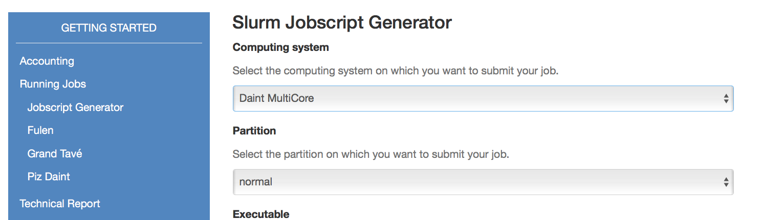
Slurm jobscripts
Our web interface for generating job scripts covers most cases
Slurm Jobscript Generator
https://user.cscs.ch/access/running/jobscript_generator/
For a comprehensive list of all options check:
$ man sbatch
A Practical Introduction to CSCS HPC Infrastructure
17
Notes:
17

Slide 18
Slurm queues on Piz Daint
Corresponding Slurm option: --partition
Permits users to run jobs on different queues
Name of the queue | Max time | Max nodes | Brief Description
debug | 30 min | 4 | Quick turnaround for test jobs (one per user)
large | 12 h | 4400 | Large scale work, by arrangement only
long | 72 h | 4 | Maximum 5 long jobs in total (one per user)
low | 6 h | 2400(gpu)/512(mc) | (currently disabled)
normal | 24 h | 2400(gpu)/512(mc) | Standard queue for production work
prepost | 30 min | 1 | High priority pre/post processing
xfer | 24h | 1 | Data transfer queue
total | 2 h |  | CSCS maintenance queue (restricted use)
https://user.cscs.ch/access/running/piz_daint/#slurm-batch-queues
A Practical Introduction to CSCS HPC Infrastructure
18
Notes:
Transfer queue free of charge. Skip mention of the low queue
18

Slide 19
Slurm queues (2)
Watch your jobs in queues with
Observe state of queues with
$ squeue -u ${USER}
daint103:~$ squeue -u simbergm
JOBID USER ACCOUNT NAME ST REASON START_TIME TIME TIME_LEFT NODES CPUS
11942503 simbergm csstaff hpx-3662-gcc-7 R None 16:36:57 30:26 5:29:34 1 24
11945966 simbergm csstaff hpx-3712-gcc-7 R None 16:44:24 22:59 5:37:01 1 72
11947200 simbergm csstaff hpx-3229-clang PD BeginTime 17:34:15 0:00 6:00:00 1 1
11947180 simbergm csstaff hpx-3684-gcc-7 PD BeginTime Tomorr 00:19 0:00 6:00:00 1 1
$ sinfo -o"%P %.5a %.10l %.6D %.6t"
daint103:~$ sinfo
PARTITION AVAIL JOB_SIZE TIMELIMIT CPUS S:C:T NODES STATE NODELIST
debug up 1-4 30:00 72 2:18:2 2 allocated nid00[448-449]
debug up 1-4 30:00 24+ 1+:12+ 14 idle nid0[0008-0011,0450-0451,3508-3511,4276-4279]
xfer up 1 1-00:00:00 9 9:1:1 2 idle nordend0[3-4]
uftp up 1 1-00:00:00 0 0:0:0 0 n/a
cscsci up 1 1-00:00:00 24+ 1+:12+ 7 down$ nid0[0125,0299,3541-3543,4579,5967]
cscsci up 1 1-00:00:00 24+ 1+:1+: 28 maint nid0[0124,0126,1144-1147,1804-1807,3492-3495,3576-
A Practical Introduction to CSCS HPC Infrastructure
19
Notes:
Mention that sinfo produces a long list of info
19

Slide 20
Job Priority
Job priority is based on partition, fairshare and waiting time
Check the reason why a job is pending with
Check your budget with Even if you still have lots of hours left, there may be other users/accounts with less usage and/or more hours allocated
If the reason is “priority”, then you have to wait longer!
Also, make sure there are no reservations in the system (maintenances, large runs, etc.)
$ sprio -w
$ squeue -u ${USER}
$ sbucheck
$ scontrol show reservations
A Practical Introduction to CSCS HPC Infrastructure
20
Notes:
20

Slide 21
Job allocations
CSCS has 3-month allocation periods
If you want to fully utilize your allocated node hours, it’s better to have a constant stream of jobs rather than packing all the jobs at the end of the allocation period
A Practical Introduction to CSCS HPC Infrastructure
21

Slide 22
Good practices when submitting jobs
For jobs with many tasks, use greasy
Specify accurate wall time
#!/bin/bash -l
#SBATCH --nodes=120
#SBATCH --time=0:30:00
#SBATCH --partition=normal
#SBATCH --constraint=gpu
module load daint-mc
module load GREASY/2.1-cscs-CrayGNU-18.08
greasy -f greasy_tasks.list
#!/bin/bash -l
#SBATCH --nodes=120
#SBATCH --time=0:30:00
#SBATCH --partition=normal
#SBATCH --constraint=gpu
[...]
Make sure your sruns work! (or sleep a little bit in between)
Run jobs off ${SCRATCH}
#!/bin/bash -l
#SBATCH --nodes=120
#SBATCH --time=0:30:00
#SBATCH --partition=normal
#SBATCH --constraint=gpu
function p() {
rt=$?;
if [[ ${rt} -ne 0 ]]; then
sleep 2
fi
return ${rt}
}
srun mytask ; p
srun mytask2 ; p
#!/bin/bash -l
#SBATCH --nodes=120
#SBATCH --time=0:30:00
#SBATCH --partition=normal
#SBATCH --constraint=gpu
#SBATCH --mail-type=ALL
#SBATCH --mail-user=<your_email>
cd ${SCRATCH}
srun ${SCRATCH}/my_binary
A Practical Introduction to CSCS HPC Infrastructure
22

Slide 23
What not to do when submitting jobs
Jobs that submit other jobs/tasks in loops
#!/bin/bash
#SBATCH ...
while :
do
srun sbatch my_job.sbatch
sleep 1
done
Jobs with hundreds of tasks in parallel
#!/bin/bash -l
#SBATCH --nodes=3
#SBATCH --time=0:30:00
#SBATCH --partition=normal
#SBATCH --constraint=gpu
export CRAY_CUDA_MPS=1
cd $SLURM_SUBMIT_DIR
date
srun --nodes=1 --bcast=/tmp/${USER} --ntasks=1 --ntasks-per-node=1 --cpus-per-task=12 tune_5x16x13_exe0 &
srun --nodes=1 --bcast=/tmp/${USER} --ntasks=1 --ntasks-per-node=1 --cpus-per-task=12 tune_5x16x13_exe1 &
srun --nodes=1 --bcast=/tmp/${USER} --ntasks=1 --ntasks-per-node=1 --cpus-per-task=12 tune_5x16x13_exe10 &
[...]
sleep 29m
Jobs with thousands of tasks
# sacct -j 123456789 |wc -l
25337
Jobs that run off ${HOME}
#!/bin/bash -l
#SBATCH --nodes=120
#SBATCH --time=0:30:00
#SBATCH --partition=normal
#SBATCH --constraint=gpu
srun ~/my_binary ~/Large_input
A Practical Introduction to CSCS HPC Infrastructure
23
Notes:
23

Slide 24


What not to do on login nodes
squeue without filtering
Avoid infinite loops
$ squeue | grep ${USER}
$ squeue -u ${USER}
#!/bin/bash
while :
do
clear
squeue | grep JOBID
squeue | grep ${USER}
sleep 1
done
watch overloads the scheduler
$ watch squeue -u ${USER}
Other loops are even more evil!
sacct + watch: even worse!
#!/bin/bash
for i in ${var}; do
sbatch my_job.sbatch
done
$ watch sacct
Use e-mail notification instead of loops with Slurm commands
GNU make without number of tasks
$ make -j
$ make -j8
#!/bin/bash -l
#SBATCH --nodes=2
#SBATCH --mail-type=ALL
#SBATCH --mail-user=<your_email>
A Practical Introduction to CSCS HPC Infrastructure
24
Notes:
24

Slide 25

Summary: How to submit jobs at CSCS
Move input data to $SCRATCH
Use the jobscript generator and accurately specify runtime
Monitor (manually) your jobs with
Use Slurm e-mail notification for live-updates on job status instead of repeated Slurm commands
Copy important output data back to /project or /home
$ cd $SCRATCH
$ cp -r ~/input .
$ sbatch job.sh
$ squeue -u ${USER}
A Practical Introduction to CSCS HPC Infrastructure
25
Notes:
25

Slide 26
Troubleshooting

Slide 27
What to do in case of trouble?
If you experience an issue on the systems:
Search the content of the User Portal (top right field)
Does your issue match any Frequently Asked Question?
For advanced topics, user’s guides may also help
module help
man
CrayPubs
A Practical Introduction to CSCS HPC Infrastructure
27
Notes:
27

Slide 28
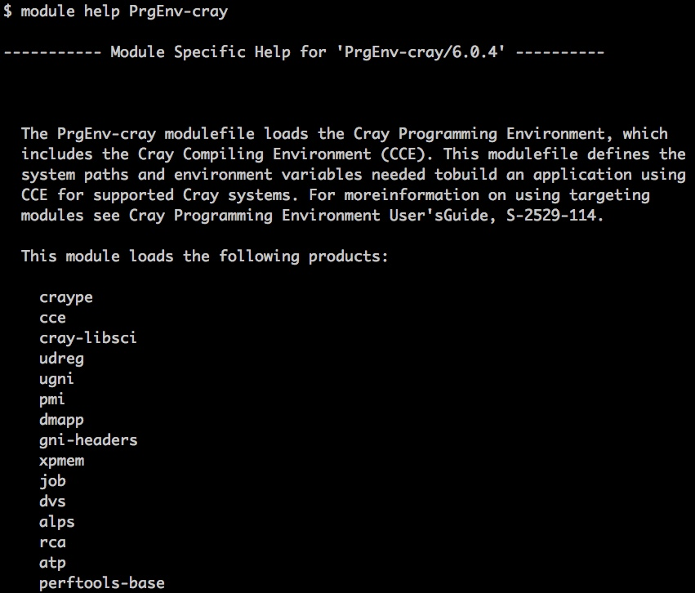
Basic Documentation
User Portal: http://user.cscs.ch
Frequently Asked Questions: https://user.cscs.ch/access/faq
More info with module help:
module help cce
Manuals and User’s Guides: command man on the shell
A Practical Introduction to CSCS HPC Infrastructure
28
Notes:
28

Slide 29
Cray Documentation
CrayPubs at http://pubs.cray.com:
Quick access and search of Cray books
man pages and third-party documentation
Available in HTML and PDF formats
Cray man pages:
Textual help files on the command line of Cray systems
man command followed by the name of the man page
Described on man(1) page accessible with man man
A Practical Introduction to CSCS HPC Infrastructure
29

Slide 30
How to submit a support request
Contact us if you can‘t find a solution:
Write an e-mail to help@cscs.ch
Specify the system and your project ID in the subject
Report the Slurm job ID and indicate the Slurm job script
Copy scripts and source files to $SCRATCH and give us access
The more detailed the request, the more effective the reply!
A Practical Introduction to CSCS HPC Infrastructure
30
Notes:
30

Slide 31
Example of a request for support
Template message to be adapted for help@cscs.ch:
Subject: Slurm job failed on Piz Daint (project <project ID>)
Content:
My username is <user name>, I submitted the job <job ID> on Piz Daint.
The job running <code name> exited with state FAILED but no error in output.
The job script (<script name>) and input files (<file list>) can be found here:
/scratch/snx3000/$USER/job
I have given read access with chmod –R +r $SCRATCH/job
Please let me know the reason of the failure.
A Practical Introduction to CSCS HPC Infrastructure
31
Notes:
7
31

Slide 32
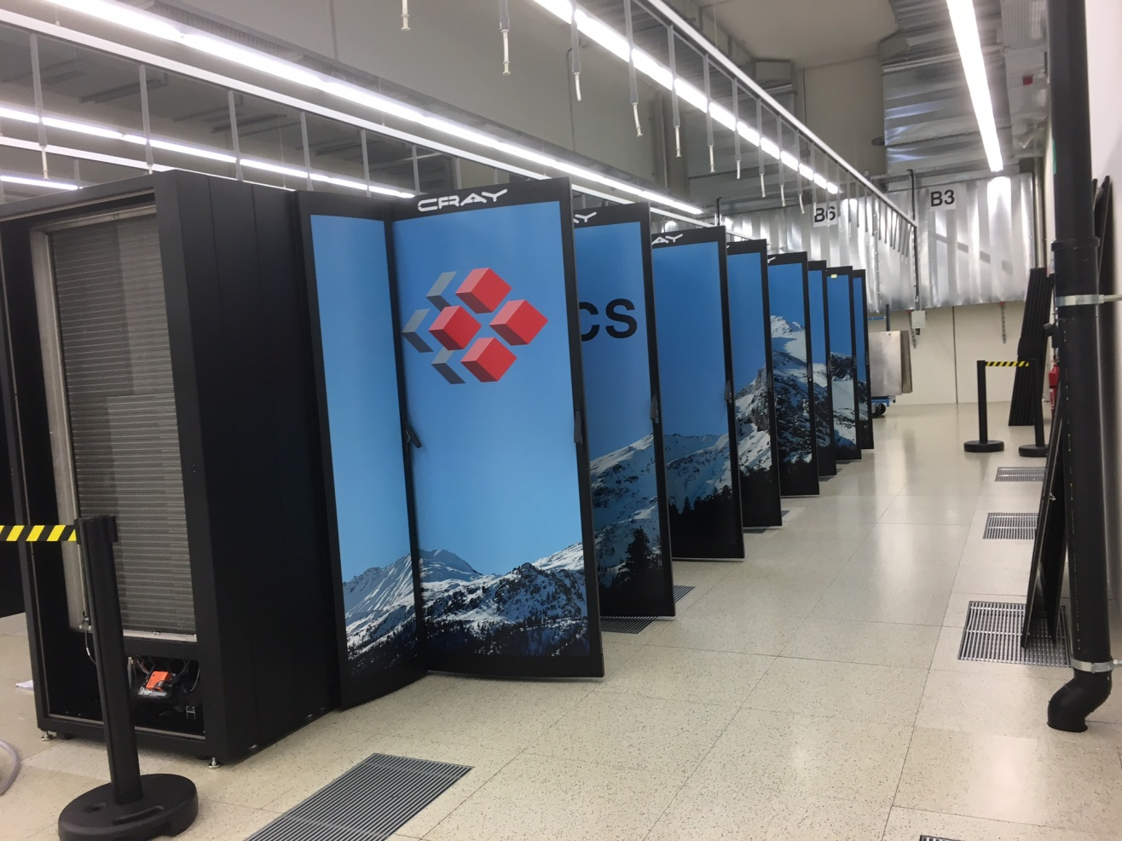
Useful links
CSCS User Portal:
https://user.cscs.ch
Cray Documentation:
https://pubs.cray.com
NVIDIA Documentation:
https://docs.nvidia.com
Contact us:
help@cscs.ch
Piz Daint in the machine room at CSCS
A Practical Introduction to CSCS HPC Infrastructure
32
Notes:
32

Slide 33
Thank you for your kind attention

