Slide 1
Regression Testing and Continuous Integration with ReFrame
CSCS User Lab Day – Meet the Swiss National Supercomputing Centre
Vasileios Karakasis, CSCS
September 11, 2018

Slide 2
Table of Contents
Overview of ReFrame
Using ReFrame with CSCS’ CI infrastructure

Slide 3
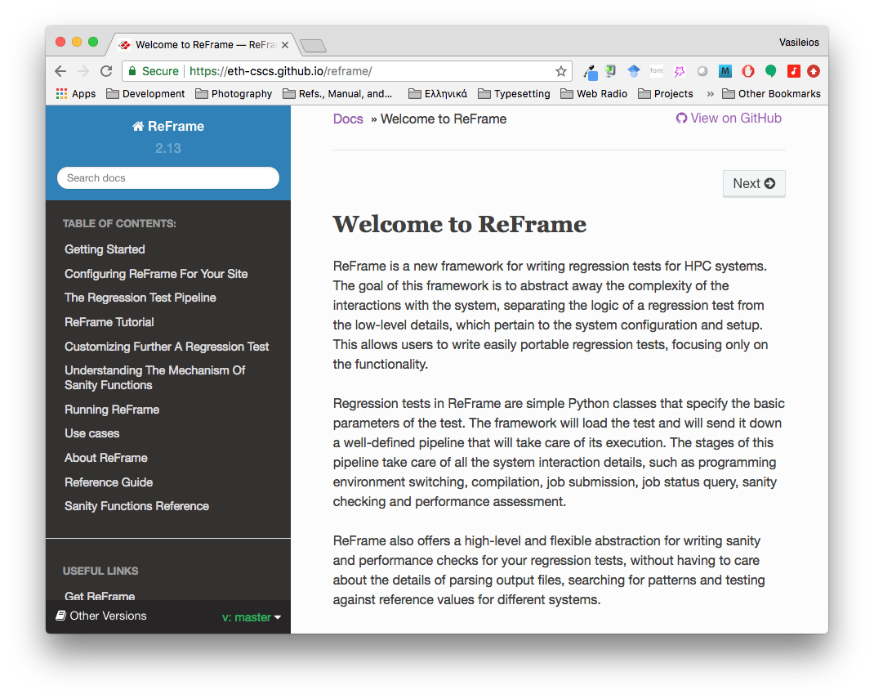
What is ReFrame?
A new regression testing framework that
allows writing portable HPC regression tests in Python,
abstracts away the system interaction details,
lets users focus solely on the logic of their test.
https://github.com/eth-cscs/reframe

Slide 4
Design Goals
Productivity
Portability
Speed and Ease of Use
Robustness
Write once, test everywhere!

Slide 5
Key Features
Separation of system and prog. environment configuration from test’s logic
Support for cycling through prog. environments and system partitions
Regression tests written in Python
Easy customization of tests
Flexibility in organizing the tests
Support for sanity and performance tests
Allows complex and custom analysis of the output through an embedded mini-language for sanity and performance checking.
Progress and result reports
Performance logging with support for Graylog
Clean internal APIs that allow the easy extension of the framework’s functionality
... and more (https://github.com/eth-cscs/reframe)

Slide 6
More Features
Multiple workload manager backends
SLURM
PBS
Torque
Multiple parallel launchers backends
srun, mpirun, mpiexec etc.
Multiple environment modules backends
Tmod, Tmod4, Lmod
Build system backends
Asynchronous execution of regression tests
Complete documentation (tutorials, reference guide)
... and more (https://github.com/eth-cscs/reframe)

Slide 7



ReFrame’s architecture
Developer of regression tests
class MyTest(…):…
Regression Test API
System abstractions
Environment abstractions
ReFrame Frontend
reframe -r
Job schedulers
Job launchers
Build systems
Environment modules
Pluggable backends
Operating System

Slide 8
Writing a Regression Rest in ReFrame
A regression test writer should not care about...
How to access to system partitions and if there are any.
How (programming) environments are switched.
How the test’s environment is actually set up.
How a job script is generated and if it’s needed at all.
How a sanity/performance pattern is looked up in the output.
ReFrame allows you to focus on the logic of your test.

Slide 9
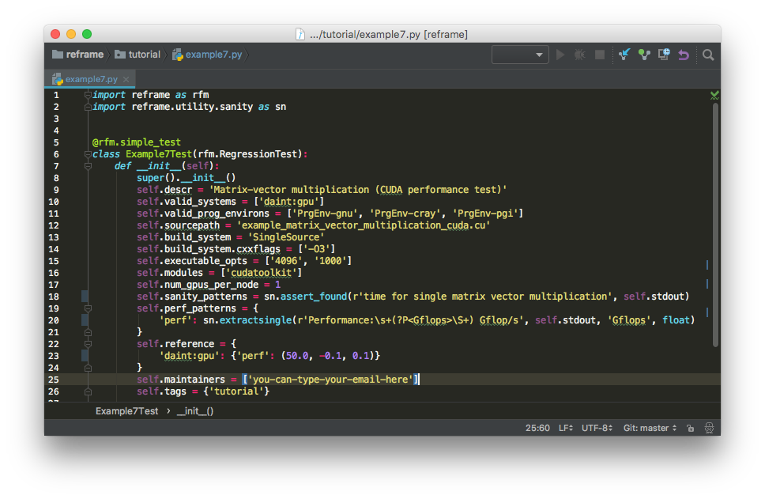
Writing a Regression Rest in ReFrame
ReFrame tests are specially
decorated classes
Valid systems and
prog. environments for this test
Sanity checking
Compilation and run setup
Extract performance
values from output
Reference values and
perf. thresholds
Tag test for easy lookup

Slide 10
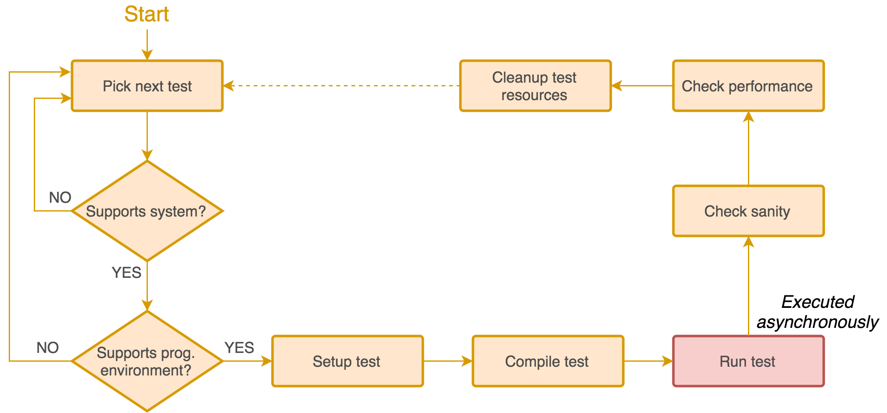
The Regression Test Pipeline / How ReFrame Executes Tests
A series of well defined phases that each regression test goes through

Slide 11
The Regression Test Pipeline / How ReFrame Executes Tests
Tests may skip some pipeline stages
Compile-only tests
Run-only tests
Users may define additional actions before or after every pipeline stage by overriding the corresponding methods of the regression test API.
E.g., override the setup stage for customizing the behavior of the test per programming environment and/or system partition.
Frontend passes through three phases and drives the execution of the tests
Regression test discovery and loading
Regression test selection (by name, tag, prog. environment support etc.)
Regression test listing or execution

Slide 12
Running ReFrame
reframe -C /path/to/config.py -c /path/to/checks -r
ReFrame uses three directories when running:
Stage directory: Stores temporarily all the resources (static and generated) of the tests
Source code, input files, generated build script, generated job script, output etc.
This directory is removed if the test finishes successfully.
Output directory: Keeps important files from the run for later reference
Job and build scripts, outputs and any user-specified files.
Performance log directory: Keeps performance logs for the performance tests
ReFrame generates a summary report at the end with detailed failure information.

Slide 13
Running ReFrame (sample output)
[==========] Running 1 check(s)
[==========] Started on Fri Sep 7 15:32:50 2018
[----------] started processing Example7Test (Matrix-vector multiplication using CUDA)
[ RUN ] Example7Test on daint:gpu using PrgEnv-cray
[ OK ] Example7Test on daint:gpu using PrgEnv-cray
[ RUN ] Example7Test on daint:gpu using PrgEnv-gnu
[ OK ] Example7Test on daint:gpu using PrgEnv-gnu
[ RUN ] Example7Test on daint:gpu using PrgEnv-pgi
[ OK ] Example7Test on daint:gpu using PrgEnv-pgi
[----------] finished processing Example7Test (Matrix-vector multiplication using CUDA)
[ PASSED ] Ran 3 test case(s) from 1 check(s) (0 failure(s))
[==========] Finished on Fri Sep 7 15:33:42 2018

Slide 14
Running ReFrame (sample failure)
[==========] Running 1 check(s)
[==========] Started on Fri Sep 7 16:40:12 2018
[----------] started processing Example7Test (Matrix-vector multiplication using CUDA)
[ RUN ] Example7Test on daint:gpu using PrgEnv-gnu
[ FAIL ] Example7Test on daint:gpu using PrgEnv-gnu
[----------] finished processing Example7Test (Matrix-vector multiplication using CUDA)
[ FAILED ] Ran 1 test case(s) from 1 check(s) (1 failure(s))
[==========] Finished on Fri Sep 7 16:40:22 2018
==============================================================================
SUMMARY OF FAILURES
------------------------------------------------------------------------------
FAILURE INFO for Example7Test
* System partition: daint:gpu
* Environment: PrgEnv-gnu
* Stage directory: /path/to/stage/daint/gpu/PrgEnv-gnu/Example7Test
* Job type: batch job (id=823427)
* Maintainers: ['you-can-type-your-email-here']
* Failing phase: performance
* Reason: sanity error: 50.363125 is beyond reference value 70.0 (l=63.0, u=77.0)
------------------------------------------------------------------------------

Slide 15
Running ReFrame (examining a failure)
ReFrame executes each test case from a separate stage directory:
/path/to/stage/<system>/<partition>/<testname>/<environ>
Auto-generated build script and compilation’s standard output/error
rfm_<testname>_build.sh
rfm_<testname>_build.out
rfm_<testname>_build.err
Auto-generated job script and execution’s standard output/error
rfm_<testname>_job.sh
rfm_<testname>_job.out
rfm_<testname>_job.err

Slide 16
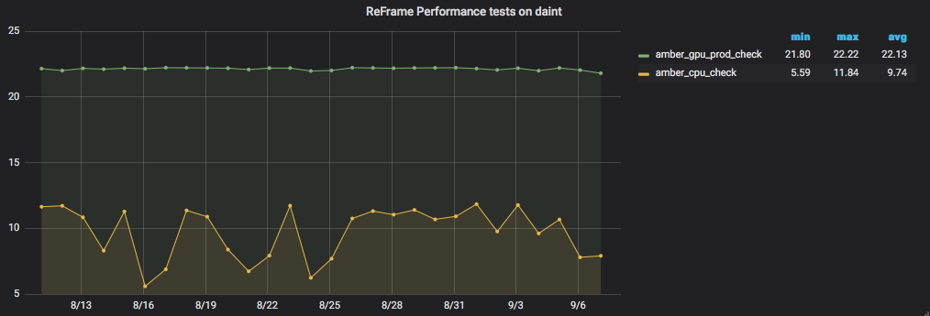
Running ReFrame (examining performance logs)
/path/to/reframe/prefix/perflogs/<testname>.log
A single file named after the test’s name is updated every time the test is run
Log record output is fully configurable
2018-09-07T15:32:59|reframe 2.14-dev2|Example7Test on daint:gpu using PrgEnv-cray|jobid=823394|perf=49.71432|ref=50.0 (l=-0.1, u=0.1)
2018-09-07T15:33:11|reframe 2.14-dev2|Example7Test on daint:gpu using PrgEnv-gnu|jobid=823395|perf=50.1609|ref=50.0 (l=-0.1, u=0.1)
2018-09-07T15:33:42|reframe 2.14-dev2|Example7Test on daint:gpu using PrgEnv-pgi|jobid=823396|perf=51.078648|ref=50.0 (l=-0.1, u=0.1)
2018-09-07T16:40:22|reframe 2.14-dev2|Example7Test on daint:gpu using PrgEnv-gnu|jobid=823427|perf=50.363125|ref=70.0 (l=-0.1, u=0.1)
ReFrame can also send logs to a Graylog server, where you can plot them with web tools.

Slide 17
Using ReFrame with the CSCS CI service

Slide 18
Use Case
Target code: Arbor Library
A library for implementing performance portable network simulations of multi-compartment neuron models.
https://github.com/eth-cscs/arbor
Goals
Run the library’s unit tests with...
different supported compilers (GNU, Clang)
different code configurations (base, GPU-enabled, SIMD-enabled)
Reuse the same ReFrame tests for other target systems
My laptop (where Clang is available)

Slide 19
Limitations
The Jenkins VM is allowed to run only sbatch
VM’s environment is completely different from the target environment (Daint)
ReFrame cannot be run directly from the Jenkins VM, but...
we can configure it properly for Daint’s compute nodes and sbatch it.

Slide 20
Configuration Steps
Set up the Jenkins project (as shown previously)
Prepare the code repository
Add a Jenkinsfile at the top-level directory
Add a batch script for running ReFrame on the compute nodes
Add the ReFrame tests
Add a ReFrame configuration file for the target systems
Open a pull request

Slide 21
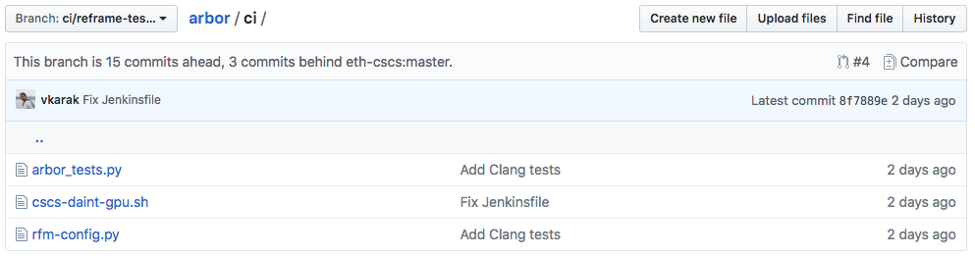
Code Repository Set-up
ReFrame tests
Batch script to launch
ReFrame on the compute nodes
ReFrame config
Demo branch: https://github.com/vkarak/arbor/tree/ci/reframe-tests/ci

Slide 22
ReFrame Configuration
Daint
Job scheduler: local+srun (i.e., do not submit any job, but use srun to parallel launch executables)
Programming environments: Cray, GNU, Intel, PGI
My laptop
Job scheduler: local (i.e., do not submit any job and do not use any parallel launcher)
Programming environments: Clang
Other systems (such as TravisCI’s VMs) etc.

Slide 23
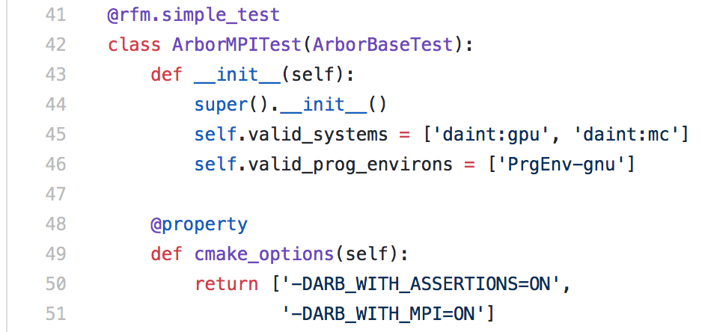
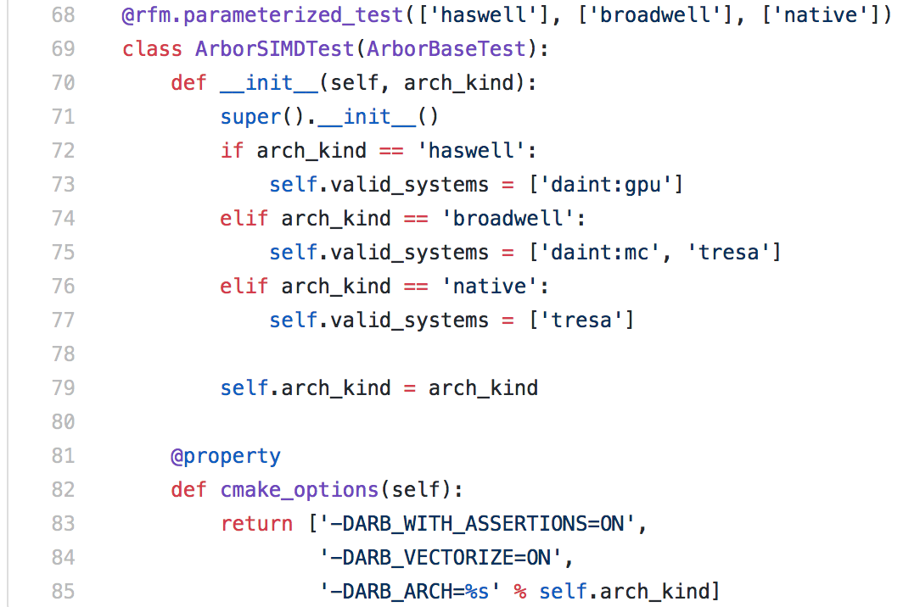
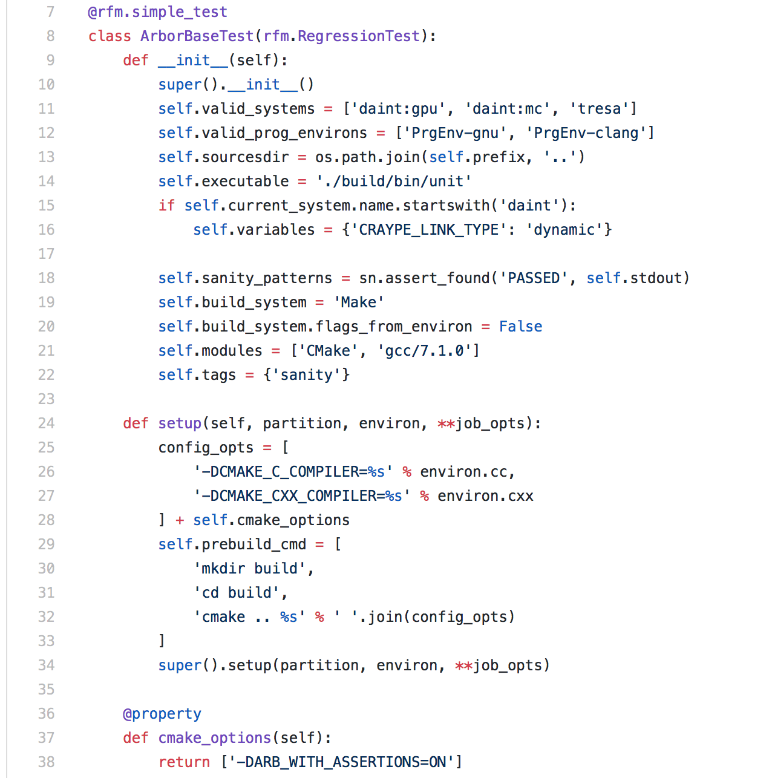
ReFrame Tests
You can use inheritance to avoid redefining common functionality!
Valid systems and
valid prog. environments
Top-level source directory
Execute the unit tests
Look for PASSED in stdout
Setup the corresponding CMake flags from the current environment
Configure build
Use parameterized tests to create test factories!

Slide 24
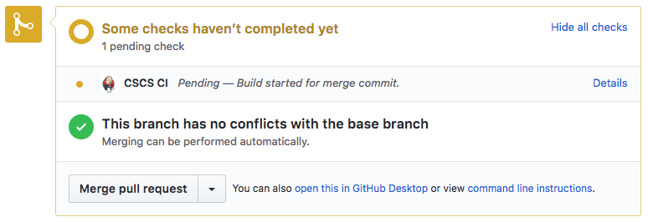
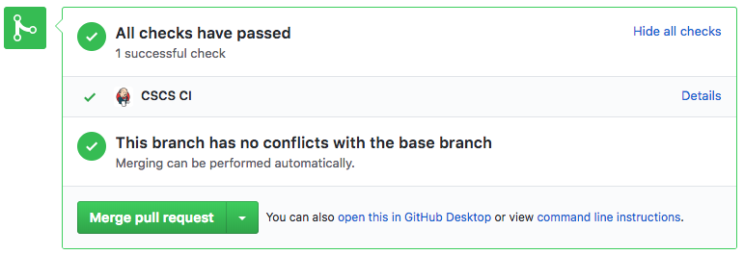
Open a Pull Request
As soon as you open a PR or push to the PR, CSCS’ CI will be triggered.
Demo PR: https://github.com/vkarak/arbor/pull/4

Slide 25
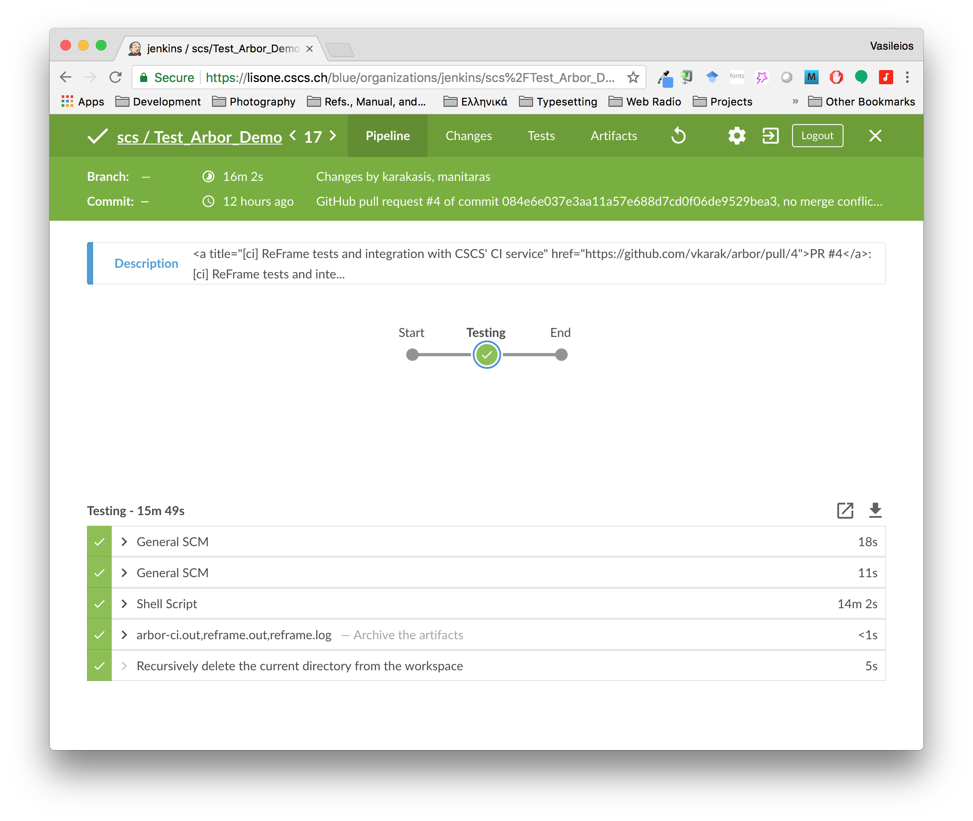
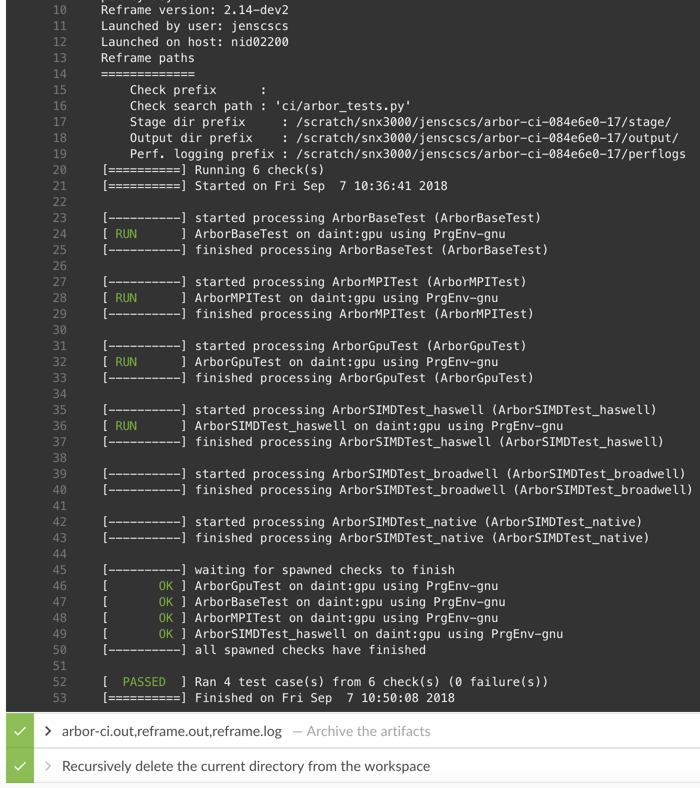
Examine ReFrame’s Output Inside Jenkins

Slide 26
Conclusions and Future Directions
ReFrame is a powerful tool that allows you to leverage continuous integration in an HPC environment without having to deal with the low-level system interaction details.
High-level tests written in Python
Portability across HPC system platforms
Comprehensive reports and reproducible methods
ReFrame is being actively developed with a monthly release-cycle.
Future directions
Full integration with CSCS’ CI service (no need for the intermediate submission script)
Test dependencies
Support for containers
Frontend and API improvements
Bug reports, feature requests, help @ https://github.com/eth-cscs/reframe

Slide 27
Thank you for your attention.

