Slide 1
Advanced Python
Statistics with Python for Advanced Users

Slide 2
An overview

Slide 3
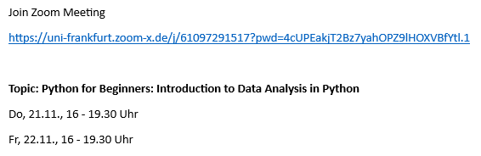
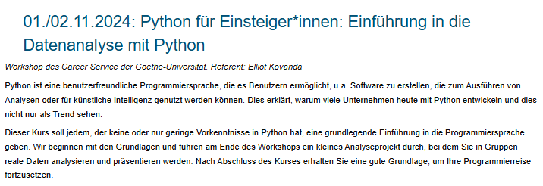
Previously...
1x
2x
Statistics and Data Visualization in Python for Advanced Users (German, 2-Day)
3x
3
Python courses in the summer semester 2025 (so far)

Slide 4
Whom did I develop the course for?
Python
Newbies
Code Users
Python Users
Python Experts
Python Knowledge

Slide 5
Feedback from previous courses
❤ High demand & high satisfaction
❤ Python data analysis is a valuable skillset
❤ Tasks can be completed at your own pace
❤ Possibility to ask questions at any time
_____________________________________________________________________
💡 Placing an even stronger focus on career prospects
💡 Cheat Sheet for reference

Slide 6
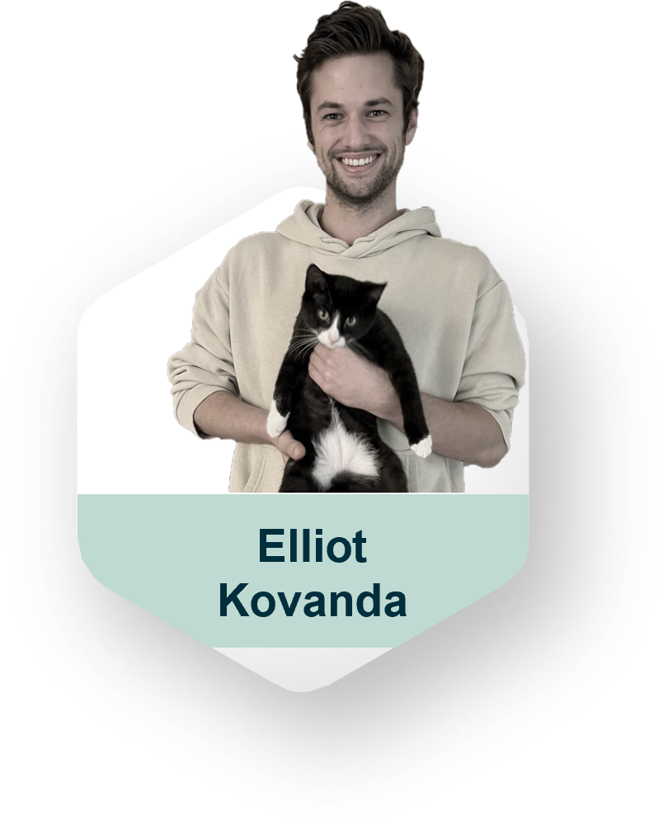
Who am I?
Call me Elliot 😊
Studied abroad
Business Psychology (BSc)
Operational Research with Data Science (MSc)
Data Scientist at Commerzbank
I work with data and develop AI models
My favorite library is pandas
My Hobbies
🐈 🐈
🎮🎲
👩‍💻💻

Slide 7
Course Objectives
Theory
Practice
Statistical concepts
Variables
Correlation vs. Causation
Introduction to Hypothesis Testing
Introduction to Linear Regression
Implementation with Python
Advanced data processing
Create interactive visualizations
Calculation of statistical analyses
You won't need a master’s degree in mathematics

Slide 8



How do we achieve your goals?
Presen-tations
Interactive Challenges
Your questions
Notes:
Presentations prepared by me
Interactive Coding Challenges
Own projects
Your questions and mutual support

Slide 9


What will we need?
Trinket
Colab, JupyterLite
LLM
Notes:
PCs / Laptops / MacBooks
Trinket.io, Google Colaboratory / JupyterLite
Workshop Forum TBD
Bing Copilot / Chat GPT / Google Gemini

Slide 10
Schedule Day 1
Fell free to take breaks ☕ at any time
4pm – 7:30pm:
Introduction to Statistical Concepts + Python Practice
If you have to leave earlier, you may 👋
This is your course. Make the most of it 🙋‍♀️
Notes:
You develop one or more projects of your choice
Project 1: Interactive mini-games
Hangman, Match Four etc.
Project 2: Trading Bot
You develop an algorithm that simulates stock purchases and sales
You test your bot on real historical data

Slide 11
Schedule Day 2
Fell free to take breaks ☕ at any time
4pm – 7:30pm:
(Introduction to Statistical Concepts + Python Practice)
Advanced data processing in Python
Interactive visualizations in Python
If you have to leave earlier, you may 👋
This is your course. Make the most of it 🙋‍♀️
Notes:
You develop one or more projects of your choice
Project 1: Interactive mini-games
Hangman, Match Four etc.
Project 2: Trading Bot
You develop an algorithm that simulates stock purchases and sales
You test your bot on real historical data

Slide 12
Why pursue data analysis and statistics?

Slide 13
Disclaimer
This will not be a statistics lecture.
I will present some things in a simplified way.
This makes the content more accessible to everyone.
@Stats nerds: Forgive me if I am sometimes imprecise or simplify topics to achieve this goal

Slide 14
Benefits of Data Analysis & Statistics
Applications
Identifying patterns & connections
Facts > opinions
Make automated decisions
Studies & Research Creating new knowledge through analysis
Management Make informed decisions
Data Analyst / Data Scientist Enable or automate informed decisions
In everyday life
Better media literacy

Slide 15
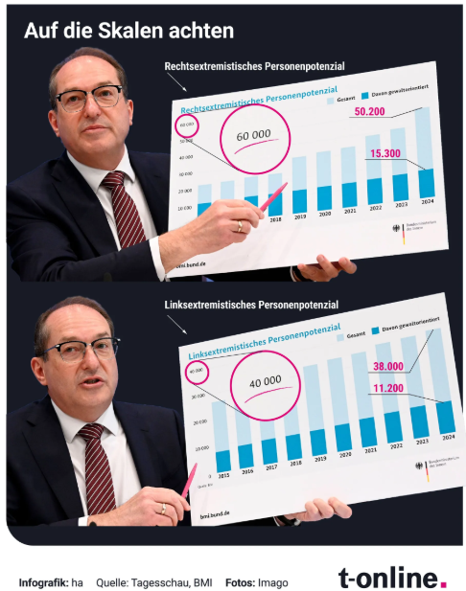
Distorted axes

Slide 16
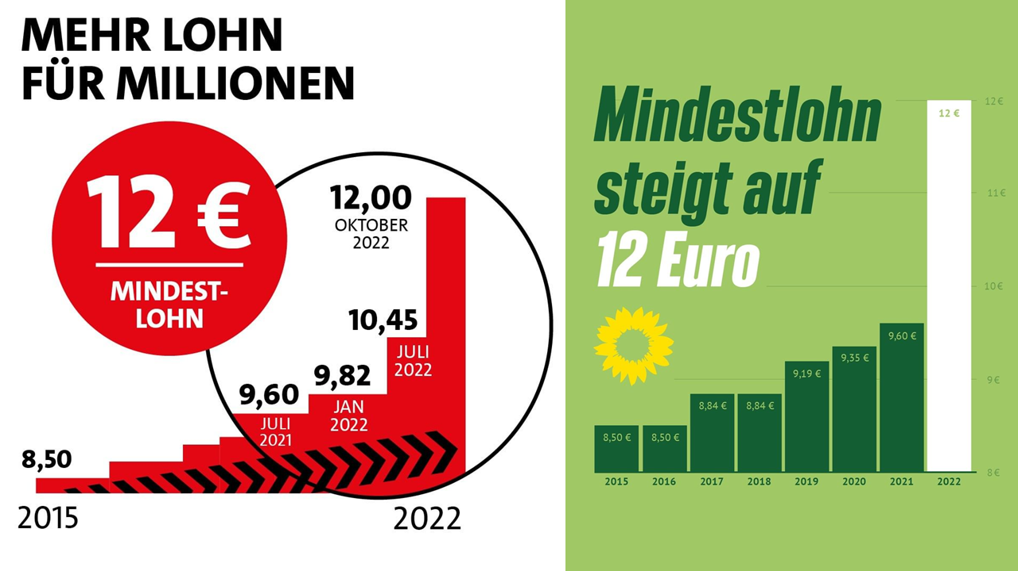
Distorted axes

Slide 18
Our sales grew 20%!
We doubled our market share!
Year | Sales Units | Market Share
2023 | 100 | 0.5%
2024 | 120 | 1%

Slide 19
What about the profit?
Looks like the market shrunk...
Year | Sales Units | Market Share
2023 | 100 | 0.5%
2024 | 120 | 1%

Slide 20

Professional relevance
Discipline | Example question
Marketing | Will the new advertising campaign increase sales?
Pharma Research | Does a new drug shorten recovery time?
Sports Analysis | What player metrics are related to win rate?
Education | Do students learn more effectively with a new tool?
Management / Finance | What factors determine the development of a company or portfolio?
Human resource management | How does working from home affect employee satisfaction?
Journalism | How do we communicate income differences effectively?
… | …
Notes:
It is both about creating analyses and consuming.

Slide 21
An outlook… 🔜
Python Demo

Slide 22
What do we mean by data analysis & statistics?

Slide 23
Exploratory analysis
Statistical analysis
Describes the past
Describes the future
Tries to find patterns –
Regardless of their causality
Tries to find patterns with a causal relationship.
Uses statistics such as mean, minimum, maximum to describe characteristics of the collected data.
Uses numerous visualizations to discover various connections
Uses statistics such as p-value or R-value to describe the validity of predictive models.
Uses visualizations sparingly, especially to communicate results

Slide 24

An example
6.1% of all women, but only 4.5% of men, clicked on the advertisement. → Exploratory
Advertising leads to significantly more interaction among women than men (p = 0.02). → Statistical

Slide 25
An example
6.1% of all women, but only 4.5% of men, clicked on the advertisement. → Exploratory
Advertising leads to significantly more interaction among women than men (p = 0.02). → Statistical
Makes a statement about the given observations
Makes a statement about future
observations

Slide 26
Correlation vs Causation

Slide 27
"Correlation does not imply causation"
- Every statistics professor ever

Slide 28
An example
Firefighters do MORE DAMAGE!!! 🔥🧑‍🚒🚒

Slide 29
An example
Ice cream sales cause heat stroke!!1! 🍧🤯

Slide 30
Correlation
Causality
Two variables change with each other.
The measure of correlation is the r-value from -1 to +1.
Two variables change because of each other.
The measure of causality is the p-value
and the effect size.
Common change can be accidental:
🍧 & 🎳
Common change can be explained by third factors: 🍧&🤯← 🌞
Joint change can be causal:
🍧& 😊 / 😢
To establish causality, we need to prove with sufficient probability that independent variables
affect dependent variables.
Notes:
*to put it simply,

Slide 31
Three types of correlation
Positive (r > 0)
Negative ( r < 0)
None (r ≈ 0)
"If A rises, B rises" (or vice versa)
"If A rises, B falls" (or vice versa)
“If A rises, B falls or rises"

Slide 32
It's your turn!
Python Exercises
Notebook 1 - Beginning

Slide 33
The Great Tree of Statistical Tests
Notes:
https://editverse.com/de/choosing-the-right-statistical-test-a-2024-flowchart-approach/

Slide 34
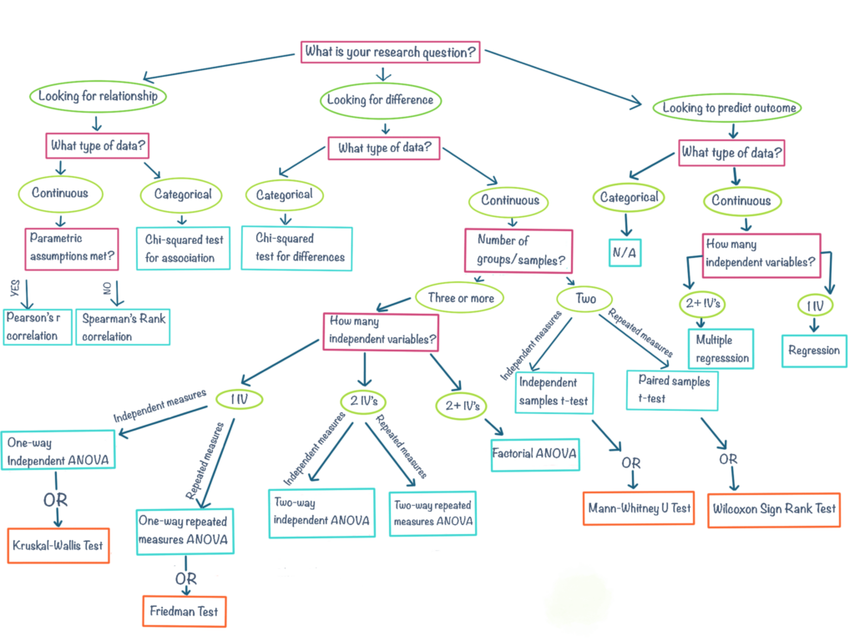
Those: https://ctil.dundee.ac.uk/kb/stats-bites-choosing-your-analysis/

Slide 35
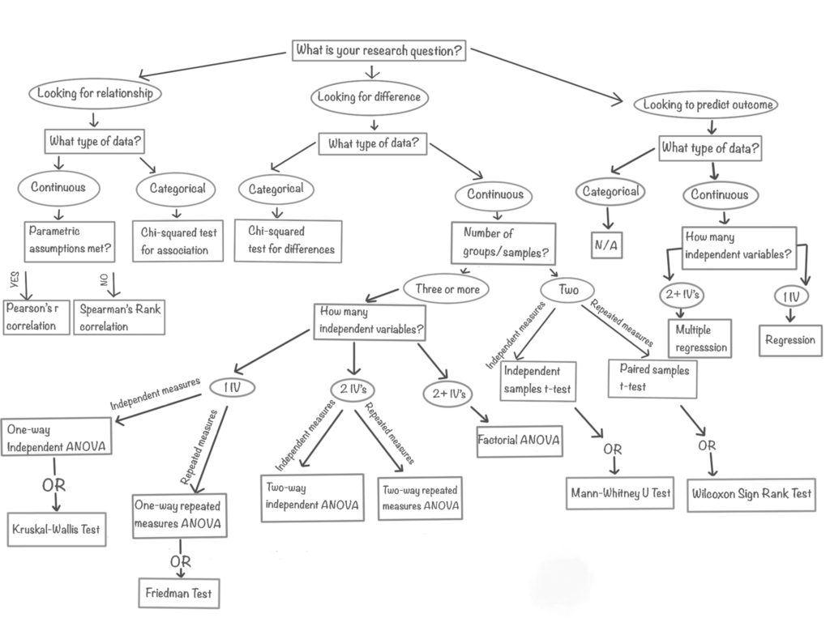
Those: https://ctil.dundee.ac.uk/kb/stats-bites-choosing-your-analysis/

Slide 36
Those: https://ctil.dundee.ac.uk/kb/stats-bites-choosing-your-analysis/

Slide 37
Those: https://ctil.dundee.ac.uk/kb/stats-bites-choosing-your-analysis/

Slide 38
Those: https://ctil.dundee.ac.uk/kb/stats-bites-choosing-your-analysis/

Slide 39
Requirements for Pearson's r
Two numeric variables
Linear relationship
Free of outliers
Normally distributed
Those: https://ctil.dundee.ac.uk/kb/stats-bites-choosing-your-analysis/

Slide 40
Those: https://ctil.dundee.ac.uk/kb/stats-bites-choosing-your-analysis/

Slide 41
It's your turn!
Python Exercises
Notebook 1 - End

Slide 42
Different types of statistical variables

Slide 43
Categorical
Ordinal
Numerical
Countable Python: String
Sortable
Python: String / Int
Measurable
Python: Int / Float
Examples
Gender
Medication or placebo
Product bought or not
Favorite ice cream
…
Examples
Age group: young, old
Dose: low, medium, high
Rating: poor, medium, good
…
Examples
Monthly income
Number of children
Points in an exam
Weight & Height
hours of sleep per night
…

Slide 44
Dependent & Independent Variables
Manipulated
Measured
Independent variable (IV)
Dependent Variable (DV)

Slide 45
Dependent & Independent Variables
💊
😊
❌
🤒
Manipulated
Measured
💊
😊
Experimental Group
Health

Slide 46
Dependent & Independent Variables
🧓
10
🧒
2
Manipulated
Measured
🧓
8
Age of the target group
Product Rating

Slide 47
Dependent & Independent Variables
🧓
💊
😊
🧒
❌
🤒
Manipulated
Measured
🧓
💊
😊
Age
Group
Health

Slide 48
Dependent & Independent Variables
Independent variables (IV) may influence dependent variables (DV)
IV are therefore also considered predictors of DV (result)
Typically, we can influence IV and but not DV.
A dependent variable should be changed by manipulating an independent variable
For example, we want to increase buying behavior (DV) through the design of our online shop (IV) or the sales price.

Slide 49
Categorical
Ordinal
Numerical
Countable Python: String
Sortable
Python: String / Int
Measurable
Python: Int / Float
Examples
Gender
Medication or placebo
Product bought or not
Favorite ice cream
…
Examples
Age group: young, old
Dose: low, medium, high
Rating: poor, medium, good
…
Examples
Monthly income
Number of children
Points in an exam
Weight & Height
hours of sleep per night
…
Mostly IV, occasionally DV
Sometimes IV, sometimes DV
Sometimes IV, sometimes DV

Slide 50
Finding Differences with Hypothesis Testing

Slide 51
Those: https://ctil.dundee.ac.uk/kb/stats-bites-choosing-your-analysis/

Slide 52







Hypothesis: Recipe B tastes better
6.4 / 10
Recipe B
is better
7.2 / 10

Slide 53

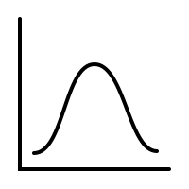







Hypothesis: Recipe B tastes better

Slide 54
Frequency
Averages
Distribution of the
Taste-Ratings
Rating

Slide 55
How likely is it that this difference is coincidental?
T-Test
A p-value tells us how likely it is that an effect occurred by chance.
Rating

Slide 56
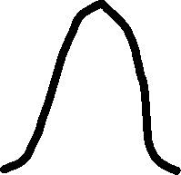
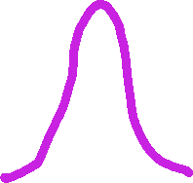
T-Test Intuition
Large gap compared to variance
A p-value tells us how likely it is that an effect occurred by chance.

Slide 57


T-Test Intuition
Small gap compared to variance
A p-value tells us how likely it is that an effect occurred by chance.

Slide 58
Side Note on Scientific Notation
Decimals with many leading zeroes are difficult to read and are often rewritten in scientific notation.
5 zeroes
p = 0.000014 = 1.4 × 10⁻⁵ = 1.4e-5
Notice the minus

Slide 59
It's your turn!
Python Exercises
Notebook 2

Slide 60
Requirements for t-tests
One numeric & one grouping variable or two numeric variables.
Free of outliers
Target variable is normally distributed
Homogeneity of variances
Those: https://ctil.dundee.ac.uk/kb/stats-bites-choosing-your-analysis/

Slide 61
Making predictions with regressions

Slide 62
Those: https://ctil.dundee.ac.uk/kb/stats-bites-choosing-your-analysis/

Slide 63
Linear Regression: Starting Point
What can I predict about a DV if I only know / can influence one IV?
DV
IV
How does sales change for every euro discount for a product?
What exam grade can I expect if I study 0 days?
If I take X mg of medicine, how much will my fever decrease?
IV
DV

Slide 64
How does a linear regression work?
DV
Two numeric variables
Linear relationship
Causality from IV → DV presumed
IV

Slide 65
How does a linear regression work?
DV
Model: DV = m * IV + b
m is the slope of the straight line
b is the value of DV if IV = 0
IV

Slide 66
How does a linear regression work?
DV
Model: DV = m * IV + b
Predicted
m is the slope of the straight line
b is the value of DV if IV = 0
We can predict a measurement by applying the formula.
Measured
IV

Slide 67
It's your turn!
Python Exercises
Notebook 3

Slide 68
Working with Multiple Datasets

Slide 69
The simple case: concatination
Customer ID | Forename | Surname
1000 | Tim | Meier
1001 | Melanie | Schmidt
1002 | Markus | Miller
Zip code | Street | Number
20095 | Main Street | 45
70173 | King Street | 28
60594 | Diagon Alley | 76
Customer ID | Forename | Surname
1000 | Anna | Yang
1001 | Abu | Yildirim
1002 | Luca | Rossi
pd.concat([df1, df2], axis = 0 or 1)

Slide 70
The Difficult Case: Join
Customer ID | Forename | Surname
1000 | Tim | Meier
1001 | Melanie | Schmidt
1002 | Markus | Miller
OrderID | Customer ID | ItemID | Quantity
68914 | 1001 | 154 | 1
80151 | 1002 | 512 | 3
70815 | 1001 | 767 | 1
51805 | 1001 | 794 | 2

Slide 71
The Difficult Case: Join
Customer ID | Forename | Surname
1000 | Tim | Meier
1001 | Melanie | Schmidt
1002 | Markus | Miller
OrderID | Customer ID | ItemID | Quantity
68914 | 1001 | 154 | 1
80151 | 1002 | 512 | 3
70815 | 1001 | 767 | 1
51805 | 1001 | 794 | 2
pd.merge(df1, df2, on=„CustomerID“, how=„outer“)

Slide 72
The Difficult Case: Join
Customer ID | Name | Surname | OrderID | ItemID | Quantity
1000 | Tim | Meier
1001 | Melanie | Schmidt | 68914 | 154 | 1
1001 | Melanie | Schmidt | 70815 | 767 | 1
1001 | Melanie | Schmidt | 51805 | 794 | 2
1002 | Markus | Miller | 80151 | 512 | 1
pd.merge(df1, df2, on=„CustomerID“, how=„outer“)

Slide 73
How: Left/Right vs Inner vs Outer
Left / Right
Inner
Outer
Rows of IDs in the filled area are kept. Differences shown are important if
Table A does not have the same IDs as Table B.

Slide 74
It's your turn!
Python Exercises
Notebook 4

Slide 76
What else can you do?

Slide 78
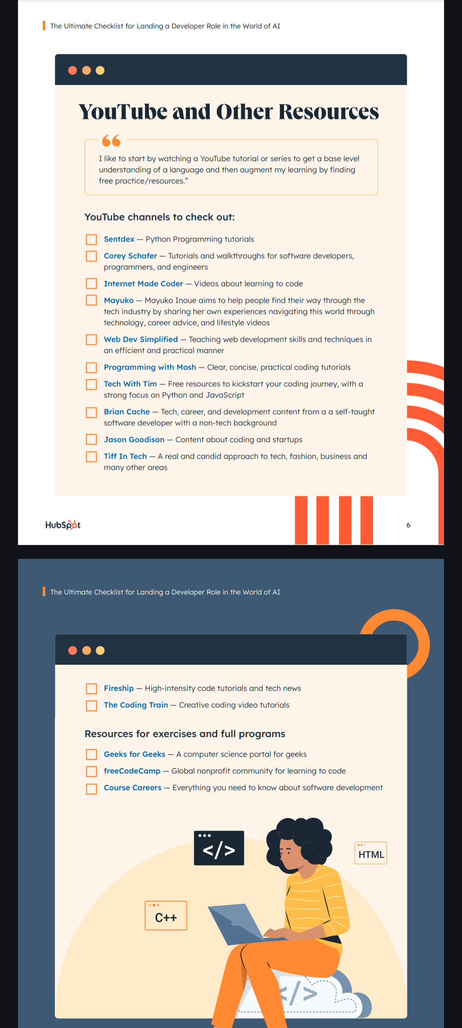

Slide 80
Experience > Credentials

Slide 81
Active Practice is Key!

Slide 82
Where to find data to practice with?
Kaggle Datasets
Github Awesome Public Datasets
Statistisches Bundesamt
Data World
Your personal life?

Slide 83
Follow a Course if You‘re Interested
Coursera, LinkedIn Learning
Google, Microsoft
YouTube
…
Use AI Assistants for sparring

Slide 84
Let Goethe University know if you want more Python 🐍

Slide 85
https://online-eval.studiumdigitale.uni-frankfurt.de/
Code: 2E7AL

Slide 86


Connect & Post on LinkedIn if You Wish!

Slide 88
Those: https://ctil.dundee.ac.uk/kb/stats-bites-choosing-your-analysis/

Slide 89
Those: https://ctil.dundee.ac.uk/kb/stats-bites-choosing-your-analysis/

