Slide 1
PRESENTASI LAPORAN PKL
MENGATASI KERUSKAN HARDWARE PC
OLEH
Nama : Eko Saputra
Kelas : XI RPL 1

Slide 2



EVSYSTEM
3.1.2 Prosedur Kerja
3.2.1 Kompter Tidak Mau Hidup
Cara Mengatasinya :
Cek koneksi kabel (dari power outletnya ke tombol power pada PC)
Cek apabila stabillizer berfungsi atau tidak (jika memakai stabillizer)
Jika masih juga tidak mau hidup permasalahanya mungkin terletak pada power supply atau MB
Back
Next
CopyRight 2018
Lisence GNU GPL.3
Author : Eko Saputra (evsystem)
evsystem.github.io

Slide 3
EVSYSTEM
THE
END
CopyRight 2018
Lisence GNU GPL.3
Author : Eko Saputra (evsystem)
evsystem.github.io

Slide 4
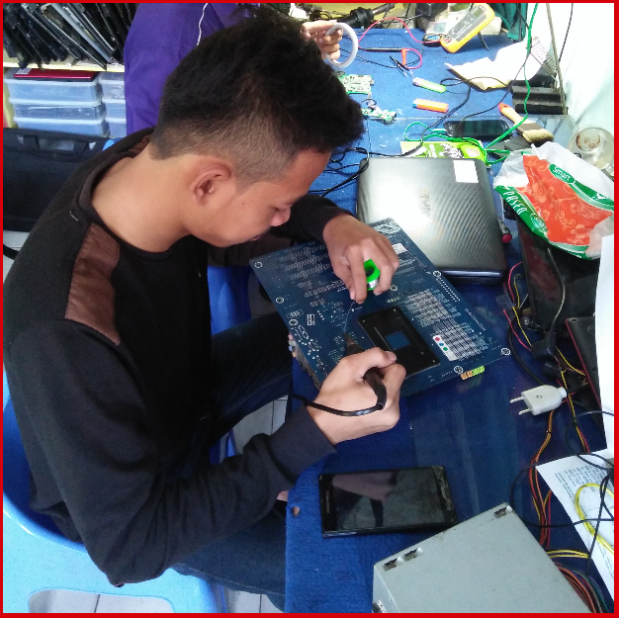
EVSYSTEM
PENULIS
Security Entusiastic
Developer Team in Xenta OS & Contrib dracOs Linux
System Analyst
Bash and Shell Development
Developer wece - Simple Instalation Package Linux
Developer DDoS – Simple Distributed Danial of Service
And another Penetration tools
Website evsystem.github.io
Contact me in ekovegeance7@gmail.com
Github www.github.com/ekovegeance
Partner : IndoXploit | LinuxSec | Kitploit | ctf.me
Eko Saputra - evsystem
CopyRight 2018
Lisence GNU GPL.3
Author : Eko Saputra (evsystem)
evsystem.github.io

Slide 5



FEATURES IN DRACOS
OPEN SOURCE
PERFORMANCE
Everyone can use, copy, study, modify, and redistribute.
Dracos is built to be fast, strong, and powerfull OS
SAFE AND SECURE
We don't collect any your sensitive personal data

