Slide 1
Converting Casual Riders Into Annual Members
A case study of how members use Cyclistic bikes compared to casual users
By: Francis Ekow Hinson
Date: 20201-06-16

Slide 2
Executive Summary
Casual riders use Cyclistic services lower number of times compared to annual members
Casual riders ride for longer periods than annual members
Service patronage peaks in August for both casual users and annual members

Slide 3
Data available at https://divvy-tripdata.s3.amazonaws.com/index.html
The most recent one(1) year of data which was from second quarter 2019 to first quarter 2020 was used for the analysis
The data was broken into a single csv file per quarter
This was full usage data of all customers

Slide 4
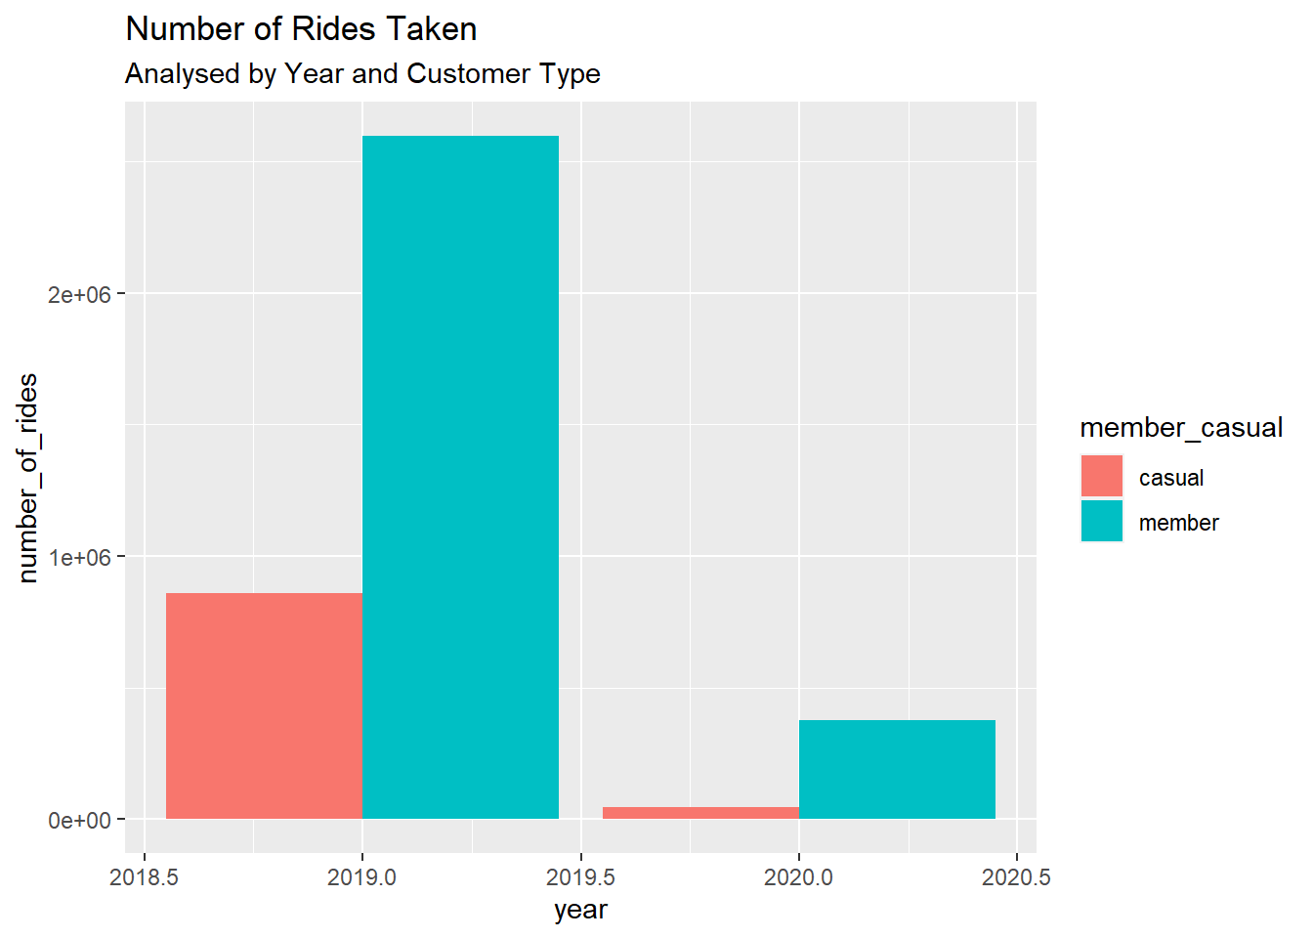
No of Rides Taken
Members took much more rides in 2019 and first quarter 2020 than casual users

Slide 5
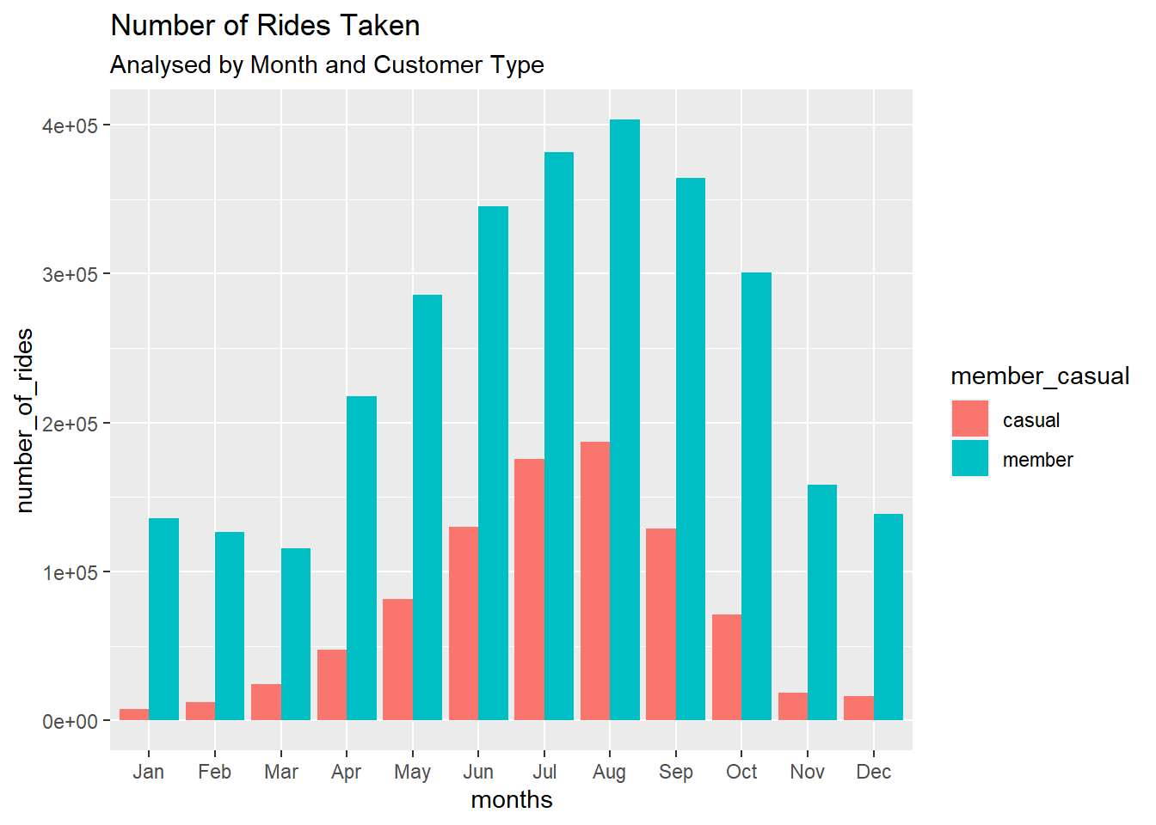
No of Rides Taken
Monthly usage indicates that services are used most in August, this is a good period to intensify marketing

Slide 6
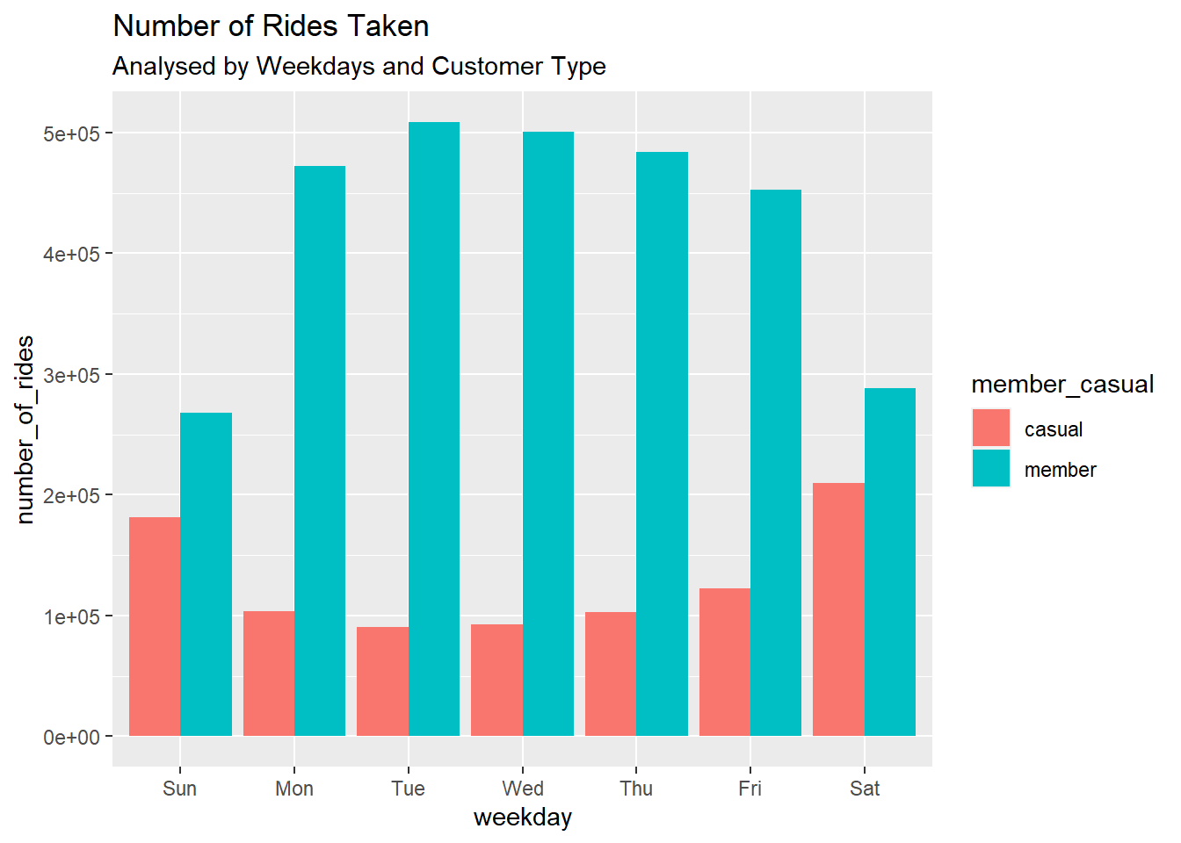
No of Rides Taken
Weekly usage indicates that bikes are used more on Saturday and Sunday by casual users, but on Mondays to Fridays by members

Slide 7
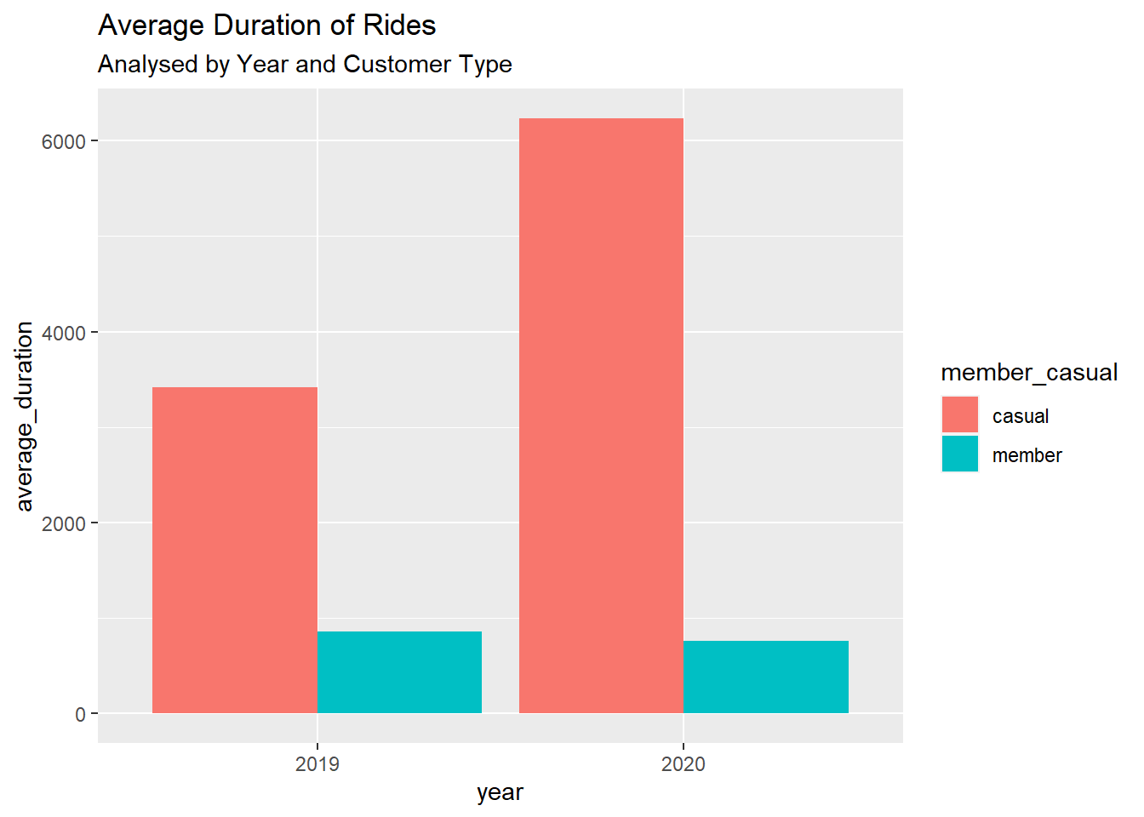
Ride Duration
Yearly trend of average duration of ride indicates that casual users ride bikes for much longer periods than members.
Casual riders also rode much longer in 2020 compared to 2019, while member usage was generally unchanged

Slide 8
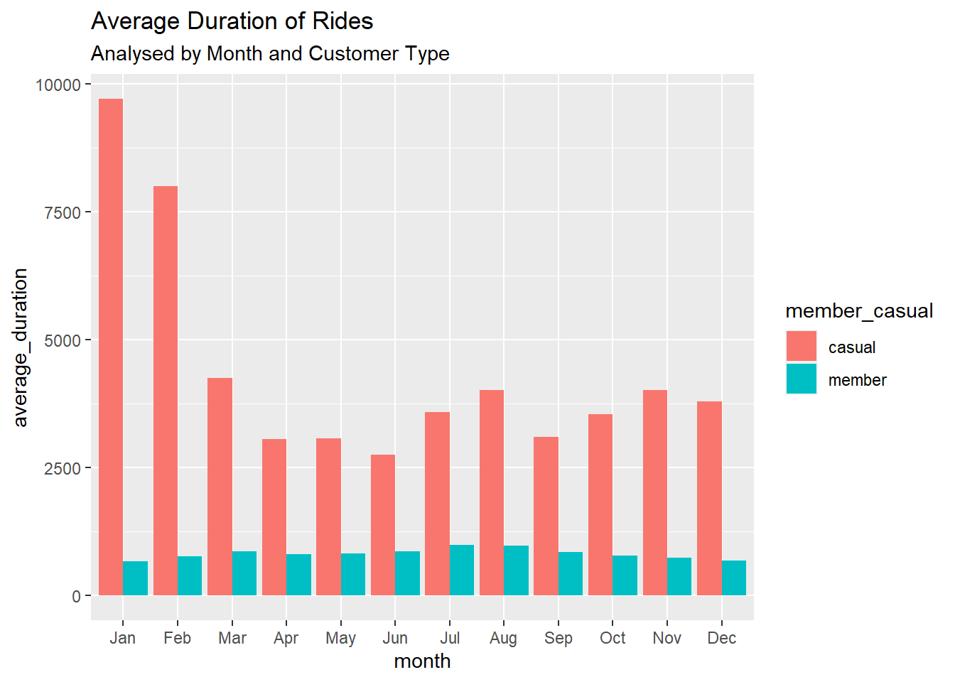
Ride Duration
Casual members rode longer in January and Feb then any other month, while members rode generally at same levels and peaked slightly in August 2020

Slide 9
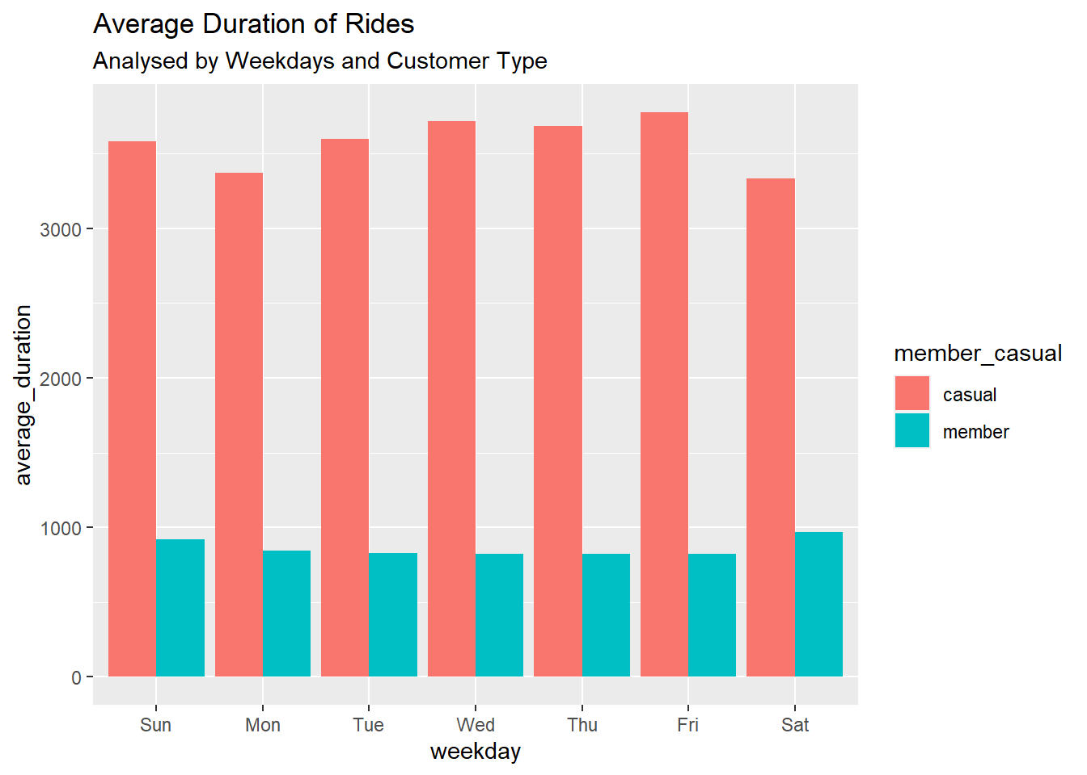
Ride Duration
Although weekly ride length was averagely not very different, Friday ride duration was highest for casual riders and Saturday was highest for members

Slide 10
Recommendations
Advertisements and efforts to enroll casual users as annual members should be done between June and October as this is the period of highest patronage of services and any adverts has a greater chance of reaching the most casual riders.
These adverts can be run more intensely on Saturdays and Sundays since more casual riders use the services on those days.
Incentives and rewards can be created for new members who ride for a long period to attract more casual riders since they tend to ride longer periods than members.

