Slide 1

Group 101: Software Engineering
Sprint 9

Slide 2
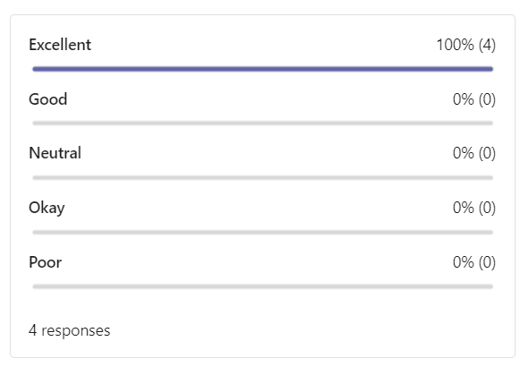
Team’s Overall Thoughts

Slide 3
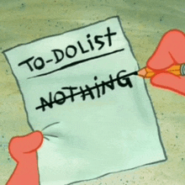
How did the sprint go?
What went well
Time management – team completed tasks way ahead of time
Communication – members collaborated to ensure fully-fledged application
Creativity – members contributed what they wanted to improve upon and improved UX
Overall – our last sprint was, as always, a great experience
Areas of Improvement

Slide 4
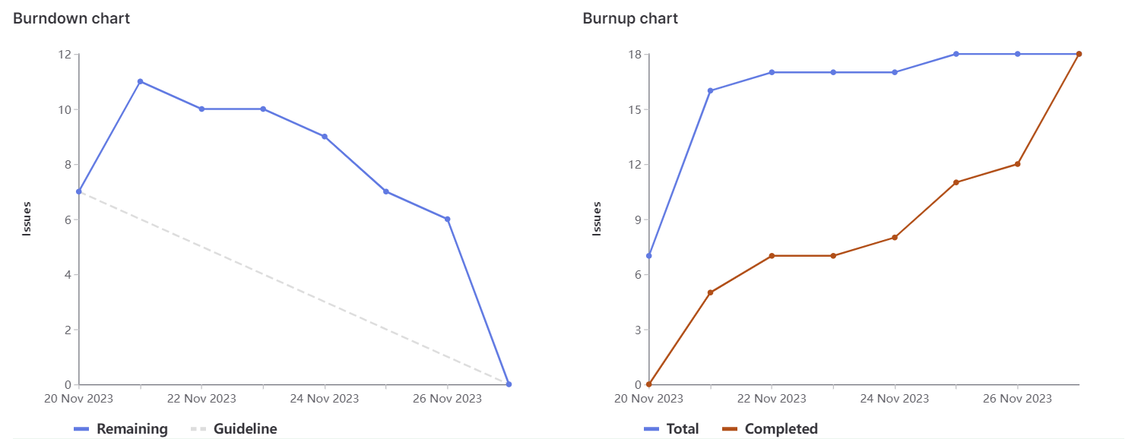
Burndown Charts

Slide 5
Emily 23 weights
Assigned to sprint lead
Responsible for documentation, demo slides, task progress, and repo organization
Took on development of making website keyboard accessible through tabbing, entering, and arrow keys
Highlight
Ending as sprint lead on the last one

Slide 6
Maneesh 21 weights
Implemented CI/CD pipeline for an automated development environment within gitlab
Included selenium test cases as continuous testing being done for every push
Worked with Simardeep to include the new test cases to the pipeline
Highlight:
Learning how to implement CI/CD on gitlab

Slide 7
Sara 20 weights
Worked on general clean up of the UI/UX in our website
Worked on improving the API documentation page to match the updated look of the site
Ensured the front-end was consistent, clear and user friendly throughout all pages
Highlight:
to see all of our efforts come together for a final product (:

Slide 8
Fee 23 weights
Implemented night mode on all pages of the application
Made the night mode state consistent when changing the URL between pages
Implemented option to delete an inputted course instead of clearing all inputs on the course generator page
Highlight:
Learning how to improve dark mode across the website

Slide 9
Simardeep 20 weights
Added more selenium test cases for the newly added functionalities
More robust test cases for the prerequisite recommendations on the course generator page
Collaborated with Maneesh to implement test cases as part of CI/CD
Highlight:
Writing tests for tree generator page

Slide 10
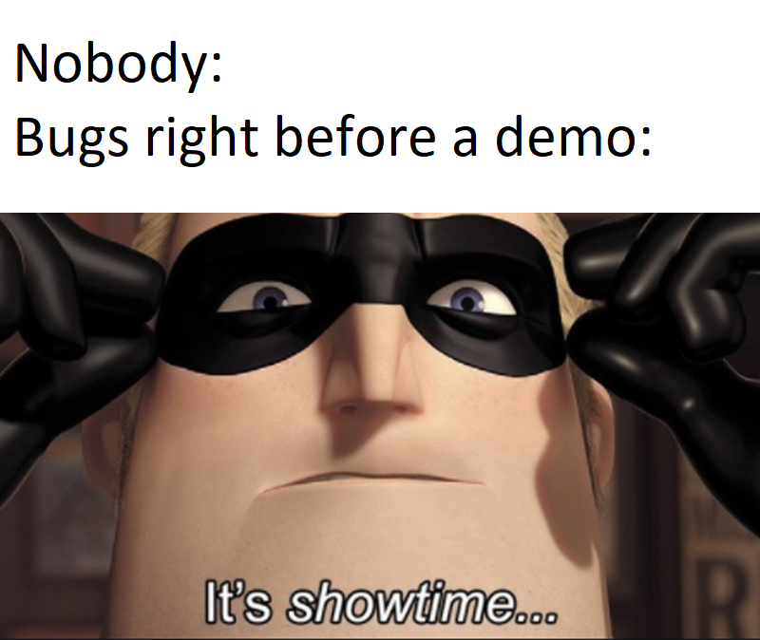
Demo Time!

