Slide 1
TLS 1.3 Adoption in the Wild
Sajjad Arshad
Some slides are borrowed from the paper published in NDSS 2017
“The Security Impact of HTTPS Interception”

Slide 2
About me
Fourth year PhD student at Northeastern University in Boston
Winter is Coming!
Studying Web security/privacy problems by large-scale measurements
Working with Eric "Ekr" Rescorla as part of Advanced Technology Lab

Slide 3
HTTPS
Secure Socket Layer (SSL)
Developed by Netscape
1.0 (1993) , 2.0 (1995), 3.0 (1996)
Deprecated!
Transport Layer Security (TLS)
TLS 1.0 (1999) was an upgrade of SSL 3.0
TLS 1.1 (2006)
TLS 1.2 (2008) is now supported by more than 86% of HTTPS-enabled websites
TLS 1.3 (2017) is faster and more secure than its predecessor
Firefox and Chrome enabled it by default
But it was disabled due to incompatible middleboxes

Slide 4
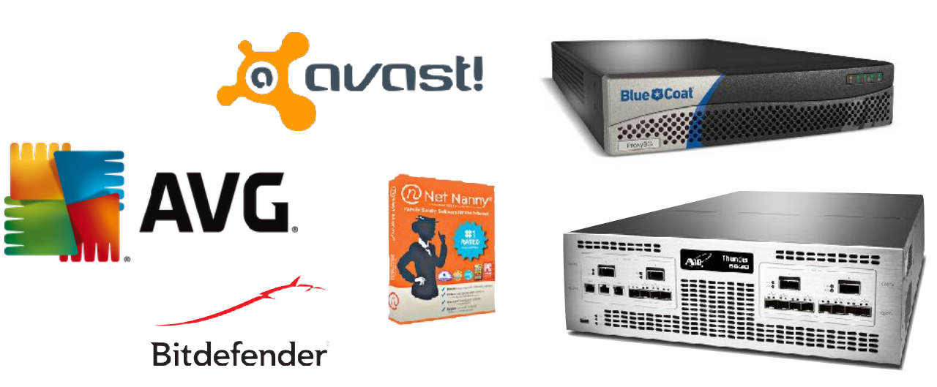
Middleboxes
Borrowed from “The Security Impact of HTTPS Interception (NDSS 2017)”
Some middleboxes (e.g., Firewalls, IDS/IPS, Antiviruses, Proxies) intercept HTTPS connections
Passively (e.g., Network-level Firewalls and IDS/IPS)
Actively (e.g., Proxies, WAF)

Slide 5
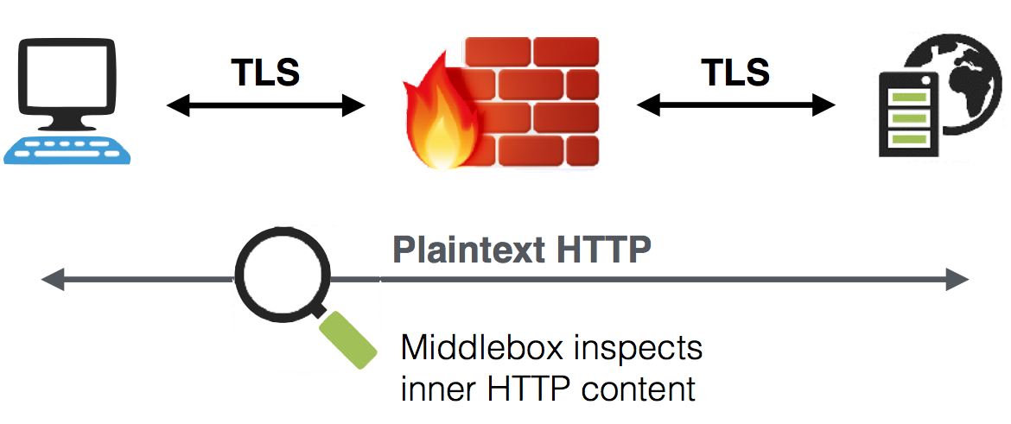
HTTPS Interception (Active)
Borrowed from “The Security Impact of HTTPS Interception (NDSS 2017)”

Slide 6
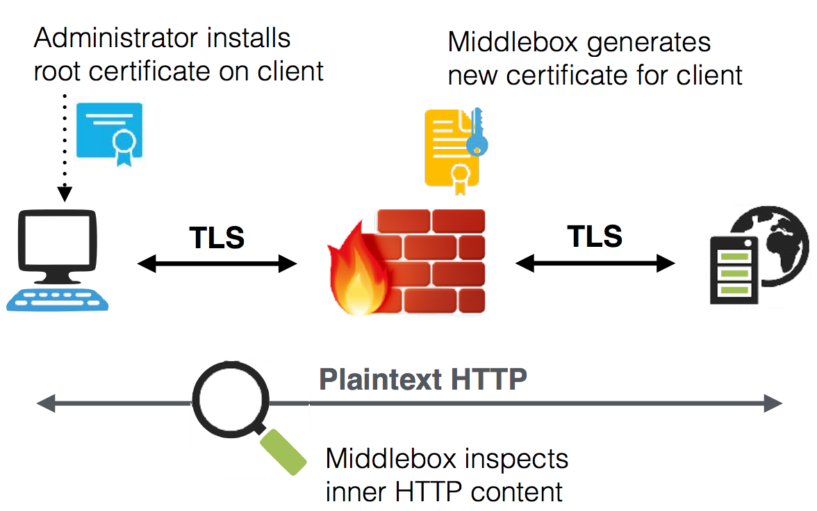
HTTPS Interception (Active)
Borrowed from “The Security Impact of HTTPS Interception (NDSS 2017)”

Slide 7
Experiment
Developed a Firefox add-on that makes XHR requests to some known websites
Modify preferences to enable TLS 1.3 in Firefox
Connect to a server NOT supporting TLS 1.3
Connect to a server supporting TLS 1.3
If the first connection succeeded and the second connection failed, we have a problem!
Shipped the add-on to 20% of Firefox Beta users
Collected the results using Telemetry platform

Slide 8
Preliminary Results
991,740 clients participated in the experiment
The experiment failed for 3,933 clients
297,541 (~30%) of the clients had a third-party root certificate installed
24,431 (~2.5%) of the clients faced errors initiating a TLS 1.3 connection
They succeeded initiating TLS 1.2 connections though
We also observed clients that successfully initiated TLS 1.3 connection but not TLS 1.2
Solution: running the experiment multiple times to gather more reliable data
We observed 31 different error types:
NS_ERROR_NET_INTERRUPT (The connection was established, but the data transfer was interrupted)
SSL_ERROR_ACCESS_DENIED_ALERT (Peer received a valid certificate, but access was denied.)
SSL_ERROR_RX_UNEXPECTED_APPLICATION_DATA (SSL received an unexpected Application Data record.)
SEC_ERROR_UNKNOWN_ISSUER (Peer's Certificate issuer is not recognized.)
SSL_ERROR_RX_RECORD_TOO_LONG (SSL received a record that exceeded the maximum permissible length.)

Slide 9
Ongoing Work
Constantly improving the add-on
Gathering more reliable data by running experiment multiple times
Minimizing the experiment’s side-effects on the users
In case of crash, it leaves the browser with the modified preferences that could affect future user’s browsing experience
Providing more fine-grained access on the TLS configurations to developers
Modifying Firefox code base
Running the experiments without changing the preferences (no side-effects)

Slide 10
Thank You
Questions?

