Slide 1
TLS 1.3 Adoption in the Wild
Sajjad Arshad
Some slides are borrowed from the paper published in NDSS 2017
“The Security Impact of HTTPS Interception”

Slide 2
About me
Fourth year PhD student at Northeastern University in Boston
Winter is Coming!
Studying Web security/privacy problems by large-scale measurements
Working with Eric "Ekr" Rescorla as part of Advanced Technology Lab

Slide 3
HTTPS
Secure Socket Layer (SSL)
Developed by Netscape
1.0 (1993) , 2.0 (1995), 3.0 (1996)
Deprecated!
Transport Layer Security (TLS)
TLS 1.0 (1999) was an upgrade of SSL 3.0
TLS 1.1 (2006)
TLS 1.2 (2008) is now supported by more than 86% of HTTPS-enabled websites
TLS 1.3 (2017) is faster and more secure than its predecessor
Firefox and Chrome enabled it by default
But it was disabled due to incompatible middleboxes such as Blue Coat web proxy

Slide 4
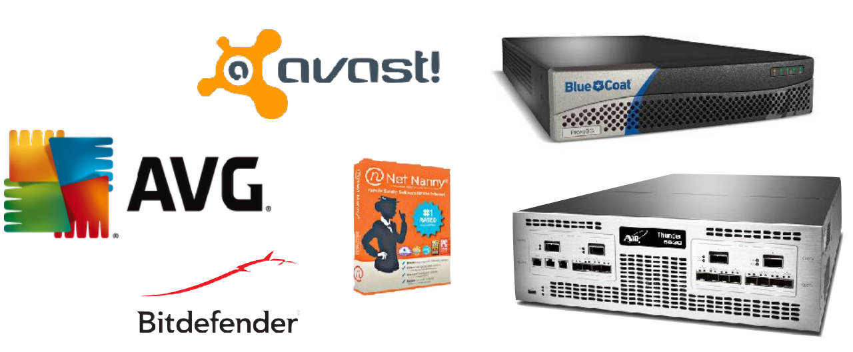
Middleboxes
Borrowed from “The Security Impact of HTTPS Interception (NDSS 2017)”
Some middleboxes (e.g., Firewalls, Antiviruses, Web Proxies) intercept HTTPS connections to inspect the content

Slide 5
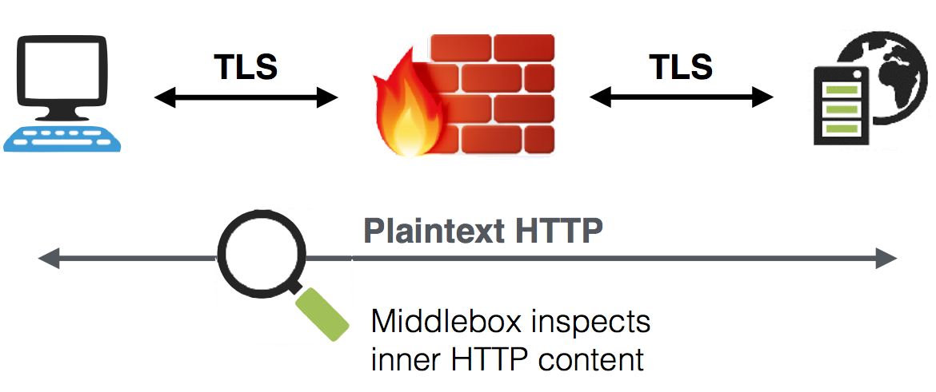
HTTPS Interception
Borrowed from “The Security Impact of HTTPS Interception (NDSS 2017)”

Slide 6
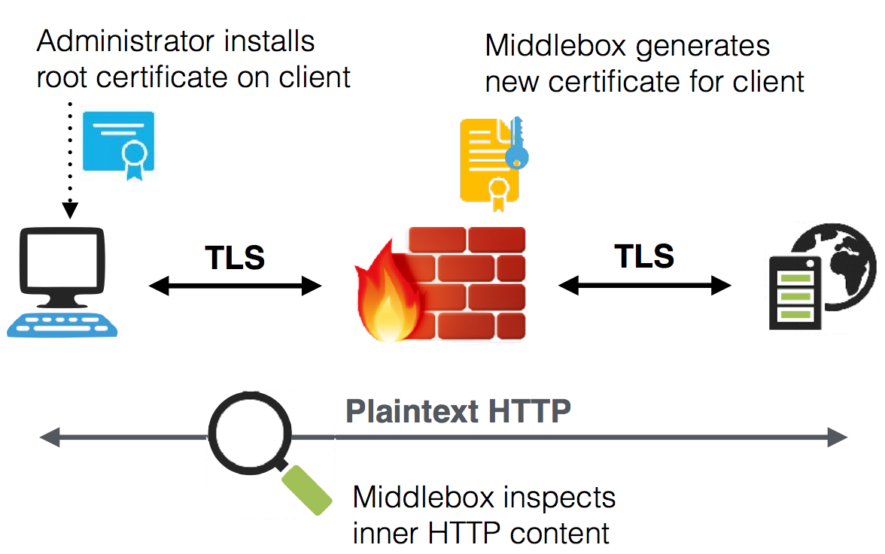
HTTPS Interception
Borrowed from “The Security Impact of HTTPS Interception (NDSS 2017)”

Slide 7
Experiment
Developed a Firefox add-on that makes XHR requests to some known websites
Change the TLS preferences accordingly
Connect to a server NOT supporting TLS 1.3
Connect to a server supporting TLS 1.3
If the first connection succeeded and the second connection failed, we have a problem!
Shipped the add-on to 20% of Firefox Beta users
Collected the results using Telemetry platform

Slide 8
Preliminary Results
991,740 clients participated in the experiment
The experiment failed for 3,933 clients
297,541 (~30%) of the clients had a third-party root certificate installed
24,431 (~2.5%) of the clients faced errors initiating a TLS 1.3 connection
They succeeded initiating TLS 1.2 connections though
We observed 31 different error types:
NS_ERROR_NET_INTERRUPT (The connection was established, but the data transfer was interrupted)
SSL_ERROR_ACCESS_DENIED_ALERT (Peer received a valid certificate, but access was denied.)
SSL_ERROR_RX_UNEXPECTED_APPLICATION_DATA (SSL received an unexpected Application Data record.)
SEC_ERROR_UNKNOWN_ISSUER (Peer's Certificate issuer is not recognized.)
SSL_ERROR_RX_RECORD_TOO_LONG (SSL received a record that exceeded the maximum permissible length.)

Slide 9
Ongoing Work
Constantly improving the add-on
Gathering more reliable data
Minimizing the experiment’s side-effects on the users
Providing more fine-grained access on the TLS configurations to developers
Modifying Firefox code base
Running the experiments without changing the preferences (no side-effects)

Slide 10
Thank You
Questions?

