Slide 1

novem technologies BANKING SYSTEM
Course Project : CS6350/4350 Spring 2019
Group #: 9
Team Members
Phillip Hawkins
Edmund Osbourne
Shivam Patel
Dhanalakshmi Lakshmanan
Professor:

Slide 2
AGENDA
Problem Statement
Requirement Handling
System Design
Implementation
Testing
DEMO

Slide 3
Problem Statement
Why do we need a banking system?
1
Importance of virtual currency
2
Secure way to deposit/Withdraw/ transfer money online/ATM system
3
Design an inexpensive banking system for small start up banks
4
Design a highly secure system for small banks with smaller budgets

Slide 4
Problem Statement
Plan/Schedule
Collaboration : GitHub
https://github.com/novem-technology
Development Plan: Incremental
Smaller project
Tested once one increment was completed
Any bugs/ enhancements identified was applied in the next increment.

Slide 5
Requirement
Elicitation

Slide 6
Context Diagram

Slide 7
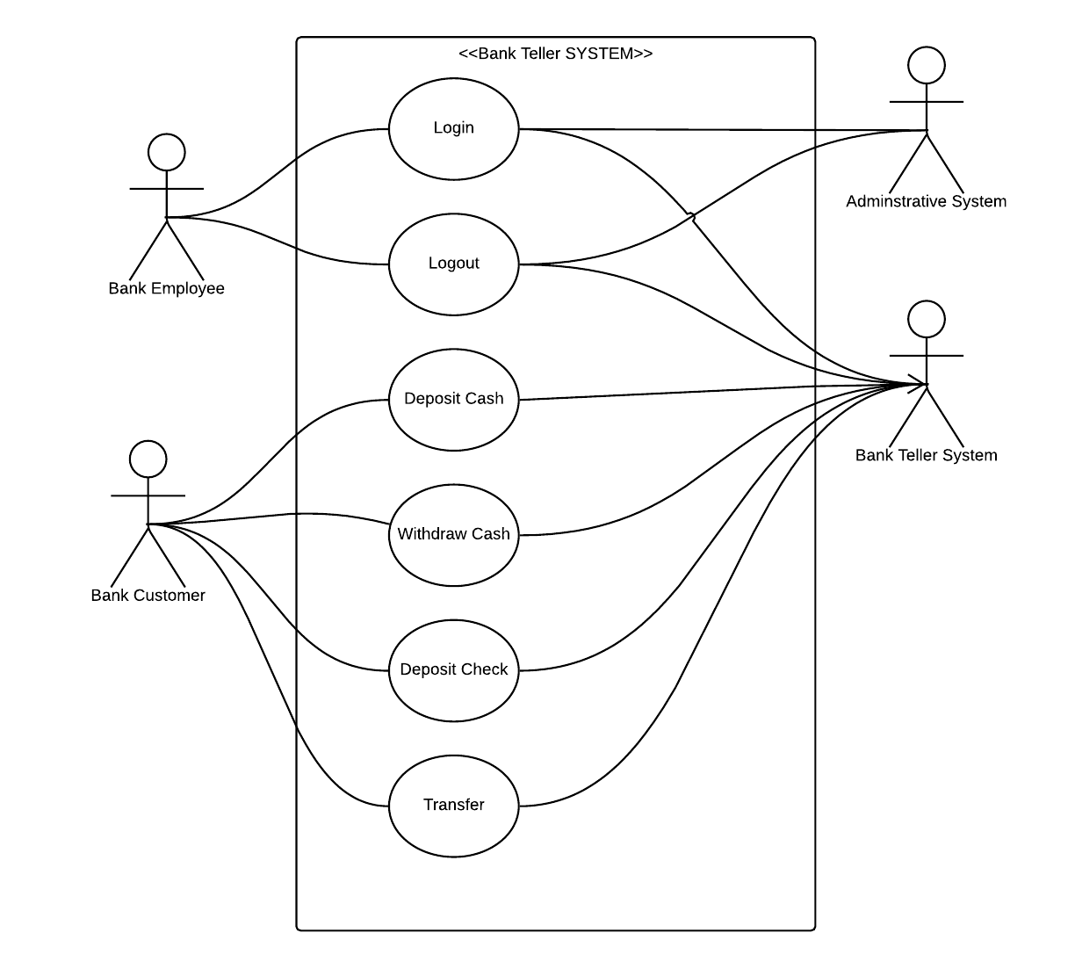
Use Case Diagram

Slide 8
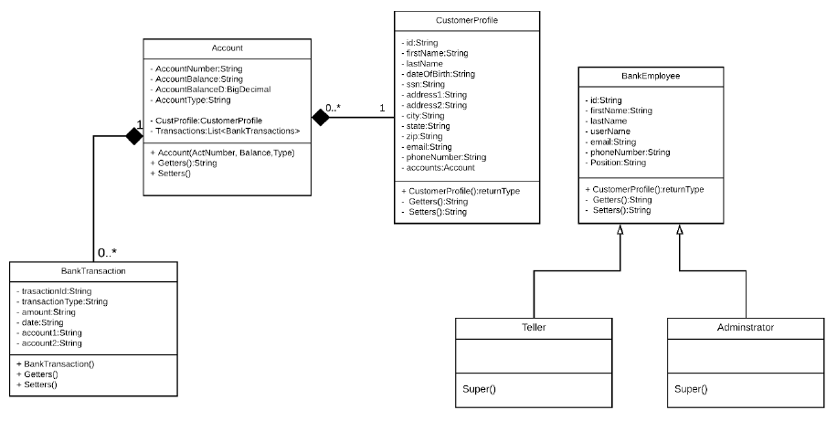
Class Diagram

Slide 9
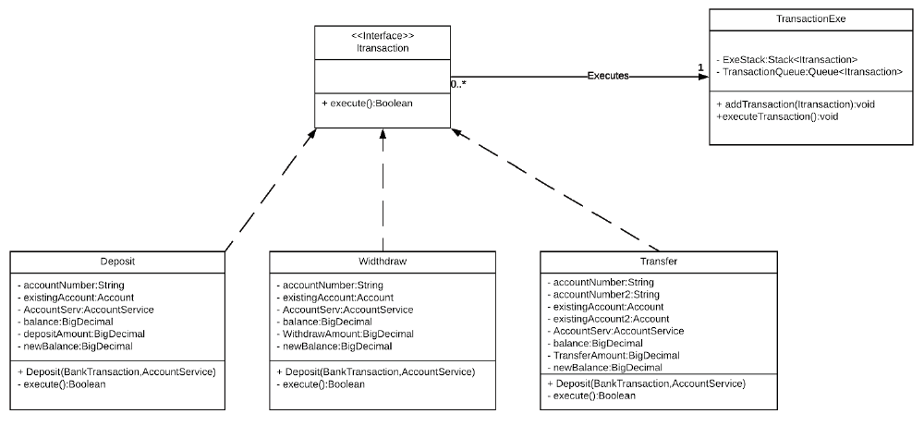
Class Diagram

Slide 10
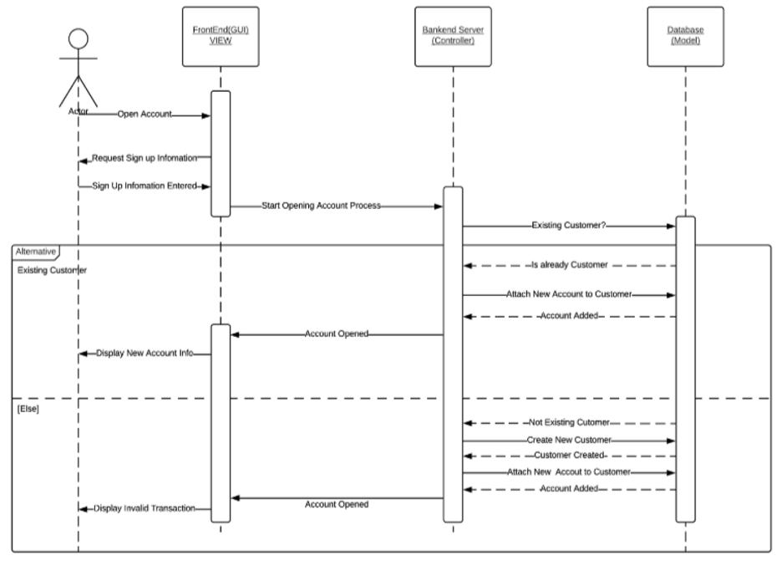
Sequence Diagram – I : Adding Account

Slide 11
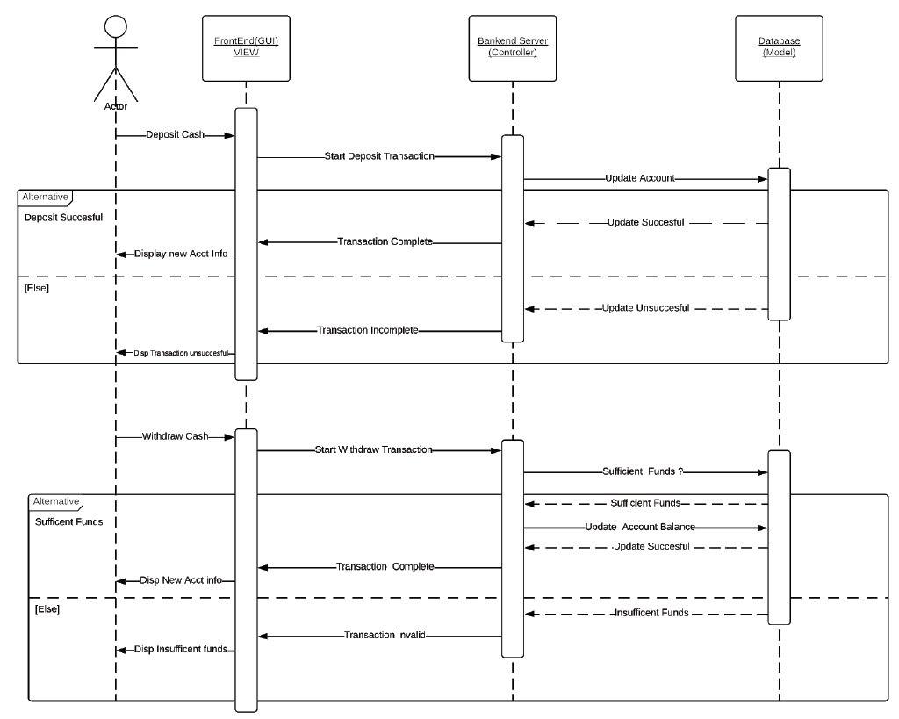
Sequence Diagram – II : Adding Account

Slide 12
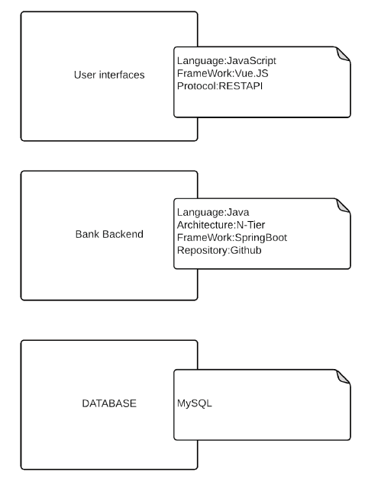
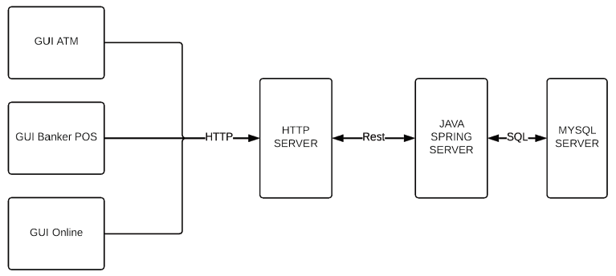
DESIGN ARCHITECTURE

Slide 13
IMPLEMENTATION

Slide 14
TESTING

Slide 15
PROJECT DEMO
Questions???????

