Slide 1
CAPTCHA
Presented By:

Slide 2
CAPTCHA
Presented By: EKRAJ POKHREL

Slide 3
What Is Captcha?
Completely Automated Public Turing test to tell Computers and Humans Apart
Turing test (The Imitation Game, 1950): The legendary British mathematician and computer scientist Alan Turing was having arguments with his colleagues and critics over if a machine (digital computers) could ever have a human-level intelligence?
To prove his point Turing proposed a game. In this game, an interrogator would ask questions to a human and a computer through a text-only chat. If the interrogator doesn't find any difference between both their responses and the computer can successfully project itself as a real human, then it passes the test.
So, Captcha is also called as reverse Turing Test.

Slide 4

History of CAPTCHA
The most common type of CAPTCHA (displayed as Version 1.0) was first invented in 1997. This form of CAPTCHA requires entering a sequence of letters or numbers in a distorted image
The Gausebeck-Levchin test is one of the earliest uses and the first commercial application of CAPTCHA, a Completely Automated Public Turing Test for separating computers and humans. The security test was utilized by PayPal in 2001.
A popular deployment of CAPTCHA technology, reCAPTCHA, was acquired by Google in 2009

Slide 5
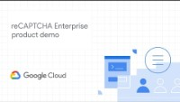
reCAPCHA
Easy on Humans, Hard on Bots
reCAPTCHA is a security measure developed by Google that differentiates between humans and bots through interactive challenges.

Slide 6
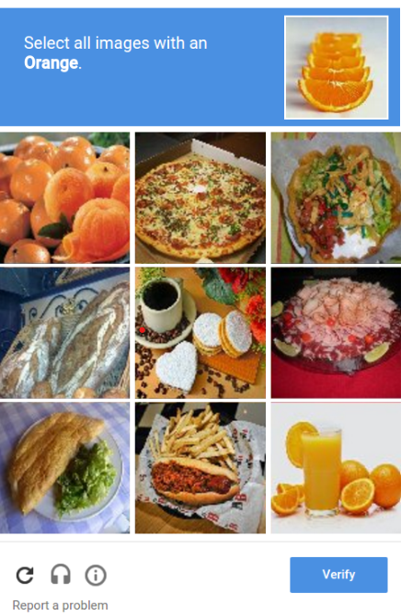
reCAPCHA User Benifit
Enhanced security: By distinguishing humans from bots, reCAPTCHA protects websites and online services from automated attacks, ensuring a safer browsing experience for users.
Improved user experience: reCAPTCHA is designed to minimize disruption for genuine users, providing a smooth and seamless browsing experience.
Accessibility: reCAPTCHA offers various challenge types, including audio and image-based challenges, enabling individuals with visual or hearing impairments to participate.

Slide 7
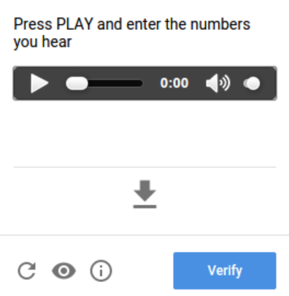
reCAPCHA is FREE
So how does Google benefit from it???
Data collection and Training machine learning models: When users encounter reCAPTCHA challenges, such as selecting specific objects in images or solving puzzles, their interactions provide valuable data for training machine learning models.
Improving accuracy: More data Google collects, the better its algorithms become at accurately classifying user interactions, reducing false positives and negatives.
Adapting to new threats: Google leverages the data collected from user interactions to identify and understand evolving threats. This knowledge helps Google enhance its algorithms to stay one step ahead of malicious actors and protect online platforms effectively.

Slide 8
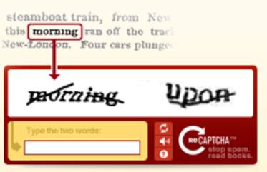
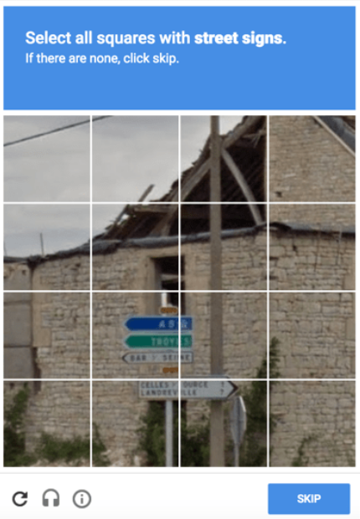
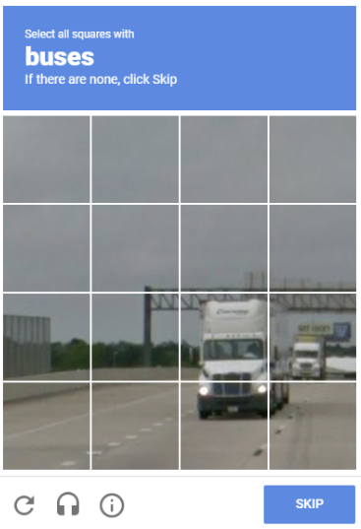
reCAPCHA in Action
How Google use reCAPTCHA?
By 2011 ReCAPTCHA had finished digitizing the entire Google Books archive - as well as 13 million articles from the New York Times back-catalogue dating back to 1851
In 2012, Google introduced reCAPTCHA with a collage of photos, making users to label traffic lights and signs on the public places.
In October 2020, Waymo (Subsidiary company of Alphabet) operates commercial driver-less self-driving taxi services in Phoenix, Arizona and San Francisco, CA.

Slide 9
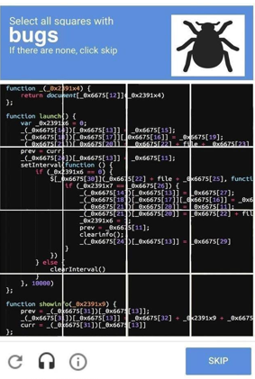
Thank You

Slide 10

Thank You

