Slide 1
Data Thieves! A Digital Nomad Adventure

Slide 2
What are these called Digital Nomads?
Digital nomads are people who travel freely while working remotely using technology and the internet. Such people generally have minimal material possessions and work remotely in temporary housing, hotels, cafes, public libraries, co-working spaces, or recreational vehicles, using Wi-Fi, smartphones or mobile hotspots to access the Internet

Slide 3
Objective
Our objective for this project was to create an easy way for Digital Nomads to choose their next
pit-stop.
But how?

Slide 4
We started by figuring out what they look for in a Country
01
03
05
02
Safety
Traffic
Rent
04
06
Living
Crime
Internet

Slide 5


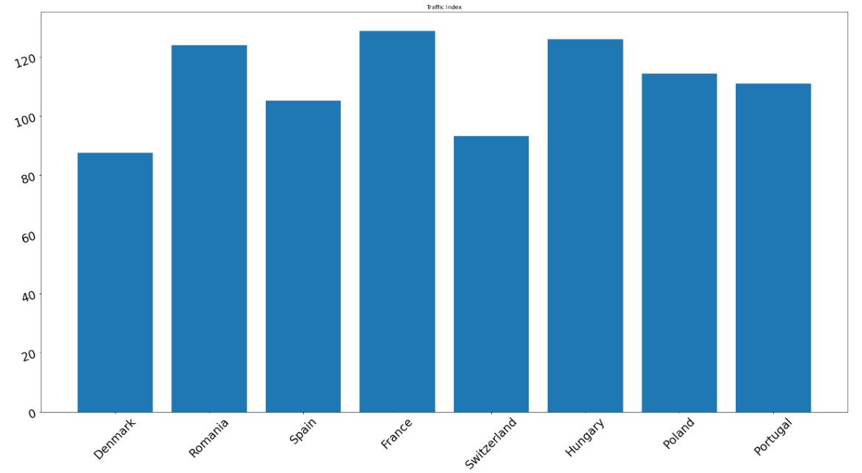

Slide 6


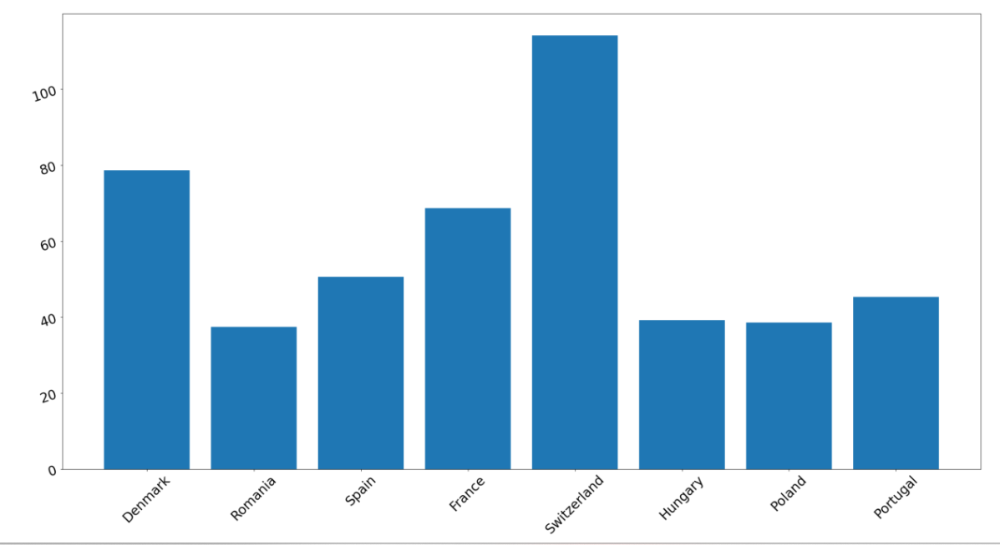

Slide 7


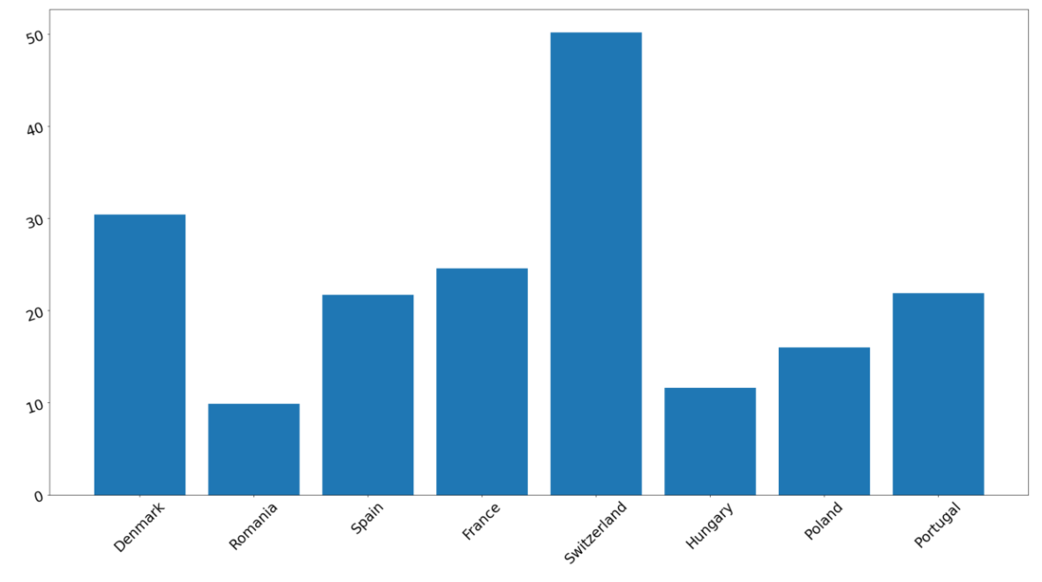

Slide 8


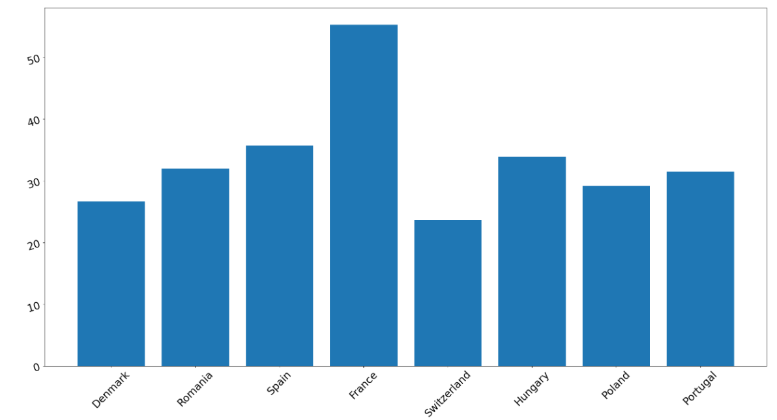

Slide 9


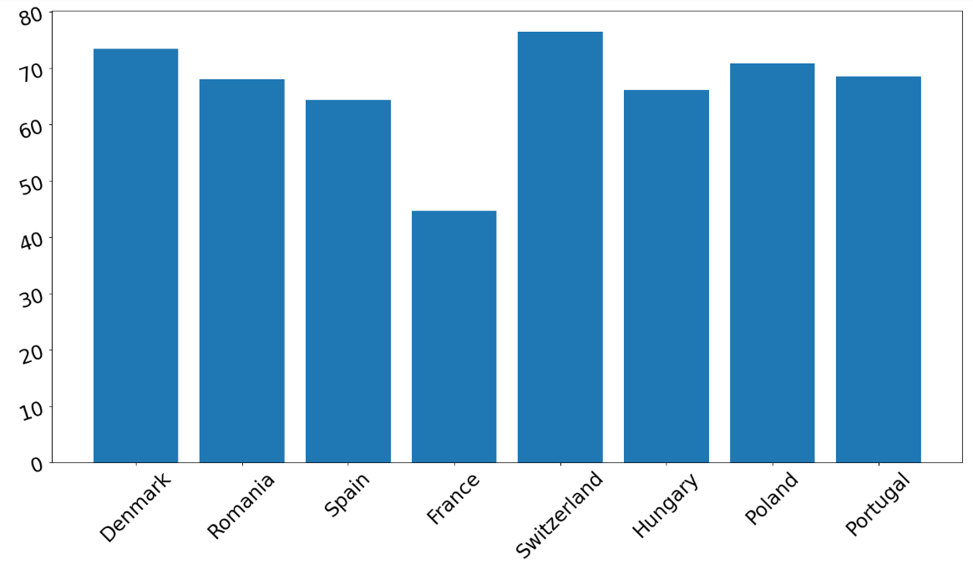

Slide 10


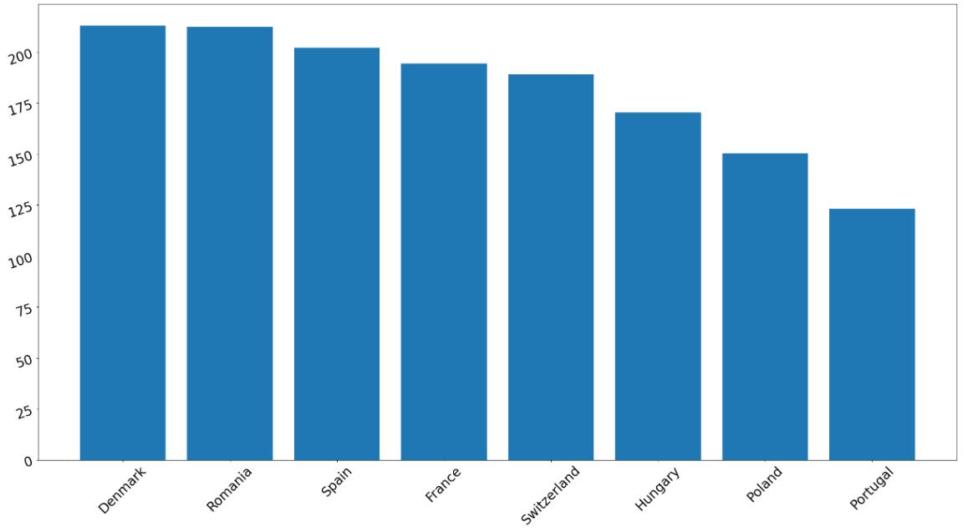

Slide 11
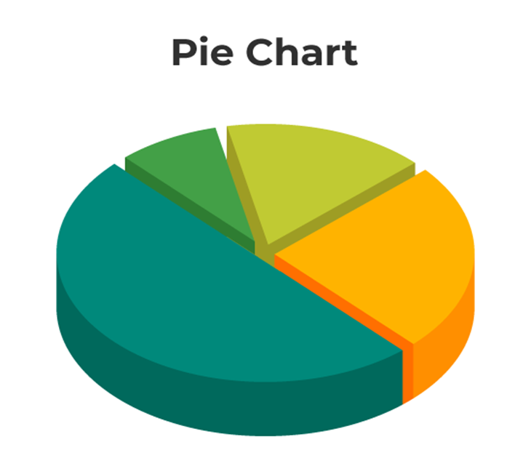

How do we visualize the data?

Slide 12
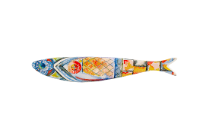



We all know the best way to visualize something is by

Slide 13
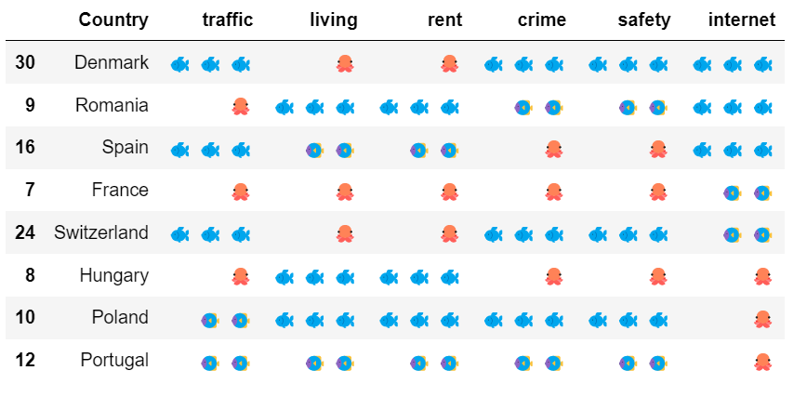

Slide 14


Reality
Expectation

